Slide 1
Reducing Customer Churn at Company A
A profit-driven, calibrated, and fair churn model — predict, prioritize, and act.
Telecom Retention Analytics
100,000 customers | 123 engineered behavioral features | demographics excluded by design

Slide 2
EXECUTIVE SUMMARY
The bottom line
REALISTIC MODEL
TARGETING LIFT
BASE-CASE ROI
AUC 0.70
1.34x
2.4x
Tuned + calibrated XGBoost. No leakage, no 0.99 fantasy.
vs. random outreach, ranking by expected value at risk.
Net $189,190 at the profit-optimal 42% contact depth.
What changed from a naive first pass: protected attributes removed, probabilities calibrated, scores re-weighted to the true ~2% churn rate, the decision threshold set on a profit curve, drivers explained with SHAP, and the business case shown as bear / base / bull with cited assumptions.

Slide 3
PROBLEM FRAMING
Churn is expensive — but not every customer is worth the same call
The task.
Predict which subscribers will churn, explain why, and turn that into a retention plan that makes money.
The data.
100,000 customers, 100 raw columns across account, usage, and demographic tables.
The honesty problem.
The sample is balanced to ~50% churn for training, but real monthly churn is ~2%. We train on the sample, then re-weight predictions back to reality so the dollars are credible.
KEY NUMBERS
ARPU (avg monthly revenue)
$59
Median tenure
16 months
Model features (engineered)
123
Protected attributes dropped
20
Assumed true monthly churn
2%

Slide 4
RESPONSIBLE MODELING
We deliberately excluded demographics
Targeting retention by ethnicity, income, marital status, or dwelling is a legal and ethical hazard — and it isn't actionable. All 20 such attributes are dropped before the model sees the data, with an automated guard that fails the build if one leaks through encoding.
EXCLUDED
• ethnic
• crclscod
• kid11_15
• dwlltype
• infobase
EXCLUDED
• marital
• kid0_2
• kid16_17
• dwllsize
• numbcars
EXCLUDED
• income
• kid3_5
• adults
• lor
• truck
EXCLUDED
• creditcd
• kid6_10
• ownrent
• HHstatin
• rv

Slide 5
APPROACH
One reproducible pipeline, end to end
1 Engineer
Merge usage + account tables; build behavioral features (equipment age, usage trend, care intensity, overage share).
2 Model
Compare Logistic Regression, Random Forest, XGBoost; tune XGBoost with randomized search + 5-fold CV.
3 Calibrate
Isotonic calibration so scores are real probabilities; re-weight to the true 2% base rate.
4 Decide
Rank by expected value at risk; choose contact depth on the profit curve, not an arbitrary 0.5 cutoff.
5 Explain & act
SHAP drivers, K-means personas, and an uplift/persuadables view feed a bear/base/bull business case.

Slide 6
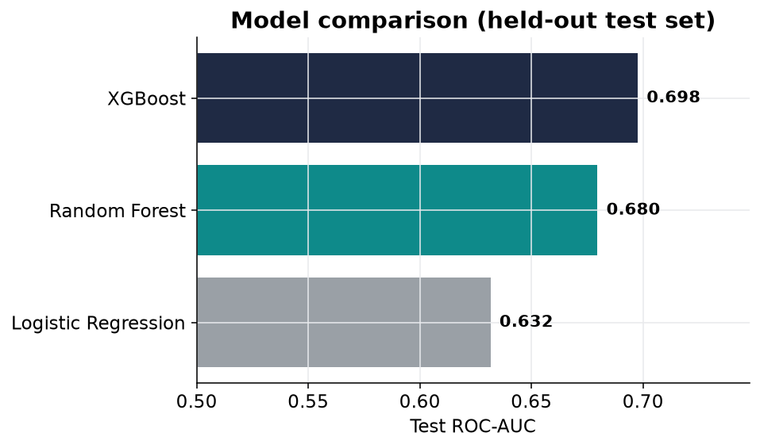
MODEL SELECTION
XGBoost wins — at a believable accuracy
Why this is credible
AUC 0.70, PR-AUC 0.69. An AUC near 0.70 is normal for telecom churn on behavioral data — a 0.95+ score would signal target leakage.
5-fold CV: 0.699 ± 0.003. Tiny variance across folds means the model is stable, not lucky.
Brier score improves after calibration — the probabilities can be trusted for dollar math.

Slide 7
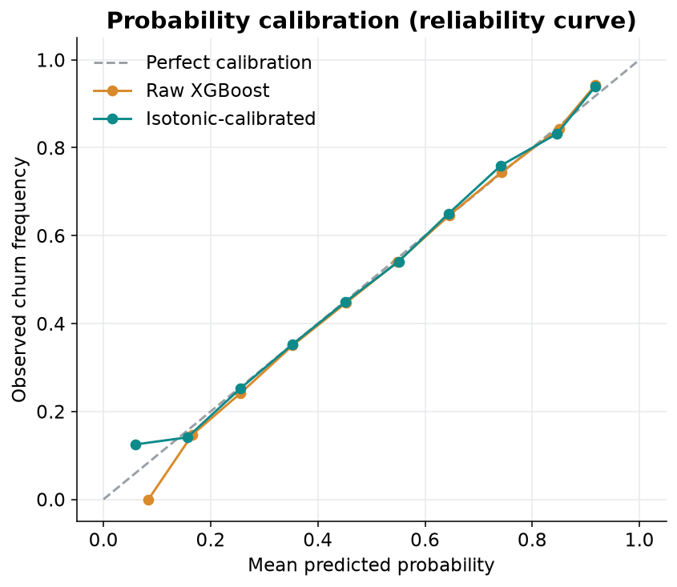
TRUSTWORTHY PROBABILITIES
Calibration + the base-rate correction
A score is not a probability
Raw model scores cluster near 0.5 because the training sample is balanced. Isotonic calibration aligns predicted probability with observed frequency (the diagonal).
Then we correct the prior:
mean P(churn) 0.50 in the sample → 0.027 re-weighted to the real ~2% rate.
Without this step, every revenue-at-risk and ROI figure would be inflated by ~20x.

Slide 8
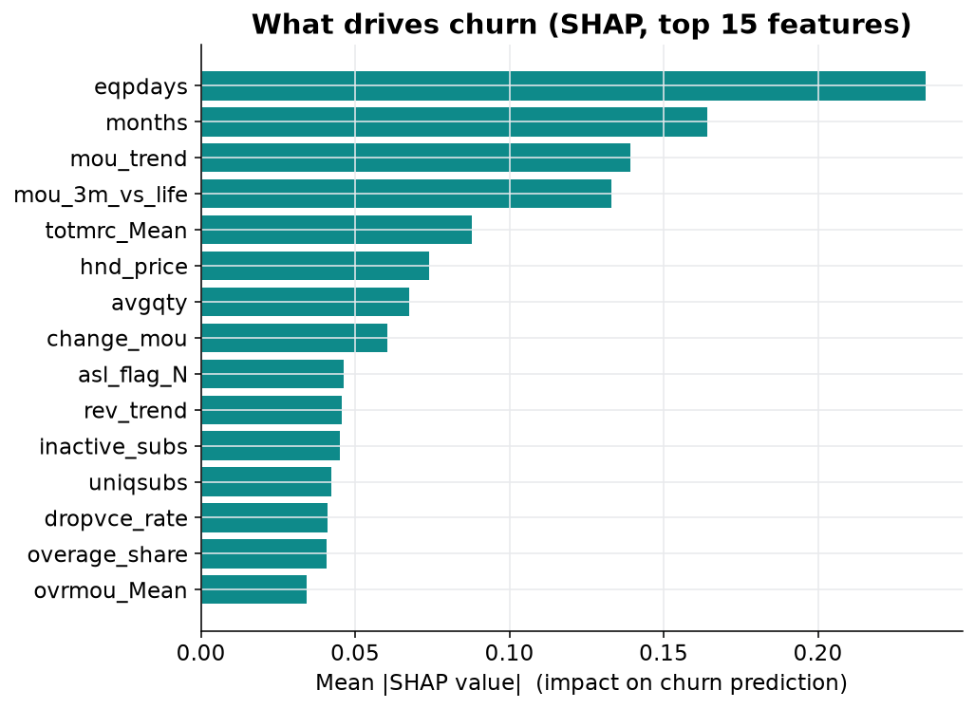
WHY CUSTOMERS LEAVE
SHAP — the model's honest drivers
All actionable, none demographic
Equipment age (eqpdays) — the top driver. Old handsets churn; proactive upgrade offers are the lever.
Tenure & usage trend — declining minutes-of-use flags disengagement early.
Care intensity & dropped calls — service quality and support friction. Fixable operationally.
Because demographics were excluded, every top driver maps to an action the business can actually take.

Slide 9
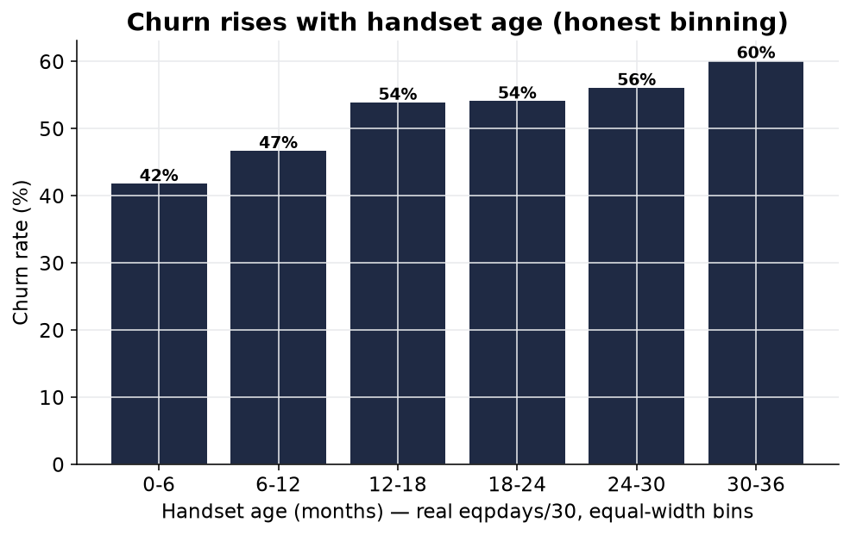
HONEST SEGMENTATION
Churn rises with equipment age
Binned, not over-precise
Equipment age is grouped into interpretable buckets rather than implying false day-level precision.
The pattern is monotonic and clean: the longer a customer keeps an aging device, the more likely they leave.
Action: trigger an upgrade offer as devices cross the high-risk age band.

Slide 10
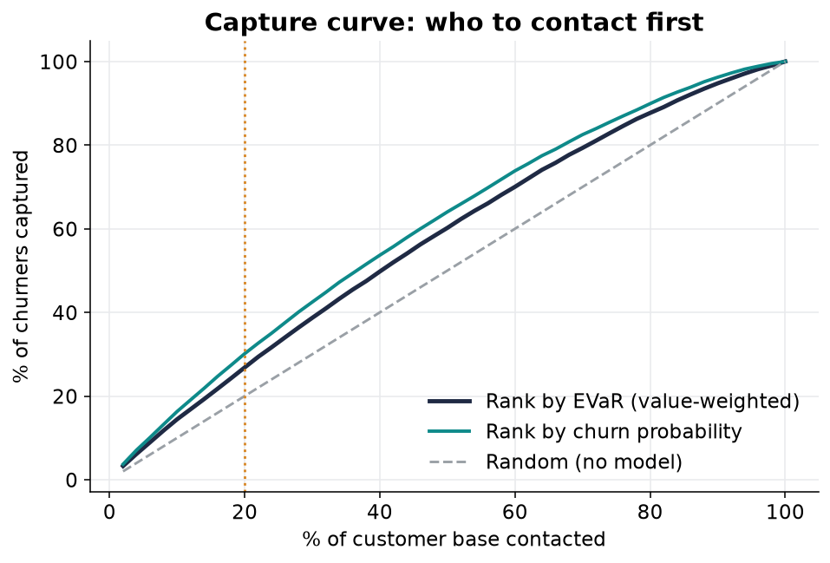
PRIORITIZE
Call the highest-value risk first
Expected value at risk
We rank by P(churn) × margin × lifetime value, not probability alone — a $100 customer at 30% risk beats a $20 customer at 60%.
Contacting the top 20% by value captures 27% of churn value — 1.34x better than random.

Slide 11
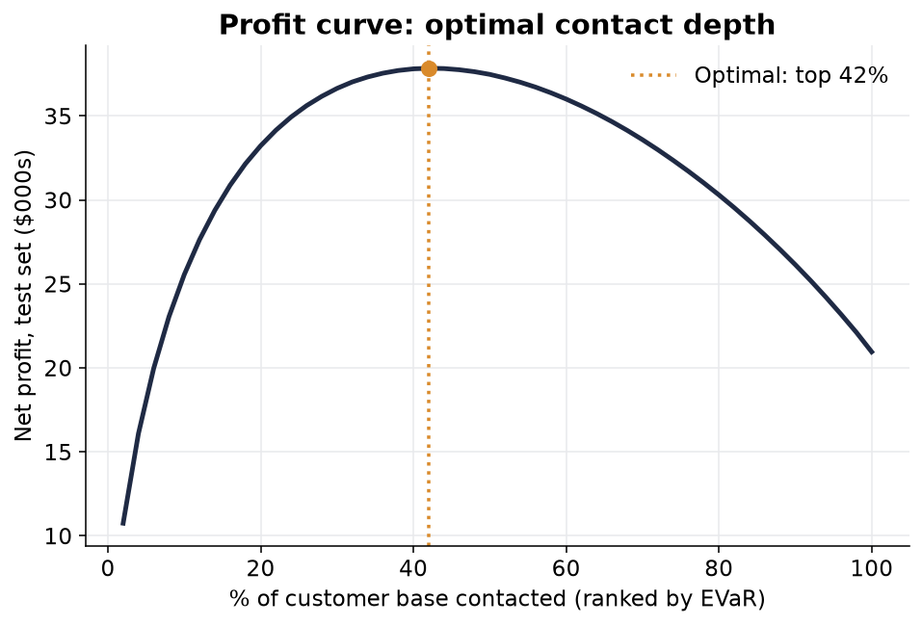
OPTIMIZE
How deep to go — the profit curve
Maximize profit, not recall
Calling everyone wastes incentives; calling too few leaves value on the table. We sweep contact depth and pick the peak.
Optimal depth: 42%
Net profit $189,190 • ROI 2.4x • ~351 customers saved (base case).

Slide 12
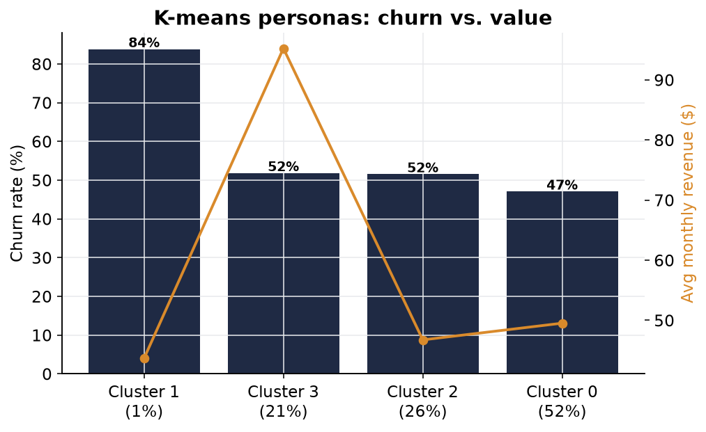
WHO THEY ARE
Four behavioral personas (K-means)
Behavioral, not demographic
Clusters are built only from behavior — usage trend, equipment age, care intensity, overage, tenure.
High-risk segment: churn rate 84%, high care-call intensity and aging equipment — the clearest save target.
A separate high-ARPU segment justifies premium, concierge-style retention offers.

Slide 13
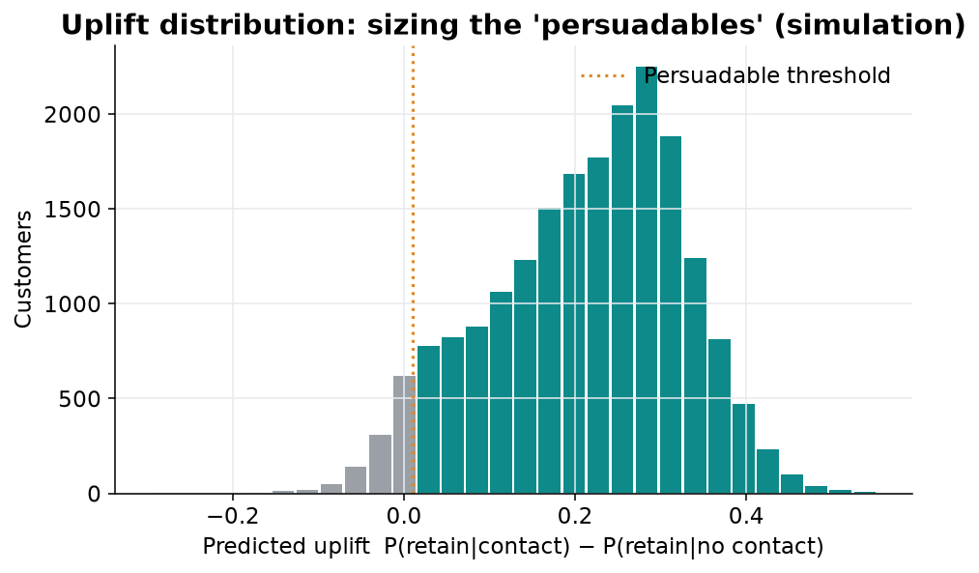
PERSUADABLES
Treat customers a campaign can actually move
Beyond risk: responsiveness
Some high-risk customers leave regardless; the money is in persuadables — those whose retention an offer actually changes (T-learner uplift).
Honesty note
This data is observational (no test/control), so the response here is a clearly-labeled simulation to demonstrate the method.
Next step: a live A/B holdout to measure real uplift before scaling.

Slide 14
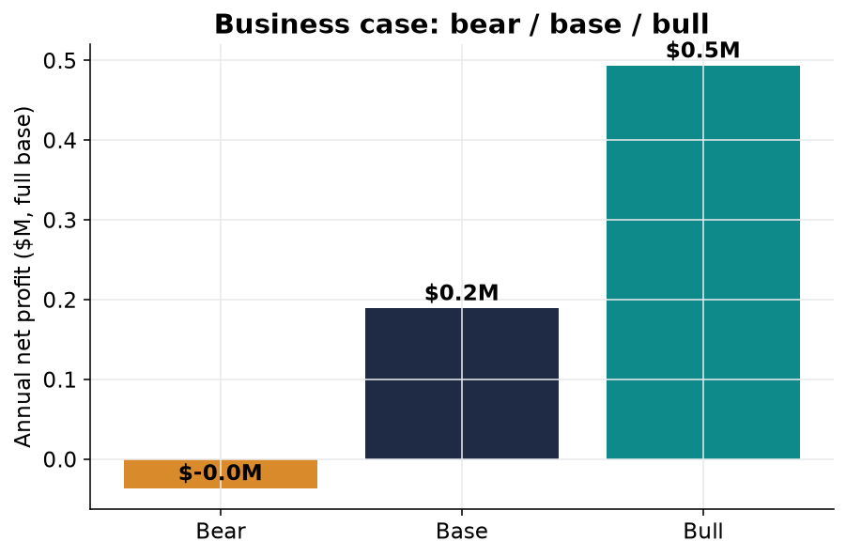
THE MONEY
Bear / base / bull — profit-positive in the base & bull
Assumptions are cited, not invented
Each scenario varies save rate, offer cost, margin, and CLV horizon — all sourced in REFERENCES.md.
Bear
save 12% · $35 offer
$-36,379
ROI 0.8x · ~211 saved
Base
save 20% · $30 offer
$189,190
ROI 2.4x · ~351 saved
Bull
save 28% · $25 offer
$493,383
ROI 6.1x · ~492 saved

Slide 15
RECOMMENDATIONS & NEXT STEPS
Operationalize the model — and prove it with a test
1
Deploy value-ranked scoring. Score the base monthly; route the profit-optimal top 42% by value-at-risk to retention.
2
Trigger device-age offers. Automate upgrade offers as handsets cross the high-risk age band — the #1 SHAP driver.
3
Fix service friction. Feed dropped-call and care-intensity signals to network and support ops as leading indicators.
4
Run an A/B retention test. Randomized treatment/control to measure REAL uplift and replace the simulated persuadables figures.
5
Re-validate assumptions. Confirm save rate, offer cost, margin, and CLV with finance; refresh the bear/base/bull case quarterly.
Reproducible: churn_analysis.ipynb regenerates every figure and number from the raw CSVs; assumptions cited in REFERENCES.md.

