Slide 1
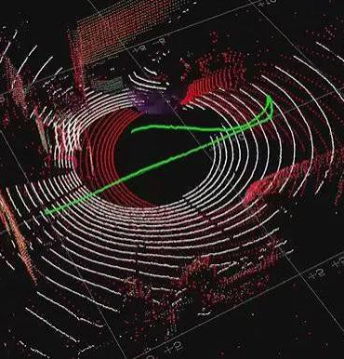
Lidar Pose Estimator – Pipeline walkthrough
Presented by:
Hazem Mohsen Abdelaziz

Slide 2
ROS2 Package
This package solves one problem: estimate the 6-DOF pose of a moving LiDAR sensor over time, using only the point cloud stream — no GPS, no IMU fusion,no wheel odometry.
It builds a map as it goes, and it ships a second node whose only job is to grade how accurate that estimate is against an external ground-truth source.
Two executables ship in this package:
1- lidar_pose_estimator_node
does the actual SLAM-style odometry
2-evaluation_node
compares it to ground truth and logs results

Slide 3
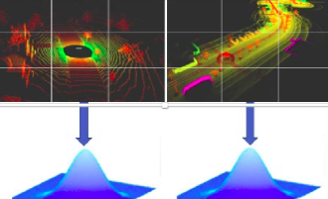
Point cloud registration (NDT)
Why Normal Distributed Transform?
Models a point cloud as a grid of local Gaussian distributions, not raw points
Registration = find the rigid transform that best aligns a new scan's points against those distributions
Smooth, differentiable cost surface — better convergence behavior than raw ICP on noisy outdoor data

Slide 4
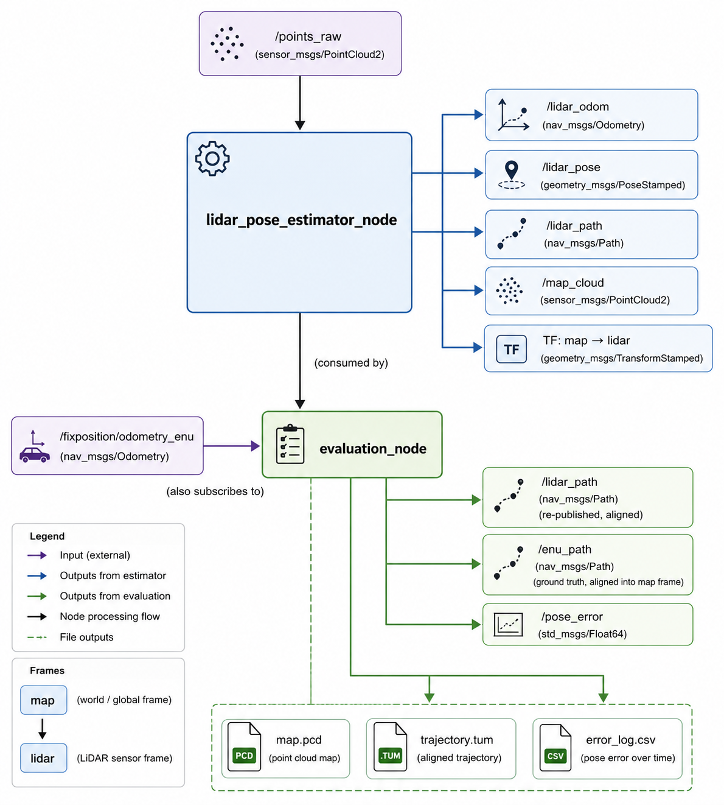
High level data flow

Slide 5
Per-frame pipeline
1. Convert ROS message → PCL point cloud
2. Voxel-downsampling
3. Range filter (remove too-near / too-far points)
4. Hard cap on point count (random subsample)
5. Bootstrap check — first frame seeds the map
6. Build initial guess from constant-velocity motion prior
7. NDT registration (scan-to-map, falls back to scan-to-scan)
8. Accept or reject based on fitness score
9. Accumulate accepted scan into the map
10. Publish odometry / pose / TF / path, log TUM line
11. Periodically publish the full map cloud
12- Converting to XYZ PCL to continue cycle processing

Slide 6
Range filtering
Without it, an outdoor scan with well over 100,000 points produces NDT normal distributions so smooth that the identity transform looks like a valid optimum — the estimated pose simply doesn't move. Cutting points below the minimum range removes self-noise and reflections off the platform; cutting points beyond the maximum range removes far-field returns that flatten the gradient.
The side effect is also a big point-count reduction, typically down to five-to-fifteen thousand points, which keeps registration fast.

Slide 7

BOOTSTRAP
First scan is treated as ground truth at identity
T_map_lidar_ and T_delta_ both initialized to identity
That first filtered scan is added directly to the map
Pose/odom/TF/path are published immediately, so downstream consumers see frame 0 with zero delay

Slide 8
Const velocity estimates (Motion Prior)
The system predicts the next pose using the previous motion:
Uses last two accepted poses to compute relative motion (T_delta)
Extrapolates current initial guess: Tguess = Tmap_lidar * T_delta
Scan-to-map Vs Scan-to-Scan
Two registration modes depending on map size
Early stage: scan-to-scan (frame-to-frame)
Later stage: scan-to-map (full accumulated map)
Fallback exists if scan-to-map fails (relaxed retry on previous frame)

Slide 9
Robust pose update & failure handling
NDT output is validated before being accepted
Conditions:
Converged
Fitness < threshold
If valid:
Update pose (T_map_lidar)
Update motion prior (T_delta)
If invalid:
Keep last good pose
Do NOT update motion model
Track failure count

Slide 10
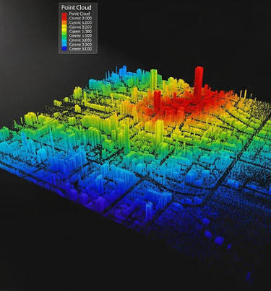
Map construction strategy
Full filtered scan is transformed into map frame
Added to global accumulated map
NOT limited to NDT correspondence points → preserves structure
Periodic voxel re-filtering prevents memory explosion
Map published every N frames, not every scan

Slide 11
System outputs and evaluation node purpose
Real-time outputs:
/lidar_odom, /lidar_pose, /lidar_path
TF: map → lidar
/map_cloud (periodic)
Offline outputs:
.pcd → final map
.tum → trajectory
.csv → logs (if evaluation used)
Why Evaluation node?
Separate node for independent evaluation
Compares LiDAR odometry vs ground truth (ENU)
Computes error metrics without affecting SLAM
Fully decoupled from estimator

Slide 12
Frame Alignment Problem & Solution
Problem:
LiDAR frame = arbitrary origin + heading
ENU frame = global reference (North-aligned)
Solution:
Auto alignment using first pose yaw difference
OR manual yaw offset override
Application:
Fixed transform T_enu_to_map
Applied to all ENU points

Slide 13
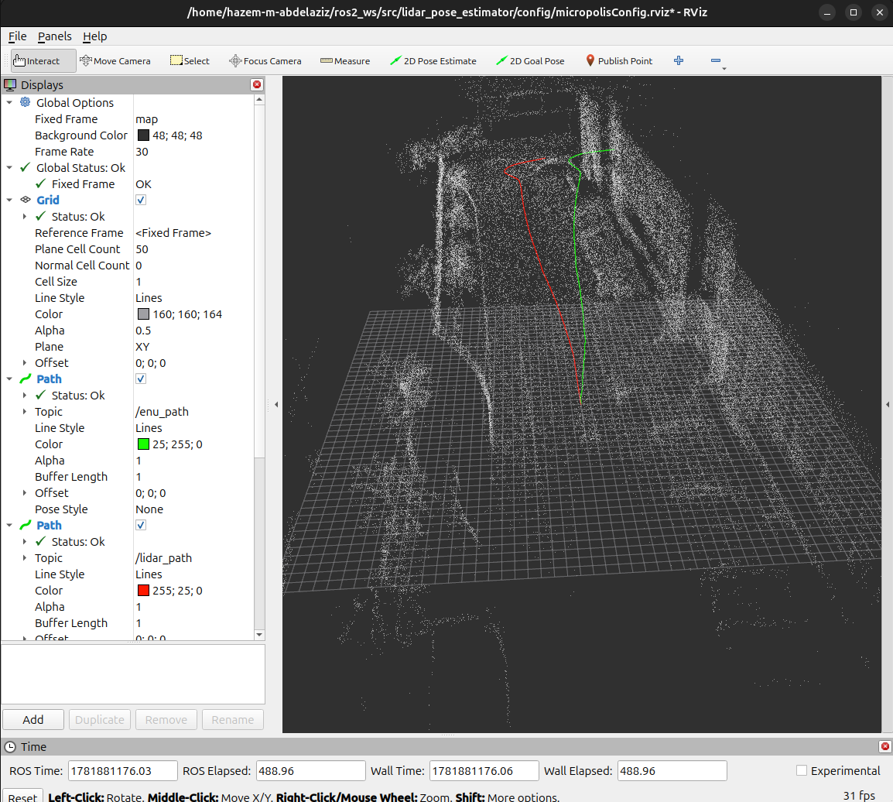
Visualization and takeaway
RViz2 visualization:
LiDAR path
Ground truth ENU path
Point cloud map
Live error signal
Key system ideas:
Heavy preprocessing → stable NDT
Motion prior improves convergence
Scan-to-map + fallback ensures robustness
Bad frames are rejected, not propagated
Fully reproducible evaluation pipeline

