Slide 1
Backwards Compatible Improvement of the
EPCglobal Class 1 Gen 2 Standard
Hazem A. Ahmed
IEEE RFID-TA 2015, 18.09.2015

Slide 2
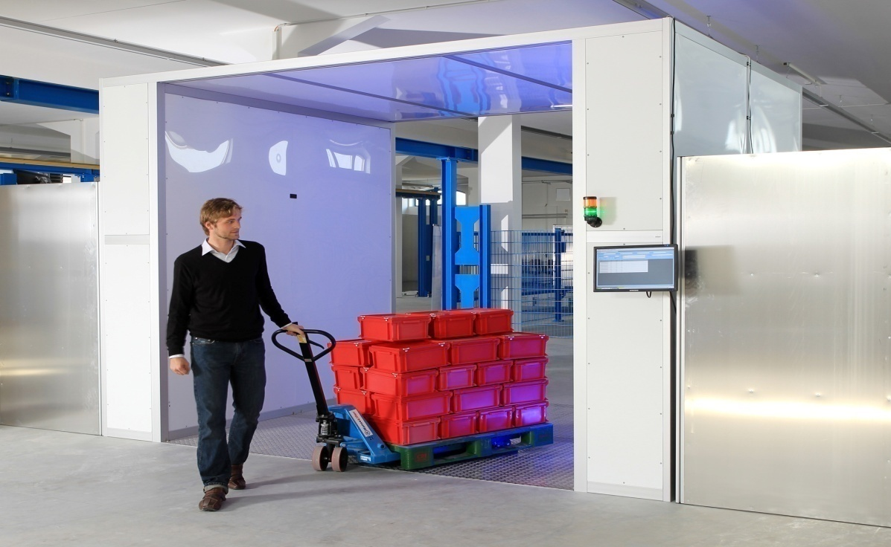
Motivation
System Model:
Single RFID reader.
Dense RFID network >3000 passive UHF tags.
Working standard EPCglobal C1 G2 with Framed Slotted ALOHA anti-collision protocol.
Tags should be identified in the minimum possible time.
http://bin95.com/BarCode_RFID.htm

Slide 3

Motivation
Conventional Framed Slotted ALOHA
No collision recovery capability
C₂ , C₃ , and C₄ are 2, 3, and 4 tags collided slots
Improved Framed Slotted ALOHA with Collision Recovery
Convert part of the collided slots into successful slots
Acknowledge only one tag per collided slot (EPCgloabal C1G2).
S
C₂
E
S
C₃
E
C₄
S
C₂
E
S
C₃
E
C₄
S
S
E
S
S
E
S
S: Successful slot
C: Collided slot
E: Empty slot
Can we Acknowledge more than one tag per slot under EPCglobal C1G2?

Slide 4
Agenda
EPCglobal C1 G2 Reading Process
Proposed Reading Process
Performance Analysis
Measurements and Simulation Results
Conclusion
Notes:
presentation consists of 5 parts
based on NW, we‘ll model the interference seen by the base station
I‘ll close with some conlcusions

Slide 5
EPCglobal C1 G2 Reading Process
L
Tag
Interrogation Zone
Reader

Slide 6
EPCglobal C1 G2 Reading Process
E
L
No Answer
Tag
Reader

Slide 7
EPCglobal C1 G2 Reading Process
E
C
L
Multiple answer
Tag
Reader

Slide 8
EPCglobal C1 G2 Reading Process
E
C
S
L
Unique answer
Tag
Reader

Slide 9
EPCglobal C1 G2 Reading Process
E
C
S
L
1
Collision Recovery
2
1
2
Tag
Reader

Slide 10

EPCglobal C1 G2 Reading Process
E
C
S
Arbitrate State
L
1
ACK
RN16₂
2
1
ACK State
2
1
Tag
2
2
2
Reader

Slide 11
EPCglobal C1 G2 Reading Process
E
C
S
L
EPC₂
2
1
2
1
Tag
2
2
2
Reader

Slide 12
Agenda
EPCglobal C1 G2 Reading Process
Proposed Reading Process
Performance Analysis
Measurements and Simulation Results
Conclusion
Notes:
presentation consists of 5 parts
based on NW, we‘ll model the interference seen by the base station
I‘ll close with some conlcusions

Slide 13
Proposed Reading Process
New system model
Mixed network between the conventional tags and
and the new tags.
Proposed RFID reader.
Conventional Tag
New Tag
Reader

Slide 14
Proposed Reading Process
Reader
Tags
Select Command:
Select part of the tag population
New tags & Conventional tags
Switch Command (new):
Reserved part for the future use at EPCglobal C1G2.
New tags switched to the modified mode.
Conventional tags neglect it.
Query Command:
Inform all the tags with frame length asking them
for their RN16 packets.
Select command
Switch command
Query command
 | Switch Command
Number of bits | 16
Description | 1110001001100000
t
t

Slide 15
Proposed Reading Process
Reader
Tags
K tags collided slot:
Conventional tags choose the conventional pilot (P₁)
12-bits zeros for synchronization
Each new tag chooses random pilot.
4-bits zeros for synchronization
8-bits orthogonal pilots for channel estimation
Select command
Switch command
Query command
RN16₁+RN16₂+….+RN16_{k}
Conventional pilot
P₁ | 0 0 0 0 0 0 0 0
P₁₈ | 0 0 0 1 0 0 0 1
P₆₉ | 0 1 0 0 0 1 0 0
P₈₆ | 0 1 0 1 0 1 0 1
P₁₇₁ | 1 0 1 0 1 0 1 0
P₁₈₈ | 1 0 1 1 1 0 1 1
P₂₃₉ | 1 1 1 0 1 1 1 0
P₂₅₆ | 1 1 1 1 1 1 1 1
8-bits orthogonal pilot [J. Kaitovic 2012]
t
t

Slide 16
Proposed Reading Process
Reader
Tags
Extracts each RN16 corresponding to each
single pilot reply.
Counts the number of recovered tags (R_{sol}).
recognizes if one of the replies is a conventional pilot or not:
If yes, acknowledges the conventional tag first.
If no, start from the weakest reply to the strongest.
Acknowledgement command:
The reader transmits ACK command corresponding
to one of the recovered RN16s
Select command
Switch command
Query command
RN16₁+RN16₂+….+RN16_{k}
Ack(RN16₁)
t
t

Slide 17
Proposed Reading Process
Reader
Tags
Tag which received a valid ACK command replies
with its EPC and goes to ACK state.
Tags which receive invalid ACK command enter wait state.
Select command
Switch command
Query command
RN16₁+RN16₂+….+RN16_{k}
Ack(RN16₁)
EPC(RN16₁)
(R_{sol}-1) tags
Wait state
First tag
ACK state
t
t

Slide 18

Proposed Reading Process
Reader
Tags
Reader repeat ACK command until finishing all the
extracted RN16s (pseudo parallel slot).
Successful single slot duration
$ts=tsa+tsb$
Proposed pseudo parallel slot duration
$tpps=tsa+Rsol∙tsb$
Select command
Switch command
E
C
S
Query command
t_{sa}
RN16₁+RN16₂+….+RN16_{k}
Pseudo parallel successful slot
Ack(RN16₁)
Query
+ RN16s
ACK₁+
EPC
ACK_{Rsol}
+EPC
t_{sb}
EPC(RN16₁)
t_{sa}
t_{sb}
Ack(RN16_{Rsol})
EPC(RN16_{Rsol})
t
t

Slide 19
Agenda
EPCglobal C1 G2 Reading Process
Proposed Reading Process
Performance Analysis
Measurements and Simulation Results
Conclusion
Notes:
presentation consists of 5 parts
based on NW, we‘ll model the interference seen by the base station
I‘ll close with some conlcusions

Slide 20
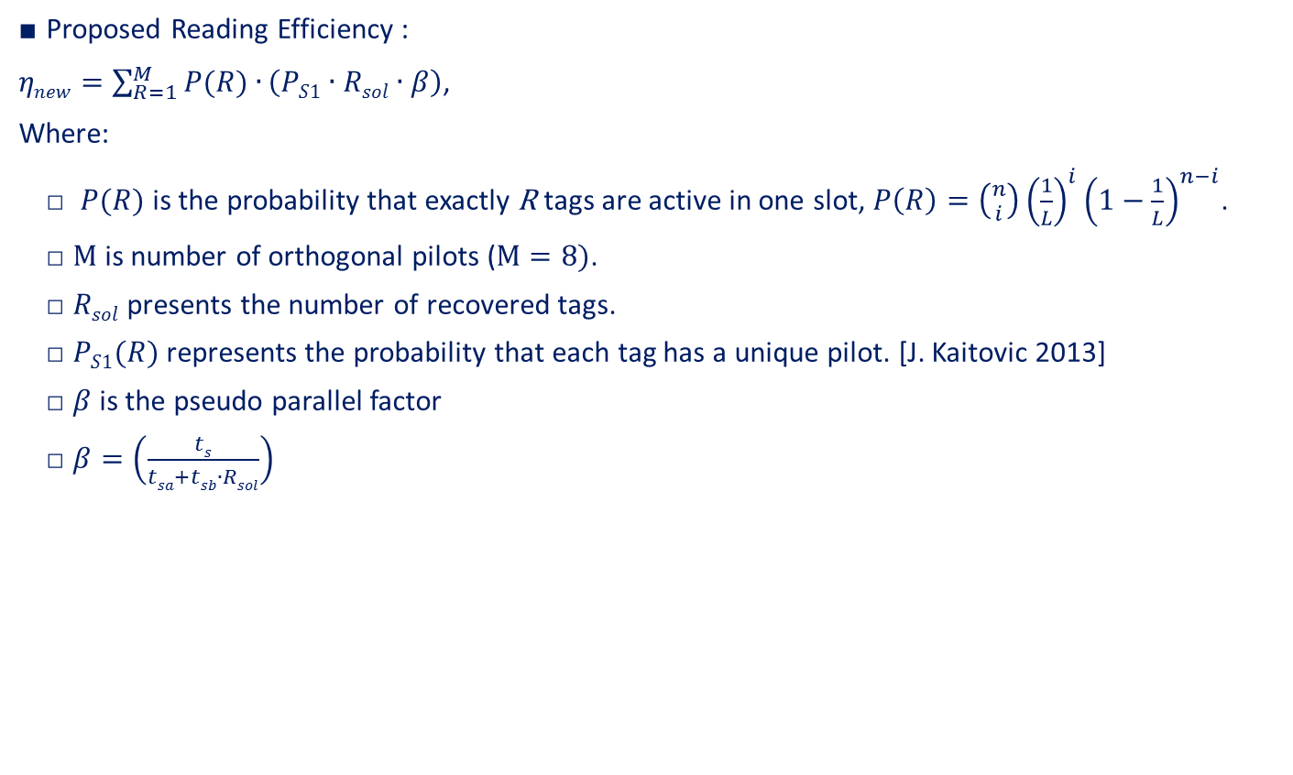
Performance Analysis
Proposed Reading Efficiency :
$ηnew=\sum_{R=1}^{M}{P(R)∙}\left(PS1∙Rsol∙β\right)$,
Where:
$P(R)$ is the probability that exactly R tags are active in one slot, $P\left(R\right)=\left({n \atop i}\right){\left(\frac{1}{L}\right)}^{i}{\left(1−\frac{1}{L}\right)}^{n−i}$.
$M$ is number of orthogonal pilots ($M=8)$.
$Rsol$ presents the number of recovered tags.
$PS1(R)$ represents the probability that each tag has a unique pilot. [J. Kaitovic 2013]
$β$ is the pseudo parallel factor
$β=\left(\frac{ts}{tsa+tsb∙Rsol}\right)$
Number of replied tags R | Probability of unique scenario
1 | Ps1=1
(1+1) | Ps1=0.875
(1+1+1) | Ps1=0.656
(1+1+1+1) | Ps1=0.41
(1+1+1+1+1) | Ps1=0.205
(1+1+1+1+1+1) | Ps1=0.077
(1+1+1+1+1+1+1) | Ps1=0.019
(1+1+1+1+1+1+1+1) | Ps1=0.002

Slide 21
Agenda
EPCglobal C1 G2 Reading Process
Proposed Reading Process
Performance Analysis
Measurements and Simulation Results
Conclusion
Notes:
presentation consists of 5 parts
based on NW, we‘ll model the interference seen by the base station
I‘ll close with some conlcusions

Slide 22
Simulation Results
Reading Efficiency comparison:
Fully parallel tags acknowledgment not applicable in practice.
Single acknowledgment system acknowledges only single tag per slot.

Slide 23
Simulation Results
Average reading time comparison:
C. Angerer [5] recover all the two collided tags.
J. Kaitovic [6] uses 8 orthogonal preambles but acknowledge only single tag.
The proposed system uses 8 orthogonal pilots and the pseudo parallel acknowledgment.
50%

Slide 24
Simulation Results
Average reading time comparison:
C. Angerer [5] recover all the two collided tags.
J. Kaitovic [6] uses 8 orthogonal preambles but acknowledge only single tag.
The proposed system uses 8 orthogonal pilots and the pseudo parallel acknowledgment.
35%

Slide 25
Simulation Results
Average reading time comparison:
C. Angerer [5] recover all the two collided tags.
J. Kaitovic [6] uses 8 orthogonal preambles but acknowledge only single tag.
The proposed system uses 8 orthogonal pilots and the pseudo parallel acknowledgment.
25%

Slide 26
Measurements
Communication link measurement:
The proposed reader is implemented on USRP B210.
The proposed tag is implemented on Wireless Identification and Sensing Platform (WISP) 5.0.

Slide 27
Measurements
Tag reply:

Slide 28
Conclusion
A new RFID system (Readers and Tgas) compatible with UHF EPCglobal class 1 gen 2 standard is proposed.
Compatibility with the EPCglobal class 1 gen 2 standards means:
The proposed tags could be inserted with conventional tags and identified by the conventional readers without affecting the performance.
The conventional tags can also inserted with the proposed tags and could be identified by the proposed readers with an improved performance.
Using the proposed system, the reading efficiency is increased signicantly up to 100%.

Slide 29

Thanks for your kind attention!
Hazem.a.elsaid@fau.de

