Slide 1
An Efficient RFID Tag Estimation Method Using Biased Chebyshev Inequality for Dynamic Frame Slotted ALOHA
Presented by: Hazem Elsaid

Slide 2
Agenda
Introduction
Motivation
Proposed Biased Chebyshev Tag Estimation
Conclusion
Hazem.a.elsaid@fau.de

Slide 3
Agenda
Introduction
Motivation
Proposed Biased Chebyshev Tag Estimation
Conclusion
Hazem.a.elsaid@fau.de

Slide 4
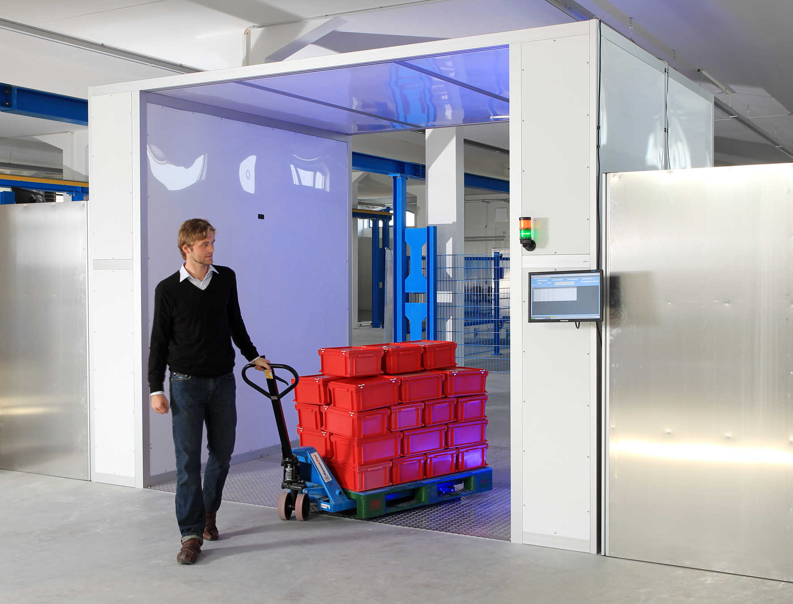
Introduction
Radio Frequency Identification (RFID) is a wireless data capture technology that can be used to electronically identify and track objects
Hazem.a.elsaid@fau.de

Slide 5
Introduction
RFID applications
Wireless
Item Tracking
Inventory Management
and Control
Bill of Lading
Material Tracking
Shipping Portals
Hazem.a.elsaid@fau.de

Slide 6

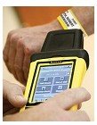
Introduction
RFID versus Barcodes:
 | Barcodes | RFID
Advantages | Smaller Cheaper than RFID Higher accurecy (today) | Large reading distance. Non-LOS technology. Automatic reading process. More secure (kill, password) Reusable. Higher reading rate.
Disadvantages | LOS technology. Small reading distance. Indvidual scanned. Easily damaged | Tag collision (dense network). Reader collision.
Hazem.a.elsaid@fau.de

Slide 7
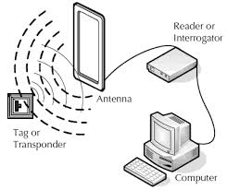
Introduction
RFID Components
Hazem.a.elsaid@fau.de

Slide 8
Introduction
RFID operating frequencies and its specifications
Microwave | Ultra High Frequency (UHF) | High Frequency (HF) | Low Frequency (LF)
2.45-5.8 GHz | 860-960 MHz | 13.56 MHz | 126-134 KHz | Frequency Range
5-100m | 2-10m | 1m | 10cm | Read Range
Electro magnetic | Electro magnetic | Magnetic | Magnetic | Coupling
18000-4 | EPC C0, C1, C1G2, 18000-6 | 18000-3.1, 15693,14443 A, B, and C | 11784/85, 14223 | Existing standards
Hazem.a.elsaid@fau.de

Slide 9
Introduction
RFID operating frequencies and its specifications
Microwave | Ultra High Frequency (UHF) | High Frequency (HF) | Low Frequency (LF)
2.45-5.8 GHz | 860-960 MHz | 13.56 MHz | 126-134 KHz | Frequency Range
5-100m | 2-10m | 1m | 10cm | Read Range
Electro magnetic | Electro magnetic | Magnetic | Magnetic | Coupling
18000-4 | EPC C0, C1, C1G2, 18000-6 | 18000-3.1, 15693,14443 A, B, and C | 11784/85, 14223 | Existing standards
Hazem.a.elsaid@fau.de

Slide 10
Introduction
Types of tags in RFID Systems
 | Active Tags | Passive Tags
Tag Power Source | Internal to the tag | Transferred from reader using RF signal
Tag Battery | Yes | No
Avilability of Power | Continious | In reading range
Required Signal strength | Very low | Very high
Reading range | Up to 100 m | Up to 10 m
Hazem.a.elsaid@fau.de

Slide 11
Introduction
Types of tags in RFID Systems
 | Active Tags | Passive Tags
Tag Power Source | Internal to the tag | Transferred from reader using RF signal
Tag Battery | Yes | No
Avilability of Power | Continious | In reading range
Required Signal strength | Very low | Very high
Reading range | Up to 100 m | Up to 10 m
Hazem.a.elsaid@fau.de

Slide 12
Agenda
Introduction
Motivation
Proposed Biased Chebyshev Tag Estimation
Conclusion
Hazem.a.elsaid@fau.de

Slide 13
Motivation
Single Reader Vs. multiple passive tags.
Interrogation Zone
Tag
Reader
Hazem.a.elsaid@fau.de

Slide 14
Motivation
Single Reader Vs. multiple passive tags.
Successful
Interrogation Zone
Tag
Reader
Hazem.a.elsaid@fau.de

Slide 15
Motivation
Single Reader Vs. multiple passive tags.
No Answer
Interrogation Zone
Tag
Reader
Hazem.a.elsaid@fau.de

Slide 16
Motivation
Single Reader Vs. multiple passive tags.
Collision Problem.
Multiple answer
Interrogation Zone
Tag
Reader
Hazem.a.elsaid@fau.de

Slide 17
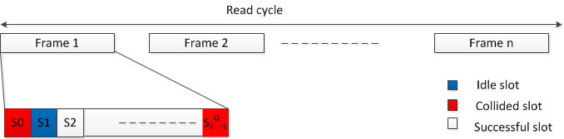
Motivation
Frame Slotted ALOHA
Time is divided into equally sized frames, each tag can access only one slot per frame.
Number of idle slots:
Number of Successful slots:
Number of collided slots:
Where:
n: Number of Tags
L: Frame Length
Hazem.a.elsaid@fau.de

Slide 18
Motivation
Frame Slotted ALOHA
Reading efficiency
For maximum reading efficiency:
n is unknown ???
Hazem.a.elsaid@fau.de

Slide 19
Agenda
Introduction
Motivation
Proposed Biased Chebyshev Tag Estimation
Conclusion
Hazem.a.elsaid@fau.de

Slide 20
Proposed Biased Chebyshev Tag Estimation
Classical Chebyshev Inequality Tag Estimation
Where:
- L is the frame length.
- n is the number of tags to be estimated.
- k is a constant >1.
Number of idle, successful, collided slots form the last reading cycle
Hazem.a.elsaid@fau.de

Slide 21
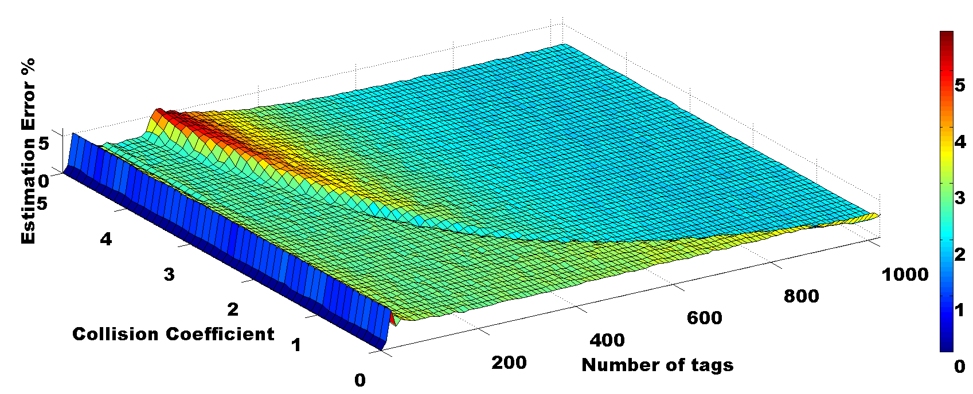
Proposed Biased Chebyshev Tag Estimation
Collision Coefficient
n >> L
n << L
n ≈ L
Frame Length= 512
Hazem.a.elsaid@fau.de

Slide 22
Proposed Biased Chebyshev Tag Estimation
Two dimensional Curve fitting:
First dimension is L:
L | Collision Coefficient
2⁰ | X₀
2¹ | X₁
2¹⁵ | X₁₅
Second dimension is n:
Proposed collision coefficient equation
Hazem.a.elsaid@fau.de

Slide 23
Proposed Biased Chebyshev Tag Estimation
Hazem.a.elsaid@fau.de

Slide 24
Proposed Biased Chebyshev Anti-collision Algorithm
Set initial frame length =128
Observe:
Collided Slots
Successful Slots
Empty Slots
Collided & Successful =0
End
Calculate:
Collision coefficient
Estimated number of tags
Frame length
Hazem.a.elsaid@fau.de

Slide 25
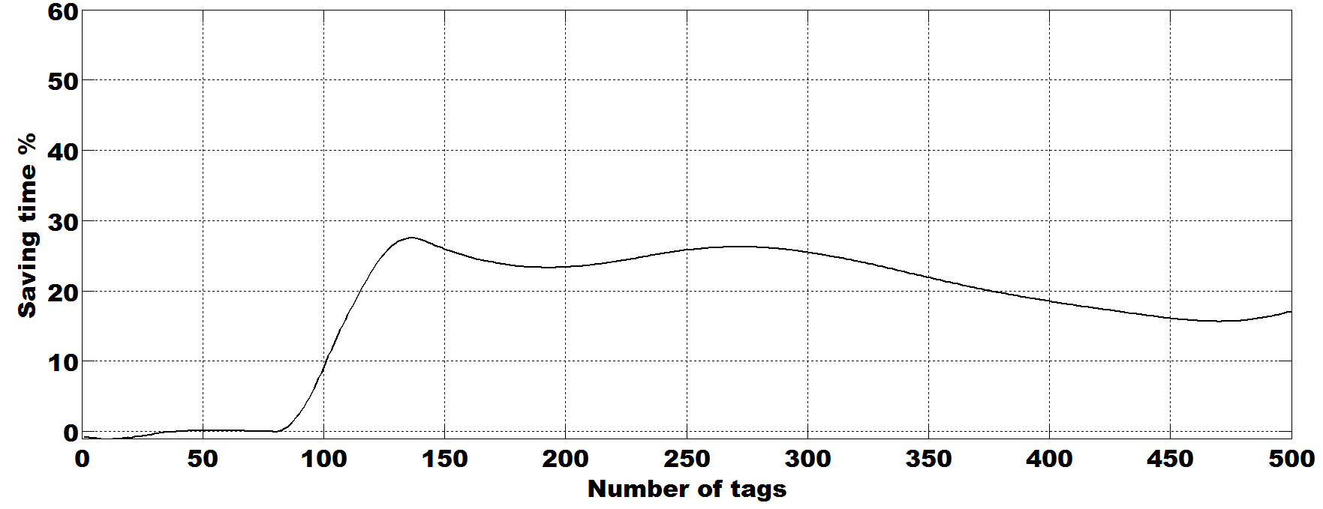
Proposed Biased Chebyshev Anti-collision Algorithm
Saving of time using the proposed biased Chebyshev estimation w.r.t. the classical Chebyshev:
Hazem.a.elsaid@fau.de

Slide 26
Agenda
Introduction
Motivation
Proposed Biased Chebyshev Tag Estimation
Conclusion
Hazem.a.elsaid@fau.de

Slide 27
Conclusion
Hazem.a.elsaid@fau.de

Slide 28
Thanks for your attention

