Slide 1
Design and Implementation of Anti-collision Algorithms for Dense RFID Systems
Hazem Elsaid Ibrahim

Slide 2
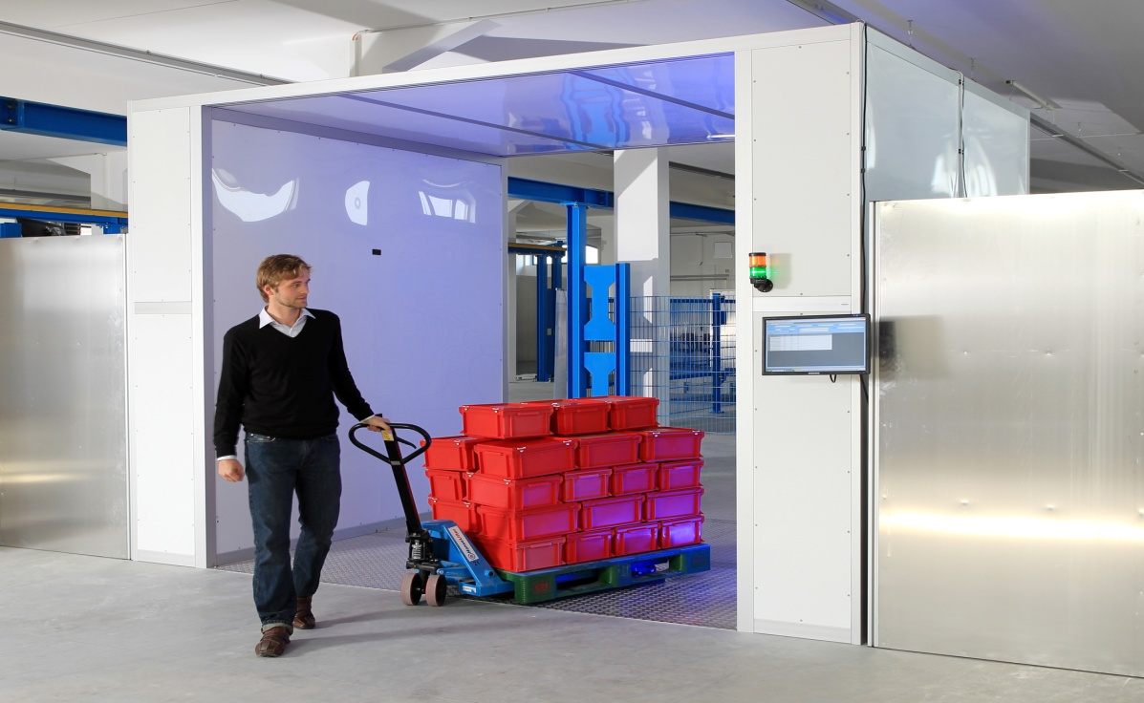
Motivation
System Model:
Single RFID Reader.
Dense RFID network with unknown
number of passive tags
Tags should be identified in the
minimum possible time
Frame Slotted ALOHA is used to maximize the reading efficiency
Taken from http://bin95.com/BarCode_RFID.htm

Slide 3
Motivation
Reader informs the tags with the current frame length
Each tag chooses random slot
L
Tag
Interrogation Zone
Reader

Slide 4
Motivation
Reader informs the tags with the current frame length
Each tag chooses random slot
Successful slot
Successful
S
L
Tag
Interrogation Zone
Reader

Slide 5
Motivation
Reader informs the tags with the current frame length
Each tag chooses random slot
Successful slot
Empty slot
No Answer
S
E
L
Tag
Interrogation Zone
Reader

Slide 6
Motivation
Reader informs the tags with the current frame length
Each tag chooses random slot
Successful slot
Empty slot
Collided slot
Performance limitation:
Empty slots
Collided slots
Multiple answer
S
E
C
L
Tag
Interrogation Zone
Reader

Slide 7






PHY-Layer Parameters
Time Aware System:
Decrease the empty slot duration
Eliminate the effect of the empty slots
Collision Recovery System
Convert collided slots to successful slots
Eliminate the effect of the collided slots
S
C
E
S
C
E
E
$$Tslot$$
$$Tslot$$
$$Tslot$$
S
C
E
S
C
E
E
$$Tk$$
$$Tk$$
$$Te$$
S
C
E
S
C
E
E
S
S
E
S
S
E
E

Slide 8

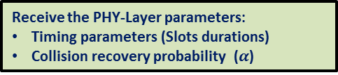
Proposed System
Modified Framed Slotted ALOHA algorithm:
Initialize: frame length
Observe: (Collided- Successful- Empty) slots
End
yes
Collided & Successful slots =0
No
Receive the PHY-Layer parameters:
Timing parameters (Slots durations)
Collision recovery probability ($α$)
Estimated number of tags ($n$)
Optimize the next frame length ($Lopt$)

Slide 9
Agenda
Proposed Cross (MAC-PHY) Layer Optimization
Number of Tags Estimation Method
Frame Slotted ALOHA Frame Length
Improvements of the EPCglobal C1 G2
Summary and Conclusion

Slide 10


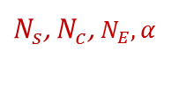
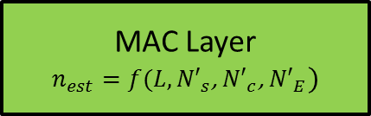
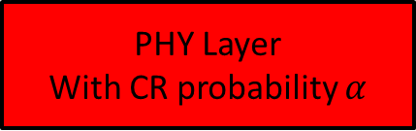
Proposed Number of Tags Estimation Method
Number of successful and collided slots before collision:
${N′}_{C}=\frac{N_{c}}{(1−α)}$
${N′}_{s}=N_{s}−\left(\frac{α}{1−α}\right)N_{c}$
${N′}_{E}=N_{E}$
Where:
$α$ is the collision recovery probability
${N′}_{s}$, ${N′}_{c}$, ${N′}_{E}$ are the number of successful, collided, and empty slots before collision recovery
$N_{s}$, $N_{c}$, $N_{E}$ are the number of successful, collided, and empty slots after collision recovery
MAC Layer
$$n_{est}=f(L,{N′}_{s}\text{, }{N′}_{c}\text{, }{N′}_{E})$$
$N_{s}\text{, }N_{c}$, $N_{E},α$
PHY Layer
With CR probability $α$
${N′}_{s}\text{, }{N′}_{c}$, ${N′}_{E}$

Slide 11







Proposed CR Aware Maximum Likelihood Tag Estimation
Proposed a posteriori distribution:
$p\left(n\backslash {L,N}_{E}{, N}_{s},N_{c},α\right)={\left(\frac{n}{L}\right)}^{{N′}_{S}}e^{−n}{\left(e^{−\frac{n}{L}}−1−\frac{n}{L}\right)}^{{N′}_{c}}$
For $n_{opt}$ $\frac{∂p\left(n\backslash {L,N}_{E}{, N}_{s},N_{c},α\right)}{∂n}=0$
After simplifications:
$$\left[\frac{1}{120}\left(L−{N′}_{c}\right)\right]n^{4}+\frac{L}{24}\left[L−{N^{′}}_{c}−\frac{{N′}_{s}}{5}\right]n^{3}+\frac{L^{2}}{6}\left[L−{N^{′}}_{c}−\frac{{N′}_{s}}{4}\right]n^{2}+\frac{L^{3}}{2}\left[L−{N^{′}}_{c}−\frac{{N′}_{s}}{3}\right]n−L^{4}\left[{N^{′}}_{c}−\frac{{N′}_{s}}{2}\right]=0$$
Using Descartes’ rules of sign:
$n_{est}=−\frac{b}{4a}−S+0.5\sqrt{−4S^{2}−2P+\frac{q}{S}}$
$$a$$
$$b$$
$$c$$
$$d$$
$$e$$
Where:
$P=\frac{8ac−3b^{2}}{8a^{2}}$
$q=\frac{b^{3}−4abc+8a^{2}d}{8a^{3}}$
$S=0.5\sqrt{−\frac{2}{3}P+\frac{1}{3a}\left(Q+\frac{∆_{0}}{Q}\right)}$
$Q=\sqrt[3]{\frac{∆_{1}+\sqrt{{∆2}_{1}^{}−4{∆3}_{0}^{}}}{2}}$
$∆_{0}=c^{2}−3bd+12ae$
$∆_{1}={2c}^{3}−9bcd+27ad^{2}−72ace$

Slide 12

Proposed CR Aware Maximum Likelihood Tag Estimation
Average percentage of estimation error comparison
Under collision recovery capability $α=0.7$

Slide 13
Agenda
Proposed Cross (MAC-PHY) Layer Optimization (PhD Contribution)
Number of Tags Estimation Method
Frame Slotted ALOHA Frame Length
Adaptive Decision Collision Recovery System
PhD Summary
Patents and Publications
Time plan and future work

Slide 14


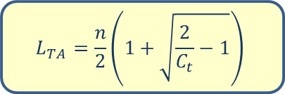

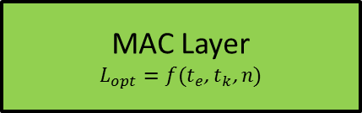
Time Aware System
Reading efficiency:
$η_{TA}=\frac{N_{s}⋅T_{s}}{N_{s}⋅T_{s}+N_{c}⋅T_{c}+N_{E}⋅T_{e}}$
For optimum frame length
$\frac{∂η_{TA}}{∂L}=0$
where : $C_{t}=\frac{T_{e}}{T_{c}}$ is the slot duration constant
After simplifications:
${\left(\frac{L_{TA}}{n}\right)}^{2}C_{t}−\left(\frac{L_{TA}}{n}\right)C_{t}+0.5\left(C_{t}−1\right)=0$
After Solving the equation and rejecting the negative solution
Proposed optimum time aware frame length:
MAC Layer
$$L_{opt}=f(t_{e}\text{,} t_{k}\text{, }n)$$
$t_{e}$, $t_{k}$
$$\left(1−\frac{n}{L_{TA}}\right)=\left(1−C_{t}\right){\left(1−\frac{1}{L_{TA}}\right)}^{n}$$
PHY Layer
$$L_{TA}=\frac{n}{2}\left(1+\sqrt{\frac{2}{C_{t}}−1}\right)$$

Slide 15

Time Aware System
Proposed closed form compared to the numerical solution for the full range of $C_{t}$:
$n=100$ tags.
$\max_{L}\left\{η_{TA}=\frac{N_{s}⋅T_{s}}{N_{s}⋅T_{s}+N_{c}⋅T_{c}+N_{E}⋅T_{e}}\right\}$
$L_{TA}=\frac{n}{2}\left(1+\sqrt{\frac{2}{C_{t}}−1}\right)$

Slide 16
Time Aware System
Mean reduction time for identical PHY environment compared to the conventional case L=n:

Slide 17

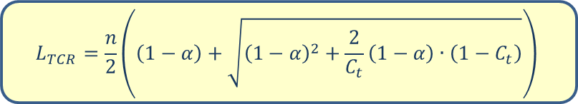

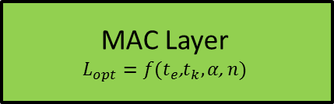
Time and Collision Recovery Aware System
Reading efficiency:
$η_{TCR}=\frac{P\left(1\right)+α∙\sum_{i=2}^{n}{P(i)}}{1+P(0)⋅\left(C_{t}−1\right)}$
For optimum frame length
$\frac{∂η_{TCR}}{∂L}=0$
The proposed final solution:
MAC Layer
$$L_{opt}=f(t_{e}\text{,}t_{k}, α\text{, }n)$$
$t_{e}$, $t_{k}, α$
PHY Layer
$$L_{TCR}=\frac{n}{2}\left(\left(1−α\right)+\sqrt{{\left(1−α\right)}^{2}+\frac{2}{C_{t}}\left(1−α\right)∙\left(1−C_{t}\right)}\right)$$

Slide 18

Time and Collision Recovery Aware System
Proposed closed form compared to the numerical solution for the full range of $C_{t}$:
$n=100$ tags.
$\max_{L}\left\{η_{TCR}=\frac{P\left(1\right)+α∙\sum_{i=2}^{n}{P(i)}}{1+P(0)⋅\left(C_{t}−1\right)}\right\}$
$L_{TCR}=\frac{n}{2}\left(\left(1−α\right)+\sqrt{{\left(1−α\right)}^{2}+\frac{2}{C_{t}}\left(1−α\right)∙\left(1−C_{t}\right)}\right)$

Slide 19
Time and Collision Recovery Aware System
Mean reduction time for identical PHY environment compared to the conventional case L=n:

Slide 20




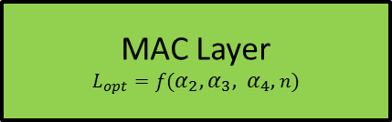
Multiple Collision Recovery Coefficients Aware System
Reading efficiency:
$η_{MCR}=P\left(1\right)+\sum_{i=2}^{n}{α_{i}∙P(i)}$
96% from collided slot is$\left\{P\left(2\right)+P\left(3\right)+P\left(4\right)\right\}$
$η_{MCR}=P\left(1\right)+α_{2}∙P(2)$+ $α_{3}∙P(3)$+${ α}_{4}∙P(4)$
For optimum frame length
$\frac{∂η_{MCR}}{∂L}=0$
The proposed final solution:
MAC Layer
$$L_{opt}=f(α_{2},α_{3}, α_{4},n)$$
$α_{2},α_{3},$ $α_{4}$
PHY Layer
$$L_{MCR}=\left(−\frac{b}{4a}−S+0.5\sqrt{−4S^{2}−2P−\frac{q}{S}}\right)⋅n$$
Where:
$P=\frac{8ac−3b^{2}}{8a^{2}}$
$q=\frac{b^{3}−4abc+8a^{2}d}{8a^{3}}$
$S=0.5\sqrt{−\frac{2}{3}P+\frac{1}{3a}\left(Q+\frac{∆_{0}}{Q}\right)}$
$Q=\sqrt[3]{\frac{∆_{1}+\sqrt{{∆2}_{1}^{}−4{∆3}_{0}^{}}}{2}}$
$∆_{0}=c^{2}−3bd+12ae$
$∆_{1}={2c}^{3}−9bcd+27ad^{2}−72ace$

Slide 21

Multiple Collision Recovery Coefficients Aware System
Proposed closed form compared to the numerical solution for the full range of $C_{t}$:
$n=100$ tags.
$\max_{L}\left\{η_{MCR}=P\left(1\right)+α_{2}∙P(2)\text{+} α_{3}∙P(3)\text{+}{ α}_{4}∙P(4)\right\}$
$L_{MCR}=\left(−\frac{b}{4a}−S+0.5\sqrt{−4S^{2}−2P−\frac{q}{S}}\right)⋅n$

Slide 22
Multiple Collision Recovery Coefficients Aware System
Mean reduction time for identical PHY environment compared to the conventional case L=n:

Slide 23




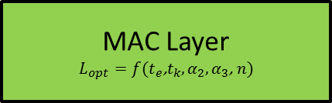
Time and Multiple Collision Recovery Coefficients Aware System
Reading efficiency:
$η_{TMCR}=\frac{P\left(1\right)+α_{2}∙P(2)+α_{3}∙P(3)}{1+P(0)⋅\left(C_{t}−1\right)}$
For optimum frame length
$\frac{∂η_{TMCR}}{∂L}=0$
The proposed final solution:
MAC Layer
$$L_{opt}=f(t_{e}\text{,}t_{k},α_{2},α_{3}\text{, }n)$$
$t_{e}$, $t_{k},α_{2},α_{3}$
PHY Layer
$$L_{TMCR}=\left(−\frac{b}{4a}−S+0.5\sqrt{−4S^{2}−2P−\frac{q}{S}}\right)⋅n$$
Where:
$P=\frac{8ac−3b^{2}}{8a^{2}}$
$q=\frac{b^{3}−4abc+8a^{2}d}{8a^{3}}$
$S=0.5\sqrt{−\frac{2}{3}P+\frac{1}{3a}\left(Q+\frac{∆_{0}}{Q}\right)}$
$Q=\sqrt[3]{\frac{∆_{1}+\sqrt{{∆2}_{1}^{}−4{∆3}_{0}^{}}}{2}}$
$∆_{0}=c^{2}−3bd+12ae$
$∆_{1}={2c}^{3}−9bcd+27ad^{2}−72ace$

Slide 24

Time and Multiple Collision Recovery Coefficients Aware System
Proposed closed form compared to the numerical solution for the full range of $C_{t}$:
$n=100$ tags.
$\max_{L}\left\{η_{TMCR}=\frac{P\left(1\right)+α_{2}∙P(2)+α_{3}∙P(3)}{1+P(0)⋅\left(C_{t}−1\right)}\right\}$
$L_{MCR}=\left(−\frac{b}{4a}−S+0.5\sqrt{−4S^{2}−2P−\frac{q}{S}}\right)⋅n$

Slide 25
Time and Multiple Collision Recovery Coefficients Aware System
Mean reduction time for identical PHY environment compared to the conventional case L=n:

Slide 26
Agenda
Proposed Cross (MAC-PHY) Layer Optimization (PhD Contribution)
Number of Tags Estimation Method
Frame Slotted ALOHA Frame Length
Adaptive Decision Collision Recovery System
PhD Summary
Patents and Publications
Time plan and future work

Slide 27
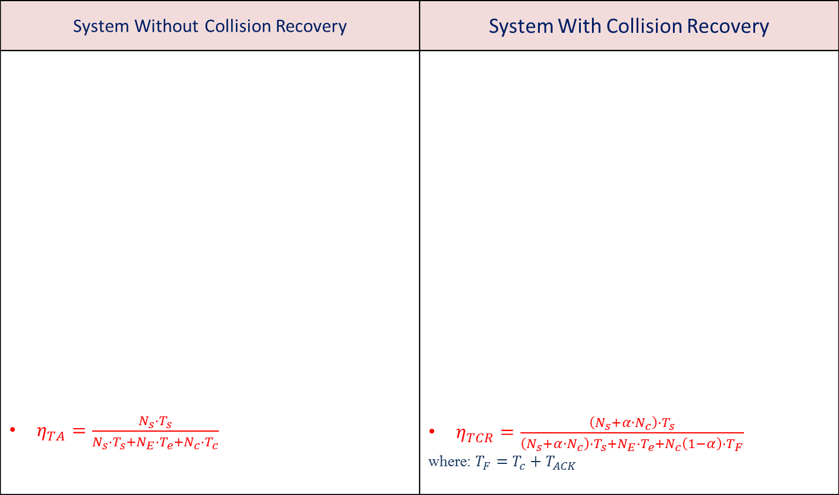
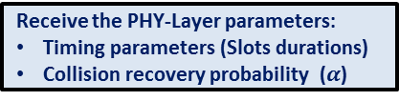
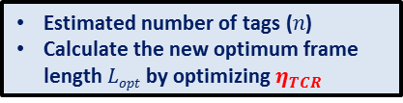
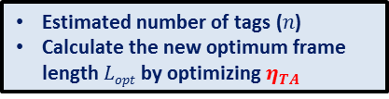
Adaptive Decision Collision Recovery System
System Without Collision Recovery | System With Collision Recovery
$η_{TA}=\frac{N_{s}⋅T_{s}}{N_{s}⋅T_{s}+N_{E}⋅T_{e}+N_{c}⋅T_{c}}$ | $η_{TCR}=\frac{\left(N_{s}+α∙N_{c}\right)⋅T_{s}}{\left(N_{s}+α∙N_{c}\right)⋅T_{s}+N_{E}⋅T_{e}+N_{c}\left(1−α\right)⋅T_{F}}$ where: $T_{F}=T_{c}+T_{ACK}$
Initialize: frame length
Initialize: frame length
Observe: (Collided- Successful- Empty) slots
Observe: (Collided- Successful- Empty) slots
End
yes
Collided & Successful slots =0
End
yes
Collided & Successful slots =0
No
No
Receive the PHY-Layer parameters:
Timing parameters (Slots durations)
Receive the PHY-Layer parameters:
Timing parameters (Slots durations)
Collision recovery probability ($α$)
Estimated number of tags ($n$)
Calculate the new optimum frame length $Lopt$ by optimizing $η_{TA}$
Estimated number of tags ($n$)
Calculate the new optimum frame length $Lopt$ by optimizing $η_{TCR}$

Slide 28

Adaptive Decision Collision Recovery System
Total Reading Time for 100 tags:
$$α_{critical}$$

Slide 29
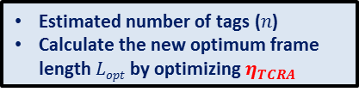


Adaptive Decision Collision Recovery System
Proposed Adaptive Decision FSA Algorithm
Initialize: frame length
Observe: (Collided- Successful- Empty) slots
End
yes
Collided & Successful slots =0
No
Receive the PHY-Layer parameters:
Timing parameters (Slots durations)
Collision recovery probability ($α$)
yes
$η_{TA}$> $η_{TCRA}$
No
Estimated number of tags ($n$)
Calculate the new optimum frame length $Lopt$ by optimizing $η_{TA}$
Estimated number of tags ($n$)
Calculate the new optimum frame length $Lopt$ by optimizing $η_{TCRA}$

Slide 30

Adaptive Decision Collision Recovery System
Total Reading Time comparison for system with random collision recovery probability $α∈[0,1]$:

Slide 31
Agenda
Proposed Cross (MAC-PHY) Layer Optimization (PhD Contribution)
Number of Tags Estimation Method
Frame Slotted ALOHA Frame Length
Adaptive Decision Collision Recovery System
PhD Summary
Patents and Publications
Time plan and future work

Slide 32
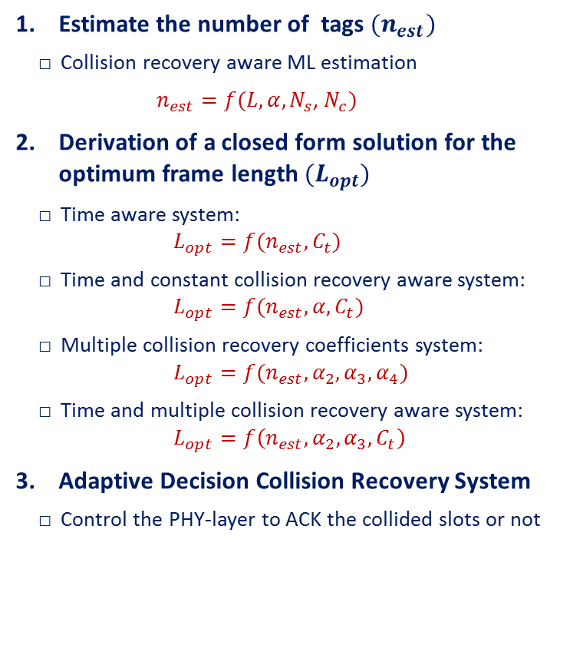



Main Contribution of my PhD Thesis
Estimate the number of tags ${(n}_{est})$
Collision recovery aware ML estimation
$n_{est}=f(L,α,N_{s}\text{, }N_{c})$
Derivation of a closed form solution for the optimum frame length${ (L}_{opt})$
Time aware system: $L_{opt}=f(n_{est},C_{t})$
Time and constant collision recovery aware system: $L_{opt}=f(n_{est},α,C_{t})$
Multiple collision recovery coefficients system: $L_{opt}=f(n_{est}, α_{2},α_{3},α_{4})$
Time and multiple collision recovery aware system: $L_{opt}=f\left(n_{est}, α_{2},α_{3},C_{t}\right)$
Adaptive Decision Collision Recovery System
Control the PHY-layer to ACK the collided slots or not
MAC Layer
$${(n}_{est}{ ,L}_{opt})$$
Adaptive
Decision
$t_{e}$, $t_{k}, α$
$L\text{, }N_{s}\text{, }N_{c}$, $N_{E}$
PHY Layer

Slide 33
Agenda
Proposed Cross (MAC-PHY) Layer Optimization (PhD Contribution)
Number of Tags Estimation Method
Frame Slotted ALOHA Frame Length
Adaptive Decision Collision Recovery System
PhD Summary
Patents and Publications
Time plan and future work

Slide 34

Thanks for your kind attention!
Hazem.a.elsaid@fau.de

