Slide 1
A Closed Form Solution for Frame Slotted ALOHA Utilizing Time and Multiple Collision Recovery Coefficients
Hazem A. Ahmed
IEEE Radio & Wireless Week 2016

Slide 2
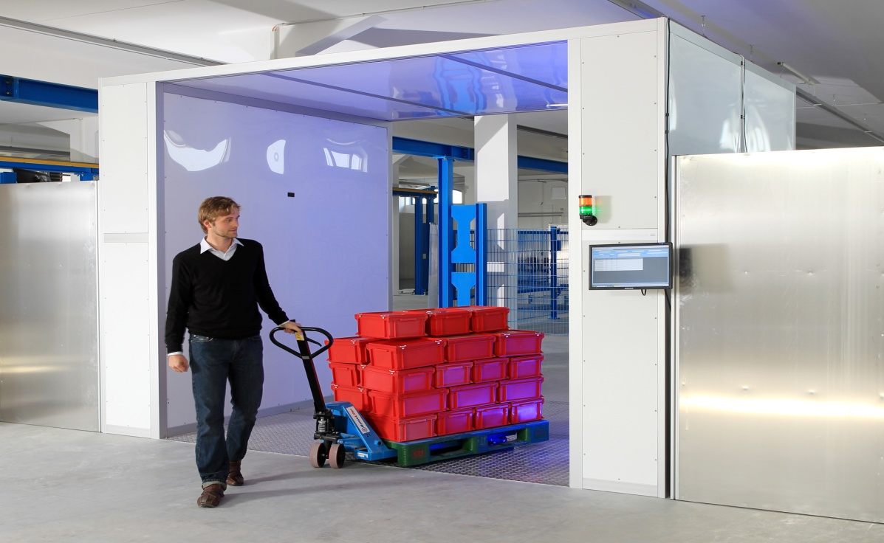

Motivation
System Model:
Single RFID Reader.
Dense RFID network with unknown
number of passive tags >1000 tags.
Tags should be identified at the
minimum possible time.
Maximizing the reading efficiency.
Taken from http://bin95.com/BarCode_RFID.htm
How can we maximize the reading efficiency?

Slide 3
Agenda
Conventional Frame Slotted ALOHA
Proposed System Model
Time differences is slot durations
Multiple collision recovery coefficients
Proposed closed form solution
Simulation results and conclusions.

Slide 4
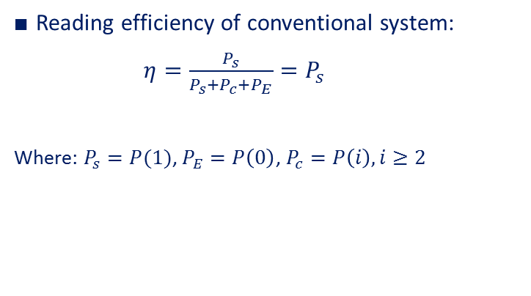


Conventional Framed Slotted ALOHA (FSA) System
Total Reading time
Frame₁
Frame₂
Frame_{i}
Where:
- Collided Slot
- Successful Slot
- Empty Slot
S
C
E
C
$$L$$
Reading efficiency of conventional system:
$η=\frac{P_{s}}{P_{s}+P_{c}+P_{E}}=P_{s}$
Where: $P_{s}=P(1)$, $P_{E}=P\left(0\right)$, $P_{c}=P\left(i\right), i≥2$
$$L=n$$

Slide 5



Proposed System Model
Practical systems
Systems with different slots durations:
Reading efficiency:
$η_{TA}=\frac{P_{s}⋅t_{k}}{P_{s}⋅t_{k}+P_{c}⋅t_{k}+P_{E}⋅t_{E}}=\frac{P_{s}}{1+P_{E}⋅\left(C_{t}−1\right)}$
where $C_{t}$ is the slot duration constant, $C_{t}=\frac{t_{E}}{t_{k}}$
Systems have a collision recovery capability:
Reading efficiency:
$η_{CR}=P\left(1\right)+\sum_{i=2}^{n}{α_{i}⋅P(i)}$
where $α_{i}$ is the collision recovery probability of i collided tags.
S
C
E
S
C
E
E
$$tk$$
$$tk$$
$$tE$$
S
C
E
S
C
E
E
S
S
E
S
S
E
E

Slide 6



Proposed System Model
Time and collision recovery aware system:
Reading efficiency:
$η_{TAMCR}=\frac{P\left(1\right)+\sum_{i=2}^{n}{α_{i}⋅P(i)}}{1+P(0)⋅\left(C_{t}−1\right)}$
Proposed time and collision recovery aware system:
Reading efficiency:
S
C
E
S
C
E
E
S
S
E
S
S
E
E
$\left(\frac{n}{2}≤L≤2n\right)$
$η_{TAMCR}=\frac{P\left(1\right)+α_{2}⋅P\left(2\right)+α_{3}⋅P(3)}{1+P(0)⋅\left(C_{t}−1\right)}$
85%

Slide 7

Proposed System Model
Effect of the Optimum frame length ${(L}_{opt.})$
Reading efficiency:
How can we get the optimum frame length?
MAC
PHY
ΔL

Slide 8
Numerical Method for Optimum Frame Length Calculation
The optimum frame length:
Multi-dimensional look up table.
L_{opt=}0.52

Slide 9
Numerical Method for Optimum Frame Length Calculation
The optimum frame length:
Multi-dimensional look up table:
Slots durations constant C_{t} :
EPCglobal C1G2 Standards
Divided Ratio: DR | Modulation: M | Pilot Length: X | Slots Duration Constant C_{t}
8 | 1 | 0 | 0.5
 |  | 12 | 0.4
 | 2 | 4 | 0.35
 |  | 16 | 0.3
 | 4 | 4 | 0.25
 |  | 16 | 0.23
 | 8 | 4 | 0.2
 |  | 16 | 0.15
64/3 | 1 | 0 | 0.7
 |  | 12 | 0.6
 | 2 | 4 | 0.5
 |  | 16 | 0.45
 | 4 | 4 | 0.4
 |  | 16 | 0.35
 | 8 | 4 | 0.3
 |  | 16 | 0.25

Slide 10
Numerical Method for Optimum Frame Length Calculation
The optimum frame length:
Multi-dimensional look up table:
Slots durations constant C_{t} :
Collision recovery coefficients α_{i}:
The probability of successful collision recovery (PHY-work).
According to the practical measurements, the SNR for successful slots varies between 4 to 12 dB.

Slide 11



Proposed closed form solution
Proposed reading efficiency:
$η_{TAMCR}=\frac{P\left(1\right)+α_{2}⋅P\left(2\right)+α_{3}⋅P(3)}{1+P(0)⋅\left(C_{t}−1\right)}$
$\frac{∂η_{TAMCR}}{∂β}=0$
where $β=\frac{L}{n}$.
Using Descartes’ rules of sign under the conditions:
$α_{2}≥α_{3}$
$0≤C_{t}≤1$
The proposed final solution:
Where:
$P=\frac{8ac−3b^{2}}{8a^{2}}$
$q=\frac{b^{3}−4abc+8a^{2}d}{8a^{3}}$
$S=0.5\sqrt{−\frac{2}{3}P+\frac{1}{3a}\left(Q+\frac{∆_{0}}{Q}\right)}$
$Q=\sqrt[3]{\frac{∆_{1}+\sqrt{{∆2}_{1}^{}−4{∆3}_{0}^{}}}{2}}$
$∆_{0}=c^{2}−3bd+12ae$
$∆_{1}={2c}^{3}−9bcd+27ad^{2}−72ace$
$$L_{TAMCR}=\left(−\frac{b}{4a}−S+0.5\sqrt{−4S^{2}−2P−\frac{q}{S}}\right)⋅n$$

Slide 12

Simulation Results
Proposed closed form compared to the numerical solution
$η_{TAMCR}=\frac{P\left(1\right)+α_{2}⋅P\left(2\right)+α_{3}⋅P(3)}{1+P(0)⋅\left(C_{t}−1\right)}$

Slide 13

Simulation Results
Mean reading time reduction using the proposed formula compared to the conventional solution
The same physical layer properties $\left(α_{2},α_{3}\text{, }C_{t}\right)$.
Proposed frame length versus the conventional frame length $\left(L=n\right)$

Slide 14

Conclusions
A new time and multiple collision recovery aware FSA reading efficiency is proposed
Differences in slots durations
Differences between the collision recovery probabilities
A closed form solution is proposed for the FSA optimum frame length for the new system
The closed form solution saves multidimensional look up tables (storage-time)
The mean reduction in reading time compared to the conventional case $(L=n)$ shows the gain of frame length adaptation (MAC-layer) using the same PHY-layer environment
MAC-layer optimization is important to fully make use of the PHY-layer evolution

Slide 15

Thanks for your kind attention!
Hazem A. Ahmed

