Slide 1
Backwards Compatible Improvement of the
EPCglobal Class 1 Gen 2 Standard
Hazem A. Ahmed
IEEE RFID-TA 2015, 18.09.2015

Slide 2
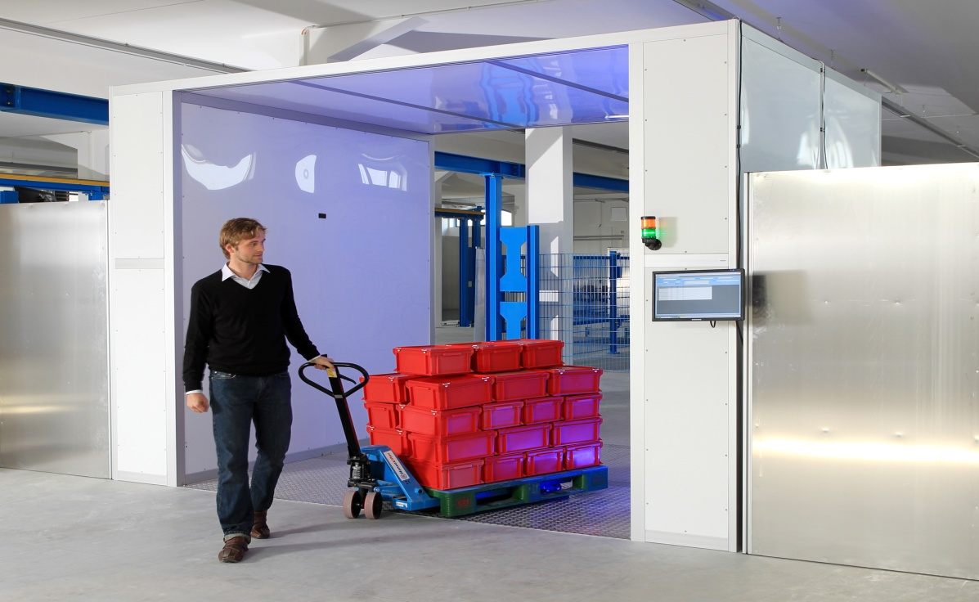
Motivation
System Model:
Single RFID reader.
Dense RFID network >3000 passive UHF tags.
Working standard EPCglobal C1 G2 with Framed Slotted ALOHA anti-collision protocol.
Tags should be identified in the minimum possible time.
http://bin95.com/BarCode_RFID.htm

Slide 3

Motivation
Conventional Framed Slotted ALOHA
No collision recovery capability
C₂ , C₃ , and C₄ are 2, 3, and 4 tags collided slots
Improved Framed Slotted ALOHA with Collision Recovery
Convert part of the collided slots into successful slots
Acknowledge only one tag per collided slot (EPCgloabal C1G2).
S
C₂
E
S
C₃
E
C₄
S
C₂
E
S
C₃
E
C₄
S
S
E
S
S
E
S
S: Successful slot
C: Collided slot
E: Empty slot
Can we Acknowledge more than one tag per slot under EPCglobal C1G2?

Slide 4
Agenda
EPCglobal C1 G2 Reading Process
Proposed System Description
Proposed Tags
Proposed Reader
Performance Analysis
Measurements and Simulation Results
Conclusion
Notes:
presentation consists of 5 parts
based on NW, we‘ll model the interference seen by the base station
I‘ll close with some conlcusions

Slide 5
EPCglobal C1 G2 Reading Process
L
Tag
Interrogation Zone
Reader

Slide 6
EPCglobal C1 G2 Reading Process
E
L
No Answer
Tag
Reader

Slide 7
EPCglobal C1 G2 Reading Process
E
C
L
Multiple answer
Tag
Reader

Slide 8
EPCglobal C1 G2 Reading Process
E
C
S
L
Unique answer
Tag
Reader

Slide 9
EPCglobal C1 G2 Reading Process
E
C
S
L
1
Collision Recovery
2
1
2
Tag
Reader

Slide 10

EPCglobal C1 G2 Reading Process
E
C
S
Arbitrate State
L
1
ACK
RN16₂
2
1
ACK State
2
1
Tag
2
2
2
Reader

Slide 11
EPCglobal C1 G2 Reading Process
E
C
S
L
EPC₂
2
1
2
1
Tag
2
2
2
Reader

Slide 12
Agenda
EPCglobal C1 G2 Reading Process
Proposed System Description
Proposed Tags
Proposed Reader
Performance Analysis
Measurements and Simulation Results
Conclusion
Notes:
presentation consists of 5 parts
based on NW, we‘ll model the interference seen by the base station
I‘ll close with some conlcusions

Slide 13
Proposed System Description (Tag)
Properties of the proposed Tag:
It includes two modes:
Conventional mode (default)
Modified mode (when it receives switch command)
The Pilot is divided into:
4-bits zeros for synchronization
8-bits orthogonal pilots for channel estimation
a- Conventional tag reply
b- Proposed tag reply
P₁ | 1 -1 1 -1 1 -1 1 -1 1 -1 1 -1 1 -1 1 -1
P₁₈ | 1 -1 1 -1 1 -1 1 1 -1 1 -1 1 -1 1 -1 -1
P₆₉ | 1 -1 1 1 -1 1 -1 1 -1 1 -1 -1 1 -1 1 -1
P₈₆ | 1 -1 1 1 -1 1 -1 -1 1 -1 1 1 -1 1 -1 -1
P₁₇₁ | 1 1 -1 1 -1 -1 1 -1 1 1 -1 1 -1 -1 1 -1
P₁₈₈ | 1 1 -1 1 -1 -1 1 1 -1 -1 1 -1 1 1 -1 -1
P₂₃₉ | 1 1 -1 -1 1 1 -1 1 -1 -1 1 1 -1 -1 1 -1
P₂₅₆ | 1 1 -1 -1 1 1 -1 -1 1 1 -1 -1 1 1 -1 -1
Example for the 8-bits orthogonal pilot [J. Kaitovic 2012]

Slide 14
Proposed System Description (Tag)
Properties of the proposed Tag:
It includes two modes:
Conventional mode (default)
Modified mode (when it receives switch command)
The Pilot is divided into:
4-bits zeros for synchronization
8-bits orthogonal pilots for channel estimation
Wait state is defined for the proposed tag, in this state:
Tag enters this state when it receives ACK command with invalid RN16.
Tag keeps on its RN16 value and wait for valid ACK to enter the Acknowledged state.
Tag goes to Arbitrate state when:
The waiting time proceeds the time out.
It receives any command except ACK command.

Slide 15
Proposed System Description (Reader)
Properties of the proposed reader:
Switch command is transmitted at the beginning of the inventory round
Converts the collided slot into pseudo parallel slot
Counts the number of single reply from each orthogonal pilot
Extracts each RN16 corresponding to each single pilot reply
Sends successive ACK commands until finishing all the extracted RN16s.
recognizes if one of these replies is the conventional pilot or not:
If yes, acknowledges the conventional tag first.
If no, start from the weakest reply to the strongest.
 | Switch Command
Number of bits | 16
Description | 1110001001100000
Proposed switch command

Slide 16
Agenda
EPCglobal C1 G2 Reading Process
Proposed System Description
Proposed Tags
Proposed Reader
Performance Analysis
Measurements and Simulation Results
Conclusion
Notes:
presentation consists of 5 parts
based on NW, we‘ll model the interference seen by the base station
I‘ll close with some conlcusions

Slide 17
Performance Analysis
New Reading Process
Each color presents tags with a unique and orthogonal
pilot.
The blue color presents conventional tag with
the conventional pilot.
Conventional Tag
New Tag
Reader

Slide 18
Performance Analysis
New Reading Process
E
C
S
3
RN16₃
Pilot₁
RN16₁
RN16₂
Pilot₂
RN16₂
2
Pilot₃
RN16₃
8 bits
16 bits
RN16₁
1
Conventional Tag
New Tag
Reader

Slide 19
Performance Analysis
New Reading Process
E
C
S
3
ACK₃
Pseudo parallel successful slot
ACK₂
Query
+ RN16s
ACK₃+
EPC
ACK₁
+EPC
ACK₂
+EPC
2
ACK₁
1
Conventional tag
Conventional Tag
New Tag
Reader

Slide 20





Performance Analysis
Proposed pseudo parallel slot duration
$ts=tsa+tsb$
$tpps=tsa+Rsol∙tsb$
S
C
E
Query
+ RN16
ACK+EPC
Query
+ RN16
ACK₁+
EPC
ACK_{Rsol}
+EPC
$$tsa$$
$$tsb$$
$$tsa$$
$$Rsol∙tsb$$
30%
70%

Slide 21
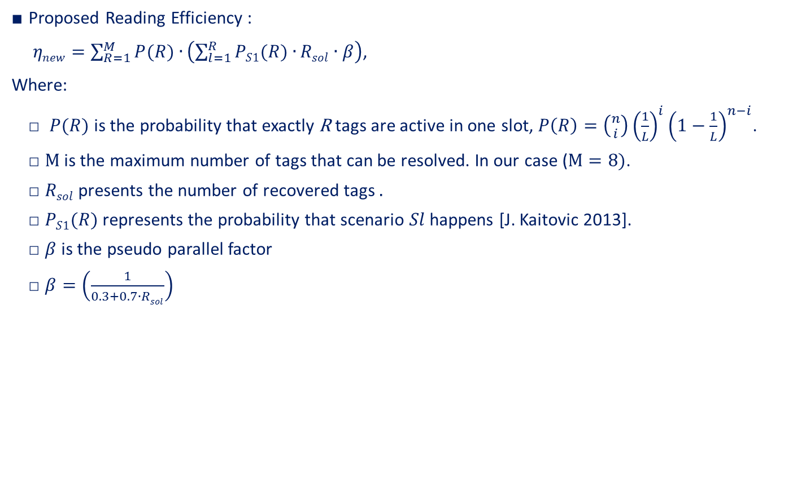
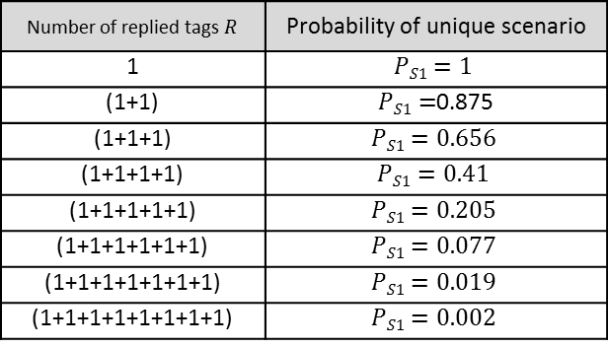
Performance Analysis
Proposed Reading Efficiency :
$ηnew=\sum_{R=1}^{M}{P(R)∙}\left(\sum_{l=1}^{R}{PS1(R)∙}Rsol∙β\right)$,
Where:
$P(R)$ is the probability that exactly R tags are active in one slot, $P\left(R\right)=\left({n \atop i}\right){\left(\frac{1}{L}\right)}^{i}{\left(1−\frac{1}{L}\right)}^{n−i}$.
$M$ is the maximum number of tags that can be resolved. In our case ($M=8)$.
$Rsol$ presents the number of recovered tags $.$
$PS1(R)$ represents the probability that scenario $Sl$ happens [J. Kaitovic 2013].
$β$ is the pseudo parallel factor
$β=\left(\frac{1}{0.3+0.7∙Rsol}\right)$
Number of replied tags $R$ | Probability of unique scenario
1 | $$PS1=1$$
(1+1) | $PS1=$0.875
(1+1+1) | $$PS1=0.656$$
(1+1+1+1) | $$PS1=0.41$$
(1+1+1+1+1) | $$PS1=0.205$$
(1+1+1+1+1+1) | $$PS1=0.077$$
(1+1+1+1+1+1+1) | $$PS1=0.019$$
(1+1+1+1+1+1+1+1) | $$PS1=0.002$$

Slide 22
Agenda
EPCglobal C1 G2 Reading Process
Proposed System Description
Proposed Tags
Proposed Reader
Performance Analysis
Measurements and Simulation Results
Conclusion
Notes:
presentation consists of 5 parts
based on NW, we‘ll model the interference seen by the base station
I‘ll close with some conlcusions

Slide 23
Measurements and Simulation Results
Communication link measurement:
The proposed reader is implemented on USRP B210.

Slide 24
Measurements and Simulation Results
Measurements Equipment:
The proposed tag is implemented on WISP 5.0.

Slide 25
Measurements and Simulation Results
Reading Efficiency comparison:
We used in simulations 8 orthogonal pilots
Fully parallel tags acknowledgment not applicable in practice.

Slide 26
Measurements and Simulation Results
Average reading time comparison:
C. Angerer [5] recover all the two collided tags.
J. Kaitovic [6] uses 8 orthogonal preambles but acknowledge only single tag.
The proposed system used the orthogonal pilots and the pseudo parallel acknowledgment.

Slide 27
Conclusion
A new RFID system (Readers and Tgas) compatible with UHF EPCglobal class 1 gen 2 standard is proposed.
The proposed system is compatible with the EPCglobal class 1 gen 2 standards, this mean that:
The proposed tags could be inserted with conventional tags and identied by the conventional readers without affecting the performance.
The conventional tags can also inserted with the proposed tags and could be identied by the proposed readers without affecting the performance.
Using the proposed system, the reading efficiency will be increased signicantly up to 100%.

Slide 28

Thanks for your kind attention!
Hazem.a.elsaid@fau.de

