Slide 1
An Efficient RFID Tag Estimation Method Using Biased Chebyshev Inequality for Dynamic Frame Slotted ALOHA
Presented by: Hazem Elsaid

Slide 2
Agenda
Motivation
Classical Tag Estimation Methods
Proposed Biased Chebyshev Tag Estimation
Summary
Hazem.a.elsaid@fau.de

Slide 3
Motivation
Single Reader Vs. multiple passive tags
Dense RFID network (up to 3000 tags)
Minimize the reading time
Interrogation Zone
Tag
Reader
Hazem.a.elsaid@fau.de

Slide 4
Motivation
Daynamic Frame Slotted ALOHA
Time is divided into variable frame sizes, each tag can access only one slot per frame.
Reading time
Frame₁
Frame₂
Frame_{m}
S₁
S₂
S₃
S₂^{Q}₋₁
Where:
n: Number of Tags
L: Frame Length
Collided Slot
Successful Slot
Idle Slot
Expected Number of idle slots:
Expected Number of successful slots:
Expected Number of collided slots:
Hazem.a.elsaid@fau.de

Slide 5
Motivation
Frame Slotted ALOHA
Reading efficiency
Maximum reading efficiency:
n is unknown ???
Robust number of tags estimation
Hazem.a.elsaid@fau.de

Slide 6
Agenda
Motivation
Classical Tag Estimation Methods
Proposed Biased Chebyshev Tag Estimation
Summary
Hazem.a.elsaid@fau.de

Slide 7
Classical Tag Estimation Methods
Lower bound
Schoute
Classical Chebyshev Tag estimation methods
Where:
- L is the frame length.
- n is the number of tags to be estimated.
- k is a constant >1.
Hazem.a.elsaid@fau.de

Slide 8
Performance of Classical Tag Estimation
Frame length L=128.
Hazem.a.elsaid@fau.de

Slide 9
Agenda
Motivation
Classical Tag Estimation Methods
Proposed Biased Chebyshev Tag Estimation
Summary
Hazem.a.elsaid@fau.de

Slide 10
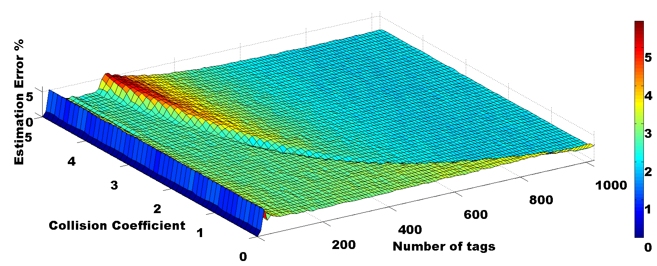
Proposed Biased Chebyshev Tag Estimation
Collision Coefficient
n >> L
n << L
n ≈ L
Frame Length= 512
Hazem.a.elsaid@fau.de

Slide 11
Proposed Biased Chebyshev Tag Estimation
Two dimensional Curve fitting:
First dimension is the frame length (L):
L | Collision Coefficient
2⁰ | X₀
2¹ | X₁
2¹⁵ | X₁₅
Second dimension is the number of tags (n):
Constant n
Proposed collision coefficient equation
Hazem.a.elsaid@fau.de

Slide 12
Proposed Biased Chebyshev Tag Estimation
Frame length L=128.
Hazem.a.elsaid@fau.de

Slide 13
Proposed Biased Chebyshev Anti-collision Algorithm
Set initial frame length
Observe:
Collided Slots
Successful Slots
Empty Slots
yes
Collided & Successful slots =0
End
No
Calculate:
Collision coefficient
Estimated number of tags
Frame length
Hazem.a.elsaid@fau.de

Slide 14
Proposed Biased Chebyshev Anti-collision Algorithm
Saving of time using the proposed biased Chebyshev estimation w.r.t. the classical Chebyshev.
Starting frame length L=128.
Hazem.a.elsaid@fau.de

Slide 15
Agenda
Motivation
Classical Tag Estimation Methods
Proposed Biased Chebyshev Tag Estimation
Summary
Hazem.a.elsaid@fau.de

Slide 16
Summary
A new biased Chebyshev inequality tag estimation method is proposed.
The proposed method is compared with the classical tag estimation methods
and gives better results with dense RFID networks.
A new biased Chebyshev inequality anti-collision algorithm is presented.
The new algorithm compared with the classical Chebyshev inequality
anti-collision and the reading time is reduced by 25%.
Hazem.a.elsaid@fau.de

Slide 17
Thanks for your attention

