Slide 1
DevOps Fundamentals & Benefits

Slide 2
What is DevOps?
DevOps is the combination of industry best practices & set of tools that improve an organization’s ability to:
Increase the speed of software delivery.
Increases the speed of software evolution.
Have better reliability of the software.
Have scalability using automation.
Improved collaboration among teams.

Slide 3
Why we need DevOps?
Some of the Issues that DevOps tries to solve:
Investing more time in a release cycle than delivering value.
Going through integration hell every time we finish a feature.
Unit test suite hasn't been green in ages.
Deployments contribute to schedule slip.
Friction between ops and development departments.
Only one engineer can deploy a system.

Slide 4
DevOps Best Practices & Tools
Continuous Integration / Continuous Delivery (CI/CD).
Infrastructure as Code (IaaC).
Microservices.
Monitoring and Logging.
Communication and Collaboration.

Slide 5
Continuous Integration & Deployment (CICD)
Continuous Integration (CI):
The practice of merging all developers' working copies to a shared mainline several times a day.
It's the process of "Making" Everything related to the code fits here, to achieve the ultimate goal of CI: a high quality, deployable artifact! Some common CI-related phases might include:
Compile
Unit Test
Static Analysis
Dependency vulnerability testing
Store artifact

Slide 6
Continuous Integration & Deployment (CICD)
Continuous Integration (CI):
A software engineering approach in which the value is delivered frequently through automated deployments. Everything related to deploying the artifact fits here. It's the process of "Moving" the artifact from the shelf to the spotlight.
Some common CD-related phases might include:
Creating infrastructure
Provisioning servers
Copying files
Promoting to production
Smoke Testing
Rollbacks

Slide 7
Continuous Integration & Deployment (CICD)
Continuous Delivery:
Continuous Delivery is an engineering practice in which teams produce and release value in short cycles.
Continuous Delivery contains and enhances the processes of Continuous Integration and Continuous Deployment to help delivering the needed value in short time with minimum Errors.

Slide 8
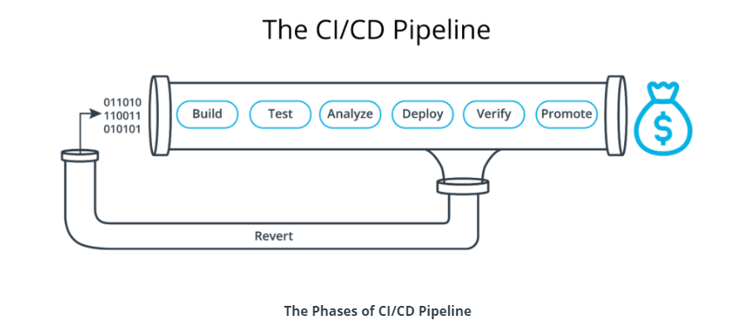
Continuous Integration & Deployment (CICD)

Slide 9
CI/CD Benefits
Detect compiling errors quickly: It will help in reducing cost by reducing the time a developer might take to trace the errors in new code of other developers.
Detect the unit test failures: It will avoid cost by providing a trusted product to customers with less bugs and reduce time compared if it will be done from testing team.
Detect vulnerability: It will help us to reduce the cost that we might face from customer due to security holes.

Slide 10
CI/CD Benefits
Automate Deployment to Prod: It will increase revenue as it will take less time to be available to market.
Automate Smoke testing: It will protect revenue as it will reduce the downtime in case facing any major bug or crash.
Automate Rollbacks: It will protect revenue as it will help in reverting changes back and bring the application to the initial working state.

