Slide 1
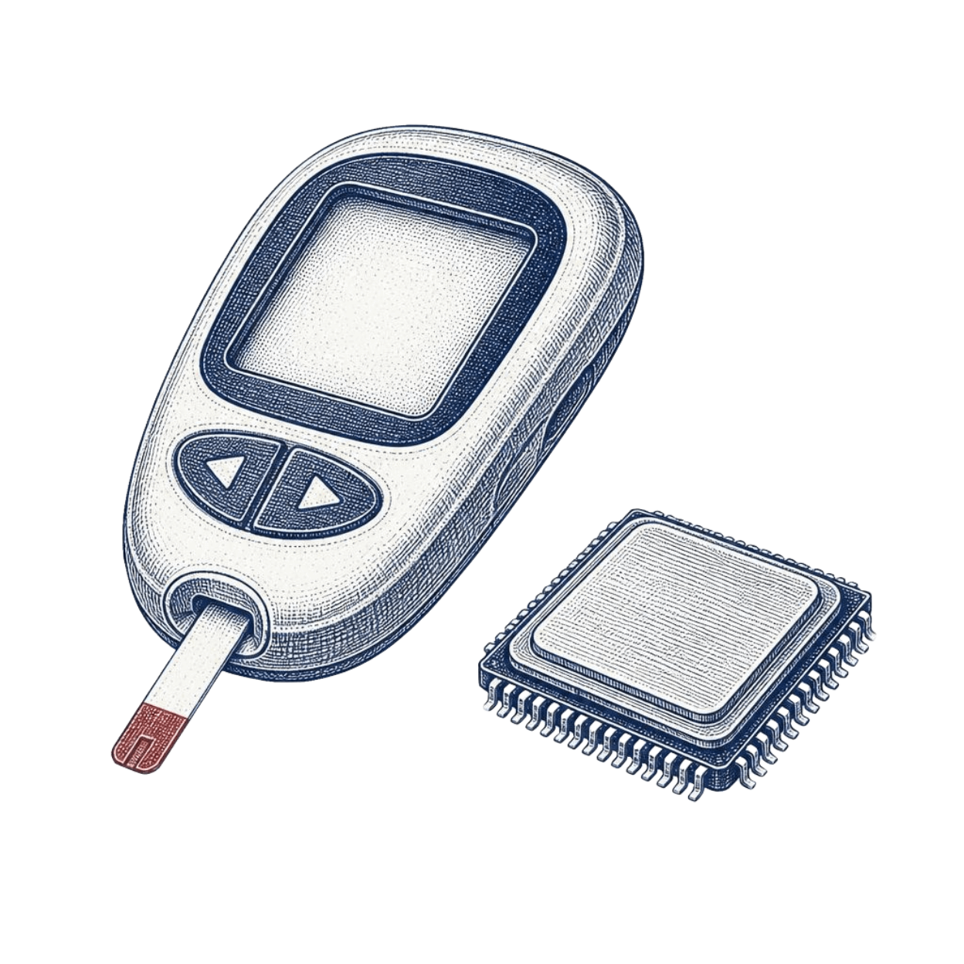
Diabetes Prediction
Comparing Classification Algorithms for Diabetes Prediction
Diabetes is a common and serious health condition that can develop without obvious symptoms. This project explores how health measurements can be used to predict the risk of diabetes and compares different machine learning approaches to find the most effective one.
Notes:
Introduce the question: can routine health measurements predict diabetes, and which classifier should we trust?

Slide 2
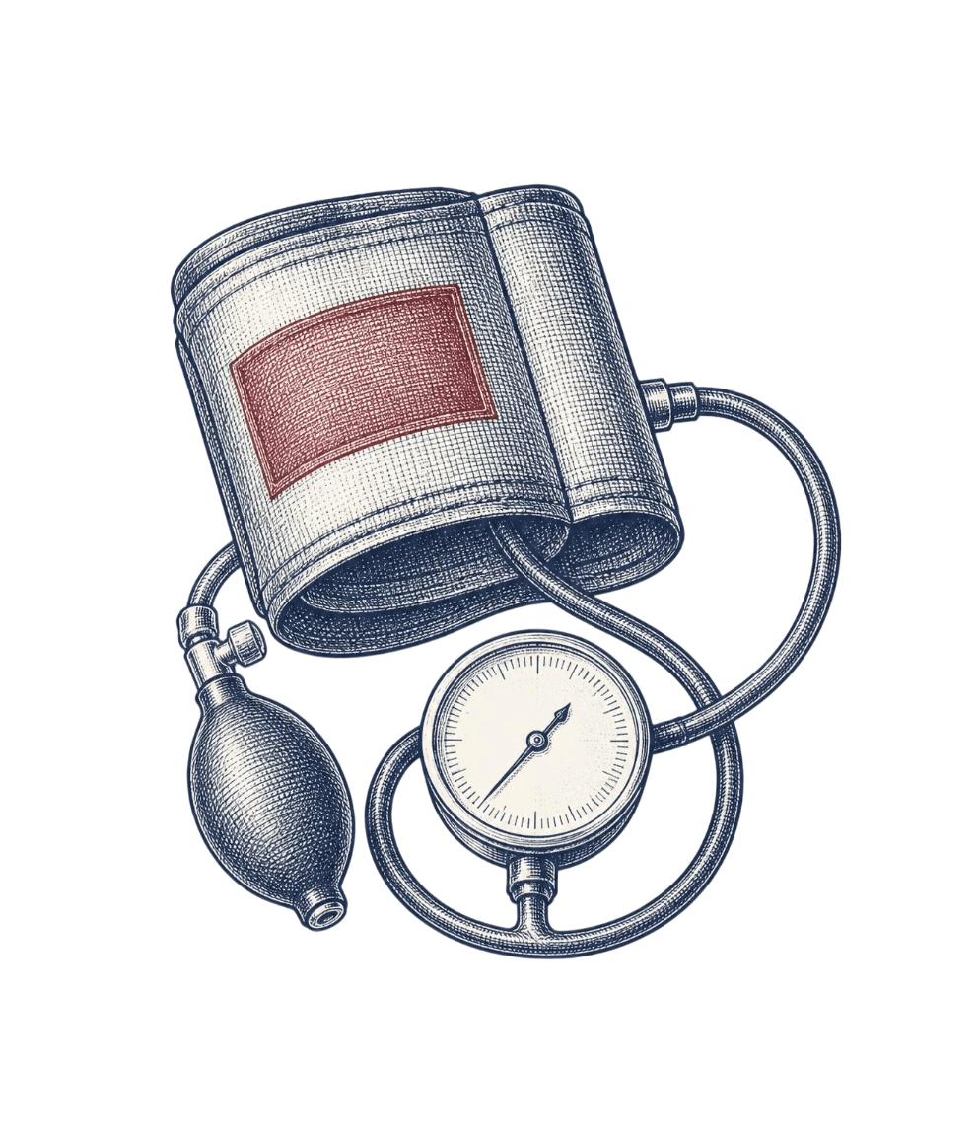
PREDICTION TASK
Machine learning can classify diabetes from health measurements
Classification algorithms predict whether a person has diabetes using health-related features.
Several algorithms are trained, evaluated and compared to identify the best-performing model in this project.
TARGET VARIABLE · OUTCOME
0
1
Blood Pressure is one of the health-related input features.
No diabetes
Diabetes
Notes:
Frame the task as a binary classification problem on routine measurements, then preview the seven algorithms we compare.

Slide 3
DATASET STRUCTURE
768 observations describe eight health features and one outcome
768
9
8
1
Observations
Columns
Input features
Target
INPUT FEATURES
PREGNANCIES
GLUCOSE
BLOODPRESSURE
SKINTHICKNESS
INSULIN
(Body Mass Index) BMI
DIABETESPEDIGREEFUNCTION
AGE
Outcome is the target column: 0 = No diabetes, 1 = Diabetes.
Source: Diabetes Dataset, Kaggle: https://www.kaggle.com/datasets/salihacur/diabetes
Notes:
Eight inputs go in, one binary label comes out. The outcome column is the target the models learn to predict.

Slide 4
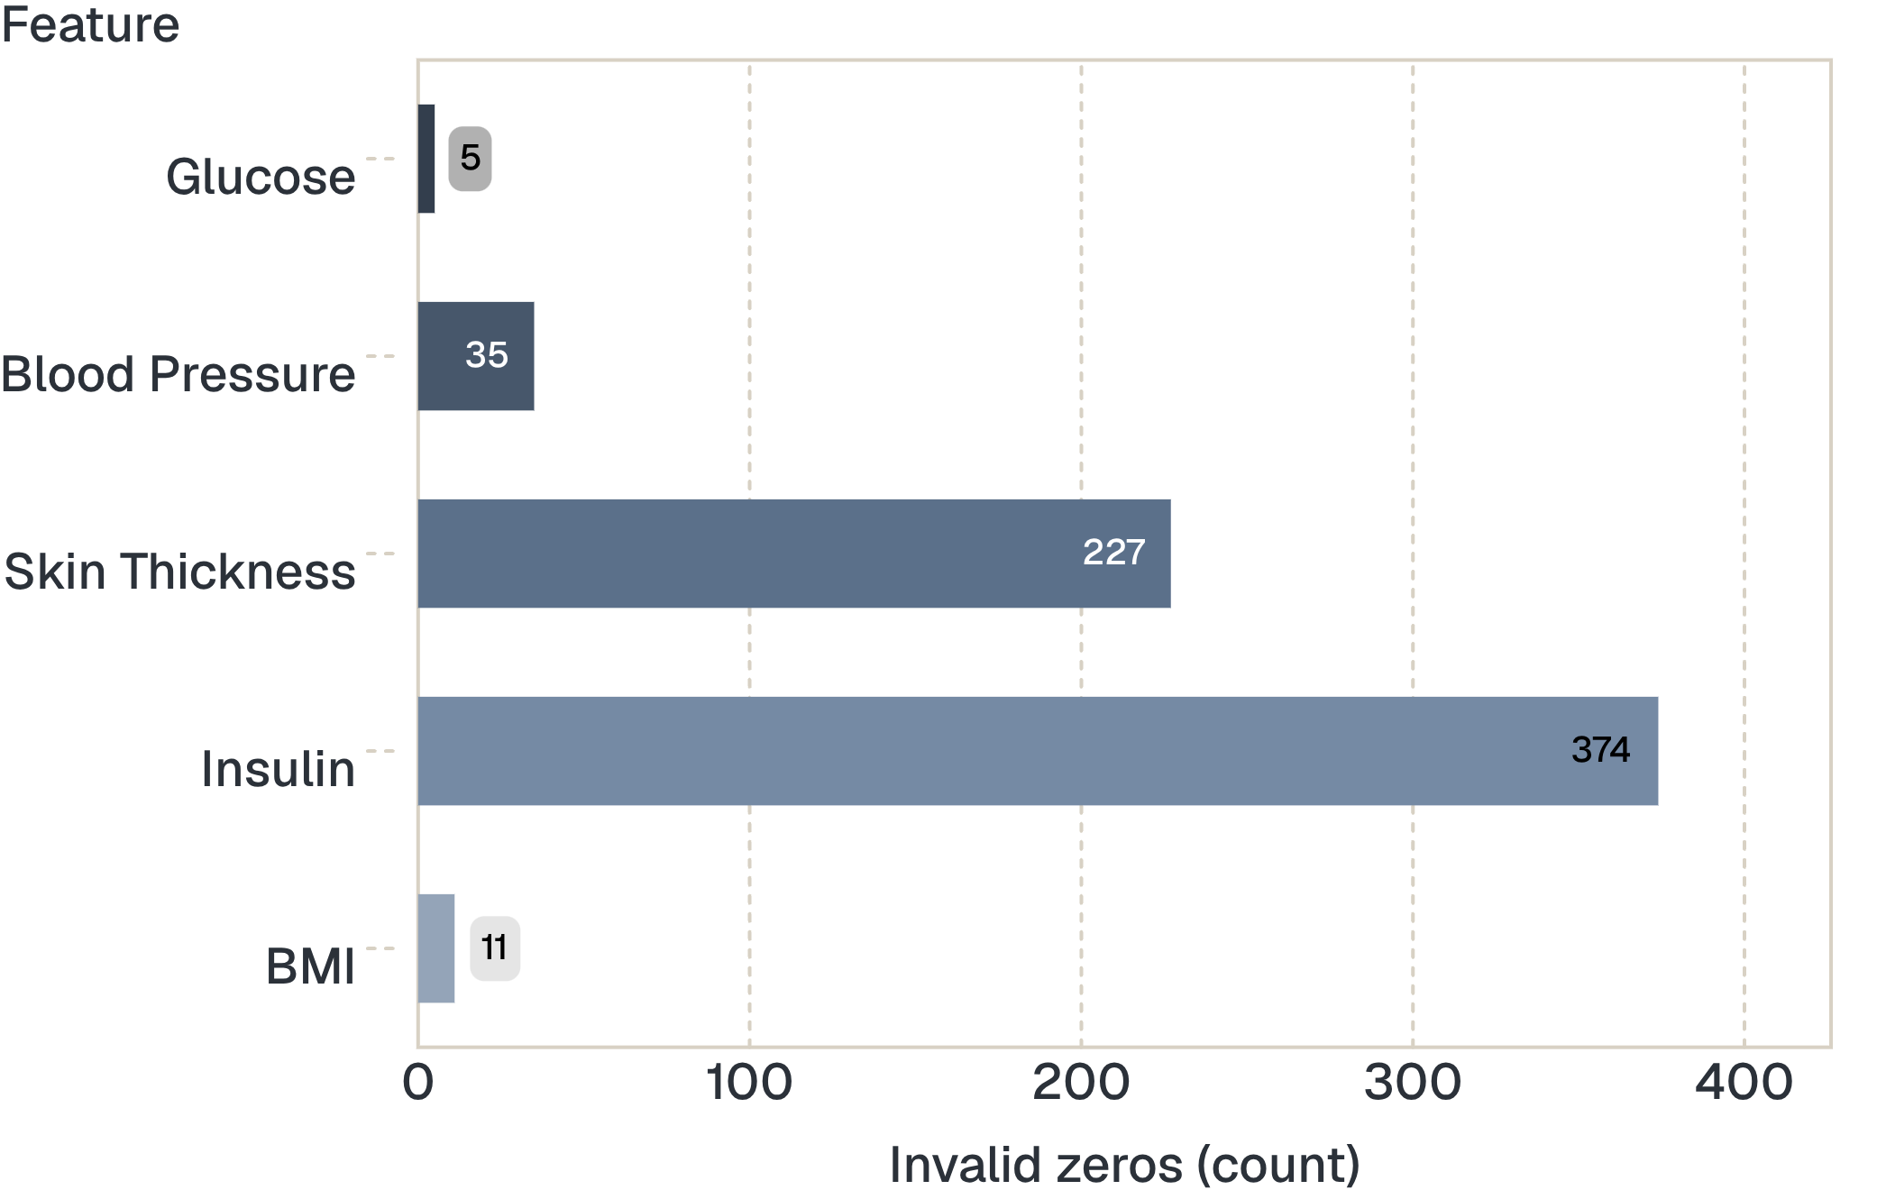
Zero values hide missing measurements
Dataset checked for shape, data types, descriptive statistics, class balance, missing values and duplicates
Invalid zeros: Glucose 5, Blood Pressure 35, Skin Thickness 227, Insulin 374, BMI 11
Notes:
A zero in these measurements is not a real reading. Skin thickness and insulin carry the most invalid zeros.

Slide 5
PREPROCESSING · OUTLIERS
Outliers were capped with the IQR method, not removed
The dataset's structure, dimensions, numerical variables and target were inspected. Plots such as boxplots helped identify extreme values.
BELOW THE LOWER BOUND
ABOVE THE UPPER BOUND
Cap at the lower bound
Cap at the upper bound
Notes:
A zero in these measurements is not a real reading. Skin thickness and insulin carry the most invalid zeros.

Slide 6
PROJECT WORKFLOW
Scaling was applied before training the distance-based models
1
2
3
4
5
6
7
Import Libraries & Dataset
Preprocessing
Train/Test Split
Feature Scaling
Model Training
Cross-Validation
Comparing all Models
Scaled training data
Unscaled training data
Scaling was for Logistic Regression, KNN, SVM and Kernel SVM.
Tree-based models and Naive Bayes were evaluated without the scaled training data.
Notes:
Read the pipeline top to bottom. Note that the split happens before the scaler is applied, and scaling is applied only where it is appropriate.

Slide 7
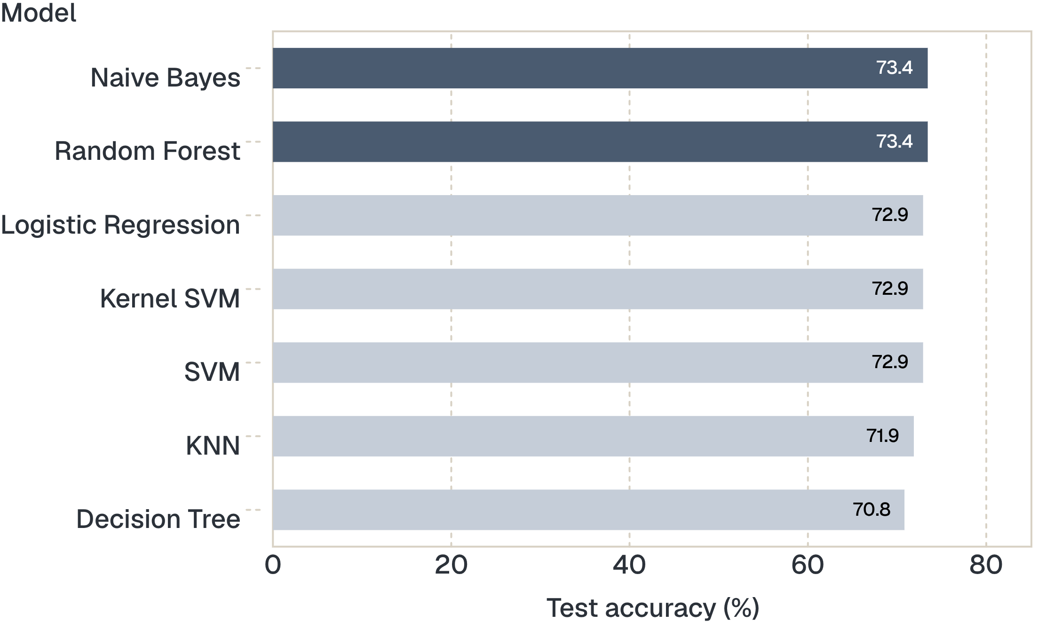
Initial test accuracy is closely clustered between 71% and 73%
TEST ACCURACY
Naive Bayes and Random Forest lead at 73.44%.
Evaluated on the 192 test records.
Notes:
On the single test split, the seven models sit within about two points of each other. Accuracy alone does not separate them, which is why we add cross-validation.

Slide 8
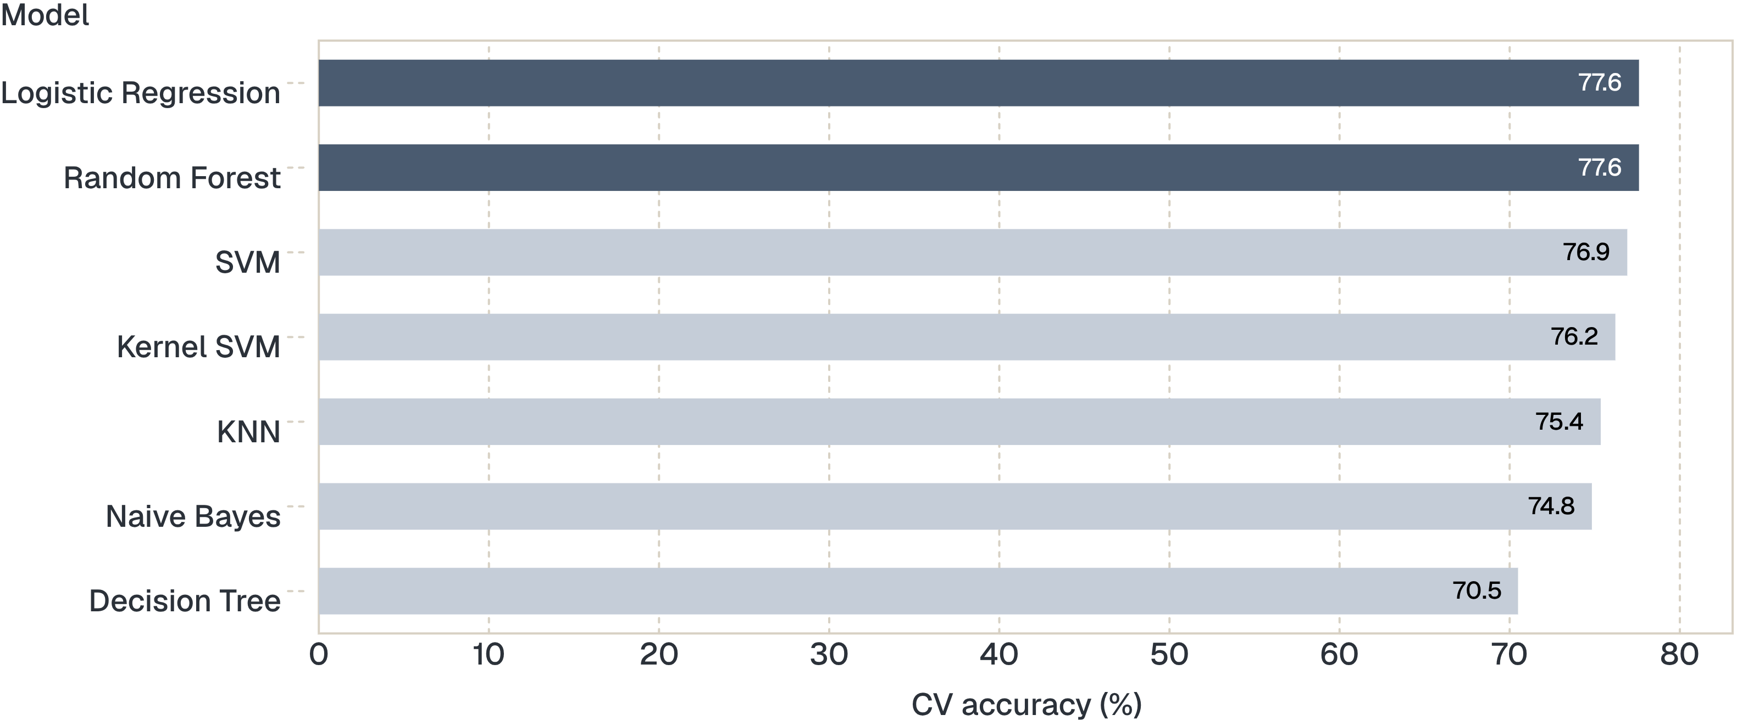
5-fold cross-validation ranks Logistic Regression first
FIVE-FOLD CROSS-VALIDATION ACCURACY (%), HIGHEST TO LOWEST
Notes:
Cross-validation spreads the evaluation over five folds. Logistic Regression ranks first, tied at 77.60% with Random Forest.

Slide 9
Logistic Regression is the best model by cross-validation
CONFUSION MATRIX, TEST SET
95
28
MEAN CV ACCURACY
77.59%
True negatives
False positives (False Alarm)
Test accuracy: 72.92%
Essentially tied with Random Forest on cross-validation
45
24
False negatives (Missed Target)
True positives
Notes:
Logistic Regression has the highest mean cross-validation accuracy. On the test set, the matrix shows 45 true positives and 24 false negatives for the diabetic class.

