Slide 1
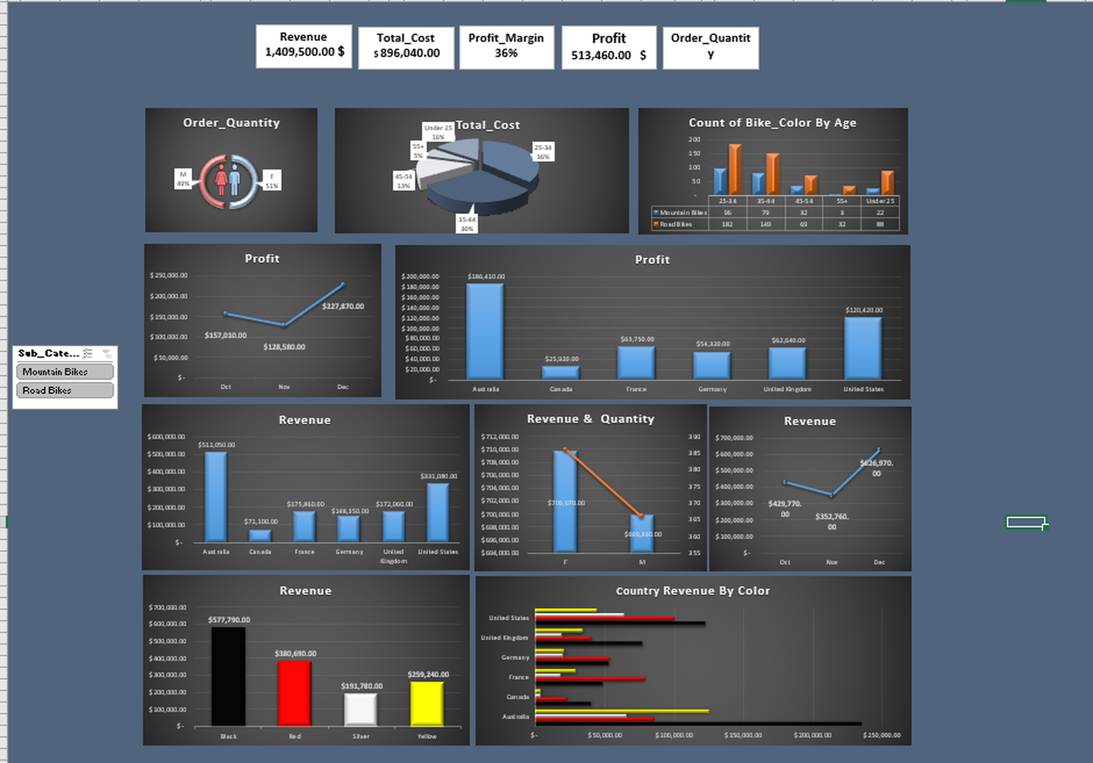
FROM DATA TO DECISIONS
Bike Sales Analysis
6 business questions answered with an interactive Excel dashboard
Data Analyst Project · Excel · Pivot Tables

Slide 2
THE BIG PICTURE
The dashboard at a glance
$1.41M
Revenue
$513K
Profit
36%
Profit margin
1,483
Units sold in 752 orders
Bike Sales Dashboard | Excel

Slide 3
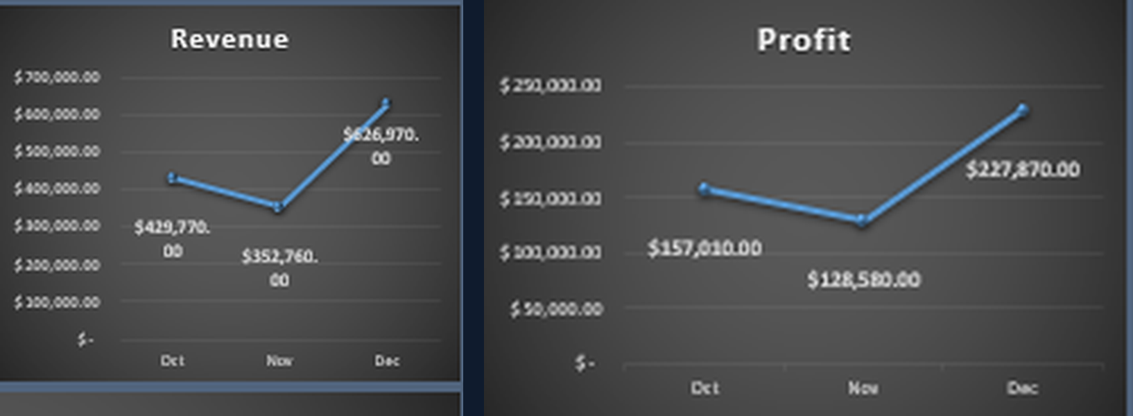
Q1 · Overall performance
How are revenue and profit trending month over month?
$626,970
+45%
36–37%
December revenue, the peak (+78% vs Nov; Nov fell 18% vs Oct)
Profit growth Oct → Dec, in line with revenue (+46%)
Margin held steady every month
Bike Sales Dashboard | Excel

Slide 4
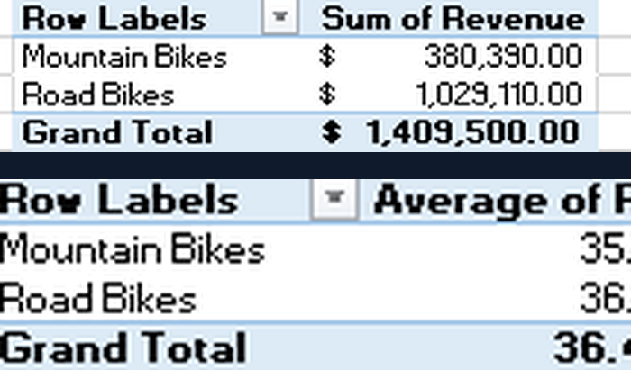
Q2 · Overall performance
Which sub-category drives the business?
73%
27%
36.7% vs 35.8%
of revenue comes from Road Bikes ($1.03M)
from Mountain Bikes ($380K)
Road Bikes also earn the higher margin
Bike Sales Dashboard | Excel

Slide 5
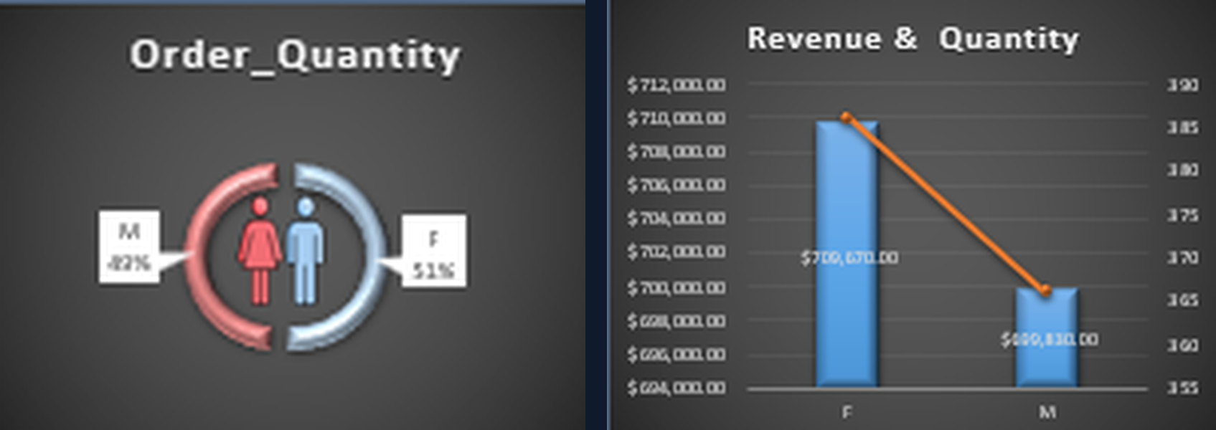
Q3 · Customer behavior
Who buys more: women or men?
$709,670
$699,830
386 vs 366
Female revenue (50.3%)
Male revenue (49.7%)
Orders, female vs male: a balanced customer base
Bike Sales Dashboard | Excel

Slide 6
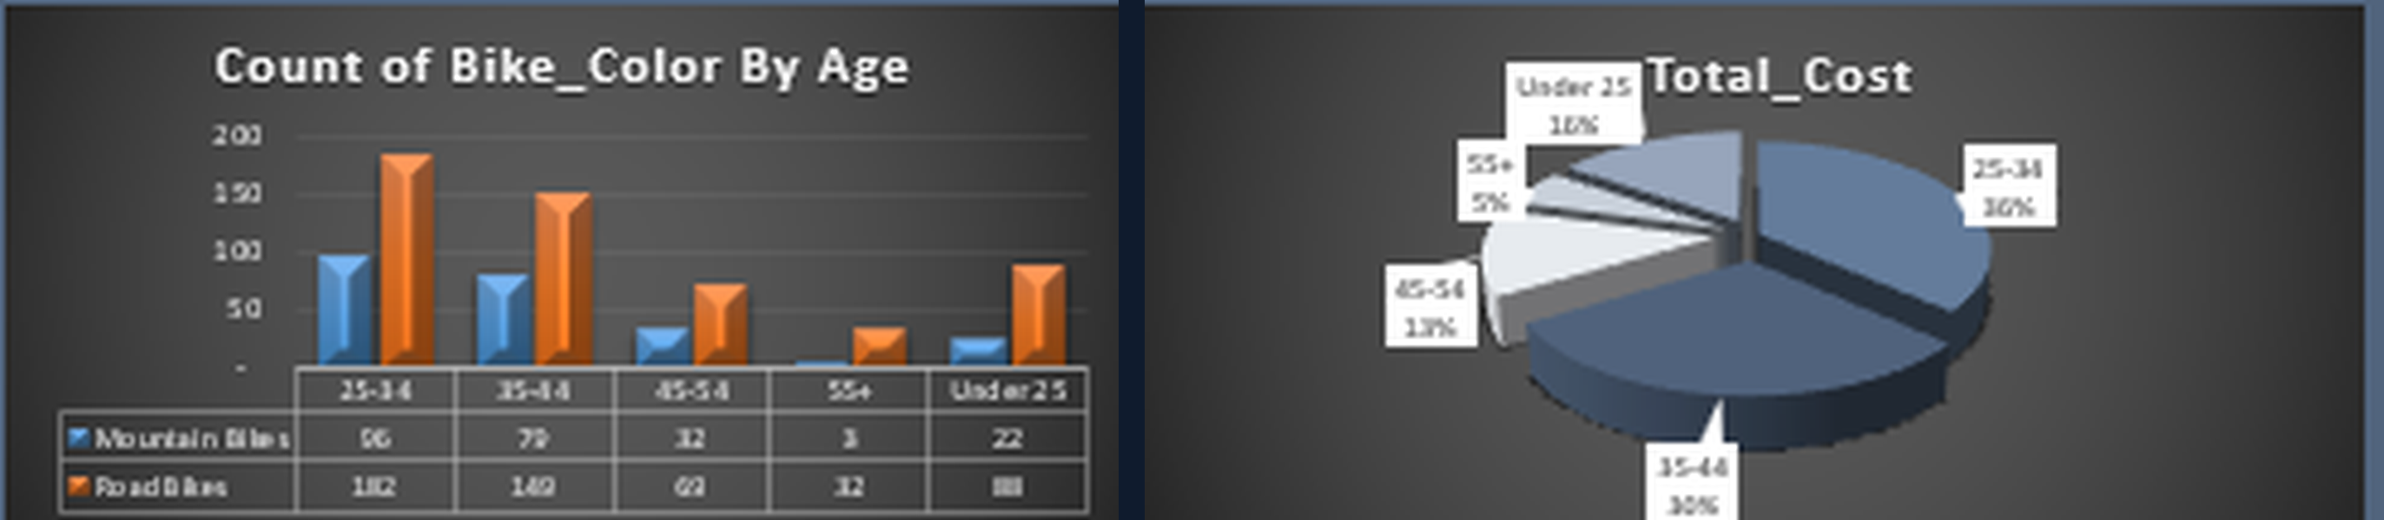
Q4 · Customer behavior
Which age group generates the most revenue?
25–34
66%
≈36.5%
Top group: $512,840 revenue, 278 orders
of revenue comes from customers aged 25–44
Margin is nearly identical across all age groups
Bike Sales Dashboard | Excel

Slide 7
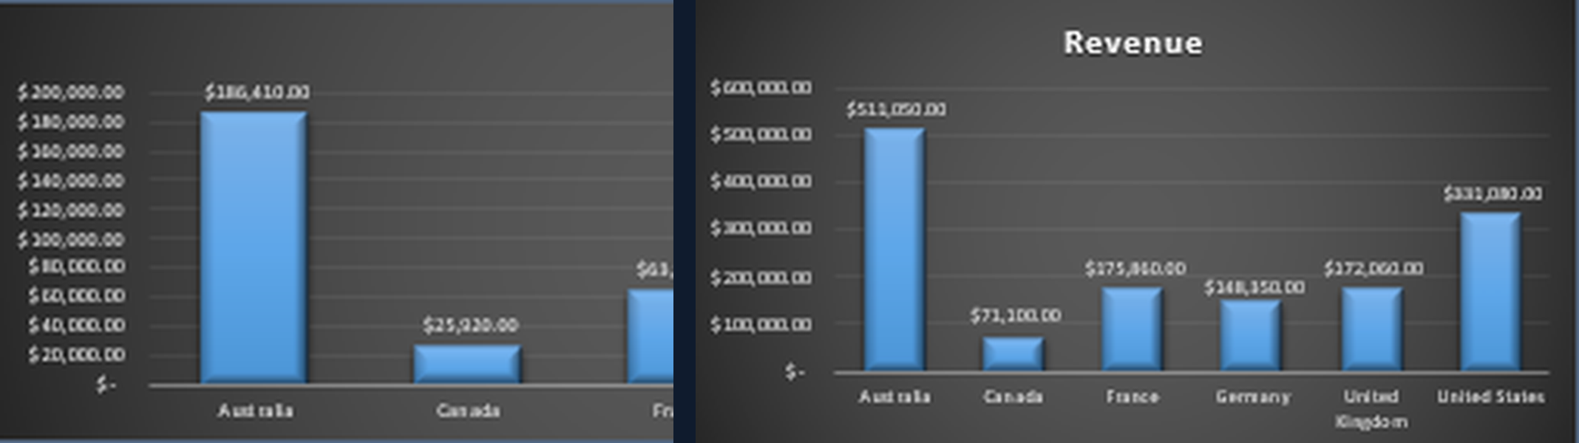
Q5 · Profitability & geography
Which countries make the most profit?
Australia
USA
≈60%
Top profit $186,410 (36% of total), also top revenue
Second: $120,420 profit, $331K revenue
of total profit from Australia + USA alone
Bike Sales Dashboard | Excel

Slide 8
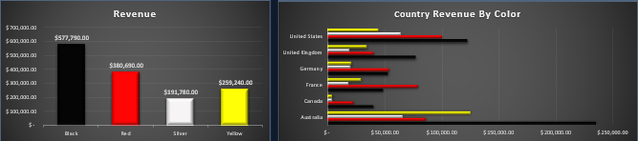
Q6 · Profitability
Does bike color affect sales or margin?
Black
Red
36–37%
Best seller: $577,790 (41% of revenue)
Second: $380,690, then Yellow $259K and Silver $192K
Margin is the same for every color: color drives volume, not margin
Bike Sales Dashboard | Excel

Slide 9
KEY TAKEAWAYS
What the data tells us to do
Double down on Road Bikes
Target the 25–44 segment
73% of revenue with a higher margin.
Two thirds of revenue; split is balanced by gender.
Grow beyond Australia & USA
Stock more Black, plan for December
Canada, Germany, UK and France have room to scale.
Black leads sales; Dec was the peak (data covers Oct–Dec only).
Questions or feedback? Let’s connect.
Bike Sales Dashboard | Excel

