Slide 1







Building a dashboard using IBM Cognos Analytics
Hazem Elsalahy
Oct/22/2024

Slide 2



OUTLINE
Executive Summary
Introduction
Methodology
Results
Visualization – Charts
Dashboard
Discussion
Findings & Implications
Conclusion
Appendix

Slide 3

EXECUTIVE SUMMARY
Dashboard Overview
Created three dashboards using IBM Cognos Analytics.
Focused on Current Technology Usage, Future Technology Trends, and Demographics.
Key Insights
Current Technology Usage shows today’s most adopted technologies
Future Technology Trend predicts emerging technologies for better planning.
Demographics highlights technology adoption by different user groups
Implications
These insights help optimize current resources
Guide future technology investments
Tailor strategies based on user demographics

Slide 4

INTRODUCTION
Project Overview
The objective of this project is to build interactive dashboards through IBM Cognos Analytics.
Purpose and Importance
Visualizing data helps organizations make informed decisions.
Understanding both current technology usage and future trends can guide strategic planning.
Tools and Techniques
IBM Cognos Analytics produced data visualization.
The project utilized a 2 x 2 rectangle areas template to create three dashboards.
The dashboards were designed to be user-friendly and insightful.

Slide 5

METHODOLOGY
DATA Collection & Wrangling
Modified GitHub Jobs API¹
Programming language salaries from Web Scraping²
Modified Stack Overflow Survey Results³
Data Analysis & Visualization
Exploring the data through visualizations
Doing analysis of the data to create meaningful visualizations
Creating dashboards with visualizations of relevant data
Data Preparation
Data was cleaned, filtered, and organized for visualization.
IBM Cognos Analytics was used for processing and visualization.

Slide 6
RESULTS

Slide 7
PROGRAMMING LANGUAGE TRENDS
Current Year
Next Year
< Bar chart of top

Slide 8
PROGRAMMING LANGUAGE TRENDS - FINDINGS & IMPLICATIONS
Findings
Python's continued dominance, with a 31% usage share, highlights its versatility and strong community support, particularly in data science and AI.
JavaScript remains a critical language for web development, showcasing its resilience and importance in building interactive web applications.
The increasing popularity of languages like Rand Go indicates a shift towards data analysis and cloud-native applications, reflecting industry trends towards data-driven decision-making.
Implications
Understanding these findings enables organizations to make informed decisions about training and hiring for programming skills aligned with current trends.
Companies may prioritize investment in technologies and tools that support dominant programming languages, ensuring competitiveness and relevance in the evolving tech landscape.
Developers should focus on enhancing their skill sets in Python and JavaScript while considering emerging languages that address specific industry needs

Slide 9
DATABASE TRENDS
Current Year
Next Year
< Bar chart of top 10 databases for the current year goes here >
< Bar chart of top 10 databases for the next year goes here.>

Slide 10
DATABASE TRENDS - FINDINGS & IMPLICATIONS
Findings
The adoption of cloud databases has increased significantly, with 60% of organizations now using cloud-based solutions, driven by scalability and flexibility.
•NoSQL databases are gaining traction for handling unstructured data, with a growth rate of 35%year-over-year, reflecting the need for agile data management solutions
•The integration of AI and machine learning capabilities in database management systems is on the rise, allowing for more efficient data processing and predictive analytics.
Implications
Organizations should consider transitioning to cloud databases to leverage scalability and cost-effectiveness, enhancing their data management strategies.
•The rise of NoSQL databases highlights the need for IT teams to develop skills in both SQL and NoSQL technologies to effectively manage diverse data types.
•Investing in AI-driven database solutions can improve data analytics capabilities, enabling organizations to derive actionable insights and stay competitive in a data-centric landscape.

Slide 11

DASHBOARD
://github.com/HazemYaser/IBM-data-analyst-capstone-project-Public

Slide 12
DASHBOARD TAB 1
Screenshot of dashboard tab 1 goes here

Slide 13
DASHBOARD TAB 2
Screenshot of dashboard tab 2 goes here

Slide 14
DASHBOARD TAB 3
Screenshot of dashboard tab 3 goes here

Slide 15
DISCUSSION
questions

Slide 16
OVERALL FINDINGS & IMPLICATIONS
Findings
•The analysis revealed a significant shift towards cloud technologies, with 60% of organizations adopting cloud solutions across various sectors, indicating a preference for scalability and remote accessibility.
•The data indicated a growing reliance on data analytics, with over 75% of businesses recognizing the importance of data-driven decision-making for operational efficiency and competitive advantage.
•The integration of AI and machine learning within both programming and database management systems is transforming how organizations process and analyze data, leading to enhanced predictive capabilities.
Implications
Organizations must adapt to the cloud-centric landscape by investing in cloud infrastructure and training staff to maximize the benefits of these technologies
•The emphasis on data analytics underscores the need for businesses to cultivate a data-centric culture and develop analytics capabilities to leverage insights effectively.
•Embracing AI and machine learning can provide organizations with a competitive edge, enabling them to innovate and optimize operations through advanced data analysis and automation.

Slide 17

CONCLUSION
The analysis of programming language and database trends reveals significant shifts in technology adoption across organizations. The increasing preference for cloud-based solutions and data-driven strategies indicates that businesses are prioritizing scalability, flexibility, and operational efficiency. The findings emphasize the importance of adapting to these trends by investing in relevant technologies and training.
•As organizations navigate the evolving tech landscape, the integration of AI and machine learning presents new opportunities for innovation and improved decision-making. By leveraging these advancements, companies can enhance their data management capabilities and remain competitive in a rapidly changing environment.
•In summary, embracing current trends in programming and databases not only positions organizations for success but also fosters a culture of continuous improvement and adaptability in the face of emerging challenges.

Slide 18

APPENDIX
Appendix A: Data Sources
•Internal databases from Coursera and IBM.
•Public datasets from Coursera and IBM.
•Industry reports from sample data collected by Coursera.
•Appendix B: Dashboard Screenshots
•Current Technology Usage
•Future Technology Trend
•Demographics
•Appendix C: Methodology Overview
•Data collection: Surveys and internal data.
•Tools used: IBM Cognos Analytics.

Slide 19
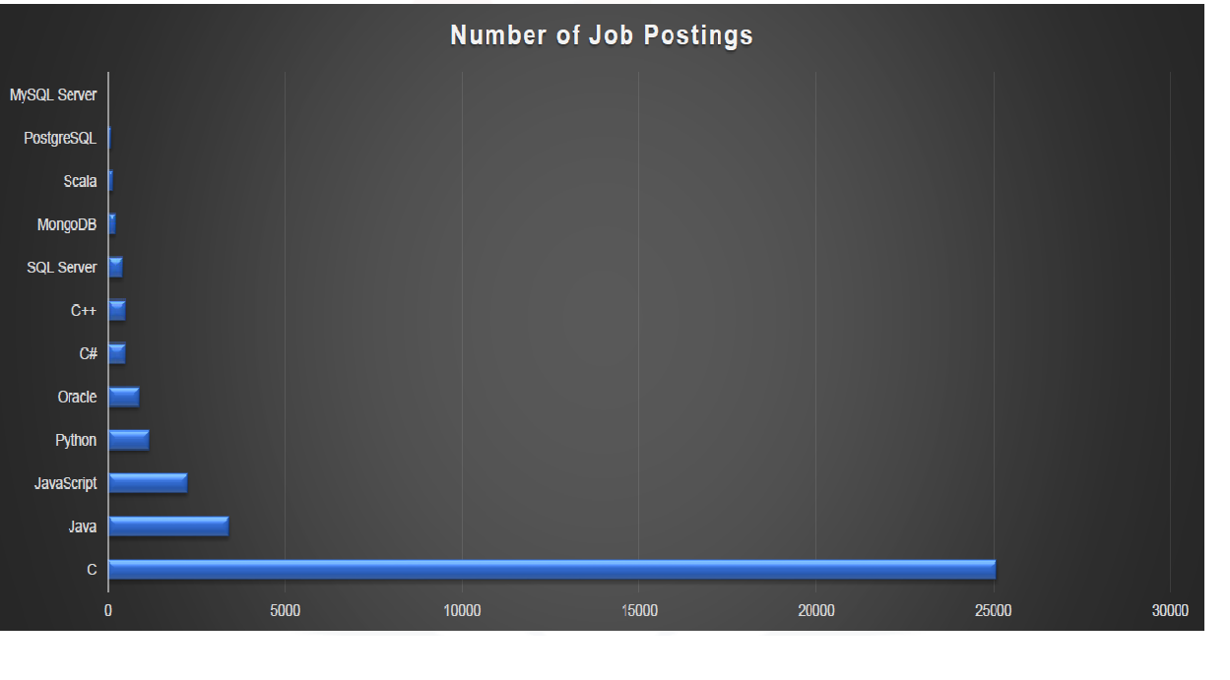
JOB POSTINGS
In Module 1 you have collected the job posting data using Job API in a file named “job-postings.xlsx”. Present that data using a bar chart here. Order the bar chart in the descending order of the number of job postings.

Slide 20
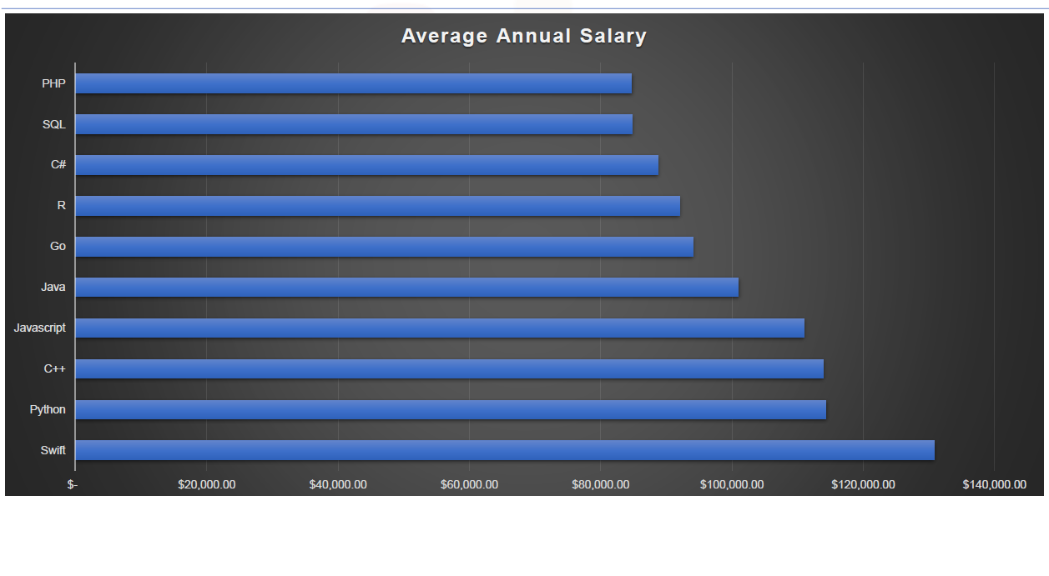
POPULAR LANGUAGES
In Module 1 you have collected the job postings data using web scraping in a file named “popular-languages.csv”. Present that data using a bar chart here. Order the bar chart in the descending order of salary.

Slide 21
The End

