Slide 1
BooK Manager – final project
Probabilistic Methods for Computer Engineering
2015-2016
Ana Tavares 76629
Diogo Ferreira 76425

Slide 2
Bloom filter

Slide 3
Bloomfilter.m
Process of Creation and Insertion
Initialize
Insert (calls Insert.m)

Slide 4
Ismember.m
Assesses whether an element belongs to a set through the values returned by Hash Function

Slide 5

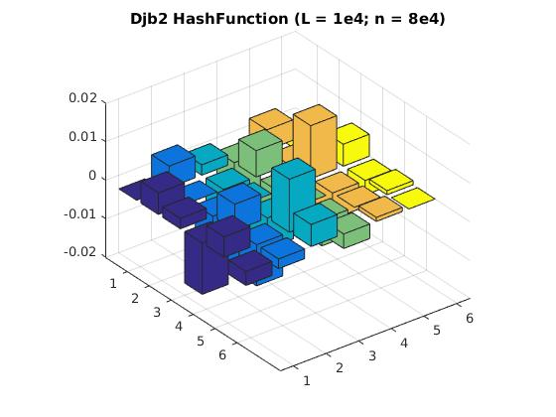
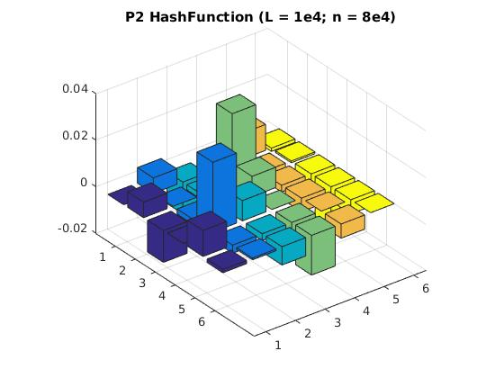
HASH FUNCTIONs
Dbj2
P2

Slide 6
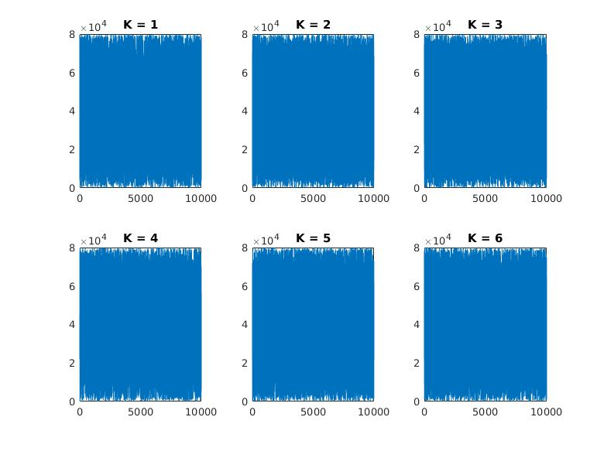
DBJ2
Created by Dan Bernstein
Mystery behind the constants (33 and 5318)
Similarities with Linear Congruential Generator(LCG)

Slide 7
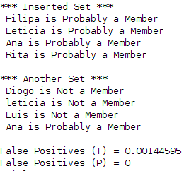

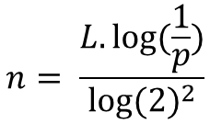
tests
BasicTest.m
TestWithOptimalN.m
n = Bloom Filter Length
; L = Set Length
p = False Positive Probability

Slide 8

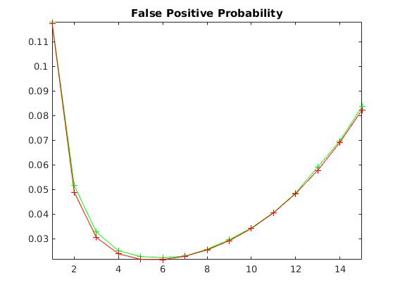


tests
TestWithOptimalK.m
RandomStringTest.m
n = Bloom Filter Length
; L = Set Length
k = Hash Functions Number

Slide 9
Jaccard similarities

Slide 10
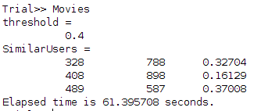
Test – jaccard distance
MoviesTest.m

Slide 11
minhash

Slide 12
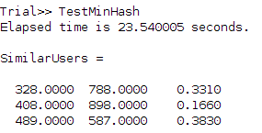
tests
TestMinHash.m

Slide 13
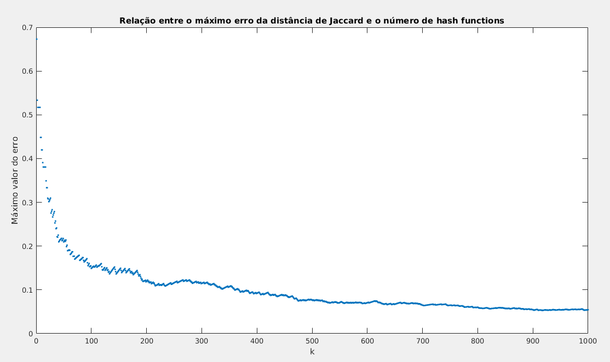
Tests
FindKMinhash.m

Slide 14
Application

Slide 15
dATASET
Book Crossing Freiburg University
BX-Users
BX-Books
BX-Books-Ratings

Slide 16
Read and process data
ReadData.m
usersBooks.m

Slide 17
Bloom filter
Evaluate the existence or the nonexistence of a book

Slide 18
minhash
Search Users (just 1k) with equal or similar ratings (Threshold = 0,5)

Slide 19
Graphic user interface
Search Bar
Book Names List
User ID List
Similar Users Window

Slide 20
LET’S TRY?

