Slide 1

Smart Feedback and Query Management for Efficient Public Service Administration
Public service departments struggle with efficiently managing user feedback and queries due to manual processing, misclassification, and spam. This leads to delays and ineffective responses. An AI-driven solution is needed to automate feedback analysis, classify queries, filter spam, and prioritize issues, ensuring faster and more efficient public service management.

Slide 2

Team Members
KAPIL SINGHAL (23MIP10111)
MUDIT AGRAWAL (22BCE11128)
UTKARSH (24BSA10039)
VAISHNAVI (23MIP10125)
Room no. :- 018
Team no. :- 26

Slide 3
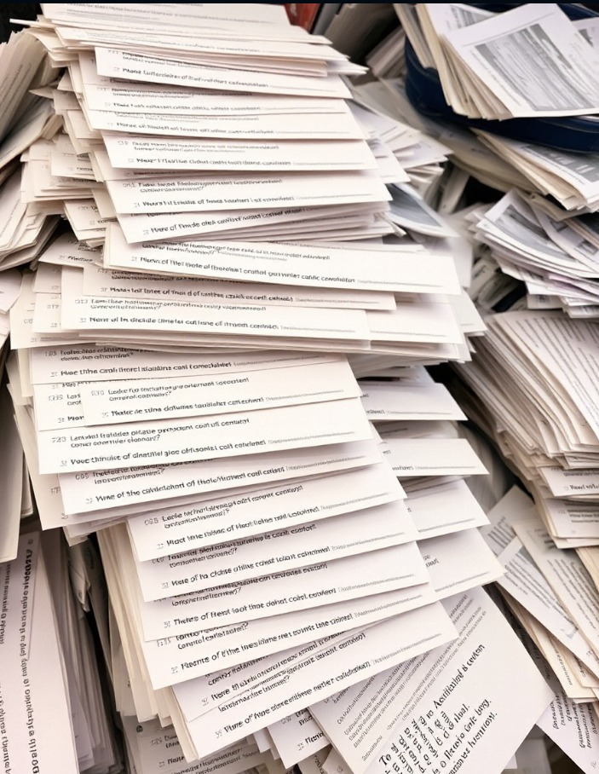
AI-Powered Public Service Feedback Management
Current Challenges in Public Service Feedback Management:
High volume of unstructured feedback.
Manual processing is inefficient.
Difficulty in prioritizing urgent queries.
Lack of automated spam detection.
Why It Matters?
Delayed responses impact citizen satisfaction.
Government services struggle with resource allocation.
How Our System Works:
Spam Detection & Filtering – Removes irrelevant or fraudulent feedback.
Service Classification – Categorizes queries into domains like electricity, water, gas, etc.
Sentiment Analysis – Predicts user satisfaction levels.
Priority Assignment – Ensures urgent queries are addressed first.
Impact:
Faster query resolution and improved citizen satisfaction.
AI-driven automation reduces manual workload.

Slide 4
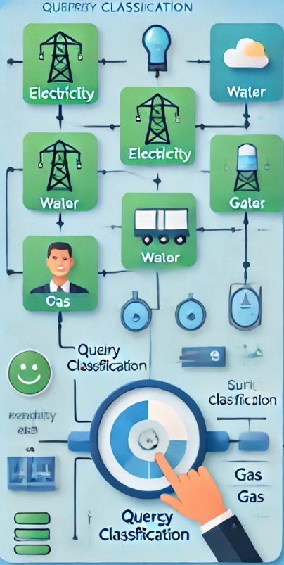
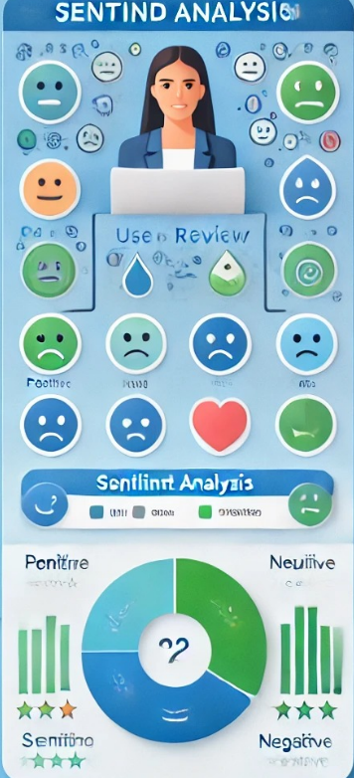
Other Applications of Functions
Sentiment Analysis :-
It is may be used by content creators to analyze their comment section like whether the content is liked by the user or audience or not.
Service or Query Classification :-
In Educational Institutes
Utility Service Centers (Electricity, Water, Gas)

Slide 5
NEUTRAL
EXTREMELY BAD
EXTREMELY BAD
“My Train has been delayed For more than 5 Hours”
NEUTRAL
BAD

Slide 6

What all things will be used in the project
Natural Language Processing (NLP): Extracts and interprets textual data from user queries.
Spam Detection Model: Identifies and removes irrelevant or fake queries.
Domain Classifier Model: Categorizes queries into relevant public service domains (electricity, water, gas).
Sentiment Analysis Engine: Assesses user satisfaction and emotional tone.
Priority Assignment System: Ranks query urgency to ensure timely resolution.
Machine Learning (ML) Algorithms: Trains models for classification, sentiment analysis, and priority assignment.

Slide 7
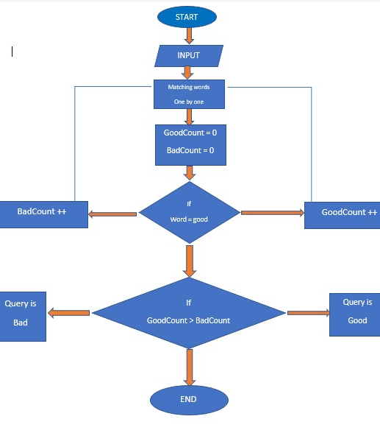
What Will be done in a Step Wise Manner
Start: Collect feedback from the public.
Spam Detection:
Check if the feedback is spam.
Yes (Spam?): Filter out spam feedback.
No (Spam?): Proceed to the next step.
Classify Query:
Categorize feedback based on its content.
Yes (Service Domain?): Determine the specific service domain (electricity, water, gas).
Analyze Feedback:
Extract insights and detect patterns from the feedback.
Predict Satisfaction:
Assess user satisfaction based on feedback content.
Assign Priority:
Set the urgency level for further action or response.
End: Complete the process by managing the feedback accordingly.

Slide 8

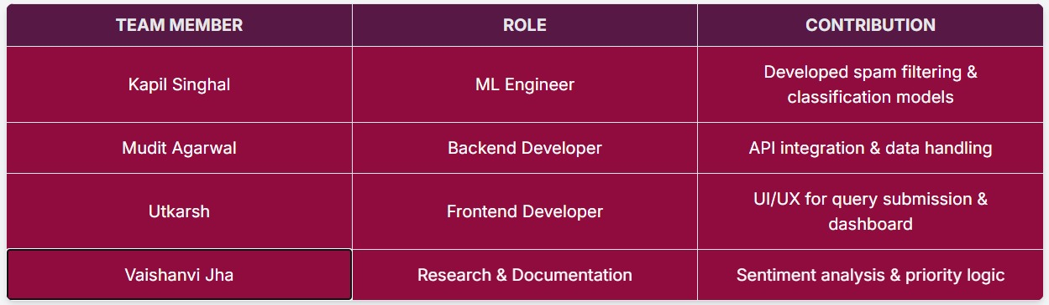

Slide 9
Specific Sectors for Future Use
Potential Impacts
Improved Service Efficiency: Faster query resolution reduces manual workload.
Enhanced User Satisfaction: Timely responses and better prioritization boost public trust
Reduced Spam and Noise: Filters out irrelevant queries, focusing on real issues.
Resource Optimization: Allows service departments to allocate resources based on priority.
Municipal Services – Automate complaints related to sanitation, waste management, and civic issues.
Healthcare – Handle patient queries, appointment scheduling, and emergency responses.
Law Enforcement – Analyze public reports, detect suspicious patterns, and prioritize emergency responses.
Transportation and Traffic Management – Manage complaints about delays, route issues, and public transport services.
Disaster Management – Prioritize queries during floods, earthquakes, or other emergencies.
Education Sector – Process student queries, feedback, and admission-related inquiries.
Utility Services – Resolve complaints related to electricity, water, and gas supply.
E-Governance Platforms – Improve citizen engagement by automating feedback and grievance redressal.

Slide 10

Thank you

