Slide 1
Dynamic Programming
Dynamic Programming is a general algorithm design technique
for solving problems defined by recurrences with overlapping
subproblems
Invented by American mathematician Richard Bellman in the 1950s to solve optimization problems and later assimilated by CS
“Programming” here means “planning”
Main idea:
    set up a recurrence relating a solution to a larger instance to solutions of some smaller instances
    - solve smaller instances once
    record solutions in a table
    extract solution to the initial instance from that table
A. Levitin “Introduction to the Design & Analysis of Algorithms,” 3rd ed., Ch. 8 ©2012 Pearson Education, Inc. Upper Saddle River, NJ. All Rights Reserved.

Slide 2
Example 1: Fibonacci numbers
Recall definition of Fibonacci numbers:
  F(n) = F(n-1) + F(n-2)
  F(0) = 0
  F(1) = 1
Computing the n^{th} Fibonacci number recursively (top-down):
F(n)
F(n-1) + F(n-2)
F(n-2) + F(n-3) F(n-3) + F(n-4)
...
A. Levitin “Introduction to the Design & Analysis of Algorithms,” 3rd ed., Ch. 8 ©2012 Pearson Education, Inc. Upper Saddle River, NJ. All Rights Reserved.

Slide 3
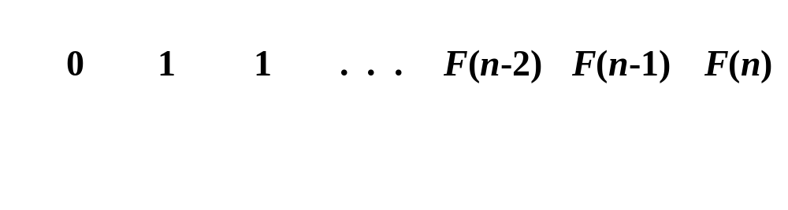
Example 1: Fibonacci numbers (cont.)
  Computing the n^{th} Fibonacci number using bottom-up iteration and recording results:
F(0) = 0
F(1) = 1
F(2) = 1+0 = 1
…
F(n-2) =
F(n-1) =
F(n) = F(n-1) + F(n-2)
Efficiency:
- time
- space
A. Levitin “Introduction to the Design & Analysis of Algorithms,” 3rd ed., Ch. 8 ©2012 Pearson Education, Inc. Upper Saddle River, NJ. All Rights Reserved.

Slide 4
Fibonacci numbers
def fibonacci(n):
if n <= 1:
return n
return fibonacci(n - 1) + fibonacci(n - 2)

Slide 5
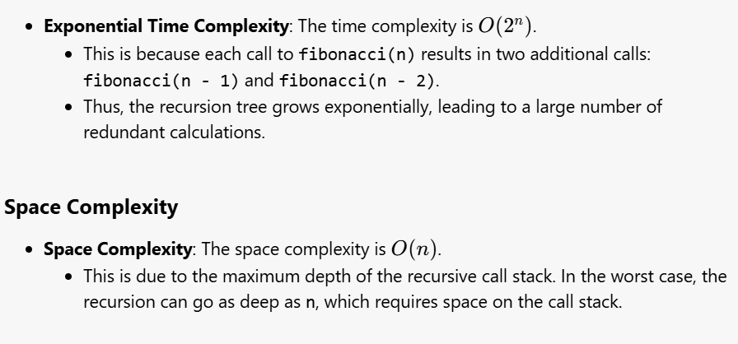
Fibonacci numbers (cont.)

Slide 6
memoization
To reduce the time complexity of calculating Fibonacci numbers, we can use memoization (top-down approach) and a bottom-up dynamic programming approach. Let's go through each method step by step.
1. Memoization (Top-Down Approach)
Step 1: Define the Problem
We want to compute Fibonacci numbers recursively but save the results of already computed Fibonacci numbers to avoid redundant calculations.
Step 2: Implement the Memoization

Slide 7
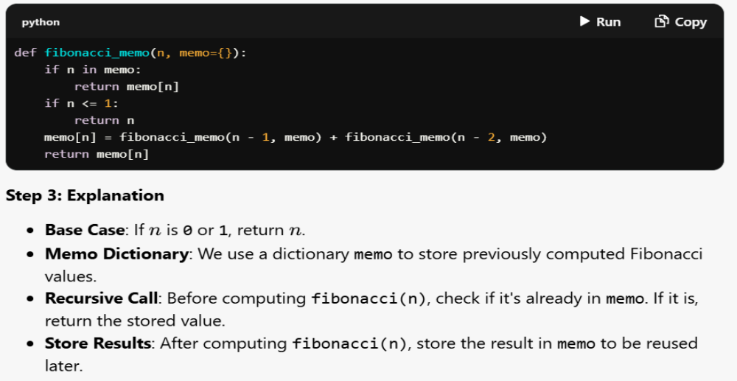
memoization

Slide 8
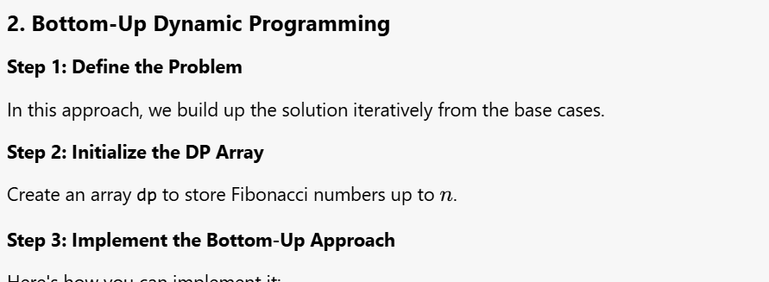

Slide 9
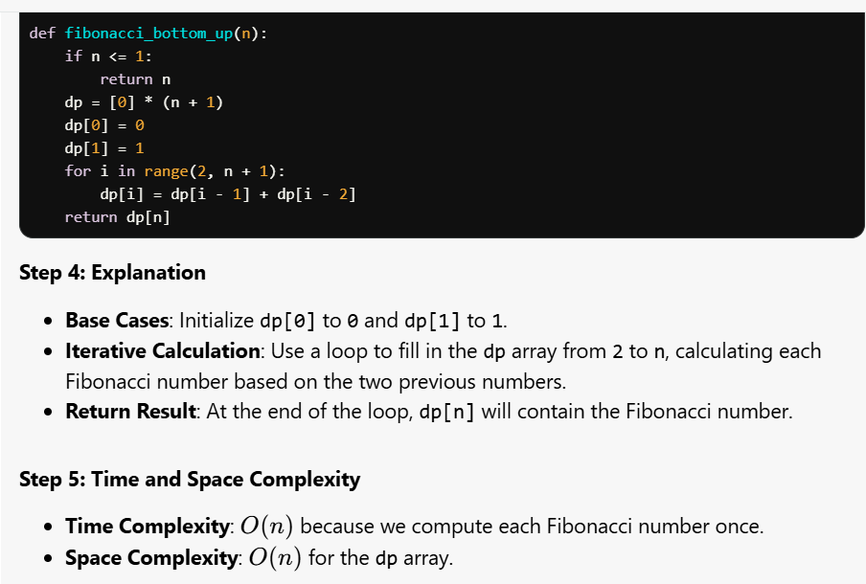

Slide 10
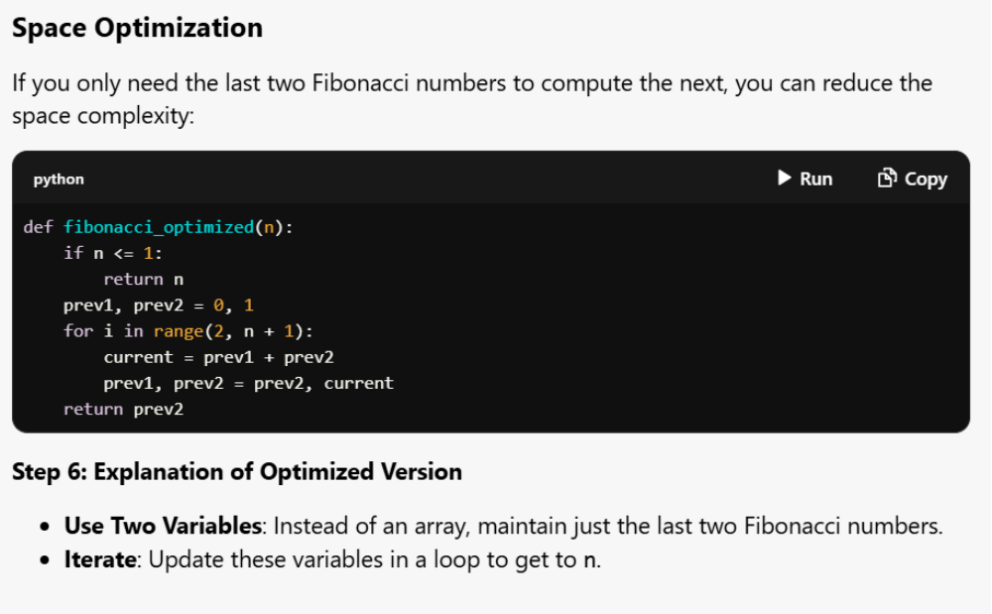
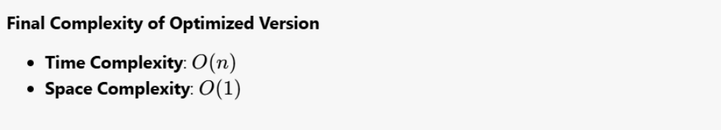

Slide 11
Example 2: Coin-row problem
There is a row of n coins whose values are some positive integers c₁, c₂,...,c_{n}, not necessarily distinct. The goal is to pick up the maximum amount of money subject to the constraint that no two coins adjacent in the initial row can be picked up.
E.g.: 5, 1, 2, 10, 6, 2. What is the best selection?
Also try: 5, 1, 6, 10, 5, 2
A. Levitin “Introduction to the Design & Analysis of Algorithms,” 3rd ed., Ch. 8 ©2012 Pearson Education, Inc. Upper Saddle River, NJ. All Rights Reserved.

Slide 12
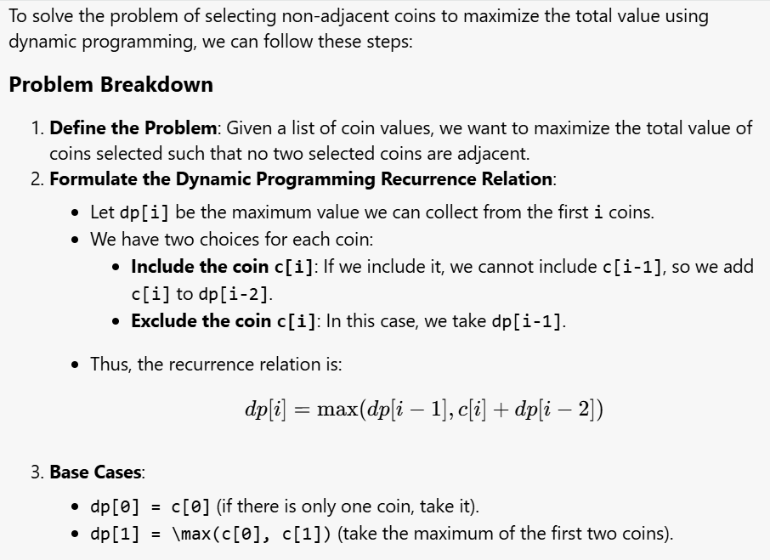
Coin-row problem

Slide 13
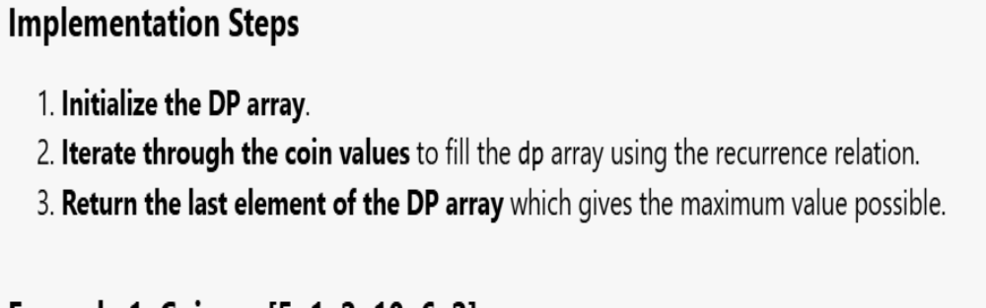

Coin-row problem

Slide 14
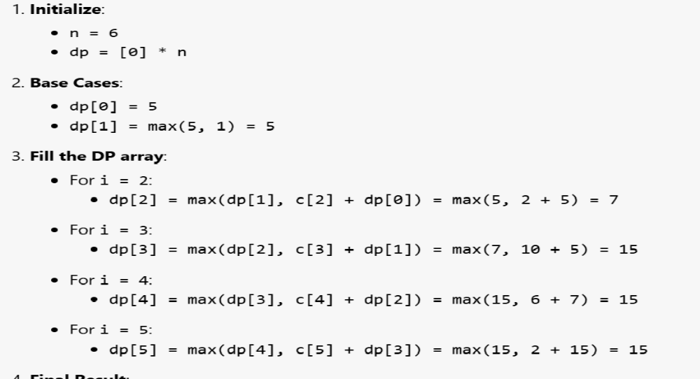

Coin-row problem

Slide 15
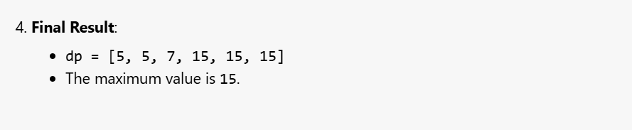
Coin-row problem

Slide 16
Coin-row problem

Slide 17
Coin-row problem

Slide 18
DP solution to the coin-row problem
Let F(n) = maximum amount that can be picked up from the first n coins in the row of coins.
To derive a recurrence for F(n), we partition all the allowed coin selections into two groups:
those without last coin – the max amount is ?
those with the last coin -- the max amount is ?
Thus we have the following recurrence
F(n) = max{ } for n > 1,
F(0) = 0, F(1)=c₁
A. Levitin “Introduction to the Design & Analysis of Algorithms,” 3rd ed., Ch. 8 ©2012 Pearson Education, Inc. Upper Saddle River, NJ. All Rights Reserved.

Slide 19
DP solution to the coin-row problem
Let F(n) = maximum amount that can be picked up from the first n coins in the row of coins.
To derive a recurrence for F(n), we partition all the allowed coin selections into two groups:
those without last coin – the max amount is ?
those with the last coin -- the max amount is ?
Thus we have the following recurrence
F(n) = max{c_{n} + F(n-2), F(n-1)} for n > 1,
F(0) = 0, F(1)=c₁
A. Levitin “Introduction to the Design & Analysis of Algorithms,” 3rd ed., Ch. 8 ©2012 Pearson Education, Inc. Upper Saddle River, NJ. All Rights Reserved.

Slide 20
DP solution to the coin-row problem (cont.)
F(n) = max{c_{n} + F(n-2), F(n-1)} for n > 1,
F(0) = 0, F(1)=c₁
index | 0 | 1 | 2 | 3 | 4 | 5 | 6
coins | -- | 5 | 1 | 6 | 10 | 5 | 2
F( ) | 0, N | 5 Y | 5 N | 11 Y | 15 Y | 16 Y | 17 Y
Max amount: Coins of optimal solution:
Time and space efficiency:
What’s missing? …
Note: All smaller instances were solved. Solution to subproblem may not be part of solution to larger problem. (Greedy algorithms don’t solve all smaller and always use solution to smaller in larger.)
A. Levitin “Introduction to the Design & Analysis of Algorithms,” 3rd ed., Ch. 8 ©2012 Pearson Education, Inc. Upper Saddle River, NJ. All Rights Reserved.

Slide 21
DP solution to the coin-row problem (cont.)
F(n) = max{c_{n} + F(n-2), F(n-1)} for n > 1,
F(0) = 0, F(1)=c₁
index | 0 | 1 | 2 | 3 | 4 | 5 | 6
coins | -- | 5 | 1 | 6 | 10 | 5 | 2
F( )
Max amount: Coins of optimal solution:
Time and space efficiency:
What’s missing? Which coins to pick up! Any ideas?
Note: All smaller instances were solved. Solution to subproblem may not be part of solution to larger problem. (Greedy algorithms don’t solve all smaller and always use solution to smaller in larger.)
A. Levitin “Introduction to the Design & Analysis of Algorithms,” 3rd ed., Ch. 8 ©2012 Pearson Education, Inc. Upper Saddle River, NJ. All Rights Reserved.

Slide 22
DP solution to the coin-row problem (cont.)
F(n) = max{c_{n} + F(n-2), F(n-1)} for n > 1,
F(0) = 0, F(1)=c₁
i | 0 | 1 | 2 | 3 | 4 | 5 | 6
c(i) | -- | 5 | 1 | 6 | 10 | 5 | 2
F( i) | 0 | 5 | 5 | 11 | 15 | 16 | 17
To find coins, remember choice at each step:
1. Add row P(n): 0/1 = leave/pickup coin n (at that point)
2. Fill in rows F and P together, left to right
3. For final choice, work backwards from right:
0=leave and move 1 left, 1=pickup and move 2 left
A. Levitin “Introduction to the Design & Analysis of Algorithms,” 3rd ed., Ch. 8 ©2012 Pearson Education, Inc. Upper Saddle River, NJ. All Rights Reserved.

Slide 23
DP solution to the coin-row problem (cont.)
F(n) = max{c_{n} + F(n-2), F(n-1)} for n > 1,
F(0) = 0, F(1)=c₁
i | 0 | 1 | 2 | 3 | 4 | 5 | 6
c(i) | -- | 5 | 1 | 6 | 10 | 5 | 2
F(i) | 0 | 5 | 5 | 11 | 15 | 16 | 17
Choice |  | 1 | 0 | 1 | 1 | 1 | 1
Pick |  | 1 |  |  | 1 |  | 1
A. Levitin “Introduction to the Design & Analysis of Algorithms,” 3rd ed., Ch. 8 ©2012 Pearson Education, Inc. Upper Saddle River, NJ. All Rights Reserved.

Slide 24
DP Steps
F(n) = max{c_{n} + F(n-2), F(n-1)} for n > 1,
F(0) = 0, F(1)=c₁
Recursive math function describing maximum
Recursive function solving problem, top down (too slow)
Iterative solution, bottom up
Add information to find how to get maximum
Work backward to find maximum
A. Levitin “Introduction to the Design & Analysis of Algorithms,” 3rd ed., Ch. 8 ©2012 Pearson Education, Inc. Upper Saddle River, NJ. All Rights Reserved.

Slide 25
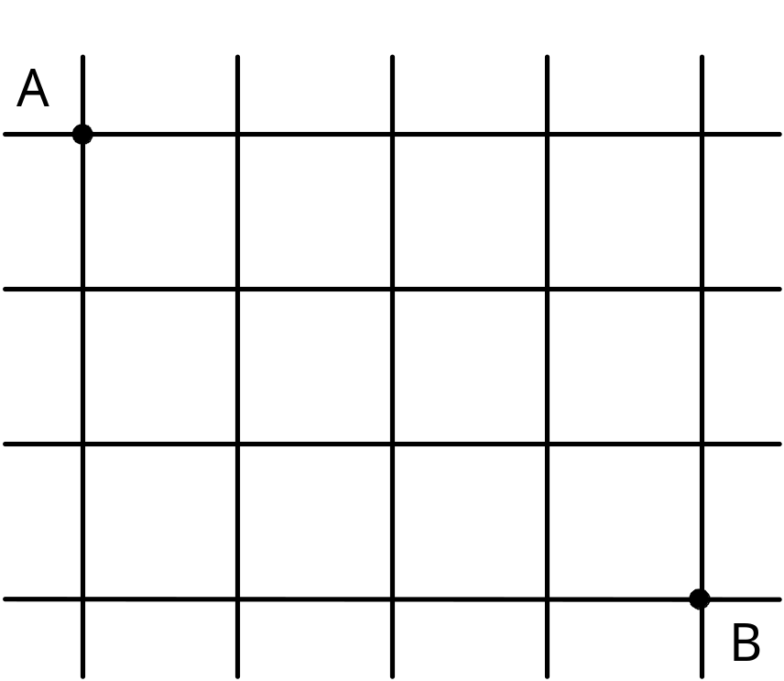
Example 3: Path counting
Consider the problem of counting the number of shortest paths from point A to point B in a city with perfectly horizontal streets and vertical avenues
F(i,j)=
F(i-1,j) + F(I, j-1)
A. Levitin “Introduction to the Design & Analysis of Algorithms,” 3rd ed., Ch. 8 ©2012 Pearson Education, Inc. Upper Saddle River, NJ. All Rights Reserved.

Slide 26
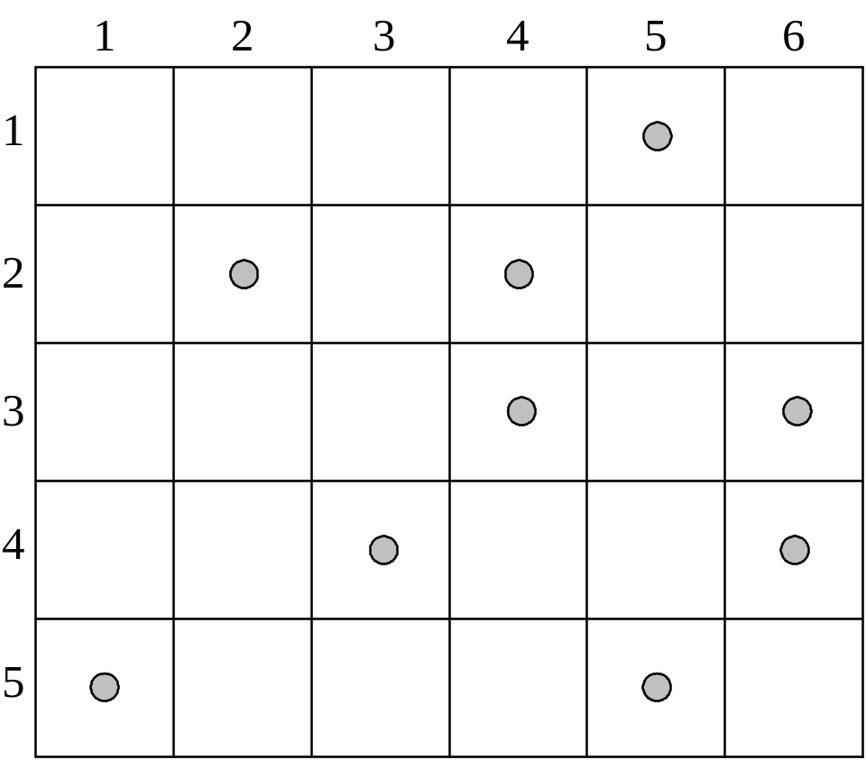
Example 4: Coin-collecting by robot
Several coins are placed in cells of an n×m board. A robot, located in the upper left cell of the board, needs to collect as many of the coins as possible and bring them to the bottom right cell. On each step, the robot can move either one cell to the right or one cell down from its current location.
A. Levitin “Introduction to the Design & Analysis of Algorithms,” 3rd ed., Ch. 8 ©2012 Pearson Education, Inc. Upper Saddle River, NJ. All Rights Reserved.

Slide 27
Solution to the coin-collecting problem
Let F(i,j) be the largest number of coins the robot can collect and bring to cell (i,j) in the ith row and jth column.
The largest number of coins that can be brought to cell (i,j):
from the left neighbor ?
from the neighbor above?
The recurrence:
F(i, j) = max{F(i-1, j), F(i, j-1)} + c_{ij} for 1 ≤ i ≤ n, 1 ≤ j ≤ m
where c_{ij} = 1 if there is a coin in cell (i,j), and c_{ij} = 0 otherwise
F(0, j) = 0 for 1 ≤ j ≤ m and F(i, 0) = 0 for 1 ≤ i ≤ n.
A. Levitin “Introduction to the Design & Analysis of Algorithms,” 3rd ed., Ch. 8 ©2012 Pearson Education, Inc. Upper Saddle River, NJ. All Rights Reserved.

Slide 28
Solution to the coin-collecting problem (cont.)
F(i, j) = max{F(i-1, j), F(i, j-1)} + c_{ij} for 1 ≤ i ≤ n, 1 ≤ j ≤ m
where c_{ij} = 1 if there is a coin in cell (i,j), and c_{ij} = 0 otherwise
F(0, j) = 0 for 1 ≤ j ≤ m and F(i, 0) = 0 for 1 ≤ i ≤ n.
A. Levitin “Introduction to the Design & Analysis of Algorithms,” 3rd ed., Ch. 8 ©2012 Pearson Education, Inc. Upper Saddle River, NJ. All Rights Reserved.

Slide 29
Solution to coin-collecting problem (cont.)
F(i, j) = max{F(i-1, j), F(i, j-1)} + c_{ij} for 1 ≤ i ≤ n, 1 ≤ j ≤ m
where c_{ij} = 1 if there is a coin in cell (i,j), and c_{ij} = 0 otherwise
F(0, j) = 0 for 1 ≤ j ≤ m and F(i, 0) = 0 for 1 ≤ i ≤ n.
Code (3 versions)? Storage? Path? Storage? Subproblems?
A. Levitin “Introduction to the Design & Analysis of Algorithms,” 3rd ed., Ch. 8 ©2012 Pearson Education, Inc. Upper Saddle River, NJ. All Rights Reserved.

Slide 30
Other examples of DP algorithms
Computing a binomial coefficient (# 9, Exercises 8.1)
General case of the change making problem (Sec. 8.1)
Some difficult discrete optimization problems:
- knapsack (Sec. 8.2)
- traveling salesman
Constructing an optimal binary search tree (Sec. 8.3)
Warshall’s algorithm for transitive closure (Sec. 8.4)
Floyd’s algorithm for all-pairs shortest paths (Sec. 8.4)
A. Levitin “Introduction to the Design & Analysis of Algorithms,” 3rd ed., Ch. 8 ©2012 Pearson Education, Inc. Upper Saddle River, NJ. All Rights Reserved.

Slide 31
Knapsack Problem by DP
Given n items of
  integer weights: w₁ w₂ … w_{n}
  values: v₁ v₂ … v_{n}
a knapsack of integer capacity W
find most valuable subset of the items that fit into the knapsack
Recursive solution?
What is smaller problem?
How to use solution to smaller in solution to larger Table?
Order to solve?
Initial conditions?
A. Levitin “Introduction to the Design & Analysis of Algorithms,” 3rd ed., Ch. 8 ©2012 Pearson Education, Inc. Upper Saddle River, NJ. All Rights Reserved.

Slide 32
Knapsack Problem by DP (example)
Example: Knapsack of capacity W = 5
item weight value
1 2 $12
2 1 $10
3 3 $20
4 2 $15 capacity j
0 1 2 3 4 5
0 0 0 0 0 0 0
w₁ = 2, v₁= 12 1 0 0
w₂ = 1, v₂= 10 2
w₃ = 3, v₃= 20 3
w₄ = 2, v₄= 15 4 ?
A. Levitin “Introduction to the Design & Analysis of Algorithms,” 3rd ed., Ch. 8 ©2012 Pearson Education, Inc. Upper Saddle River, NJ. All Rights Reserved.

Slide 33
Knapsack Problem by DP (example)
Example: Knapsack of capacity W = 5
item weight value
1 2 $12
2 1 $10
3 3 $20
4 2 $15 capacity j
0 1 2 3 4 5
0 0 0 0 0 0 0
w₁ = 2, v₁= 12 1 0 0 12 12 12 12
w₂ = 1, v₂= 10 2 0 10 12 22 22 22
w₃ = 3, v₃= 20 3 0 10 12 22 30 32
w₄ = 2, v₄= 15 4 0 10 15 25 30 37 ?
A. Levitin “Introduction to the Design & Analysis of Algorithms,” 3rd ed., Ch. 8 ©2012 Pearson Education, Inc. Upper Saddle River, NJ. All Rights Reserved.

Slide 34
Knapsack Problem by DP
Given n items of
  integer weights: w₁ w₂ … w_{n}
  values: v₁ v₂ … v_{n}
a knapsack of integer capacity W
find most valuable subset of the items that fit into the knapsack
Recursive solution?
What is smaller problem?
How to use solution to smaller in solution to larger Table?
Order to solve?
Initial conditions?
A. Levitin “Introduction to the Design & Analysis of Algorithms,” 3rd ed., Ch. 8 ©2012 Pearson Education, Inc. Upper Saddle River, NJ. All Rights Reserved.

Slide 35
Knapsack Problem by DP
Given n items of
  integer weights: w₁ w₂ … w_{n}
  values: v₁ v₂ … v_{n}
a knapsack of integer capacity W
find most valuable subset of the items that fit into the knapsack
Consider instance defined by first i items and capacity j (j ≤ W).
Let V[i,j] be optimal value of such instance. Then
max {V[i-1,j], v_{i} + V[i-1,j- w_{i}]} if j- w_{i} ≥ 0
V[i,j] =
V[i-1,j] if j- w_{i} < 0
Initial conditions: V[0,j] = 0 and V[i,0] = 0
A. Levitin “Introduction to the Design & Analysis of Algorithms,” 3rd ed., Ch. 8 ©2012 Pearson Education, Inc. Upper Saddle River, NJ. All Rights Reserved.

Slide 36
Optimal Binary Search Trees
Problem: Given n keys a₁ < …< a_{n} and probabilities p₁ ≤ … ≤ p_{n}
searching for them, find a BST with a minimum
average number of comparisons in successful search.
Since total number of BSTs with n nodes is given by C(2n,n)/(n+1), which grows exponentially, brute force is hopeless.
Example: What is an optimal BST for keys A, B, C, and D with
search probabilities 0.1, 0.2, 0.4, and 0.3, respectively?
What smaller problems could we use?
Let’s first look at an example.
A. Levitin “Introduction to the Design & Analysis of Algorithms,” 3rd ed., Ch. 8 ©2012 Pearson Education, Inc. Upper Saddle River, NJ. All Rights Reserved.

Slide 37

Expected number of comparisons?
Example: key A B C D
probability 0.1 0.2 0.4 0.3
C
B
D
optimal BST
A

Slide 38
Expected number of comparisons for optimal BST:
1*0.4 + 2*(0.2+0.3) + 3*(0.1) = 0.4+1.0+0.3=1.7
Non-optimal BST – Swap A and B:
1*0.4 + 2*(0.1+0.3) + 3*(0.2) = 0.4+0.8+0.6=1.8
Example: key A B C D
probability 0.1 0.2 0.4 0.3
C
B
D
optimal BST
A

Slide 39
Expected number of comparisons for optimal BST:
1*0.4 + 2*(0.2+0.3) + 3*(0.1) = 0.4+1.0+0.3=1.7
Can factor out cost of visiting each node once:
1*0.4 + 2*(0.2+0.3) + 3*(0.1) = 0*.4+1*.5+2*.1 + 1*(.4+.5+.1)
Moving subtree up or down changes total by weight of subtree
- BA at level 1/2 has cost 1*.2 + 2*.1 = .4 =
- BA at level 2/3 has cost 2*.2 + 3*.1 = .7 = .4 + (.2 + .1)
- BA at level 3/4 has cost ???
Example: key A B C D
probability 0.1 0.2 0.4 0.3
C
B
D
optimal BST
A

Slide 40
Expected number of comparisons for optimal BST:
1*0.4 + 2*(0.2+0.3) + 3*(0.1) = 0.4+1.0+0.3=1.7
Can factor out cost of visiting each node once:
1*0.4 + 2*(0.2+0.3) + 3*(0.1) = 0*.4+1*.5+2*.1 + 1*(.4+.5+.1)
Moving subtree up or down changes total by weight of subtree
- BA at level 1/2 has cost 1*.2 + 2*.1 = 0.4 =
- BA at level 2/3 has cost 2*.2 + 3*.1 = 0.7 = .4 + (.2 + .1)
- BA at level 3/4 has cost 3*.2 + 4*.1 = 1.0 = .4 + (.2 + .1)
Example: key A B C D
probability 0.1 0.2 0.4 0.3
C
B
D
optimal BST
A

Slide 41
Optimal Binary Search Trees
Problem: Given n keys a₁ < …< a_{n} and probabilities p₁ ≤ … ≤ p_{n}
searching for them, find a BST with a minimum
average number of comparisons in successful search.
What smaller problems could we use?
A. Levitin “Introduction to the Design & Analysis of Algorithms,” 3rd ed., Ch. 8 ©2012 Pearson Education, Inc. Upper Saddle River, NJ. All Rights Reserved.

Slide 42
Optimal Binary Search Trees
Problem: Given n keys a₁ < …< a_{n} and probabilities p₁ ≤ … ≤ p_{n}
searching for them, find a BST with a minimum
average number of comparisons in successful search.
What smaller problems could we use?
What if we let each element be the root?
What is needed then?
A. Levitin “Introduction to the Design & Analysis of Algorithms,” 3rd ed., Ch. 8 ©2012 Pearson Education, Inc. Upper Saddle River, NJ. All Rights Reserved.

Slide 43
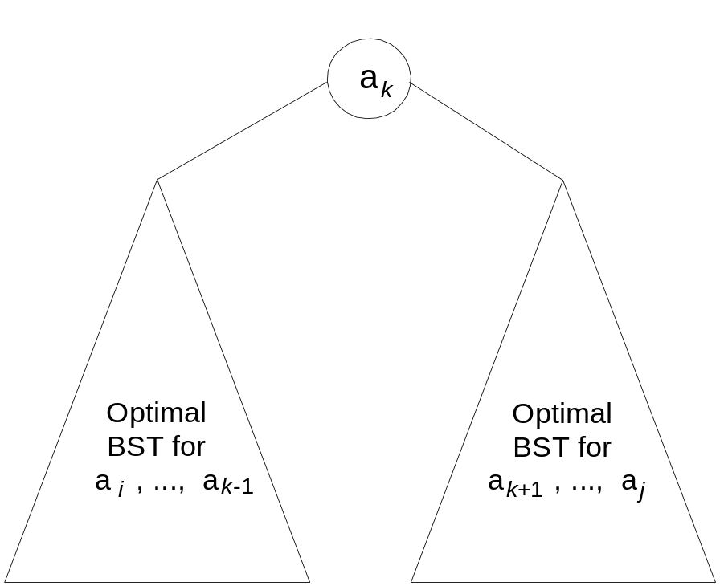
DP for Optimal BST Problem
Let T[i,j] be optimal BST for keys a_{i} < …< a_{j} , C[i,j] be minimum average number of comparisons made in T[i,j], for 1 ≤ i ≤ j ≤ n. Consider optimal BST among all BSTs with some a_{k} (i ≤ k ≤ j ) as their root; T[i,j] is the best among them.
Min Num Comparisons
C[i,j] =
min {p_{k} · 1 +
∑ p_{s} · (level a_{s} in T[i,k-1] +1) +
∑ p_{s} · (level a_{s} in T[k+1,j] +1)}
Best Tree
i ≤ k ≤ j
k-1
s = i
j
s =k+1
A. Levitin “Introduction to the Design & Analysis of Algorithms,” 3rd ed., Ch. 8 ©2012 Pearson Education, Inc. Upper Saddle River, NJ. All Rights Reserved.

Slide 44
DP for Optimal BST Problem (cont.)
After simplifications, we obtain the recurrence for C[i,j]:
C[i,j] = min {C[i,k-1] + C[k+1,j]} + ∑ p_{s} for 1 ≤ i ≤ j ≤ n
C[i,i] = p_{i} for 1 ≤ i ≤ j ≤ n
What table elements are involved?
j
i ≤ k ≤ j
s = i
A. Levitin “Introduction to the Design & Analysis of Algorithms,” 3rd ed., Ch. 8 ©2012 Pearson Education, Inc. Upper Saddle River, NJ. All Rights Reserved.

Slide 45
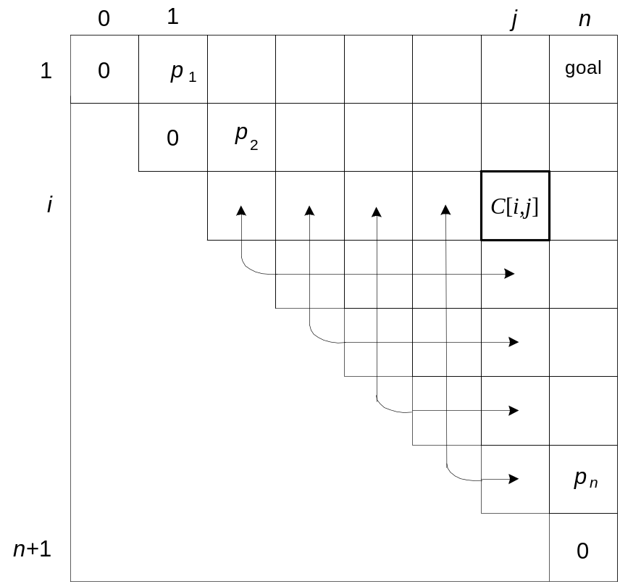
DP for Optimal BST Problem (cont.)
After simplifications, we obtain the recurrence for C[i,j]:
C[i,j] = min {C[i,k-1] + C[k+1,j]} + ∑ p_{s} for 1 ≤ i ≤ j ≤ n
C[i,i] = p_{i} for 1 ≤ i ≤ j ≤ n
j
i ≤ k ≤ j
s = i
A. Levitin “Introduction to the Design & Analysis of Algorithms,” 3rd ed., Ch. 8 ©2012 Pearson Education, Inc. Upper Saddle River, NJ. All Rights Reserved.

Slide 46
Example: key A B C D
probability 0.1 0.2 0.4 0.3
The left table is filled using the recurrence
C[i,j] = min {C[i,k-1] + C[k+1,j]} + ∑ p_{s ,} C[i,i] = p_{i}
The right saves the tree roots, which are the k’s that give the minima
j
i ≤ k ≤ j
s = i
_{i} ^{j}
_{i} ^{j}
 | 0 | 1 | 2 | 3 | 4
1 | 0 | .1 | .4 | 1.1 | 1.7
2 |  | 0 | .2 | .8 | 1.4
3 |  |  | 0 | .4 | 1.0
4 |  |  |  | 0 | .3
5 |  |  |  |  | 0
 | 0 | 1 | 2 | 3 | 4
1 |  | 1 | 2 | 3 | 3
2 |  |  | 2 | 3 | 3
3 |  |  |  | 3 | 3
4 |  |  |  |  | 4
5
C
B
D
A
optimal BST
Tables filled diagonal by diagonal (remember what C[i,j] is).

Slide 47
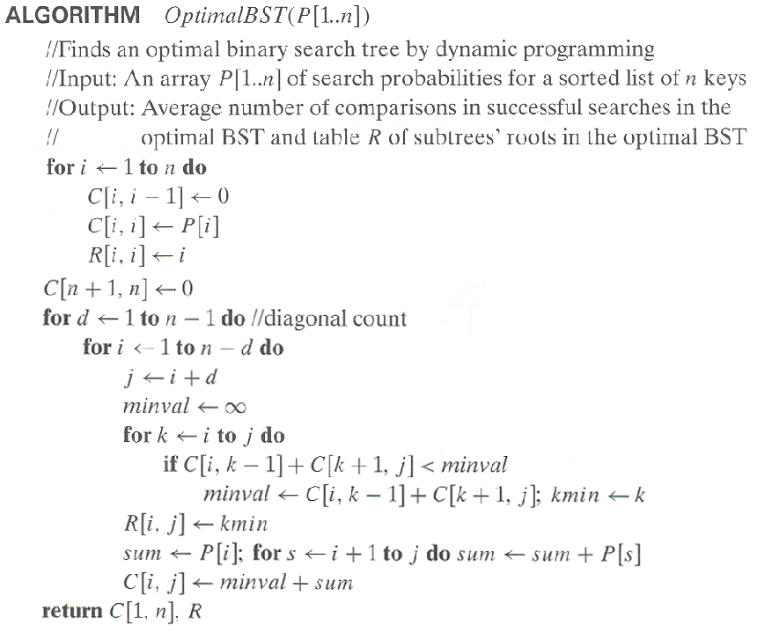
Optimal Binary Search Trees
A. Levitin “Introduction to the Design & Analysis of Algorithms,” 3rd ed., Ch. 8 ©2012 Pearson Education, Inc. Upper Saddle River, NJ. All Rights Reserved.

Slide 48
Analysis DP for Optimal BST Problem
Time efficiency: Θ(n³) but can be reduced to Θ(n²) by taking
advantage of monotonicity of entries in the
root table, i.e., R[i,j] is always in the range
between R[i,j-1] and R[i+1,j]
Space efficiency: Θ(n²)
Method can be expanded to include unsuccessful searches
A. Levitin “Introduction to the Design & Analysis of Algorithms,” 3rd ed., Ch. 8 ©2012 Pearson Education, Inc. Upper Saddle River, NJ. All Rights Reserved.

Slide 49
Warshall’s Algorithm: Transitive Closure
SKIP
Computes the transitive closure of a relation
Alternatively: existence of all nontrivial paths in a digraph
Example of transitive closure:
3
3
1
1
0 0 1 0
1 0 0 1
0 0 0 0
0 1 0 0
0 0 1 0
1 1 1 1
0 0 0 0
1 1 1 1
4
4
2
2
A. Levitin “Introduction to the Design & Analysis of Algorithms,” 3rd ed., Ch. 8 ©2012 Pearson Education, Inc. Upper Saddle River, NJ. All Rights Reserved.

Slide 50
Warshall’s Algorithm
Constructs transitive closure T as the last matrix in the sequence of n-by-n matrices R⁽⁰⁾, … , R^{(k)}, … , R^{(n)} where
R^{(k)}[i,j] = 1 iff there is nontrivial path from i to j with only first k vertices allowed as intermediate
Note that R⁽⁰⁾ = A (adjacency matrix), R^{(n)} = T (transitive closure)
3
3
3
3
3
1
1
1
1
1
4
4
4
2
4
4
2
2
2
2
R⁽⁰⁾
0 0 1 0
1 0 0 1
0 0 0 0
0 1 0 0
R⁽¹⁾
0 0 1 0
1 0 1 1
0 0 0 0
0 1 0 0
R⁽²⁾
0 0 1 0
1 0 1 1
0 0 0 0
1 1 1 1
R⁽³⁾
0 0 1 0
1 0 1 1
0 0 0 0
1 1 1 1
R⁽⁴⁾
0 0 1 0
1 1 1 1
0 0 0 0
1 1 1 1
A. Levitin “Introduction to the Design & Analysis of Algorithms,” 3rd ed., Ch. 8 ©2012 Pearson Education, Inc. Upper Saddle River, NJ. All Rights Reserved.

Slide 51
Warshall’s Algorithm (recurrence)
On the k-th iteration, the algorithm determines for every pair of vertices i, j if a path exists from i and j with just vertices 1,…,k allowed as intermediate
        R^{(k-1)}[i,j] (path using just 1 ,…,k-1)
R^{(k)}[i,j] = or
      R^{(k-1)}[i,k] and R^{(k-1)}[k,j] (path from i to k
      and from k to i
      using just 1 ,…,k-1)
{
k
i
j
A. Levitin “Introduction to the Design & Analysis of Algorithms,” 3rd ed., Ch. 8 ©2012 Pearson Education, Inc. Upper Saddle River, NJ. All Rights Reserved.

Slide 52
Warshall’s Algorithm (matrix generation)
Recurrence relating elements R^{(k)} to elements of R^{(k-1)} is:
      R^{(k)}[i,j] = R^{(k-1)}[i,j] or (R^{(k-1)}[i,k] and R^{(k-1)}[k,j])
It implies the following rules for generating R^{(k)} from R^{(k-1)}:
Rule 1 If an element in row i and column j is 1 in R^{(k-1)},
it remains 1 in R^{(k)}
Rule 2 If an element in row i and column j is 0 in R^{(k-1)},
it has to be changed to 1 in R^{(k)} if and only if
the element in its row i and column k and the element
in its column j and row k are both 1’s in R^{(k-1)}
A. Levitin “Introduction to the Design & Analysis of Algorithms,” 3rd ed., Ch. 8 ©2012 Pearson Education, Inc. Upper Saddle River, NJ. All Rights Reserved.

Slide 53
Warshall’s Algorithm (example)
3
0 0 1 0
1 0 0 1
0 0 0 0
0 1 0 0
0 0 1 0
1 0 1 1
0 0 0 0
0 1 0 0
1
R⁽⁰⁾ ⁼
R⁽¹⁾ ⁼
2
4
0 0 1 0
1 0 1 1
0 0 0 0
1 1 1 1
0 0 1 0
1 0 1 1
0 0 0 0
1 1 1 1
0 0 1 0
1 1 1 1
0 0 0 0
1 1 1 1
R⁽²⁾ ⁼
R⁽³⁾ ⁼
R⁽⁴⁾ ⁼
A. Levitin “Introduction to the Design & Analysis of Algorithms,” 3rd ed., Ch. 8 ©2012 Pearson Education, Inc. Upper Saddle River, NJ. All Rights Reserved.

Slide 54
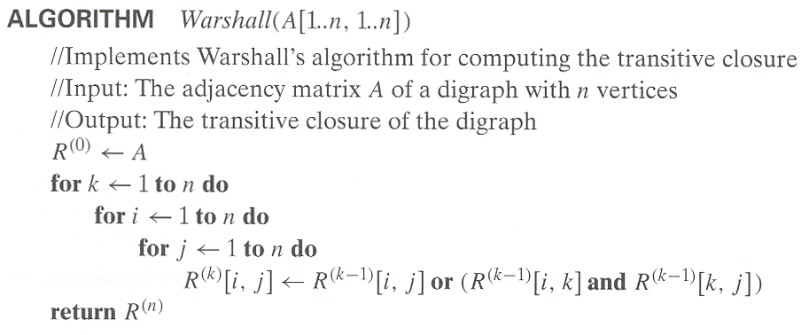
Warshall’s Algorithm (pseudocode and analysis)
Time efficiency: Θ(n³)
Space efficiency: Matrices can be written over their predecessors
A. Levitin “Introduction to the Design & Analysis of Algorithms,” 3rd ed., Ch. 8 ©2012 Pearson Education, Inc. Upper Saddle River, NJ. All Rights Reserved.

Slide 55
Floyd’s Algorithm: All pairs shortest paths
SKIP
Problem: In a weighted (di)graph, find shortest paths between
every pair of vertices
Same idea: construct solution through series of matrices D⁽⁰⁾, …,
D ^{(n)} using increasing subsets of the vertices allowed
as intermediate
Example:
4
3
1
1
6
1
5
4
2
3
A. Levitin “Introduction to the Design & Analysis of Algorithms,” 3rd ed., Ch. 8 ©2012 Pearson Education, Inc. Upper Saddle River, NJ. All Rights Reserved.

Slide 56
Floyd’s Algorithm (matrix generation)
On the k-th iteration, the algorithm determines shortest paths between every pair of vertices i, j that use only vertices among 1,…,k as intermediate
D^{(k)}[i,j] = min {D^{(k-1)}[i,j], D^{(k-1)}[i,k] + D^{(k-1)}[k,j]}
D^{(k-1)}[i,k]
k
i
D^{(k-1)}[k,j]
D^{(k-1)}[i,j]
j
A. Levitin “Introduction to the Design & Analysis of Algorithms,” 3rd ed., Ch. 8 ©2012 Pearson Education, Inc. Upper Saddle River, NJ. All Rights Reserved.

Slide 57
Floyd’s Algorithm (example)
2
1
2
0 ∞ 3 ∞ 2 0 ∞ ∞
∞ 7 0 1
6 ∞ ∞ 0
0 ∞ 3 ∞
2 0 5 ∞
∞ 7 0 1
6 ∞ 9 0
3
6
7
D⁽⁰⁾ ⁼
D⁽¹⁾ ⁼
3
1
4
0 ∞ 3 ∞
2 0 5 ∞
9 7 0 1
6 ∞ 9 0
0 10 3 4
2 0 5 6
9 7 0 1
6 16 9 0
0 10 3 4
2 0 5 6
7 7 0 1
6 16 9 0
D⁽²⁾ ⁼
D⁽³⁾ ⁼
D⁽⁴⁾ ⁼
D(3): 3 to 1 not allowing 4=9. D(4): 3 to 1 with allowing 4=7
A. Levitin “Introduction to the Design & Analysis of Algorithms,” 3rd ed., Ch. 8 ©2012 Pearson Education, Inc. Upper Saddle River, NJ. All Rights Reserved.

Slide 58
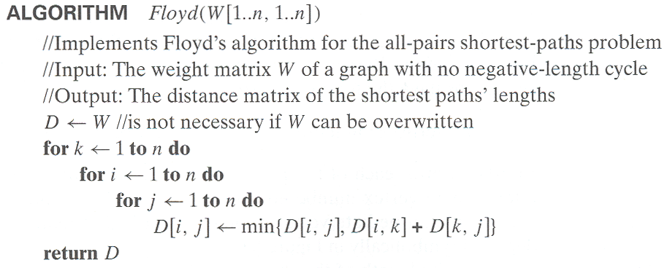
Floyd’s Algorithm (pseudocode and analysis)
Time efficiency: Θ(n³)
Space efficiency: Matrices can be written over their predecessors
Note: Shortest paths themselves can be found, too (Problem 10)
A. Levitin “Introduction to the Design & Analysis of Algorithms,” 3rd ed., Ch. 8 ©2012 Pearson Education, Inc. Upper Saddle River, NJ. All Rights Reserved.

