Slide 1
CS 332: Algorithms
Linear-Time Sorting Continued
Medians and Order Statistics
David Luebke <number> 11/08/26

Slide 2
Review: Comparison Sorts
Comparison sorts: O(n lg n) at best
  Model sort with decision tree
  Path down tree = execution trace of algorithm
  Leaves of tree = possible permutations of input
  Tree must have n! leaves, so O(n lg n) height
David Luebke <number> 11/08/26

Slide 3
Review: Counting Sort
Counting sort:
  Assumption: input is in the range 1..k
  Basic idea:
    Count number of elements k ≤ each element i
    Use that number to place i in position k of sorted array
  No comparisons! Runs in time O(n + k)
  Stable sort
  Does not sort in place:
    O(n) array to hold sorted output
    O(k) array for scratch storage
David Luebke <number> 11/08/26

Slide 4
Review: Counting Sort
1 CountingSort(A, B, k)
2 for i=1 to k
3 C[i]= 0;
4 for j=1 to n
5 C[A[j]] += 1;
6 for i=2 to k
7 C[i] = C[i] + C[i-1];
8 for j=n downto 1
9 B[C[A[j]]] = A[j];
10 C[A[j]] -= 1;
David Luebke <number> 11/08/26

Slide 5
Review: Radix Sort
How did IBM get rich originally?
Answer: punched card readers for census tabulation in early 1900’s.
  In particular, a card sorter that could sort cards into different bins
    Each column can be punched in 12 places
    Decimal digits use 10 places
  Problem: only one column can be sorted on at a time
David Luebke <number> 11/08/26

Slide 6
Review: Radix Sort
Intuitively, you might sort on the most significant digit, then the second msd, etc.
Problem: lots of intermediate piles of cards (read: scratch arrays) to keep track of
Key idea: sort the least significant digit first
  RadixSort(A, d)
  for i=1 to d
  StableSort(A) on digit i
  Example: Fig 9.3
David Luebke <number> 11/08/26

Slide 7
Radix Sort
Can we prove it will work?
Sketch of an inductive argument (induction on the number of passes):
  Assume lower-order digits {j: j<i}are sorted
  Show that sorting next digit i leaves array correctly sorted
    If two digits at position i are different, ordering numbers by that digit is correct (lower-order digits irrelevant)
    If they are the same, numbers are already sorted on the lower-order digits. Since we use a stable sort, the numbers stay in the right order
David Luebke <number> 11/08/26

Slide 8
Radix Sort
What sort will we use to sort on digits?
Counting sort is obvious choice:
  Sort n numbers on digits that range from 1..k
  Time: O(n + k)
Each pass over n numbers with d digits takes time O(n+k), so total time O(dn+dk)
  When d is constant and k=O(n), takes O(n) time
How many bits in a computer word?
David Luebke <number> 11/08/26

Slide 9
Radix Sort
Problem: sort 1 million 64-bit numbers
  Treat as four-digit radix 2¹⁶ numbers
  Can sort in just four passes with radix sort!
Compares well with typical O(n lg n) comparison sort
  Requires approx lg n = 20 operations per number being sorted
So why would we ever use anything but radix sort?
David Luebke <number> 11/08/26

Slide 10
Radix Sort
In general, radix sort based on counting sort is
  Fast
  Asymptotically fast (i.e., O(n))
  Simple to code
  A good choice
To think about: Can radix sort be used on floating-point numbers?
David Luebke <number> 11/08/26

Slide 11
Summary: Radix Sort
Radix sort:
  Assumption: input has d digits ranging from 0 to k
  Basic idea:
    Sort elements by digit starting with least significant
    Use a stable sort (like counting sort) for each stage
  Each pass over n numbers with d digits takes time O(n+k), so total time O(dn+dk)
    When d is constant and k=O(n), takes O(n) time
  Fast! Stable! Simple!
  Doesn’t sort in place
David Luebke <number> 11/08/26

Slide 12
Bucket Sort
Bucket sort
  Assumption: input is n reals from [0, 1)
  Basic idea:
    Create n linked lists (buckets) to divide interval [0,1) into subintervals of size 1/n
    Add each input element to appropriate bucket and sort buckets with insertion sort
  Uniform input distribution → O(1) bucket size
    Therefore the expected total time is O(n)
  These ideas will return when we study hash tables
David Luebke <number> 11/08/26

Slide 13
Order Statistics
The ith order statistic in a set of n elements is the ith smallest element
The minimum is thus the 1st order statistic
The maximum is (duh) the nth order statistic
The median is the n/2 order statistic
  If n is even, there are 2 medians
How can we calculate order statistics?
What is the running time?
David Luebke <number> 11/08/26

Slide 14
Order Statistics
How many comparisons are needed to find the minimum element in a set? The maximum?
Can we find the minimum and maximum with less than twice the cost?
Yes:
  Walk through elements by pairs
    Compare each element in pair to the other
    Compare the largest to maximum, smallest to minimum
  Total cost: 3 comparisons per 2 elements = O(3n/2)
David Luebke <number> 11/08/26

Slide 15
Finding Order Statistics:
The Selection Problem
A more interesting problem is selection: finding the ith smallest element of a set
We will show:
  A practical randomized algorithm with O(n) expected running time
  A cool algorithm of theoretical interest only with O(n) worst-case running time
David Luebke <number> 11/08/26

Slide 16
Randomized Selection
Key idea: use partition() from quicksort
  But, only need to examine one subarray
  This savings shows up in running time: O(n)
We will again use a slightly different partition than the book:
  q = RandomizedPartition(A, p, r)
≤ A[q]
≥ A[q]
p
q
r
David Luebke <number> 11/08/26

Slide 17
Randomized Selection
RandomizedSelect(A, p, r, i)
if (p == r) then return A[p];
q = RandomizedPartition(A, p, r)
k = q - p + 1;
if (i == k) then return A[q]; // not in book
if (i < k) then
return RandomizedSelect(A, p, q-1, i);
else
return RandomizedSelect(A, q+1, r, i-k);
k
≤ A[q]
≥ A[q]
p
q
r
David Luebke <number> 11/08/26

Slide 18
Randomized Selection
Analyzing RandomizedSelect()
  Worst case: partition always 0:n-1
    T(n) = T(n-1) + O(n) = ???
    = O(n²) (arithmetic series)
    No better than sorting!
  “Best” case: suppose a 9:1 partition
    T(n) = T(9n/10) + O(n) = ???
    = O(n) (Master Theorem, case 3)
    Better than sorting!
    What if this had been a 99:1 split?
David Luebke <number> 11/08/26

Slide 19
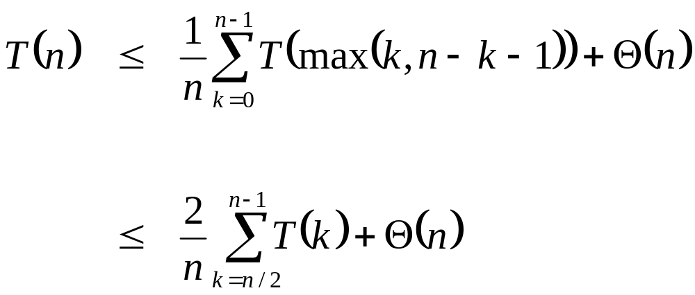
Randomized Selection
Average case
  For upper bound, assume ith element always falls in larger side of partition:
  Let’s show that T(n) = O(n) by substitution
What happened here?
David Luebke <number> 11/08/26

Slide 20
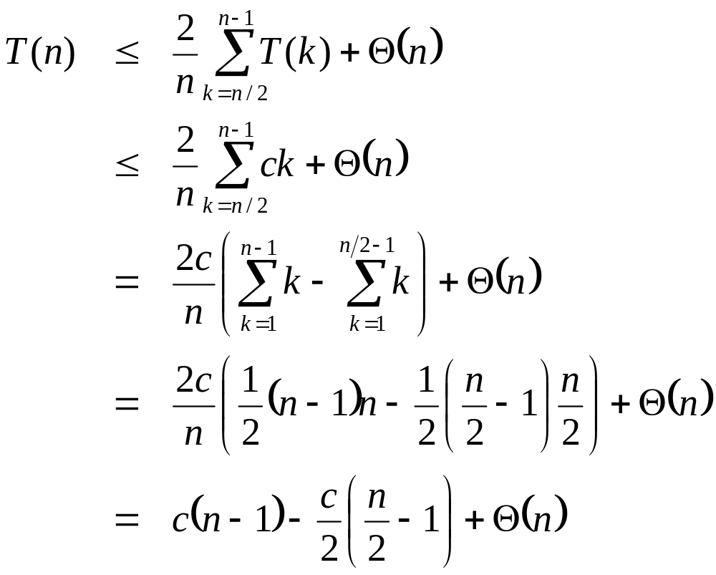
Randomized Selection
Assume T(n) ≤ cn for sufficiently large c:
The recurrence we started with
Substitute T(n) ≤ cn for T(k)
What happened here?
What happened here?
“Split” the recurrence
Expand arithmetic series
What happened here?
Multiply it out
What happened here?
David Luebke <number> 11/08/26

Slide 21
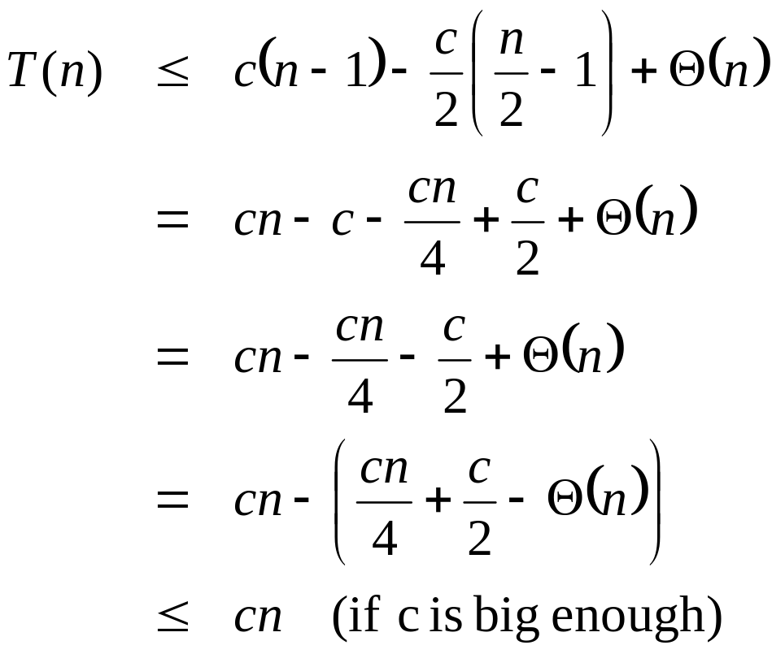
Randomized Selection
Assume T(n) ≤ cn for sufficiently large c:
The recurrence so far
What happened here?
Multiply it out
What happened here?
Subtract c/2
Rearrange the arithmetic
What happened here?
What we set out to prove
What happened here?
David Luebke <number> 11/08/26

Slide 22
Worst-Case Linear-Time Selection
Randomized algorithm works well in practice
What follows is a worst-case linear time algorithm, really of theoretical interest only
Basic idea:
  Generate a good partitioning element
  Call this element x
David Luebke <number> 11/08/26

Slide 23
Worst-Case Linear-Time Selection
The algorithm in words:
  1. Divide n elements into groups of 5
  2. Find median of each group (How? How long?)
  3. Use Select() recursively to find median x of the ⎣n/5⎦ medians
  4. Partition the n elements around x. Let k = rank(x)
  5. if (i == k) then return x
  if (i < k) then use Select() recursively to find ith smallest element in first partition
  else (i > k) use Select() recursively to find (i-k)th smallest element in last partition
David Luebke <number> 11/08/26

Slide 24
Worst-Case Linear-Time Selection
(Sketch situation on the board)
How many of the 5-element medians are ≤ x?
  At least 1/2 of the medians = ⎣⎣n/5⎦ / 2⎦ = ⎣n/10⎦
How many elements are ≤ x?
  At least 3 ⎣n/10 ⎦ elements
For large n, 3 ⎣n/10 ⎦ ≥ n/4 (How large?)
So at least n/4 elements ≤ x
Similarly: at least n/4 elements ≥ x
David Luebke <number> 11/08/26

Slide 25
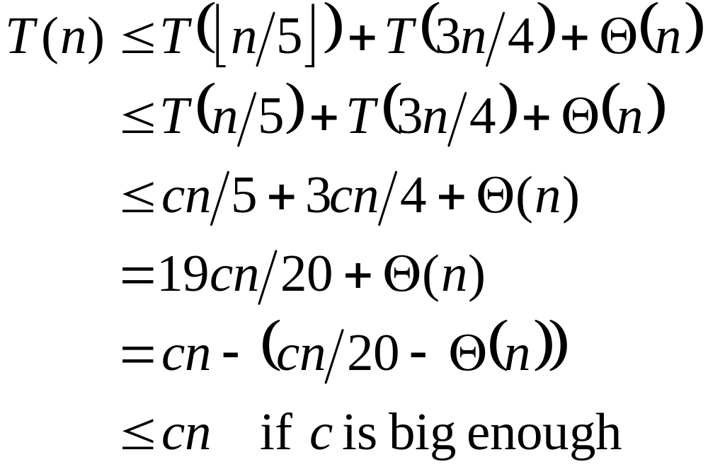
Worst-Case Linear-Time Selection
Thus after partitioning around x, step 5 will call Select() on at most 3n/4 elements
The recurrence is therefore:
⎣n/5 ⎦ ≤ n/5
???
Substitute T(n) = cn
???
Combine fractions
???
Express in desired form
???
What we set out to prove
???
David Luebke <number> 11/08/26

Slide 26
Worst-Case Linear-Time Selection
Intuitively:
  Work at each level is a constant fraction (19/20) smaller
    Geometric progression!
  Thus the O(n) work at the root dominates
David Luebke <number> 11/08/26

Slide 27
Linear-Time Median Selection
Given a “black box” O(n) median algorithm, what can we do?
  ith order statistic:
    Find median x
    Partition input around x
    if (i ≤ (n+1)/2) recursively find ith element of first half
    else find (i - (n+1)/2)th element in second half
    T(n) = T(n/2) + O(n) = O(n)
  Can you think of an application to sorting?
David Luebke <number> 11/08/26

Slide 28
Linear-Time Median Selection
Worst-case O(n lg n) quicksort
  Find median x and partition around it
  Recursively quicksort two halves
  T(n) = 2T(n/2) + O(n) = O(n lg n)
David Luebke <number> 11/08/26

Slide 29
The End
David Luebke <number> 11/08/26

