Slide 1
CS 332: Algorithms
Linear-Time Sorting Algorithms
David Luebke <number> 11/08/26

Slide 2
Sorting So Far
Insertion sort:
  Easy to code
  Fast on small inputs (less than ~50 elements)
  Fast on nearly-sorted inputs
  O(n²) worst case
  O(n²) average (equally-likely inputs) case
  O(n²) reverse-sorted case
David Luebke <number> 11/08/26

Slide 3
Sorting So Far
Merge sort:
  Divide-and-conquer:
    Split array in half
    Recursively sort subarrays
    Linear-time merge step
  O(n lg n) worst case
  Doesn’t sort in place
David Luebke <number> 11/08/26

Slide 4
Sorting So Far
Heap sort:
  Uses the very useful heap data structure
    Complete binary tree
    Heap property: parent key > children’s keys
  O(n lg n) worst case
  Sorts in place
  Fair amount of shuffling memory around
David Luebke <number> 11/08/26

Slide 5
Sorting So Far
Quick sort:
  Divide-and-conquer:
    Partition array into two subarrays, recursively sort
    All of first subarray < all of second subarray
    No merge step needed!
  O(n lg n) average case
  Fast in practice
  O(n²) worst case
    Naïve implementation: worst case on sorted input
    Address this with randomized quicksort
David Luebke <number> 11/08/26

Slide 6
How Fast Can We Sort?
We will provide a lower bound, then beat it
  How do you suppose we’ll beat it?
First, an observation: all of the sorting algorithms so far are comparison sorts
  The only operation used to gain ordering information about a sequence is the pairwise comparison of two elements
  Theorem: all comparison sorts are Ω(n lg n)
    A comparison sort must do O(n) comparisons (why?)
    What about the gap between O(n) and O(n lg n)
David Luebke <number> 11/08/26

Slide 7
Decision Trees
Decision trees provide an abstraction of comparison sorts
  A decision tree represents the comparisons made by a comparison sort. Every thing else ignored
  (Draw examples on board)
What do the leaves represent?
How many leaves must there be?
David Luebke <number> 11/08/26

Slide 8
Decision Trees
Decision trees can model comparison sorts. For a given algorithm:
  One tree for each n
  Tree paths are all possible execution traces
  What’s the longest path in a decision tree for insertion sort? For merge sort?
What is the asymptotic height of any decision tree for sorting n elements?
Answer: Ω(n lg n) (now let’s prove it…)
David Luebke <number> 11/08/26

Slide 9
Lower Bound For
Comparison Sorting
Thm: Any decision tree that sorts n elements has height Ω(n lg n)
What’s the minimum # of leaves?
What’s the maximum # of leaves of a binary tree of height h?
Clearly the minimum # of leaves is less than or equal to the maximum # of leaves
David Luebke <number> 11/08/26

Slide 10
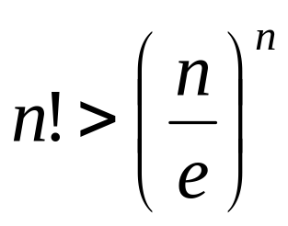
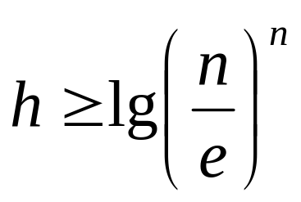
Lower Bound For
Comparison Sorting
So we have…
n! ≤ 2^{h}
Taking logarithms:
lg (n!) ≤ h
Stirling’s approximation tells us:
Thus:
David Luebke <number> 11/08/26

Slide 11
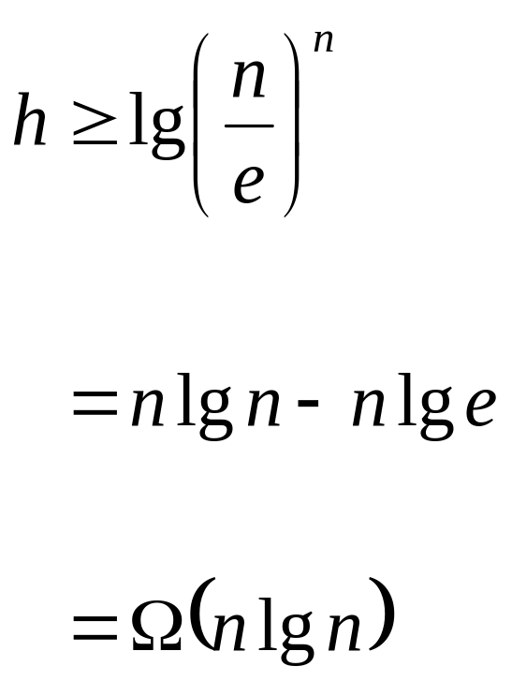
Lower Bound For
Comparison Sorting
So we have
Thus the minimum height of a decision tree is Ω(n lg n)
David Luebke <number> 11/08/26

Slide 12
Lower Bound For
Comparison Sorts
Thus the time to comparison sort n elements is Ω(n lg n)
Corollary: Heapsort and Mergesort are asymptotically optimal comparison sorts
But the name of this lecture is “Sorting in linear time”!
  How can we do better than Ω(n lg n)?
David Luebke <number> 11/08/26

Slide 13
Sorting In Linear Time
Counting sort
  No comparisons between elements!
  But…depends on assumption about the numbers being sorted
    We assume numbers are in the range 1.. k
  The algorithm:
    Input: A[1..n], where A[j] ∈ {1, 2, 3, …, k}
    Output: B[1..n], sorted (notice: not sorting in place)
    Also: Array C[1..k] for auxiliary storage
David Luebke <number> 11/08/26

Slide 14
Counting Sort
1 CountingSort(A, B, k)
2 for i=1 to k
3 C[i]= 0;
4 for j=1 to n
5 C[A[j]] += 1;
6 for i=2 to k
7 C[i] = C[i] + C[i-1];
8 for j=n downto 1
9 B[C[A[j]]] = A[j];
10 C[A[j]] -= 1;
Work through example: A={4 1 3 4 3}, k = 4
David Luebke <number> 11/08/26

Slide 15
Counting Sort
1 CountingSort(A, B, k)
2 for i=1 to k
3 C[i]= 0;
4 for j=1 to n
5 C[A[j]] += 1;
6 for i=2 to k
7 C[i] = C[i] + C[i-1];
8 for j=n downto 1
9 B[C[A[j]]] = A[j];
10 C[A[j]] -= 1;
Takes time O(k)
Takes time O(n)
What will be the running time?
David Luebke <number> 11/08/26

Slide 16
Counting Sort
Total time: O(n + k)
  Usually, k = O(n)
  Thus counting sort runs in O(n) time
But sorting is Ω(n lg n)!
  No contradiction--this is not a comparison sort (in fact, there are no comparisons at all!)
  Notice that this algorithm is stable
David Luebke <number> 11/08/26

Slide 17
Counting Sort
Cool! Why don’t we always use counting sort?
Because it depends on range k of elements
Could we use counting sort to sort 32 bit integers? Why or why not?
Answer: no, k too large (2³² = 4,294,967,296)
David Luebke <number> 11/08/26

Slide 18
Counting Sort
How did IBM get rich originally?
Answer: punched card readers for census tabulation in early 1900’s.
  In particular, a card sorter that could sort cards into different bins
    Each column can be punched in 12 places
    Decimal digits use 10 places
  Problem: only one column can be sorted on at a time
David Luebke <number> 11/08/26

Slide 19
Radix Sort
Intuitively, you might sort on the most significant digit, then the second msd, etc.
Problem: lots of intermediate piles of cards (read: scratch arrays) to keep track of
Key idea: sort the least significant digit first
  RadixSort(A, d)
  for i=1 to d
  StableSort(A) on digit i
  Example: Fig 9.3
David Luebke <number> 11/08/26

Slide 20
Radix Sort
Can we prove it will work?
Sketch of an inductive argument (induction on the number of passes):
  Assume lower-order digits {j: j<i}are sorted
  Show that sorting next digit i leaves array correctly sorted
    If two digits at position i are different, ordering numbers by that digit is correct (lower-order digits irrelevant)
    If they are the same, numbers are already sorted on the lower-order digits. Since we use a stable sort, the numbers stay in the right order
David Luebke <number> 11/08/26

Slide 21
Radix Sort
What sort will we use to sort on digits?
Counting sort is obvious choice:
  Sort n numbers on digits that range from 1..k
  Time: O(n + k)
Each pass over n numbers with d digits takes time O(n+k), so total time O(dn+dk)
  When d is constant and k=O(n), takes O(n) time
How many bits in a computer word?
David Luebke <number> 11/08/26

Slide 22
Radix Sort
Problem: sort 1 million 64-bit numbers
  Treat as four-digit radix 2¹⁶ numbers
  Can sort in just four passes with radix sort!
Compares well with typical O(n lg n) comparison sort
  Requires approx lg n = 20 operations per number being sorted
So why would we ever use anything but radix sort?
David Luebke <number> 11/08/26

Slide 23
Radix Sort
In general, radix sort based on counting sort is
  Fast
  Asymptotically fast (i.e., O(n))
  Simple to code
  A good choice
To think about: Can radix sort be used on floating-point numbers?
David Luebke <number> 11/08/26

Slide 24
The End
David Luebke <number> 11/08/26

