Slide 1
Defect’s Prediction on Starter Motor Production Lines

Slide 2
Data
Source : https://challengedata.ens.fr/participants/challenges/36/
State : some missing values and imbalance target class
Type : Numerical inputs & Categorical target (0 = OK / 1 = Failed)
df
Info extraction : date, product code,

Slide 3
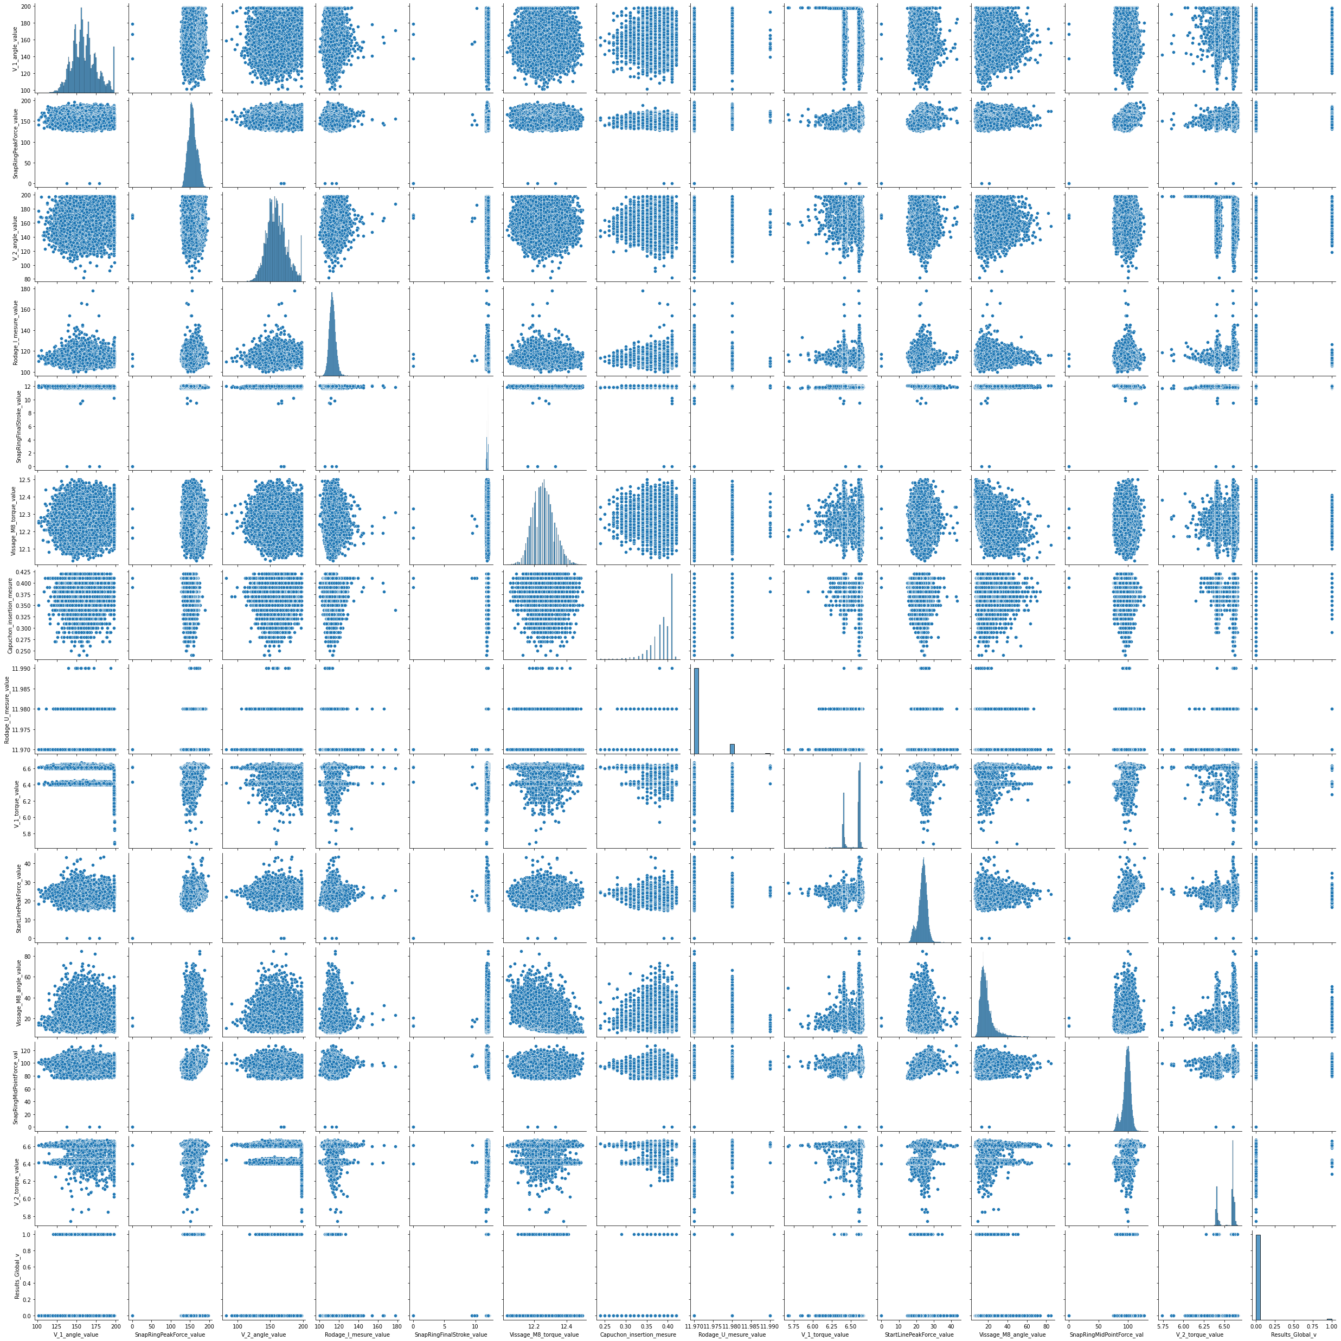
pairplot

