Slide 1
Joins Review and Bonus
Lecture 14

Slide 2
Nested Loop Joins
Lecture 14 > Section 2 > NLJ

Slide 3
Notes
Lecture 14 > Section 2 > NLJ
We are again considering “IO aware” algorithms: care about disk IO
Given a relation R, let:
T(R) = # of tuples in R
P(R) = # of pages in R
Note also that we omit ceilings in calculations… good exercise to put back in!

Slide 4
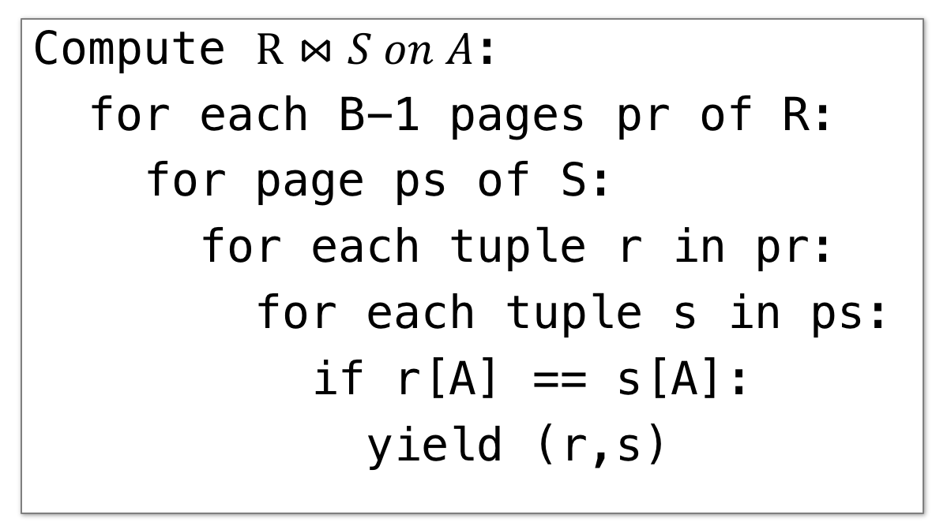
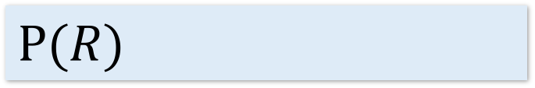
Block Nested Loop Join (BNLJ)
Lecture 14 > Section 2 > BNLJ
Given B+1 pages of memory
Cost:
Compute $R⋈S on A$:
for each B-1 pages pr of R:
for page ps of S:
for each tuple r in pr:
for each tuple s in ps:
if r[A] == s[A]:
yield (r,s)
$$P(R)$$
Load in B-1 pages of R at a time (leaving 1 page each free for S & output)

Slide 5
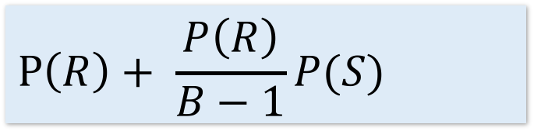
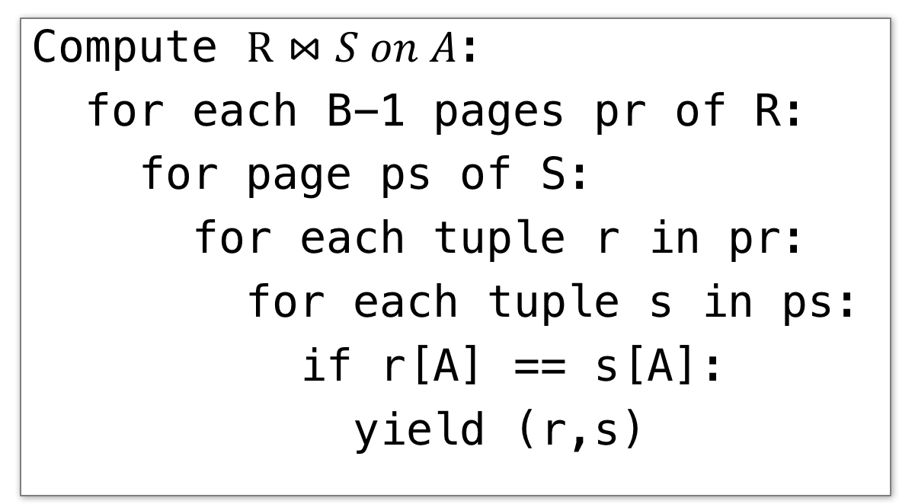
Block Nested Loop Join (BNLJ)
Lecture 14 > Section 2 > BNLJ
Given B+1 pages of memory
Cost:
Compute $R⋈S on A$:
for each B-1 pages pr of R:
for page ps of S:
for each tuple r in pr:
for each tuple s in ps:
if r[A] == s[A]:
yield (r,s)
$$P\left(R\right)+ \frac{P\left(R\right)}{B−1}P(S)$$
Load in B-1 pages of R at a time (leaving 1 page each free for S & output)
For each (B-1)-page segment of R, load each page of S
This line is called $\frac{P\left(R\right)}{B−1}$ times; the loop iterates over the entire relation S $\frac{P\left(R\right)}{B−1}$ times (ceiling!)

Slide 6
Block Nested Loop Join (BNLJ)
Lecture 14 > Section 2 > BNLJ
Given B+1 pages of memory
Cost:
Compute $R⋈S on A$:
for each B-1 pages pr of R:
for page ps of S:
for each tuple r in pr:
for each tuple s in ps:
if r[A] == s[A]:
yield (r,s)
$$P\left(R\right)+ \frac{P\left(R\right)}{B−1}P(S)$$
Load in B-1 pages of R at a time (leaving 1 page each free for S & output)
For each (B-1)-page segment of R, load each page of S
Check against the join conditions
BNLJ can also handle non-equality constraints

Slide 7
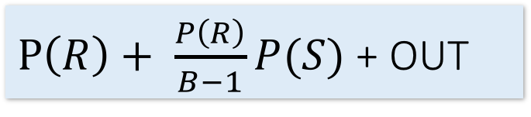
Block Nested Loop Join (BNLJ)
Lecture 14 > Section 2 > BNLJ
Given B+1 pages of memory
Cost:
Compute $R⋈S on A$:
for each B-1 pages pr of R:
for page ps of S:
for each tuple r in pr:
for each tuple s in ps:
if r[A] == s[A]:
yield (r,s)
$P\left(R\right)+ \frac{P\left(R\right)}{B−1}P(S)$ + OUT
Load in B-1 pages of R at a time (leaving 1 page each free for S & output)
For each (B-1)-page segment of R, load each page of S
Check against the join conditions
Write out

Slide 8
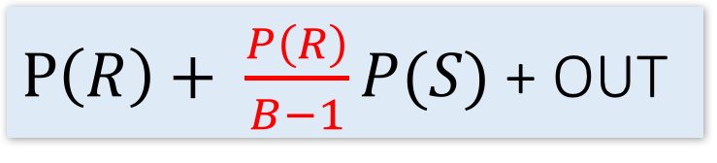
BNLJ: Some quick facts.
Lecture 14 > Section 2 > BNLJ
We use B+1 buffer pages as:
1 page for S
1 page for output
B-1 Pages for R
If P(R) <= B-1 then we do one pass over S, and we run in time P(R) + P(S) + OUT.
Note: This is optimal for our cost model!
Thus, if min {P(R), P(S)} <= B-1 we should always use BNLJ
We use this at the end of hash join. We define end condition, one of the buckets is smaller than B-1!
$P\left(R\right)+ \frac{P\left(R\right)}{B−1}P(S)$ + OUT

Slide 9
1. Sort-Merge Join (SMJ)
Lecture 15 > Section 1

Slide 10
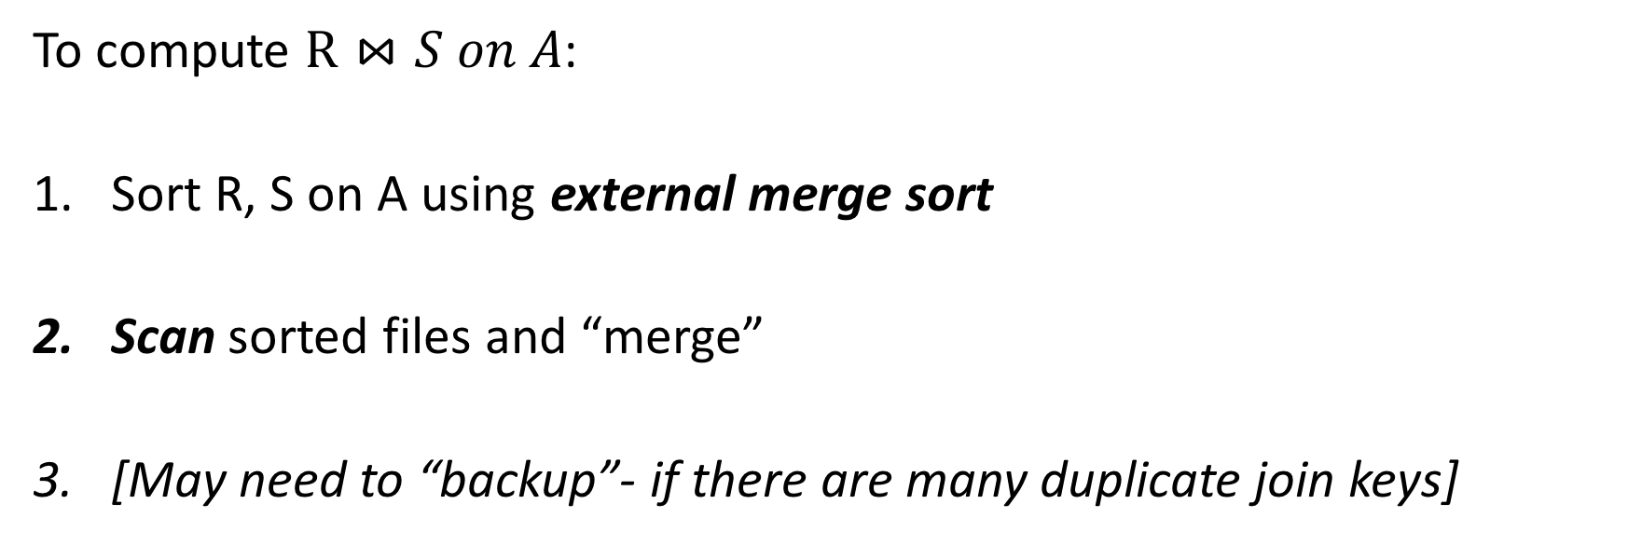
Sort Merge Join (SMJ): Basic Procedure
Lecture 15 > Section 1 > SMJ
To compute $R⋈S on A$:
Sort R, S on A using external merge sort
Scan sorted files and “merge”
[May need to “backup”- if there are many duplicate join keys]
Note that we are only considering equality join conditions here
Note that if R, S are already sorted on A, SMJ will be awesome!

Slide 11
Simple SMJ Optimization
Lecture 15 > Section 1 > Backup
Given B+1 buffer pages
Unsorted input relations
Sort Phase
(Ext. Merge Sort)
R
S
Split & sort
Split & sort
Merge
Merge
<= B total runs
B-Way Merge / Join
Merge / Join Phase
Joined output file created!

Slide 12
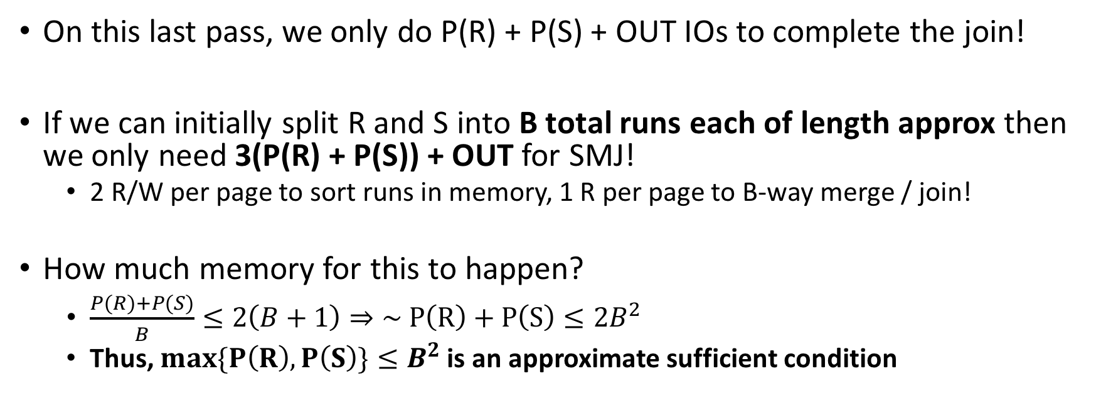
Simple SMJ Optimization
Lecture 15 > Section 1 > Backup
Given B+1 buffer pages
On this last pass, we only do P(R) + P(S) + OUT IOs to complete the join!
If we can initially split R and S into B total runs each of length approx then we only need 3(P(R) + P(S)) + OUT for SMJ!
2 R/W per page to sort runs in memory, 1 R per page to B-way merge / join!
How much memory for this to happen?
$\frac{P\left(R\right)+P(S)}{B}≤2\left(B+1\right)⇒\sim P\left(R\right)+P\left(S\right)≤2B^{2}$
Thus, $max\{P\left(R\right), P\left(S\right)\}≤B^{2}$ is an approximate sufficient condition
If the larger of R,S has <= B² pages, then SMJ costs 3(P(R)+P(S)) + OUT!

Slide 13
Bonus questions.
Q1: Fast dog.
If max {P(R), P(S)} < B² then SMJ takes 3(P(R) + P(S)) + OUT
What is the similar condition to obtain 5(P(R) + P(S)) + OUT?
What is the condition for (2k+1)(P(R) + P(S)) + OUT
Q2: BNLJ V. SMJ
Under what conditions will BNLJ outperform SMJ?
Size of R, S and # of buffer pages
Discuss! And We’ll put up a google form.

Slide 14

4. Hash Join (HJ)
Lecture 15 > Section 2

Slide 15
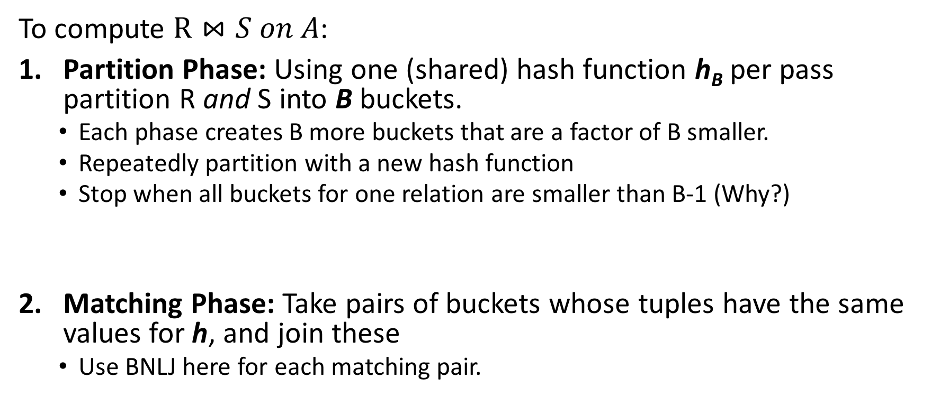
Hash Join: High-level procedure
Lecture 15 > Section 2 > HJ
To compute $R⋈S on A$:
Partition Phase: Using one (shared) hash function h_{B} per pass partition R and S into B buckets.
Each phase creates B more buckets that are a factor of B smaller.
Repeatedly partition with a new hash function
Stop when all buckets for one relation are smaller than B-1 (Why?)
Matching Phase: Take pairs of buckets whose tuples have the same values for h, and join these
Use BNLJ here for each matching pair.
Each pass takes 2(P(R) + P(S))
P(R) + P(S) + OUT
We decompose the problem using h_{B}, then complete the join

Slide 16
Hash Join: High-level procedure
Lecture 15 > Section 2 > HJ
1. Partition Phase: Using one (shared) hash function h_{B}, partition R and S into B buckets
Disk
Disk
Note our new convention: pages each have two tuples (one per row)
(0,a)
(0,a)
(0,j)
R
(0,a)
(0,a)
(3,j)
(0,j)
(3,b)
R₁
h_{B}
R₂
(3,j)
(3,b)
S
(0,a)
(0,j)
(5,b)
S₁
(0,a)
(0,j)
S₂
(5,b)
(5,b)

Slide 17
Hash Join: High-level procedure
Lecture 15 > Section 2 > HJ
2. Matching Phase: Take pairs of buckets whose tuples have the same values for h_{B}, and join these
Disk
Disk
(0,a)
(0,a)
(0,j)
R
(0,a)
(0,a)
(3,j)
(0,j)
(3,b)
R₁
h_{B}
Join matching buckets
R₂
(3,j)
(3,b)
S
(0,a)
(0,j)
(5,b)
S₁
(0,a)
(0,j)
S₂
(5,b)
(5,b)

Slide 18
Hash Join: High-level procedure
Lecture 15 > Section 2 > HJ
2. Matching Phase: Take pairs of buckets whose tuples have the same values for h_{B}, and join these
Disk
Disk
(0,a)
(0,a)
(0,j)
R
(0,a)
(0,a)
(3,j)
(0,j)
(3,b)
R₁
h_{B}
(3,j)
(3,b)
Don’t have to join the others! E.g. these!
R₂
S
(0,a)
(0,j)
(5,b)
S₁
(0,a)
(0,j)
S₂
(5,b)
(5,b)

Slide 19
Bonus questions #2
Q1: Fast little dog.
If min {P(R), P(S)} < B² then HJ takes 3(P(R) + P(S)) + OUT
What is the similar condition to obtain 5(P(R) + P(S)) + OUT?
What is the condition for (2k+1)(P(R) + P(S)) + OUT
Q2: SMJ V. HJ
Under what conditions will HJ outperform SMJ?
Under what conditions will SMJ outperform SMJ?
Size of R, S and # of buffer pages
Discuss! And We’ll put up a google form.

Slide 20
Sort-Merge v. Hash Join
Lecture 15 > Section 3 > The Cage Match
Given enough memory, both SMJ and HJ have performance:
“Enough” memory =
SMJ: B² > max{P(R), P(S)}
HJ: B² > min{P(R), P(S)}
~3(P(R)+P(S)) + OUT
Hash Join superior if relation sizes differ greatly. Why?
Notes:
16

Slide 21
Further Comparisons of Hash and Sort Joins
Lecture 15 > Section 3 > The Cage Match
Hash Joins are highly parallelizable.
Sort-Merge less sensitive to data skew and result is sorted

Slide 22
Summary
Lecture 15 > Section 3 > The Cage Match
I will ask you to compute costs on the final and PS
Walk through the algorithms, you’ll be able to compute the costs!
Memory sizes key in hash versus sort join
Hash Join = Little dog (depends on smaller relation)
Skew is a major factor (more on PS)
Message: The database can compute IO costs, and these are different than a traditional system.

