Slide 1
Image Classification
CNN from Scratch vs. Transfer Learning (MobileNetV2)
CIFAR-10 Dataset
Kalil | Ironhack Data Science & ML Bootcamp
Notes:
Good [morning/afternoon]. Today I'll present my project on image classification using CIFAR-10. I built two models: a CNN from scratch, and a transfer learning model using MobileNetV2, then compared them.

Slide 2
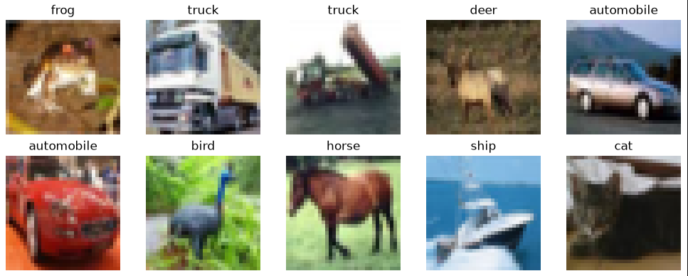
The Dataset: CIFAR-10
60,000 color images, 32x32 pixels
10 classes, 6,000 images each
50,000 train / 10,000 test split
Sample images with their true labels
2
Notes:
CIFAR-10 has 60,000 small color images across 10 categories - things like airplane, cat, dog, ship, truck. Each image is only 32 by 32 pixels, which is quite small and low resolution. Here you can see some examples with their real labels, straight from the dataset.

Slide 3
Data Preprocessing
Normalization: pixel values rescaled from [0, 255] to [0, 1]
Labels flattened to a simple 1D array
For MobileNetV2: images resized to 96x96 (its minimum input size)
Why normalize? Large, inconsistent pixel values (0-255) make training slower and less stable. Scaling to 0-1 helps the model converge faster.
3
Notes:
Before training, I normalized the pixel values - they originally range from 0 to 255, and I scaled them down to 0 to 1. This helps the neural network train faster and more reliably. Later, for the transfer learning model, I also had to resize the images up to 96 by 96 pixels, because MobileNetV2 requires a minimum input size.

Slide 4
Model 1: CNN from Scratch — Architecture
Layer | Output Shape | Params
Conv2D (32 filters, 3x3) | 32 x 32 x 32 | 896
MaxPooling2D (2x2) | 16 x 16 x 32 | 0
Conv2D (64 filters, 3x3) | 16 x 16 x 64 | 18,496
MaxPooling2D (2x2) | 8 x 8 x 64 | 0
Flatten | 4,096 | 0
Dense (64, relu) | 64 | 262,208
Dense (10, softmax) | 10 | 650
Total params: 282,250
All trainable — learns everything from scratch
Optimizer: Adam
Loss: sparse categorical crossentropy
EarlyStopping (patience=3) to avoid overfitting
4
Notes:
The first model is a CNN I built from scratch. It has two convolutional layers, each followed by a pooling layer, then dense layers at the end. Convolutional layers work like filters that slide across the image looking for patterns - edges, textures, shapes. Pooling layers reduce the image size, keeping only the strongest signal. In total, this model has about 282 thousand trainable parameters, all learned from scratch. I used the Adam optimizer and early stopping to avoid overfitting.

Slide 5
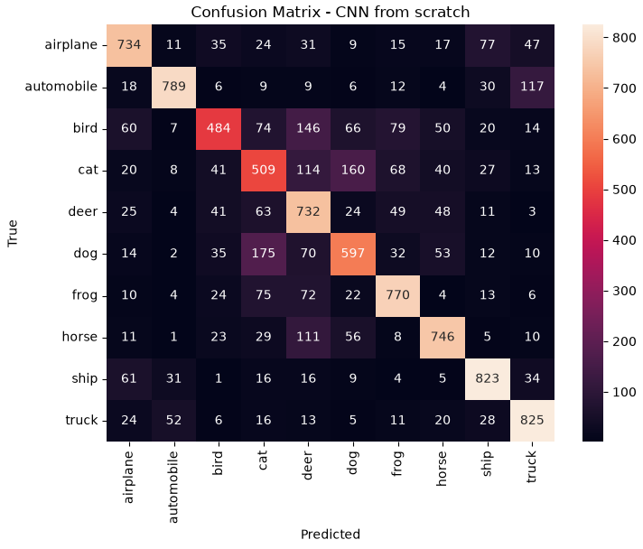
Model 1: CNN from Scratch — Results
Test Accuracy: 70%
Best classes: automobile (0.83), ship (0.80), truck (0.79)
Weakest classes: cat (0.51), bird (0.57), dog (0.61)
Signs of overfitting after ~epoch 9-11 (train accuracy kept rising, val loss increased)
5
Notes:
This is the confusion matrix for the CNN from scratch. The model reached 70% accuracy on the test set. It performs best on vehicles - automobile, ship, truck - probably because they have more rigid, consistent shapes. It struggles most with animals like cat, bird and dog, which have much more variable poses and shapes, so they're easier to confuse with each other. You can see that clearly in the matrix: cat and dog get confused with each other a lot.

Slide 6
Model 2: Transfer Learning (MobileNetV2)
Idea: reuse a model already trained on ImageNet (1.4M images, 1000 classes)
The pretrained base already knows general visual features: edges, textures, shapes
We freeze the base (its weights don't change) and train only a small new layer on top
 | Parameters
MobileNetV2 base (frozen) | 2,257,984 — not trained
New classification head (trained) | 12,810 — trained
Total | 2,270,794
Only 0.56% of the total parameters are actually trained — everything else is reused knowledge.
6
Notes:
For the second model, instead of learning from scratch, I used transfer learning with MobileNetV2 - a model already pretrained on ImageNet, a huge dataset with over a million images. The idea is that this model already learned general visual patterns, so I freeze all of its weights - meaning they don't change during training - and I only add and train a small new layer on top, specific to our 10 classes. As you can see, out of about 2.27 million total parameters, only 12,810 are actually trained. Everything else is reused knowledge.

Slide 7
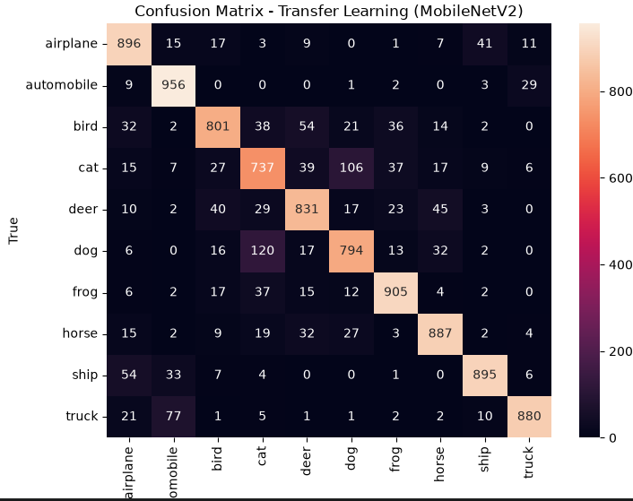
Model 2: Transfer Learning — Results
Test Accuracy: 86%
85% validation accuracy after just 1 epoch
Big improvement on the CNN's weakest classes: bird (0.57 -> 0.83), cat (0.51 -> 0.73), dog (0.61 -> 0.80)
cat/dog confusion nearly cut in half compared to the CNN from scratch
7
Notes:
The transfer learning model reached 86% accuracy on the test set, well above the 70% from the CNN from scratch. It also converged extremely fast - 85% validation accuracy after just the first epoch. The biggest gains were exactly on the classes the first model struggled with the most: bird, cat, and dog. That makes sense - the pretrained features already capture general shapes and textures well, which helps most with these harder, more visually varied classes.

Slide 8
Comparison & Trade-offs
Metric | CNN from Scratch | Transfer Learning
Test Accuracy | 70% | 86%
Trainable Parameters | 282,250 | 12,810
Epochs to Converge | ~9-11 | 1-3
Weakest Classes (f1) | cat 0.51, bird 0.57 | cat 0.73, bird 0.83
Transfer learning wins on accuracy and speed, by reusing features learned from millions of ImageNet images.
Trade-off: it requires resizing images to a larger input (96x96 min), adding preprocessing cost, and depends on an external pretrained model.
The CNN from scratch is simpler and self-contained, but needs more data/epochs to reach a similar level, and still underperforms.
8
Notes:
To summarize: transfer learning clearly outperformed the CNN from scratch, both in accuracy - 86% versus 70% - and in how fast it converged. It achieved this while training far fewer parameters, because it reuses knowledge already learned from ImageNet. The trade-off is that it needs larger images as input, so there's extra preprocessing cost, and it depends on an external pretrained model rather than learning purely from our own data. The CNN from scratch is simpler and fully self-contained, but needs more training time and still falls short in accuracy.

Slide 9
Key Takeaways
Transfer learning (MobileNetV2) significantly outperformed the CNN from scratch: 86% vs 70% accuracy.
It converged much faster, needing only a handful of epochs instead of ~10+.
Pretrained features help most on visually variable classes (animals), less on already-easy classes (vehicles).
For small, low-resolution datasets like CIFAR-10, transfer learning is a strong default choice.
Thank you
9
Notes:
To wrap up: transfer learning clearly outperformed building a CNN from scratch on this task, both in final accuracy and in training speed. The improvement was strongest on the classes that were hardest for the simple model - mostly animals with variable poses. My main conclusion is that for small datasets like CIFAR-10, transfer learning is a strong, efficient default choice. Thank you.

