Slide 1

Real-Time Maximum Power Point Tracking (MPPT) of a Photovoltaic System Using Perturb & Observe Algorithm
Presented by
Habib Saadallah
Supervised by
Dr Adel Khedher

Slide 2

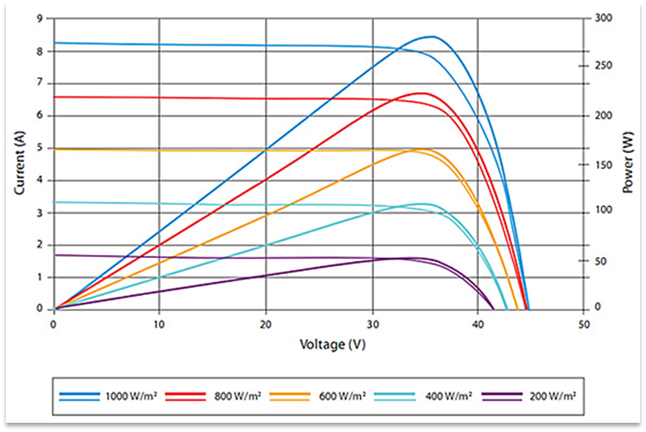
Table of Content
Introduction to PV Systems
Single-Diode PV Model
Maximum Power Point Tracking
Results and Analysis

Slide 3

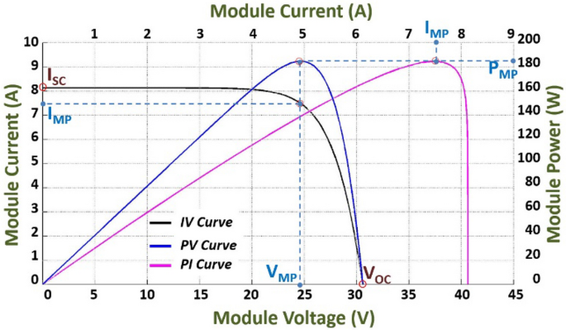


Introduction to PV Systems
Solar Photovoltaic Systems
Convert light directly into electricity through photovoltaic effect
MPPT Importance
Extracts maximum power from PV modules under varying conditions
Key Challenges
• Variable irradiance
• Temperature fluctuations
• Non-linear I-V characteristics
• Partial shading effects

Slide 4

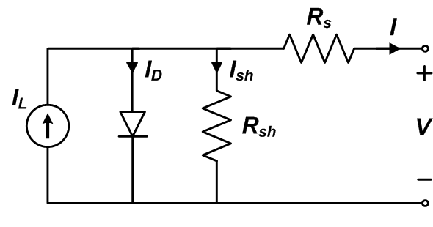


Single-Diode PV Model
Equivalent Circuit
• Current source (Iph) for photocurrent
• Diode representing p-n junction
• Series resistance (Rs)
• Shunt resistance (Rsh)
Mathematical Model
I = Iph - I0[exp(q(V+IRs)/(AkT)) - 1] - (V+IRs)/Rsh
Key Parameters
Isc: Short circuit current
Voc: Open circuit voltage
Imp: Current at max power
Vmp: Voltage at max power
Ns: Number of cells in series
Ki, Kv: Temperature coefficients

Slide 5
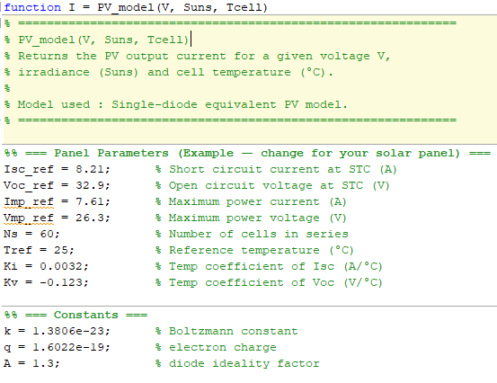
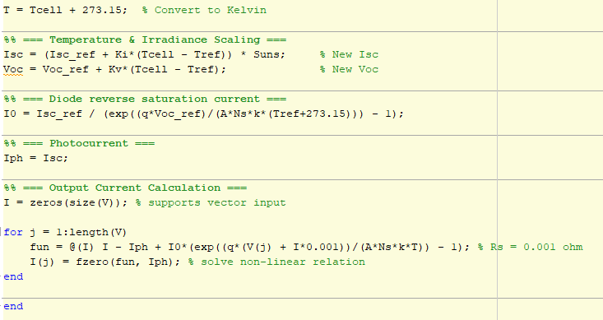
PV_model Function Implementation

Slide 6

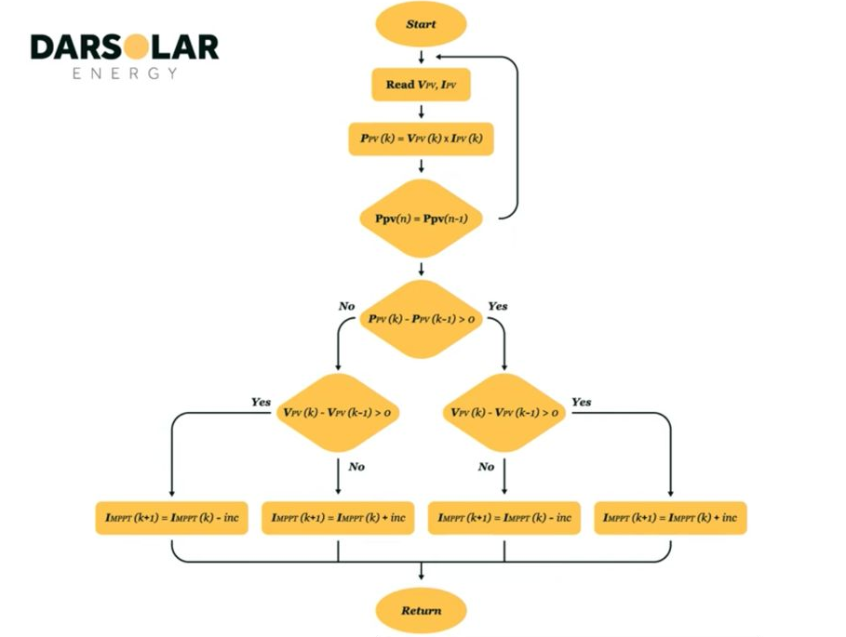



Maximum Power Point Tracking (MPPT)
MPPT Importance
• Extracts maximum power from PV modules
• Adapts to changing environmental conditions
• Increases system efficiency by 20-30%
Common MPPT Techniques
Perturb & Observe (P&O)
Incremental Conductance (IC)
Fuzzy Logic Control
Neural Networks
Perturb & Observe Algorithm
1
Measure PV voltage (V) and current (I)
2
Calculate power (P = V × I)
3
Compare with previous power value
4
Adjust voltage reference based on power change

Slide 7
Real-Time MPPT Implementation
Case | ΔV | ΔP | ΔP/ΔV | Voltage Control Action
1 | + | + | + | Increase V by ΔV
2 | - | - | + | Increase V by ΔV
3 | - | + | - | Decrease V by ΔV
4 | + | - | - | Decrease V by ΔV

Slide 8
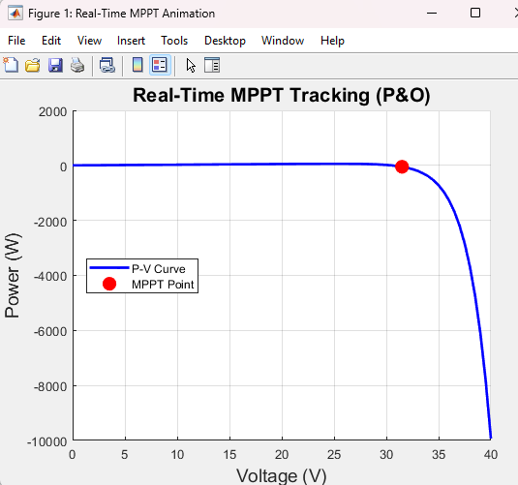
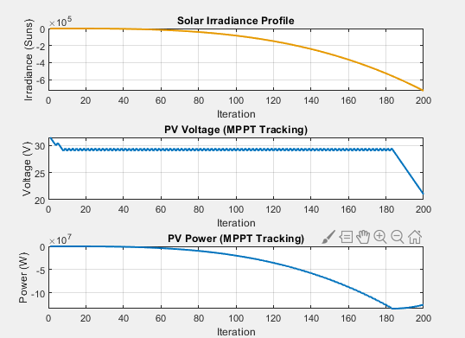
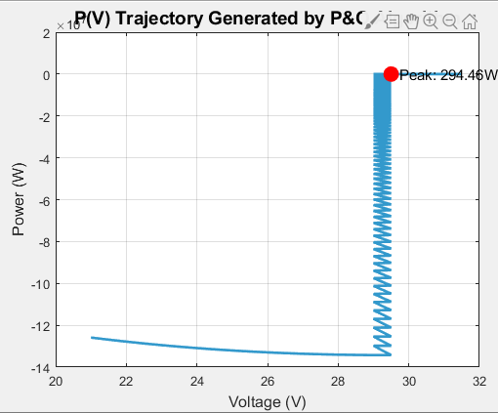
Results and Analysis
Key Parameters
C = 0.5
TaC = 25°C
Va = 31V
Rs = 0.001Ω

