Slide 1

ANAHTAR TAKİP SİSTEMİ Versiyon 1.0 Hüseyincan KAYNAK Utku Gökberk ŞEN Nisa TUNCER

Slide 2
Genel Tasarım

Slide 3
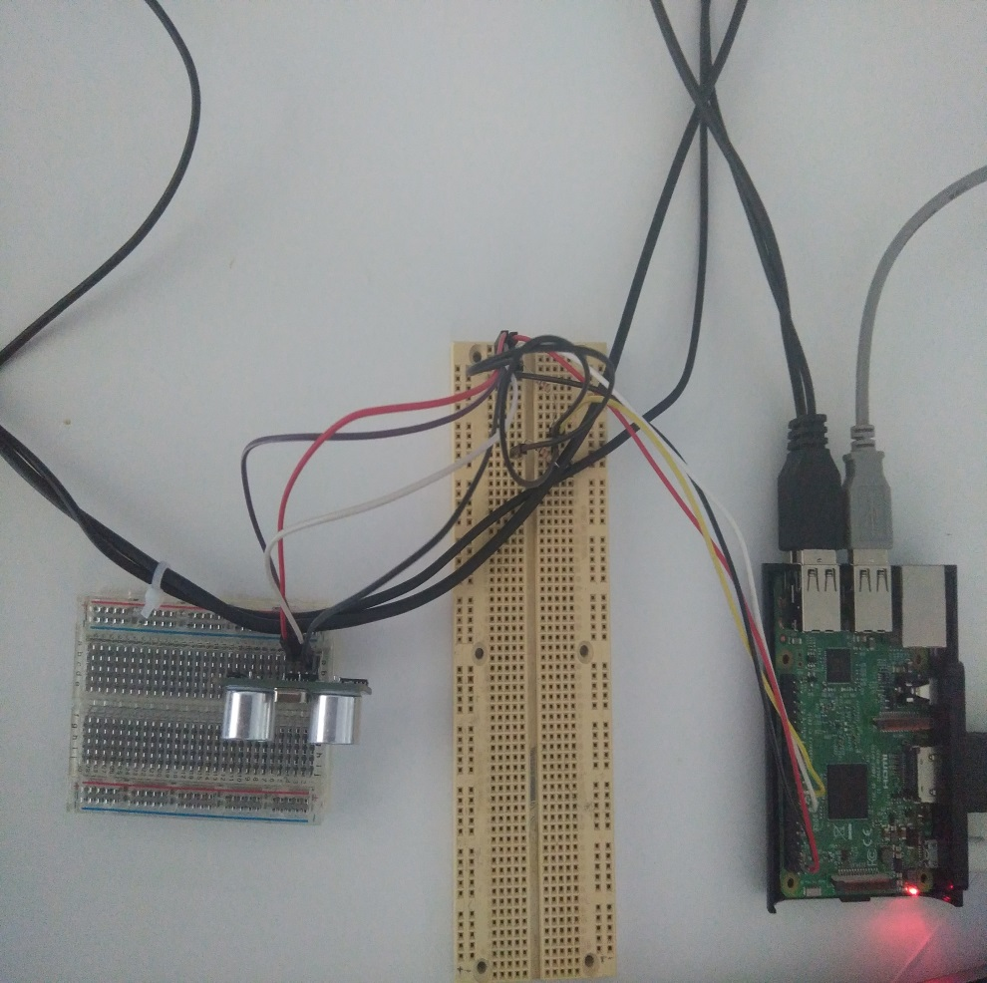
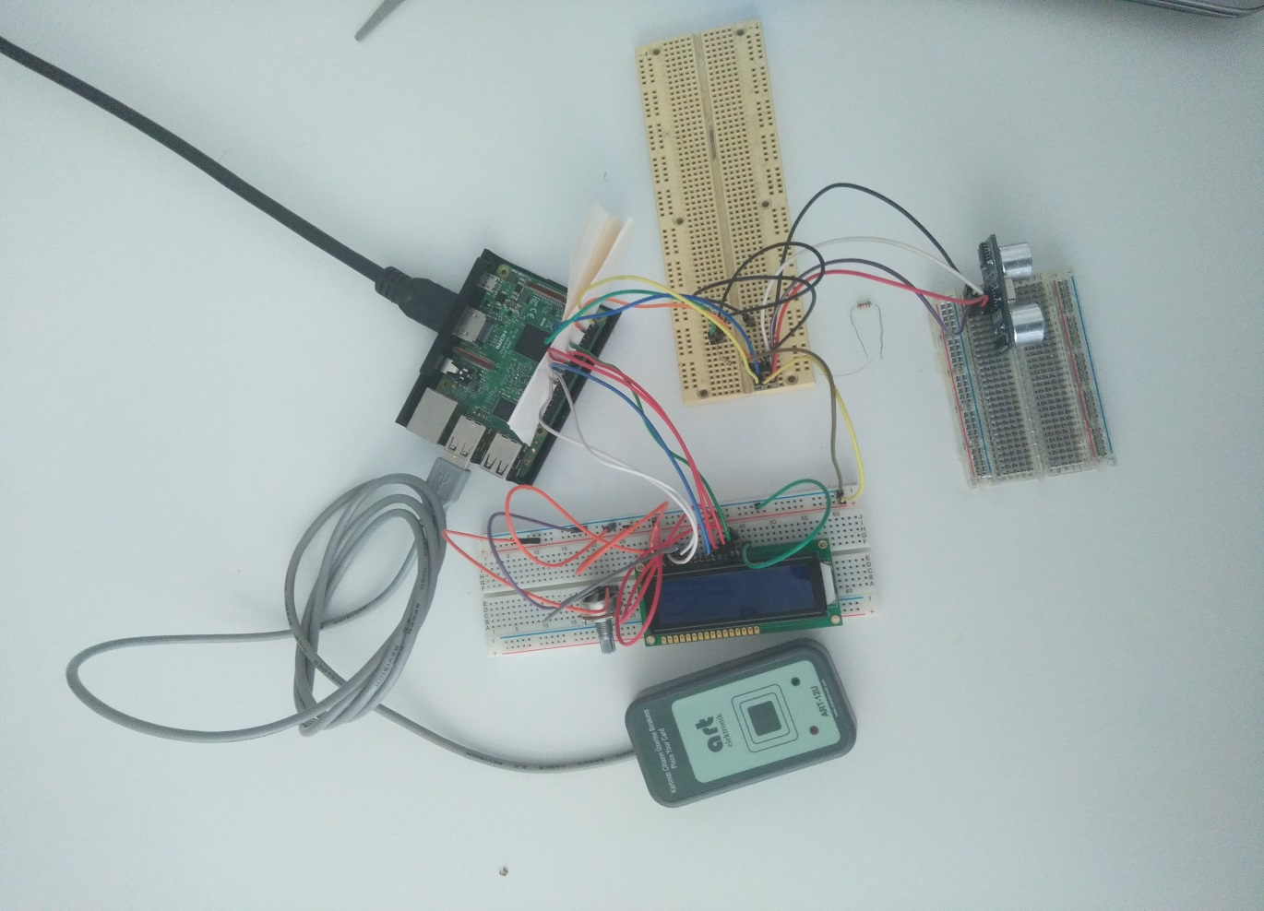
Fiziksel Tasarım

Slide 4
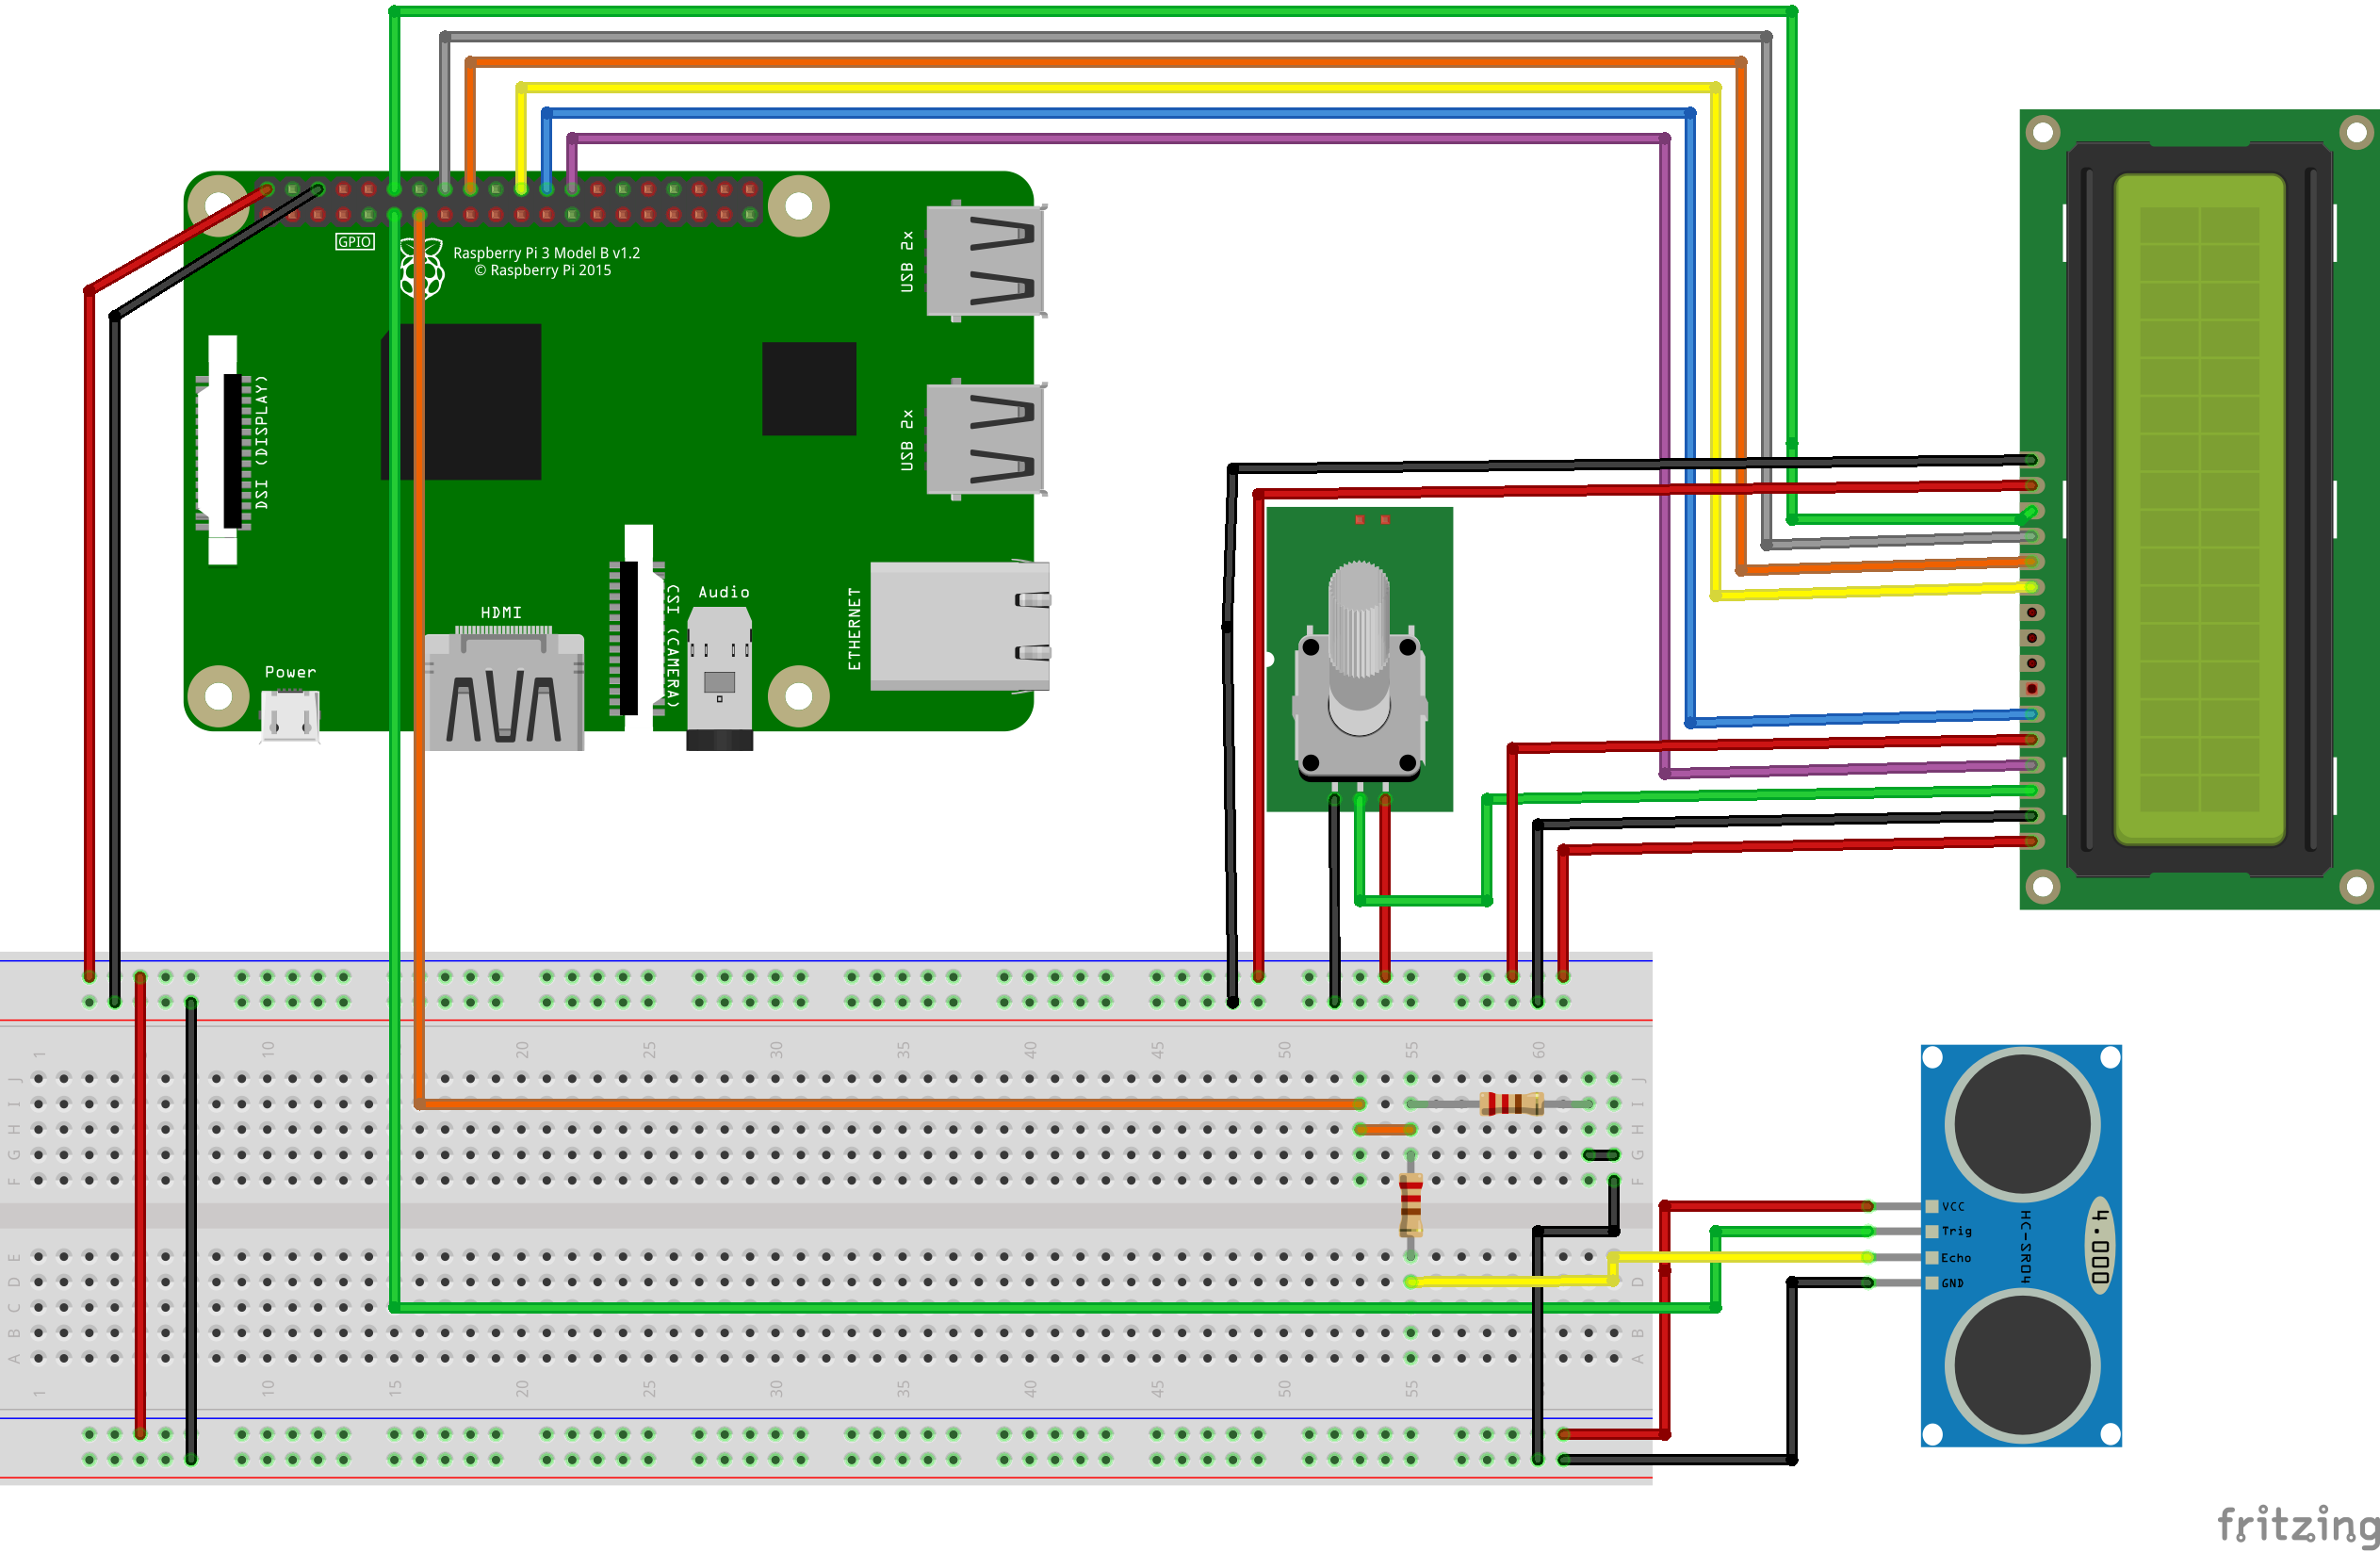
Devre Şeması

Slide 5
Alt Sistemler

Slide 6
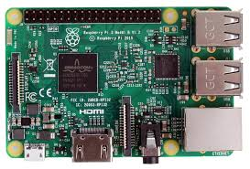
Raspberry Pi 3

Slide 7
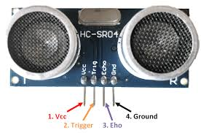
Sensör Altsisteminin Tasarımı
HC-SR 04 SENSÖR
2 cm- 400 cm non-contact measurement
Accuracy upto 3 mm
Test dşstance=(High level time*velacity of sound/2)
5 V supply
Trigger Pulse Input
Echo Pulse Output
0 V ground

Slide 8
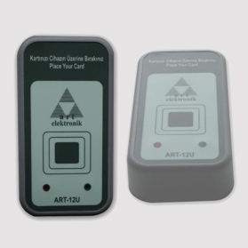
RFID
Standart USB haberleşmesi, windows işletim sistemi için yazılımsal klavye emülasyonu çalışma modları desteği ile desktop uygulamaları için tasarlanmış online bir kart okuyucudur

Slide 9
LCD
9 Way D-type Plug
16 character, 2-line alphanumeric LCD display
9 Screw terminal
Contrast Control.

Slide 10
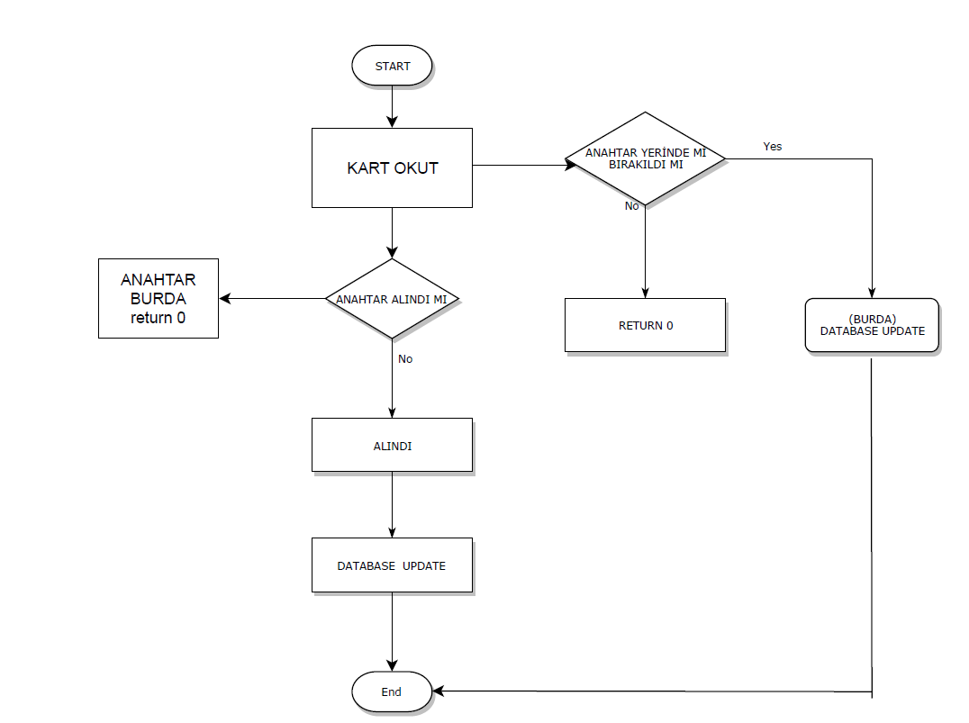
Yazılım Tasarımı
AKIŞ ŞEMASI

Slide 11
DATABASE DESIGN
MARİA DB
MariaDB Server is one of the most popular database servers in the world. It’s made by the original developers of MySQL and guaranteed to stay open source. Notable users include Wikipedia, WordPress.com and Google.
MariaDB turns data into structured information in a wide array of applications, ranging from banking to websites. It is an enhanced, drop-in replacement for MySQL. MariaDB is used because it is fast, scalable and robust, with a rich ecosystem of storage engines, plugins and many other tools make it very versatile for a wide variety of use cases.
MariaDB is developed as open source software and as a relational database it provides an SQL interface for accessing data. The latest versions of MariaDB also include GIS and JSON features.

Slide 12
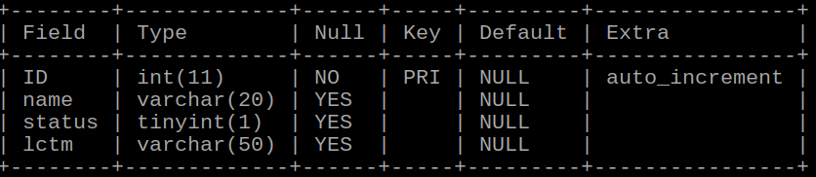
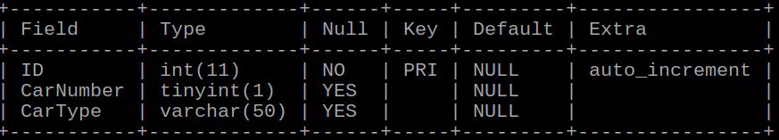
DATABASE DESIGN
AnahtarKontrol Table:
CarModels Table:

Slide 13
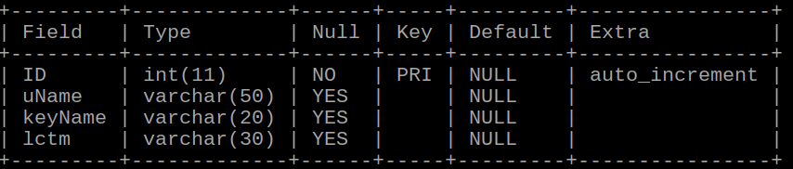

DATABASE DESIGN
GivenCarLog Table:
RealCarLog Table:

Slide 14
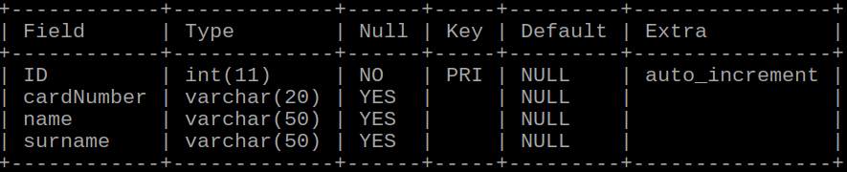
DATABASE DESIGN
Employees Table:

Slide 15
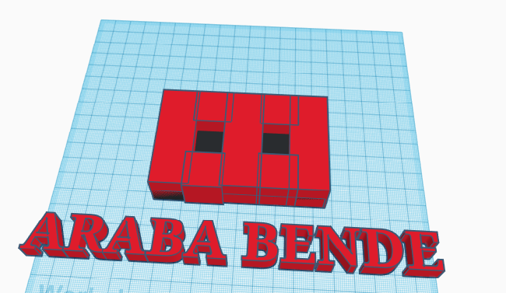
Mekanik Sistemin Tasarımı

Slide 16
KAYNAK
https://github.com/Hcankaynak/Araba-Anahtar-Kontrol-Sistemi sitesinde kaynak kodlara ulaşabilirsiniz.

