Slide 1
Diploma Web Application Development: Introduction
ICT50220 Diploma of Information Technology(Front-End Web Development)
Code | Title
ICTWEB517 | Create web-based programs
ICTWEB546 | Validate application design against specifications

Slide 2
Web Application Development & HTTP
Start by pulling down the latest class code from GitHub

Slide 3
Activity 1 – Set up Postman

Slide 4
The NASA API
Navigate to the NASA API Portal:
Go to the NASA API Portal in a web browser.
Register for an API Key:
Click on the "Get Started" or "Sign Up" button.
Fill in the required details (name, email, etc.).
Agree to the terms and conditions.
Submit the registration form.
Check your email for the API key and confirmation.

Slide 5
What is HTTP
HTTP (Hypertext Transfer Protocol) is the foundation of data communication on the web.
HTTP is a stateless protocol, meaning each request is independent.

Slide 6
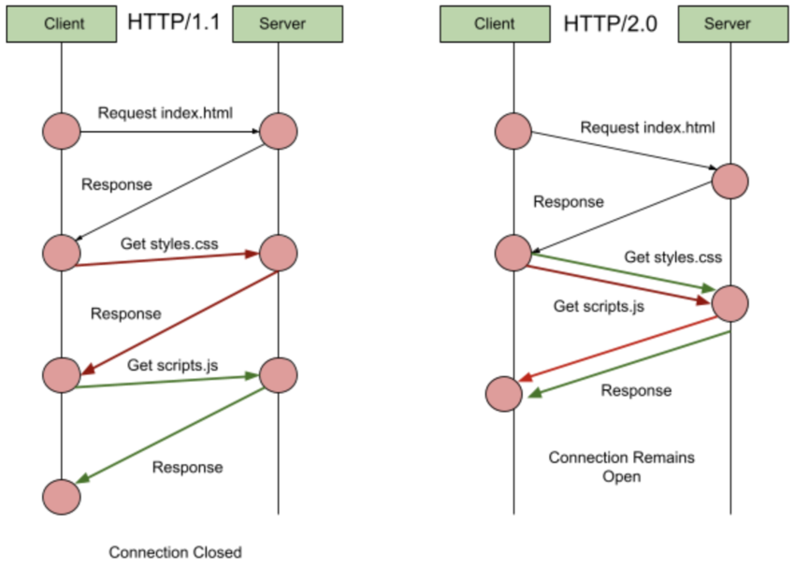
HTTP 1 vs 2
with HTTP 2 & 3 we can run multiple streams of data within one connection
the streams can run in both directions
https://code.tutsplus.com/http-the-protocol-every-web-developer-must-know-part-1--net-31177t

Slide 7
URI/URL
Uniform Resource Identifier: A generic term for all types of names and addresses.
Uniform Resource Locator: A specific type of URI that includes location information.
Components of a URL: scheme, host, path, query & fragment.
Notes:
Scheme: https — This indicates the protocol used to access the resource.
Host: api.nasa.gov — This is the domain name of the server hosting the resource.
Path: /planetary/apod — This specifies the location of the resource on the server.
Query: api_key=API_KEY — This is the query string used to pass parameters to the server.
Fragment: (none present in this URL) — A fragment would follow a # symbol, but this URL doesn’t include one.

Slide 8
Making a GET HTTP Request to API
Open/Download Postman
Inspect the NASA Api Docs
https://api.nasa.gov/#browseAPI
Add your NASA Api key to the following URL query
https://api.nasa.gov/planetary/apod?api_key=API_KEY
Paste the URL into a GET request in Postman

Slide 9
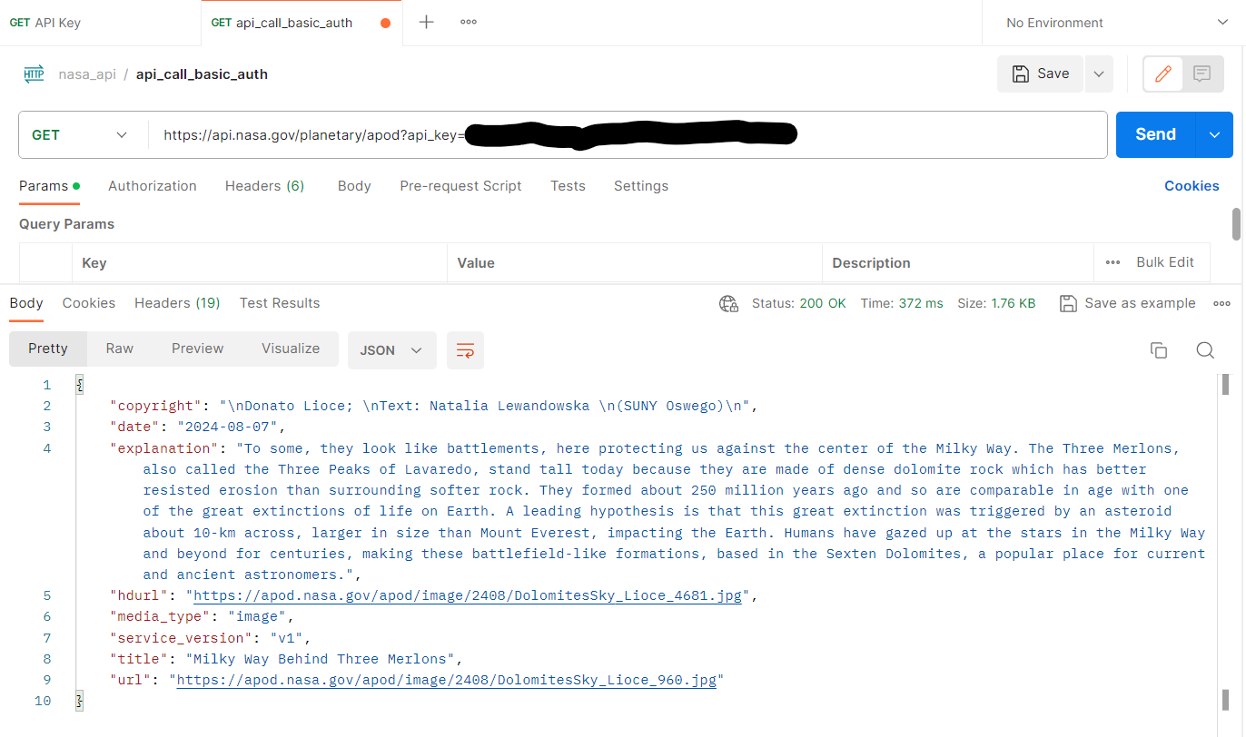
Calling the API

Slide 10
Constructing the URL
Using the API Docs add the following parameters:
start_date
end_date
count
date
Consider the 2-dimensional nature of the data you are receiving in the response.

Slide 11
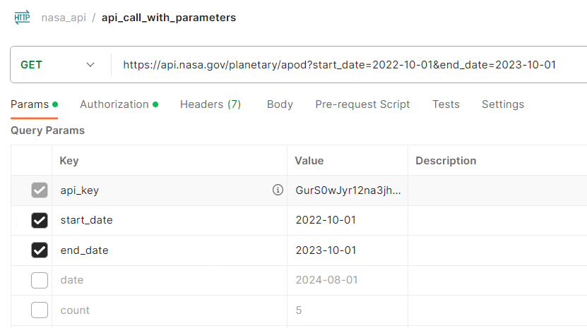
Adding parameters

Slide 12
Headers
Headers provide metadata about the request or response.
This can include:
server settings,
information on usage
cached/stored data to make content delivery faster
custom headers to transmit application specific information

Slide 13
Common HTTP Headers
Content-Type : type of the resource or the data being sent to the
Content-Type: application
Authorization: contains the credentials to authenticate a user (e.g. API Key)
Authorization: Bearer <token>
Accept: Lets the server know what types of data the client can process.
Accept: application/json
Cache-Control: caching information in requests and response for prompt delivery
Cache-Control: no-cache
Referer: Contains the address of the previous web page
Referer: https://example.com

Slide 14
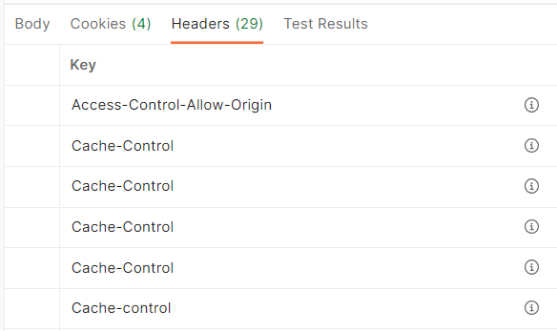
Request & Responses
Let's looks at two requests in Postman:
https://api.nasa.gov/planetary/apod
https://blackboard.northmetrotafe.wa.edu.au/
Review the headers using Postman i icon
Can you see the cookies saved in your browser's local storage?

Slide 15
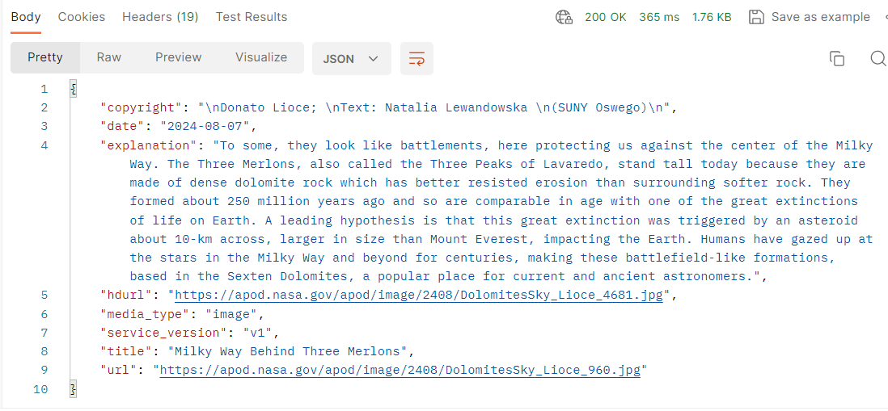
Status Codes
Responses provide a:
status line with the code
headers as we discussed
body containing your data/message

Slide 16
Status Codes Ranges
Status codes indicate the result of the request.
1xx - Informational only
2xx - Successful response
3xx - Redirection to another URI/URL
4xx - Client Errors - front end errors
5xx - Server Errors - backend errors
https://developer.mozilla.org/en-US/docs/Web/HTTP/Status

Slide 17
Request & Methods
There are several different methods however the most common relate to CRUD activities
GET: Retrieve data.
POST: Send data to the server.
PUT: Update existing data.
DELETE: Remove data.
This how we manipulate data in databases
CREATE
READ
UPDATE
DELETE

Slide 18
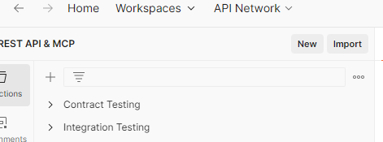
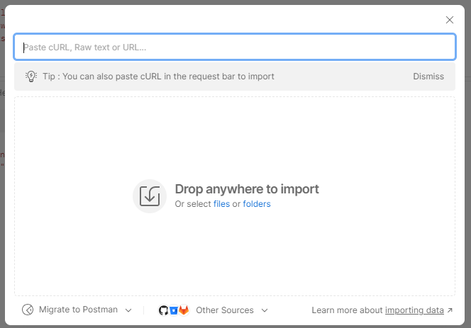
Testing HTTP Methods
Import the API collection & environment into Postman
Find the official Postman Documentation
Try the /auth/login request
Place your logins in the JSON body of the POST request
Notice how the server returned the successful request information

Slide 19
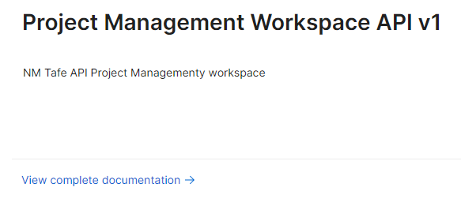
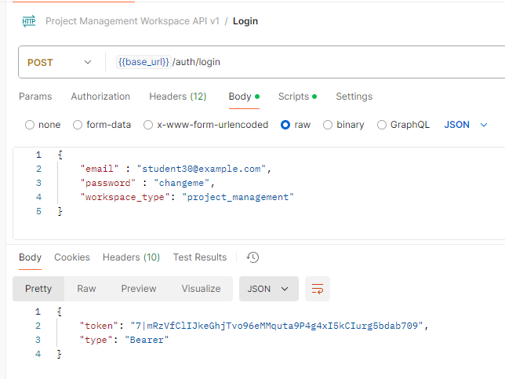
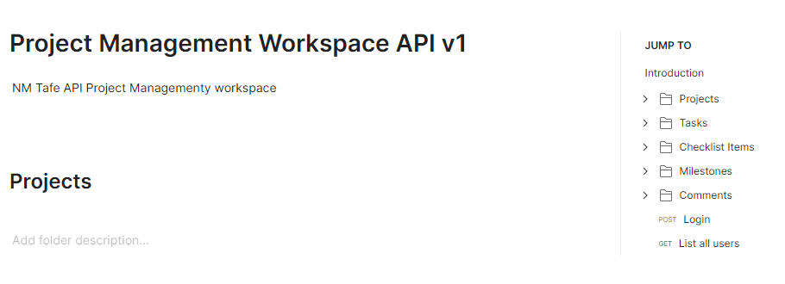
Working with our API

Slide 20
Testing HTTP Status Codes
Once you have your authentication token, go to the Projects routes
Add a parameter when listing Projects with the API
Add an incorrect authentication token key
Make a call to a Project route that doesn’t exist
Add an incorrectly form JSON to POST or PUT requests in the Project routes.
Remove some/all headers from a request

Slide 21



Decoupled Web Applications
Well-designed APIs include endpoints(routes to the data)
Secure Authentication methods like OAuth, API keys are used to protect API endpoints.
Proper handling of HTTP response statuses and errors for the user.
Caching strategies to reduce server load
// Our API endpoint
https://api.nasa.gov/planetary/apod

Slide 22
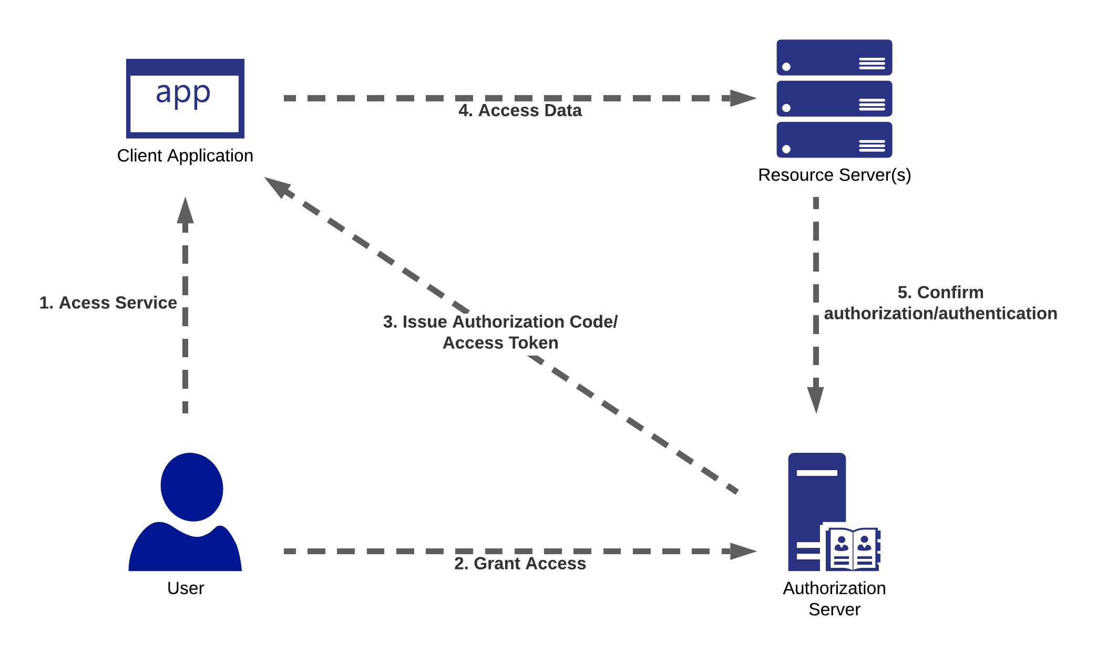
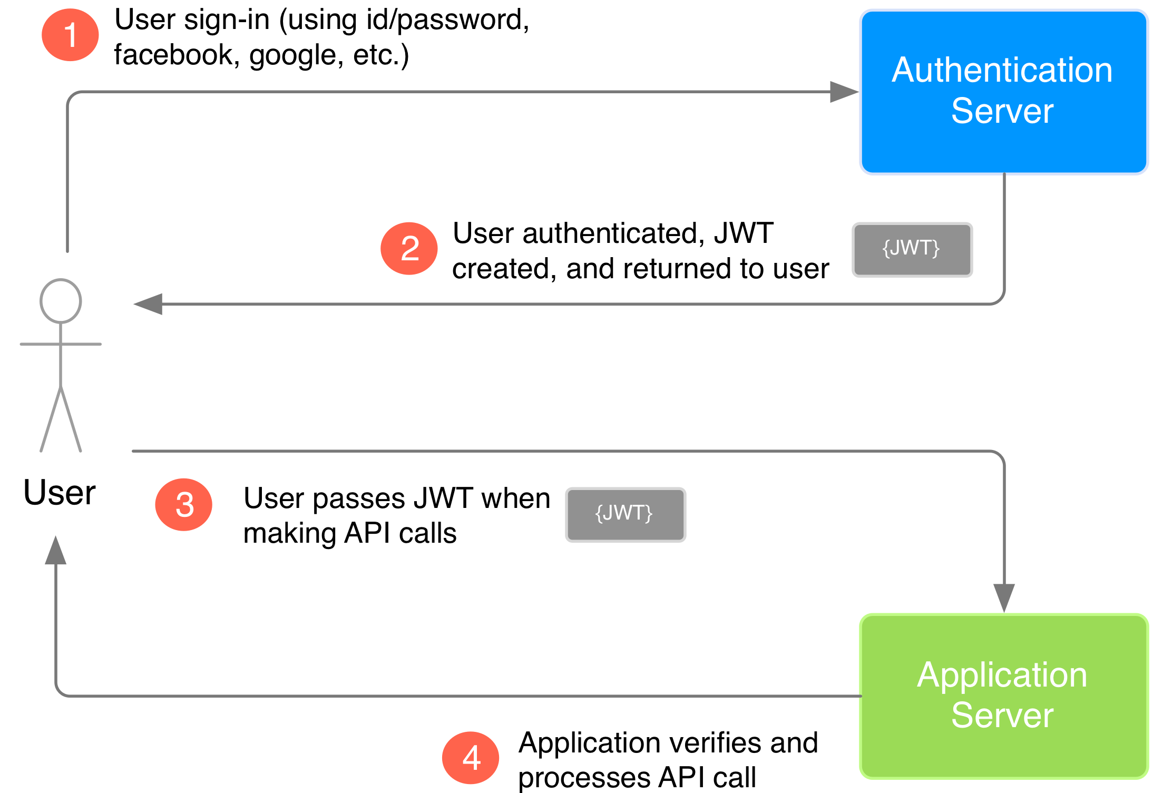
Authentication in Web Applications
O-Auth 2.0
JWT
https://securityboulevard.com/2021/04/common-rest-api-authentication-methods-explained/
https://morioh.com

Slide 23
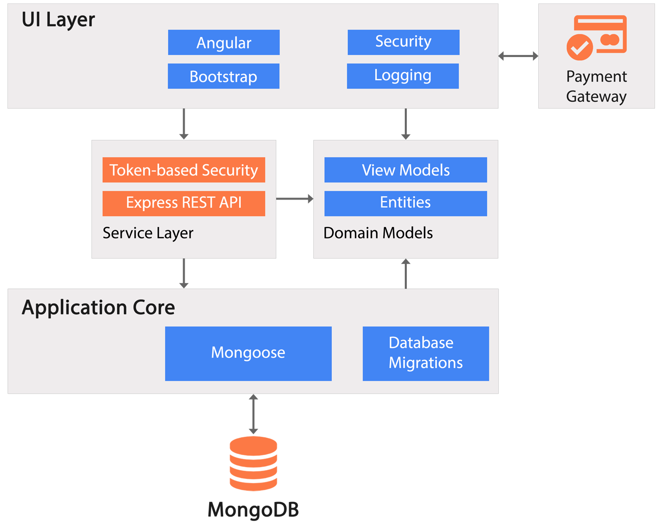
HTTP in Web Applications
Our font end code will need to:
authenticate using HTTP
handle errors using HTTP codes/response bodies
handle all status codes gracefully
be able to deal with changing complex objects
effectively cache(save) information to provide better user experience
https://www.dotnettricks.com/images/course/mean-stack-project-architecture.png

Slide 24

Challenges Using the NASA API

Slide 25
Challenge 1
1. check all the form fields to see which fields have data
2. add them to the apiURL as parameters
3. test the responses in the Network tab of your browser so they all have a status of 200
Hint: use concatenation

Slide 26
Challenge 2
1. add the following headers to your API call content type, user agent & cache control
2. set the cache control no cache
3. set the content type application/json
4. Test the responses in the Network tab of your browser so they all have a status of 200

Slide 27
Challenge 3
1. change the anonymous arrow function below to check if the response code is 200(ok)
2. if the response is ok return the response.json() object
3. if not ok throw a new error which includes the status code
4. Test the responses in the Network tab

Slide 28
Challenge 4
1.The code insert the data into the innerHTML but the code is repeated
2.Move the if/else if/else into a re-usable function ready for modularisation

Slide 29
Work on Assessment 1

Slide 30
🦆

