Slide 1
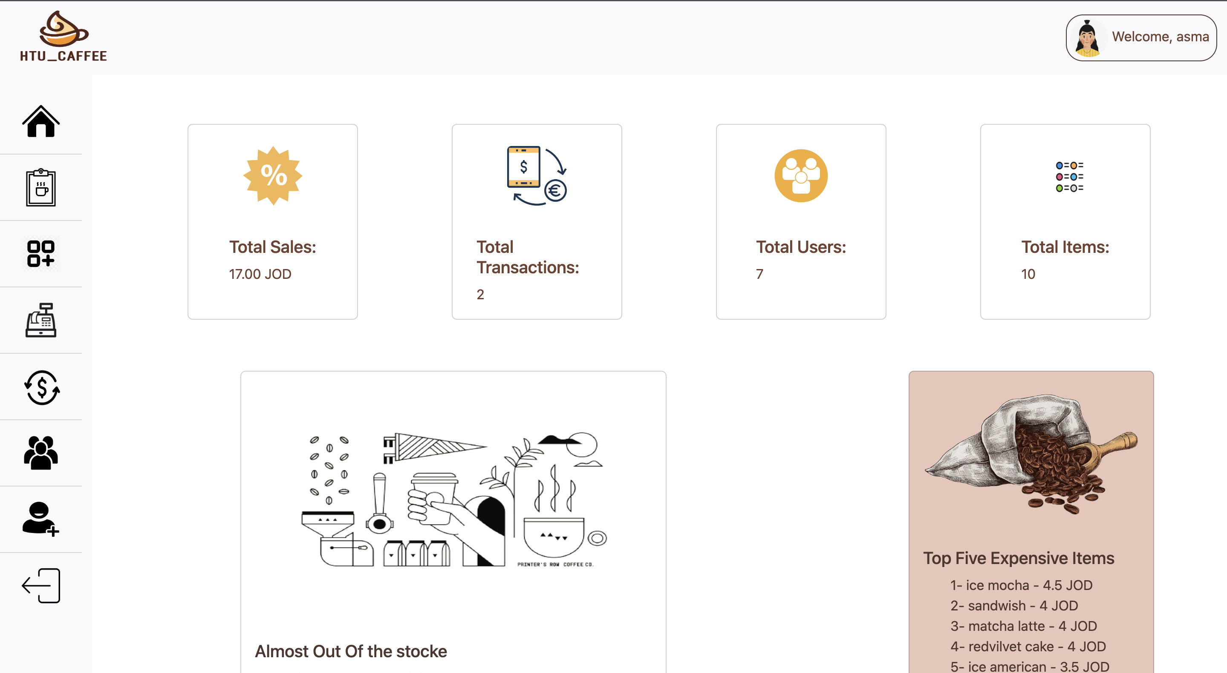
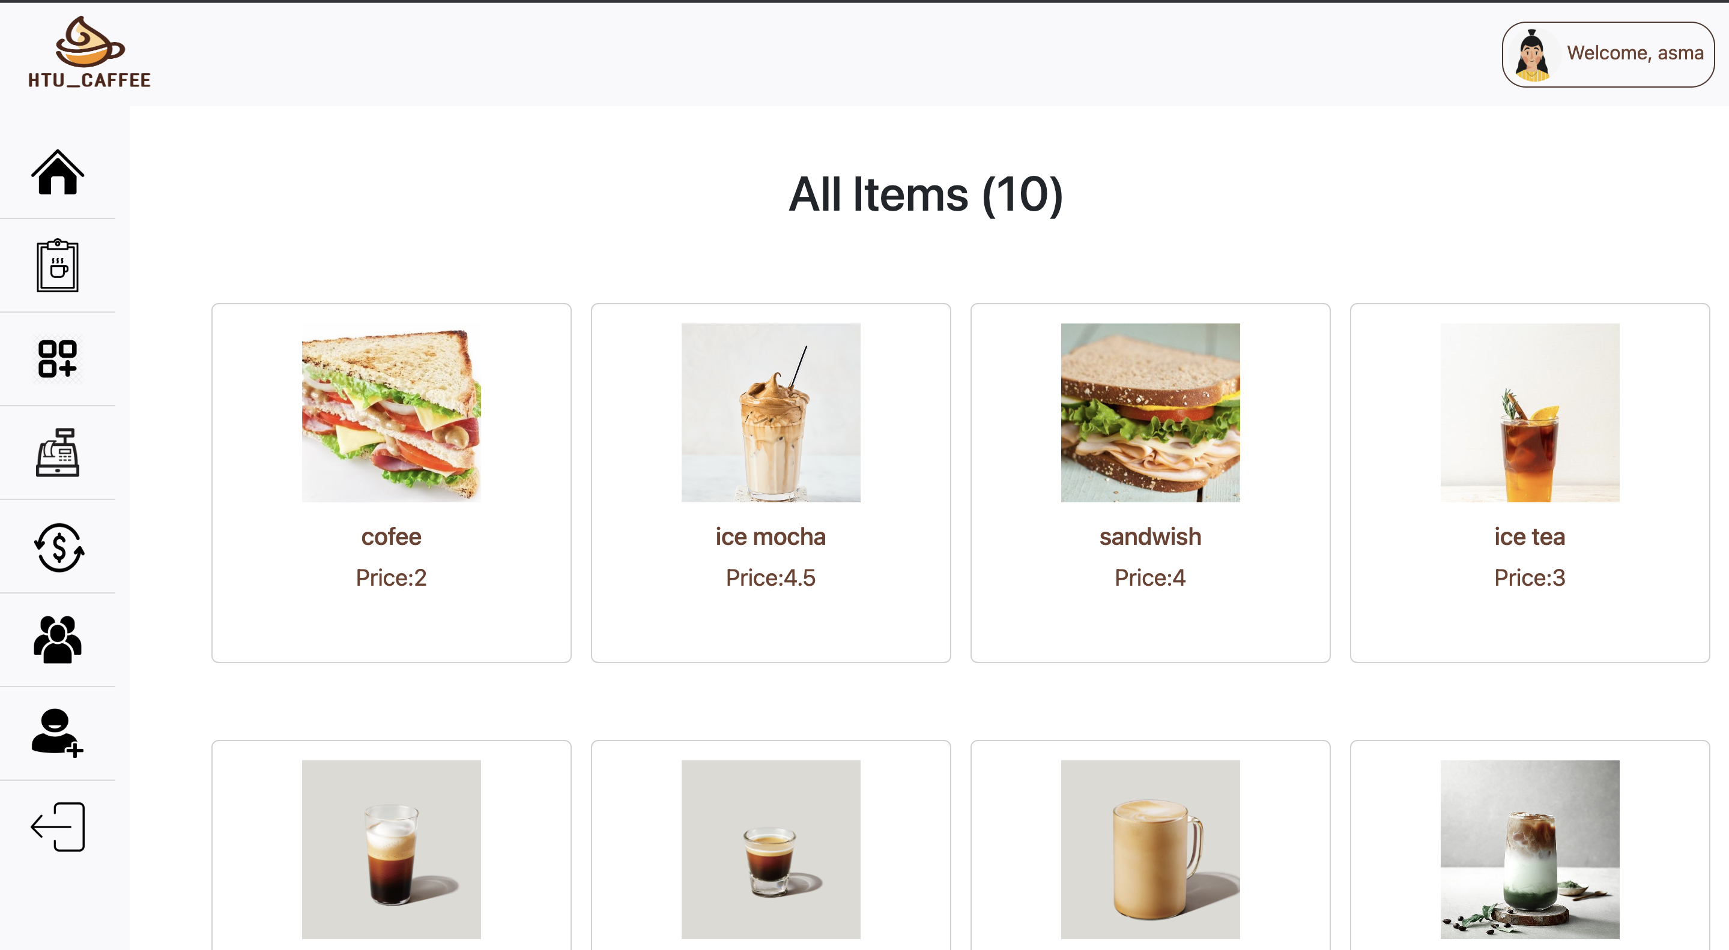
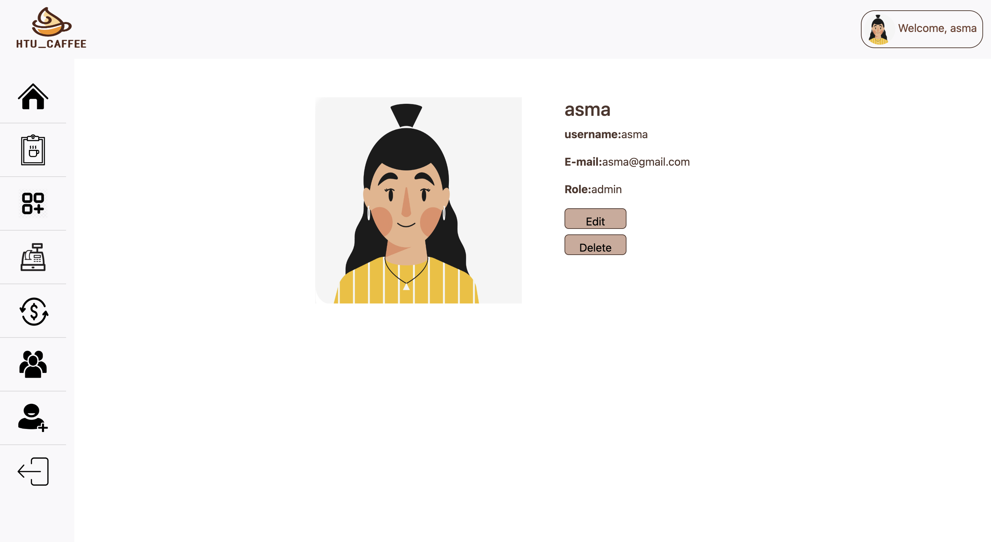
HTU-COFFEE

Slide 2
Table of contents
1
Problem statement
2
services
3
Our Aim
4
Implementation

Slide 3
Problem statement
Point of sale (POS) systems is used by businesses to process transactions with customers. POS systems typically include a computer, a cash register, and a payment terminal, and they are used to track sales, process payments, and manage inventory. In order to facilitate and streamline sales transactions and inventory management at the store located within King Abdullah Business Park, HTU has decided to implement a Point of Sale (POS) web application. With a diverse team of employees utilizing the system, the POS administrator requires immediate access to detailed information about total sales, specific transactions, and current stock levels for each item.

Slide 4
Our Aim
The aim of this project is to design and implement a Point of Sale (POS) web application that can effectively address the challenges faced by HTU in managing sales transactions and inventory at their retail store located within the King Abdullah Business Park. The POS web application should provide immediate access to detailed information about total sales, specific transactions, and current stock levels for each item in order to streamline the sales process and improve inventory management for the diverse team of employees.

Slide 5
Why HTU-CAFFEE?

Slide 6

Automated customer transactions processing and tracking sales data
Real-time data and performance analytics for store administrator
User-friendly and intuitive interface for employees to easily use the system.

Slide 7





Services
Add, edit, and delete items
Give the top five expensive items the items that are out of the stock
Add, edit, and delete users
Add, edit, and delete transactions
Give the total number of users, items, transactions, and sales.

Slide 8






Implementation
HTML
CSS
Bootstrap
JS
PHP
MYSQL

Slide 9
THANK YOU

