Slide 1
Salter And Smoother
CSV Result
Hieu Do

Slide 2
What output does
My output method is my plotter using the formula y = mx + b or in my case y = 2x + 1
It uses a writer to write into a CSV via a for loop starting from an inputted start -100 to 100
The loop goes all the way up to 100 every time y is calculated and then written alongside x to the csv
There also an interim or inter that decide the interval that the method will plot/write points into the CSV
The interim will automatically plot the very first point and the very last point

Slide 3
What Salter do
My salter method works by using a buffer reader to read each line into a string A then that String is split into an array B holding 2 that represent the x and y of the csv.
String C is called to to randomly generate a new Y value base on the range inputted. Finally string D is called to hold permanently hold everything since the previous strings are temporarily and gets overwritten every time a new line a read.
After that 2 writers are called to write all the data at once into the CSV the second writer writeSalt is there so that I have a second CSV, to view what the salted data looks like before the next method smoother is called

Slide 4
What Smoother does
The Smoother method is made up of multiple parts first a buffer reader is used to read and stored all the salted y values into an arraylist
The next part is similar to salter where there are 4 strings with String D being the one to hold all the final information for the CSV
The difference lies when we get to String C which is used to calculate and store the newY value In this case to figure out the position of our index for the inputted window Value. 3 int’s are use to count forward and backward and calculated current position. Stopping of course if there nothing beyond a certain point.
Double smooth is then called to hold the values of contained in those indexes and then to calculated the final value for the new Y after that the new Y is stored into the arraylist of Y where at the index it should be in
Finally like salter all of that is stored within String D which is then written a writer into the CSV

Slide 5
Result A1
For my graph I decide to start small using the values
Index: 0 to 100 Interval: 1
Range : 10
Window Value: 3
Result wise when all the data is plotted and put into a graph the result is pretty expected with the salted graph being very jagged spiking up and down from one point to another very randomly. With the smooth graph looking a lot more like the original graph but not quite the same

Slide 6
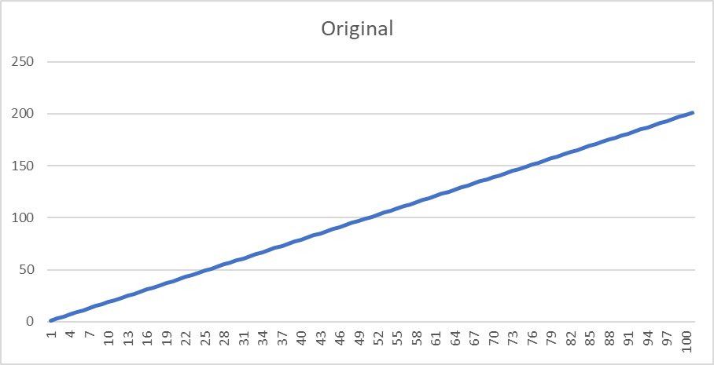
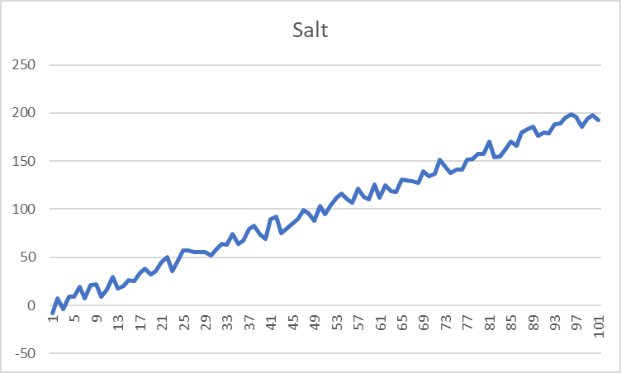
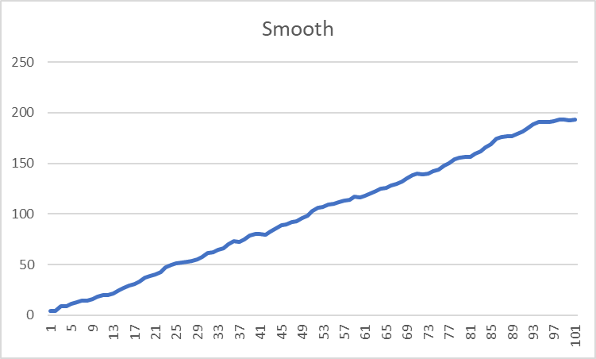
Index: 0 to 100 Interval: 1
Range : 10
Window Value: 3

Slide 7
Result A2
The following graph is made with the same setting as that in A1 however this time I smoothed the graph 2 times and then 3 times
Overall it seems that every time the data is smooth the graphs looks more and more like the original with less bumps and curves
Result are on the next slide with the 2nd time on the left
The 3rd smooth on the right

Slide 8
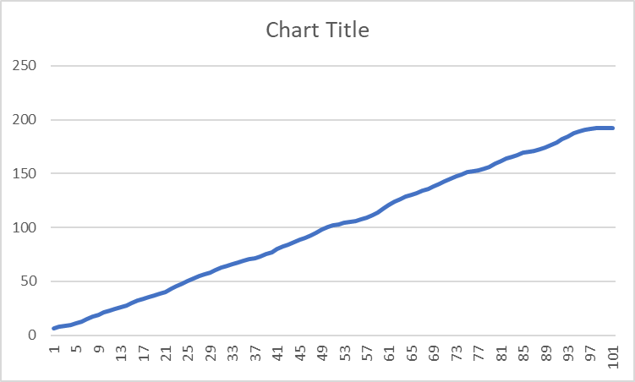
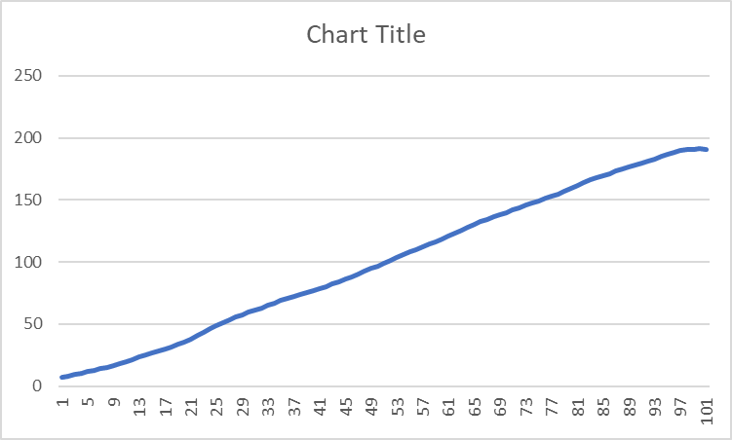

Slide 9
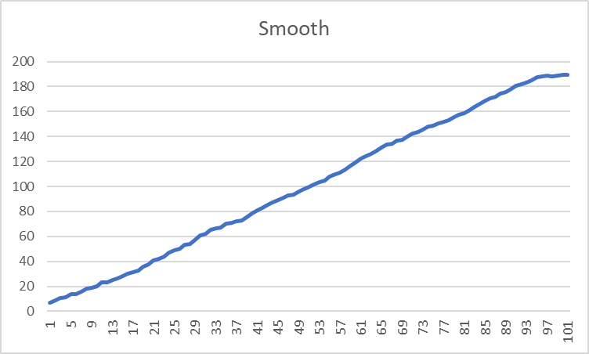
Result 3A
For my graph I decide to change the window value from 3 to 6
Index: 0 to 100 Interval: 1
Range : 10
Window Value: 6
When increasing the window value the graph
Becomes smoother after only a single smooth
Compared to before when the window value was 3
Top is when the window value was 3
Bottom is the current one

Slide 10
Result B1
For this graph the range was changed from 10 to 100
Index: 0 to 100 Interval: 1
Range : 100
Window Value: 3
So when the range change by a greater amount the graph gets even more chaotic spiking up and down even sharper than before. Even after 1 smooth the B1 smooth graph looks more like the salted graph from A1 than the smooth graph from A1.

Slide 11
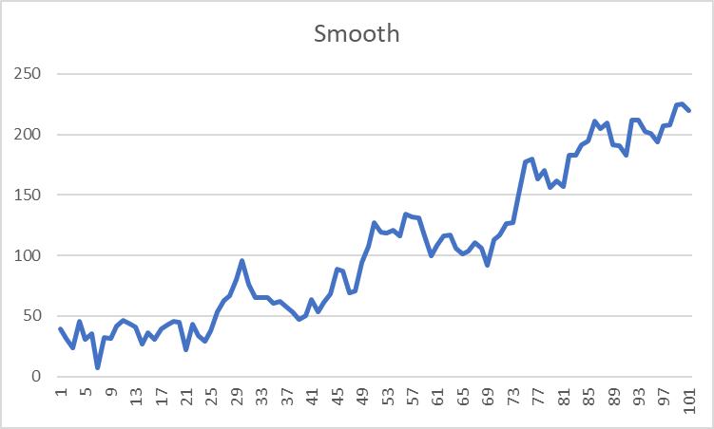
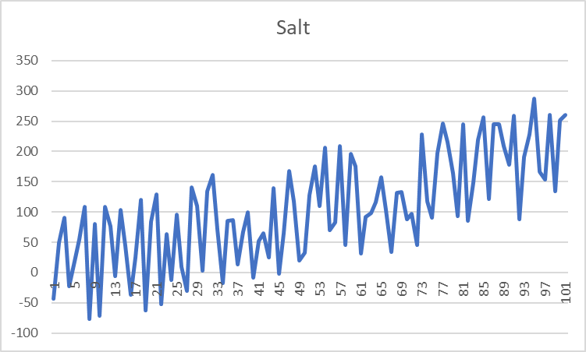

Slide 12
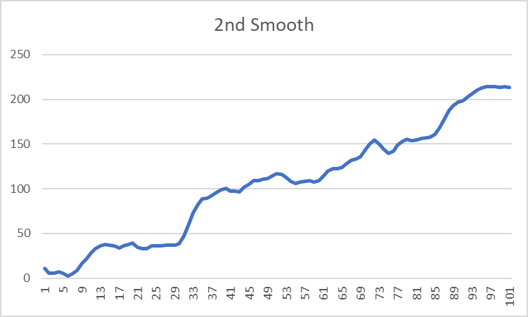
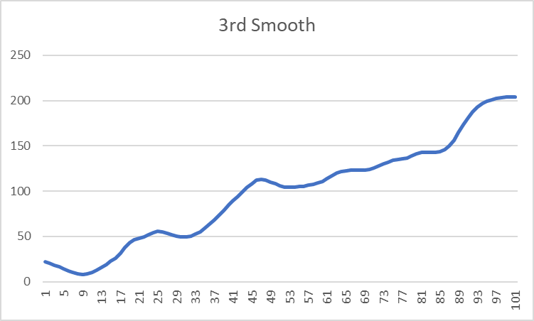

Slide 13
Result B2
For this graph the window value was changed from 3 to 9
Index: 0 to 100 Interval: 1
Range : 100
Window Value: 9
Since the range value remained the same as B1 the salted graph looks similar however the smoothed graph even after only a single smooth looks alot better than the smooth graph in B1.
Interestingly enough after a 2nd and then a 3rd smooth the graph starts looking more like an S shape compared to the second and 3rd smooth for the graphs for A
So changing the window value to a greater number smooth the graph better for bigger ranges but makes it looks a bit like an S curve

Slide 14
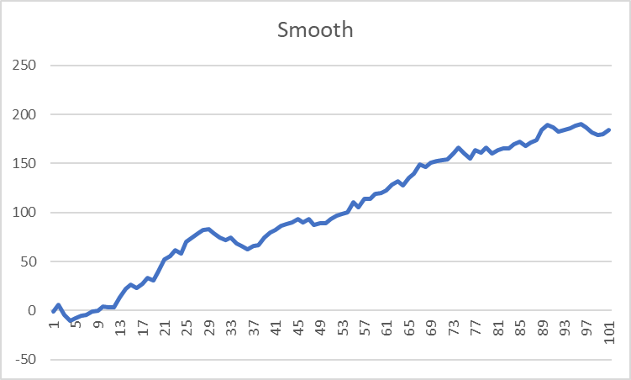
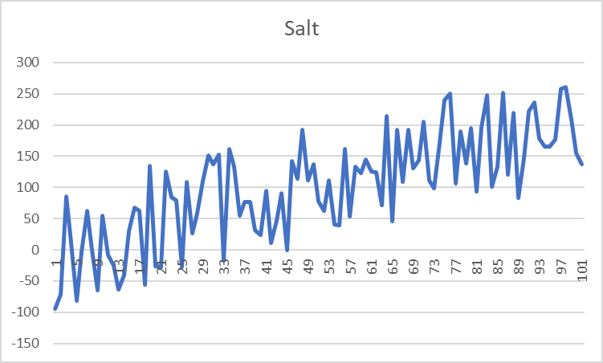

Slide 15
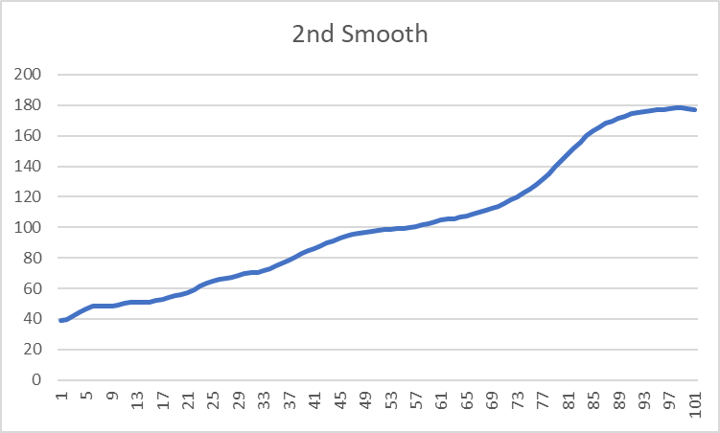
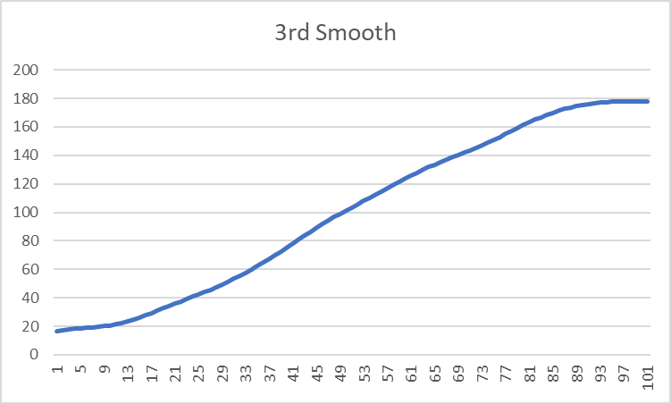

Slide 16
Possible improvements
In my smooth method I used 2 different while loops in order to calculated the point to the right and the points to the left for the window value so this could be improved by simply making a single loop capable of calculating both left and right at the same time
I also used an arraylist to stored all salted y value and then rewrite that arraylist as the method went on. A better way would have been just to read the y values in the csv and rewrite them as it went on.

