Slide 1

Sensor Based Sign Language To Speech Converter
BATCH : 104
Submitted By :
160119735058: Hridwin Vishaal
160119735059: Vishnu Alakuntla
160119735301: Supriya Chakilam
Under the esteemed guidance of
Dr. M. Ramana Reddy
Assistant Professor,
ECE Dept,
CBIT, Hyderabad

Slide 2
Table Of Contents
Aim
Objectives
Methodology
Block diagram
Hardware Setup
Working

Slide 3
Aim:
The aim of our project is to implement a sign language to voice converter in real time using a wearable hand glove.

Slide 4
Objectives
To audibly translate all twenty-six letters of the American Sign Language alphabets into the English alphabets
To audibly translate some of the American Sign Language signs into the English words.
Optimization of the device's performance to minimize latency and maximize accuracy.
To create a dataset for all the sensor data obtained for the letters and words.
To function properly for few continuous hours without having its batteries charged or replaced .

Slide 5
Methodology
There is the detailed methodology we are using in this project:
1.Hardware setup:
-Design and build a hardware setup consisting of flex sensors and accelerometer to capture the sign language gestures.
-Calibrate the sensors to ensure accurate readings.
2. Data collection:
-Collect data for a large number of signs using the hardware setup.
-Store the collected data in a format that can be easily processed.
3. Data preprocessing:
-Clean and preprocess the data to remove any noise or outliers.
-Normalize the data to ensure that it is in a consistent format.
4. Threshold determination:
-Determine appropriate threshold values for the orientation and movements of the hand based on the collected data.
-The threshold values will be used to recognize the different signs.
5.Sign recognition:
-Write an Arduino code to recognize the signs based on the orientation and movements of the hand using the determined thresholds.
-The code should be able to recognize the different signs and output the corresponding letters.
6. Text to speech conversion:
-Convert the generated text into speech using text-to-speech software or hardware.

Slide 6
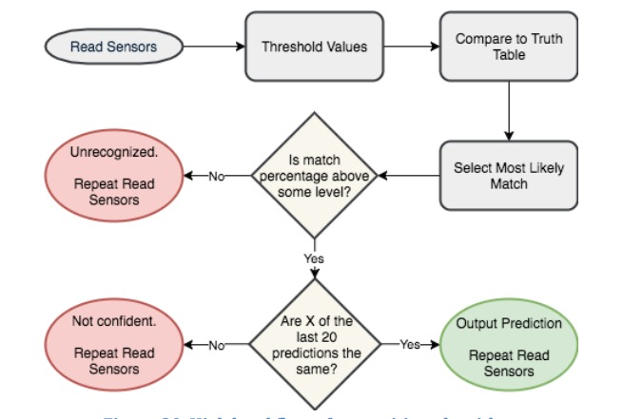
Algorithm FlowChart

Slide 7
HARDWARE COMPONENTS :
Flex Sensors
Arduino Uno
Accelerometer(ADXL345)
Bluetooth(HC-06)
SOFTWARE :
Arduino IDE
Bluetooth TTS ( text to speech ) android application

Slide 8

Block Diagram :
9V DC Supply
Flex Sensor-1
HC-05
Flex Sensor-2
Flex Sensor-3
Flex Sensor-4
Arduino Uno Atmega 328P
Flex Sensor-5
Smart phone
ADXL- 345
Accelerometer

Slide 9
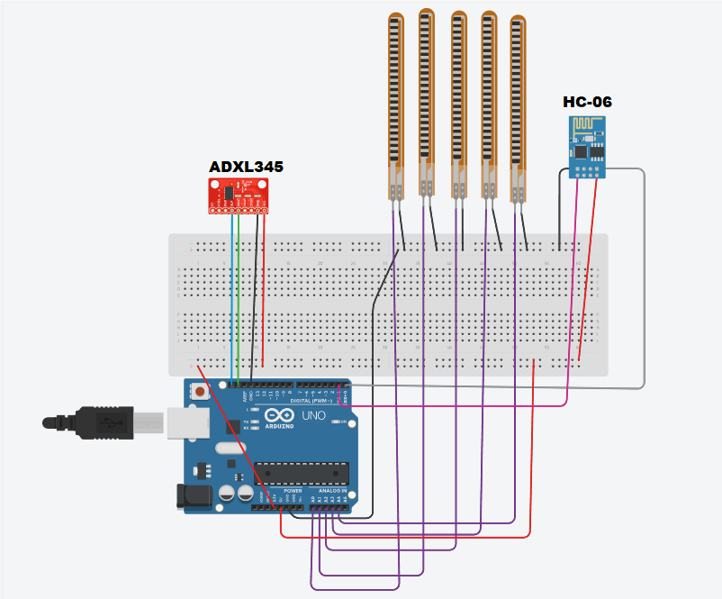
Implemented Circuit:

Slide 10
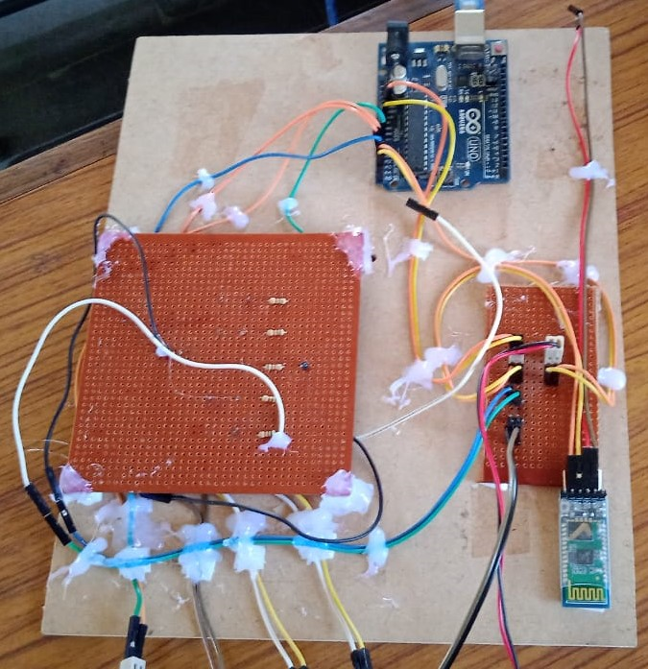
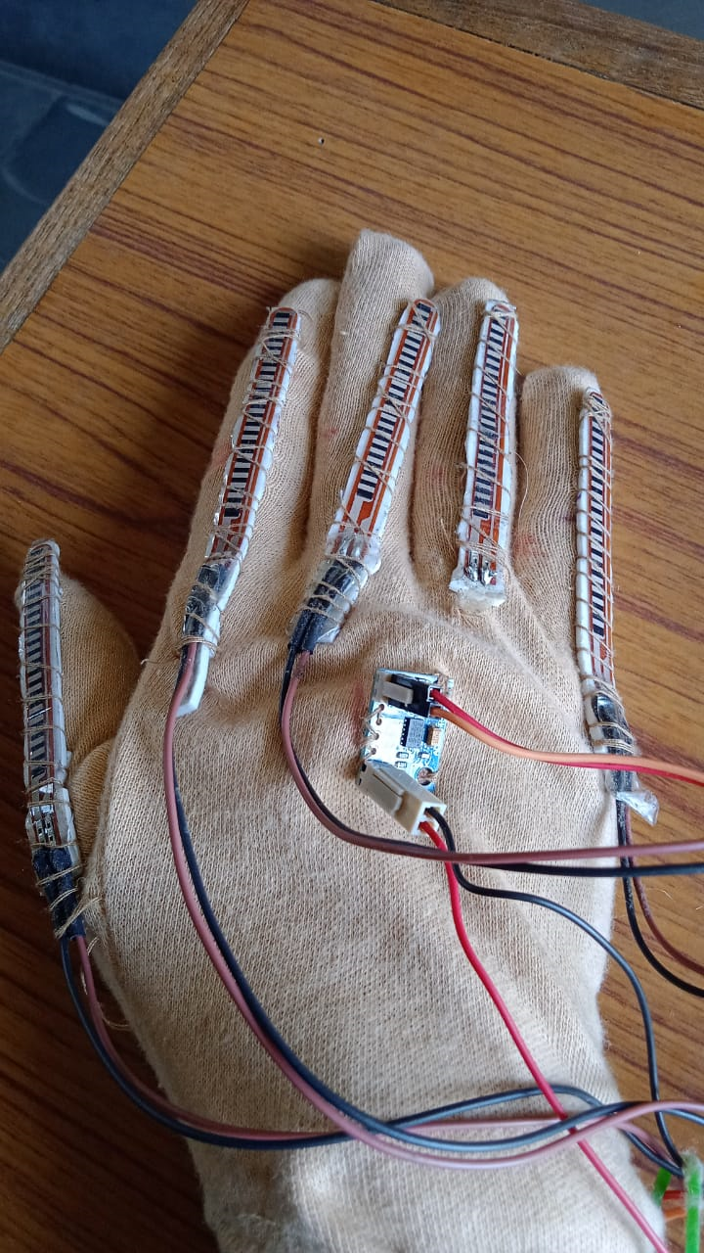
Hardware Setup:

Slide 11
Working:
Start
Take the values from sensors On glove
Convert Analog Output To Digital Input
Compare set Of Values with Database
Check for matching value
No Match
Match Found
Output corresponding Alphabet/Word To Android Application Wirelessly
Gesture is Recognized And Output is Displayed/Heard

Slide 12
1. Moving Averge Filter:
Filters:
The algorithm uses a moving average filter to smooth out the readings from five flex sensors connected to the Arduino board.
The window size for the moving average filter is set to 20, meaning that the filter takes the average of the last 20 samples from each sensor to calculate a smoothed value.
The algorithm uses five separate buffers, one for each sensor, to store the last 5 samples from each sensor. These buffers are updated with new samples in each iteration of the loop() function.
The formula for calculating the smoothed value y at time t is:
y[t] = (x[t] + x[t-1] + ... + x[t-N+1]) / N
where x[t] is the sensor reading at time t, and N is the window size of the filter.

Slide 13
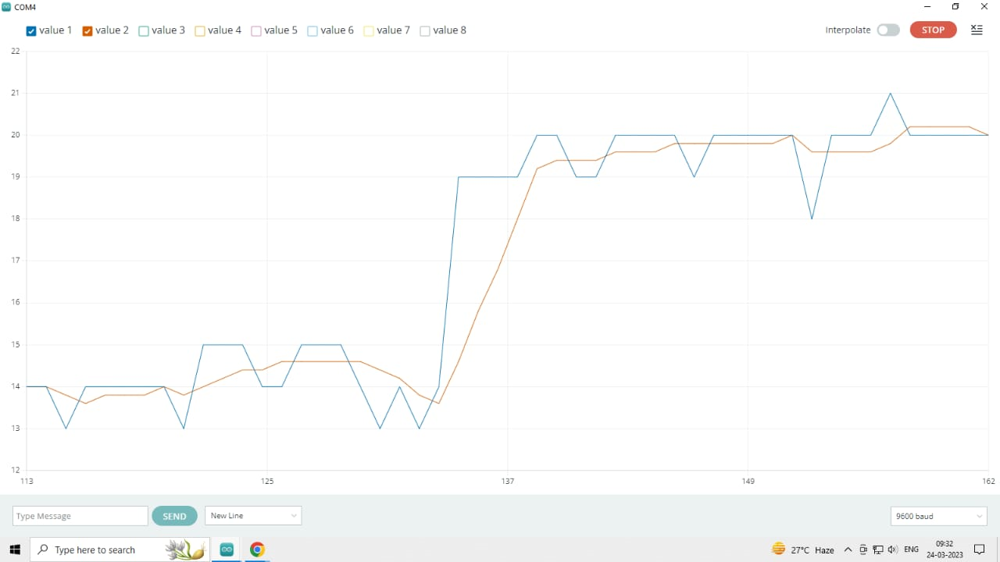
Filtered Outputs(Flex Sensors):
We can observe the smoothening of flex sensor outputs by implementing moving window filter .
Here blue line is before filter and orange line is after filter for flex sensor 1.

Slide 14
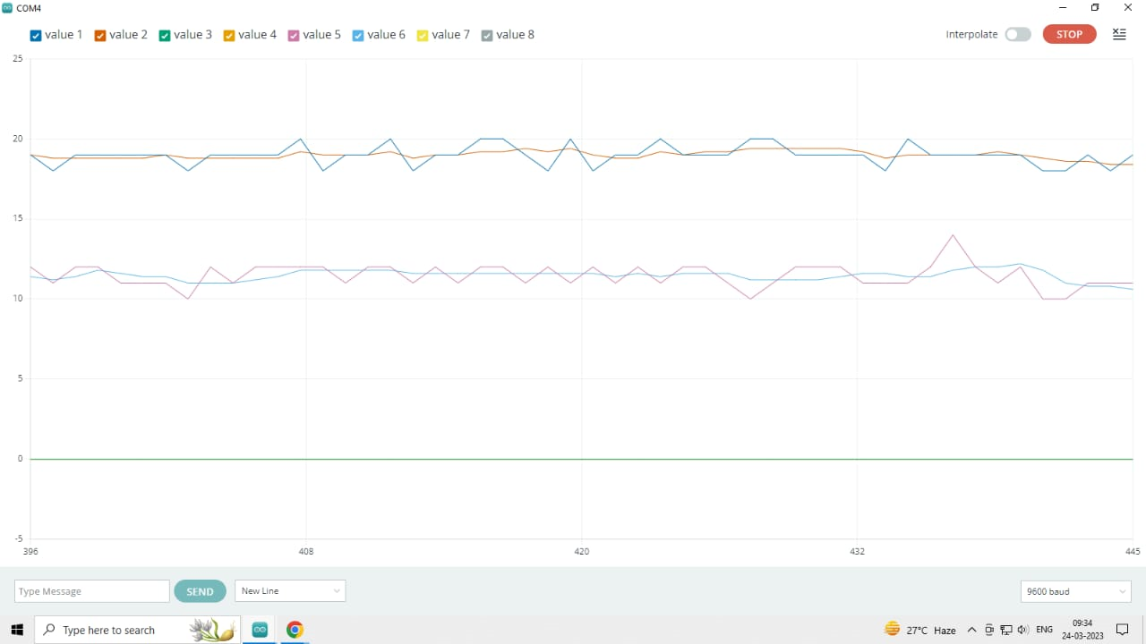
Similarly for other flex sensors
Here odd numbered values are measured analog values and even numbered values are filtered and smoothened outputs.

Slide 15
Accelerometer Readings:
2. Low Pass Filter:
X,Y,Z are the outputs of the accelerometer which give the acceleration aloing each of the axis the x,y,z .
Working: If the device is tilted forward ot backward, X willl change but Y and Z should remain relatively constant.
In this project, the accelerometer outputs (x, y, z ) can be used to determine the angle of the hand the orientation of the wrist. By using the thresholds determined from the preprocessed data, the code can recognize the different signs based on the orientation and movements of the hand.

Slide 16
Filter description:
In this algorithm, a first-order low-pass filter is implemented using a smoothing coefficient alpha of 0.65. The smoothing coefficient controls the tradeoff between smoothing the signal and preserving its responsiveness to changes.
The low-pass filter is useful for an accelerometer because the accelerometer readings may contain high-frequency noise due to various factors, such as vibrations, electromagnetic interference, or temperature fluctuations.
The filtered acceleration values are computed as a weighted sum of the previous filtered value and the current raw value, where the weight of the previous filtered value is given by alpha and the weight of the current raw value is given by (1 - alpha). The formula for filtering the acceleration values is as follows:
accel_filtered[i] = alpha * accel_filtered[i] + (1 - alpha) * actual_Acceleration
where i represents the index of the acceleration axis (0 for X, 1 for Y, and 2 for Z).
We were able to obtain a cleaner and more stable signal and it was easier to work with.

Slide 17
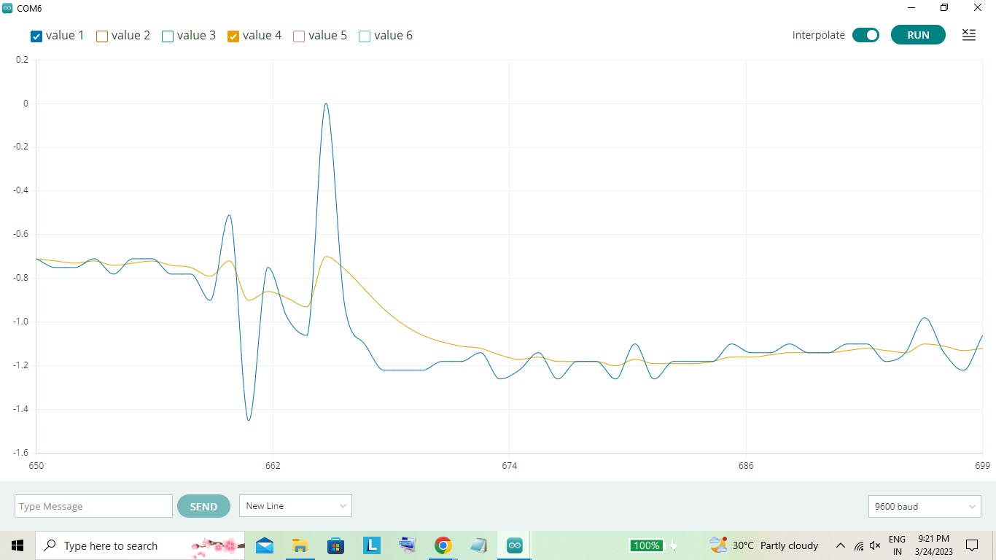
Filtered Outputs(ADXL 345):
We can observe the smoothening of accelerometer outputs by implementing low pass filter
Here blue line is before filter and orange line is after filter for the x axis accelerometer output.

Slide 18
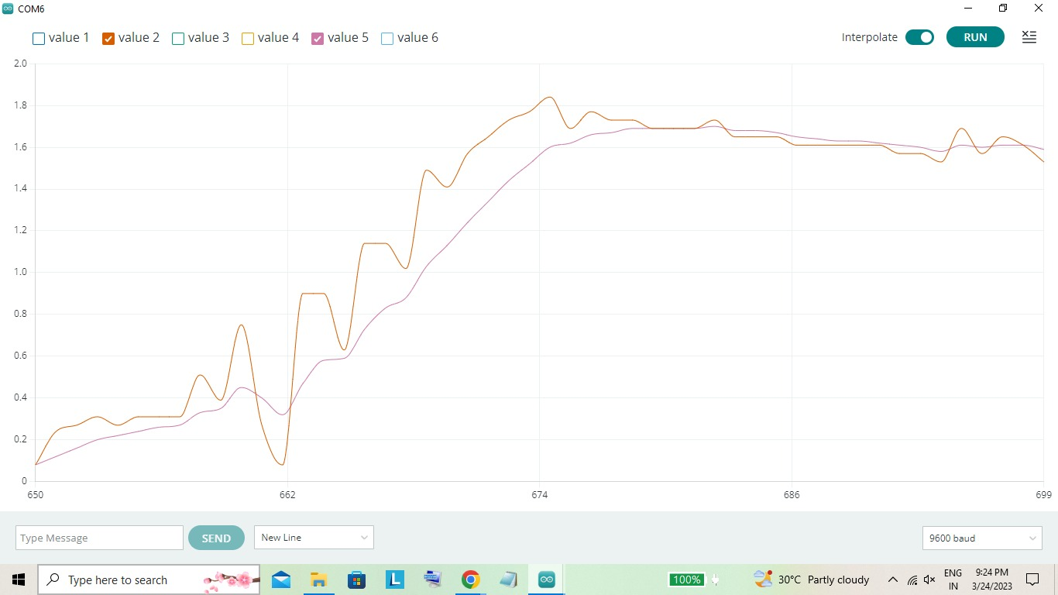
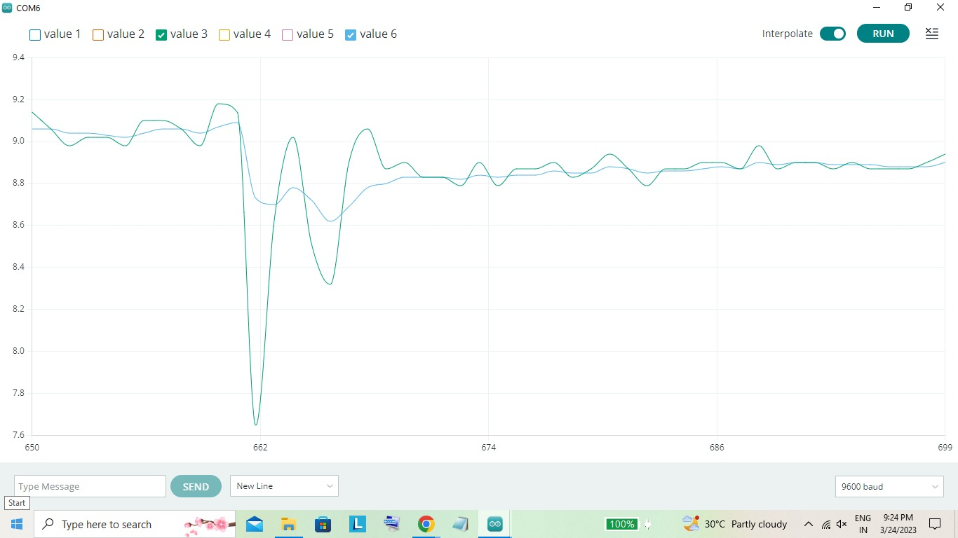
Here orange line is before filter and pink line is after filter for the y axis accelerometer output.
Here green line is before filter and blue line is after filter for the z axis accelerometer output.

Slide 19
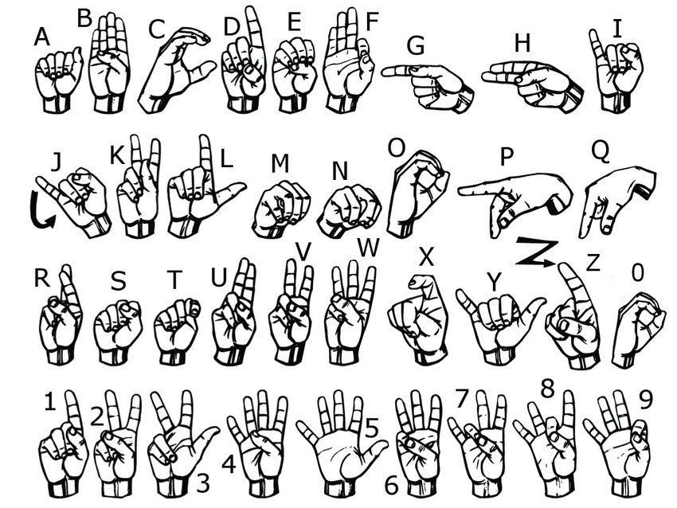
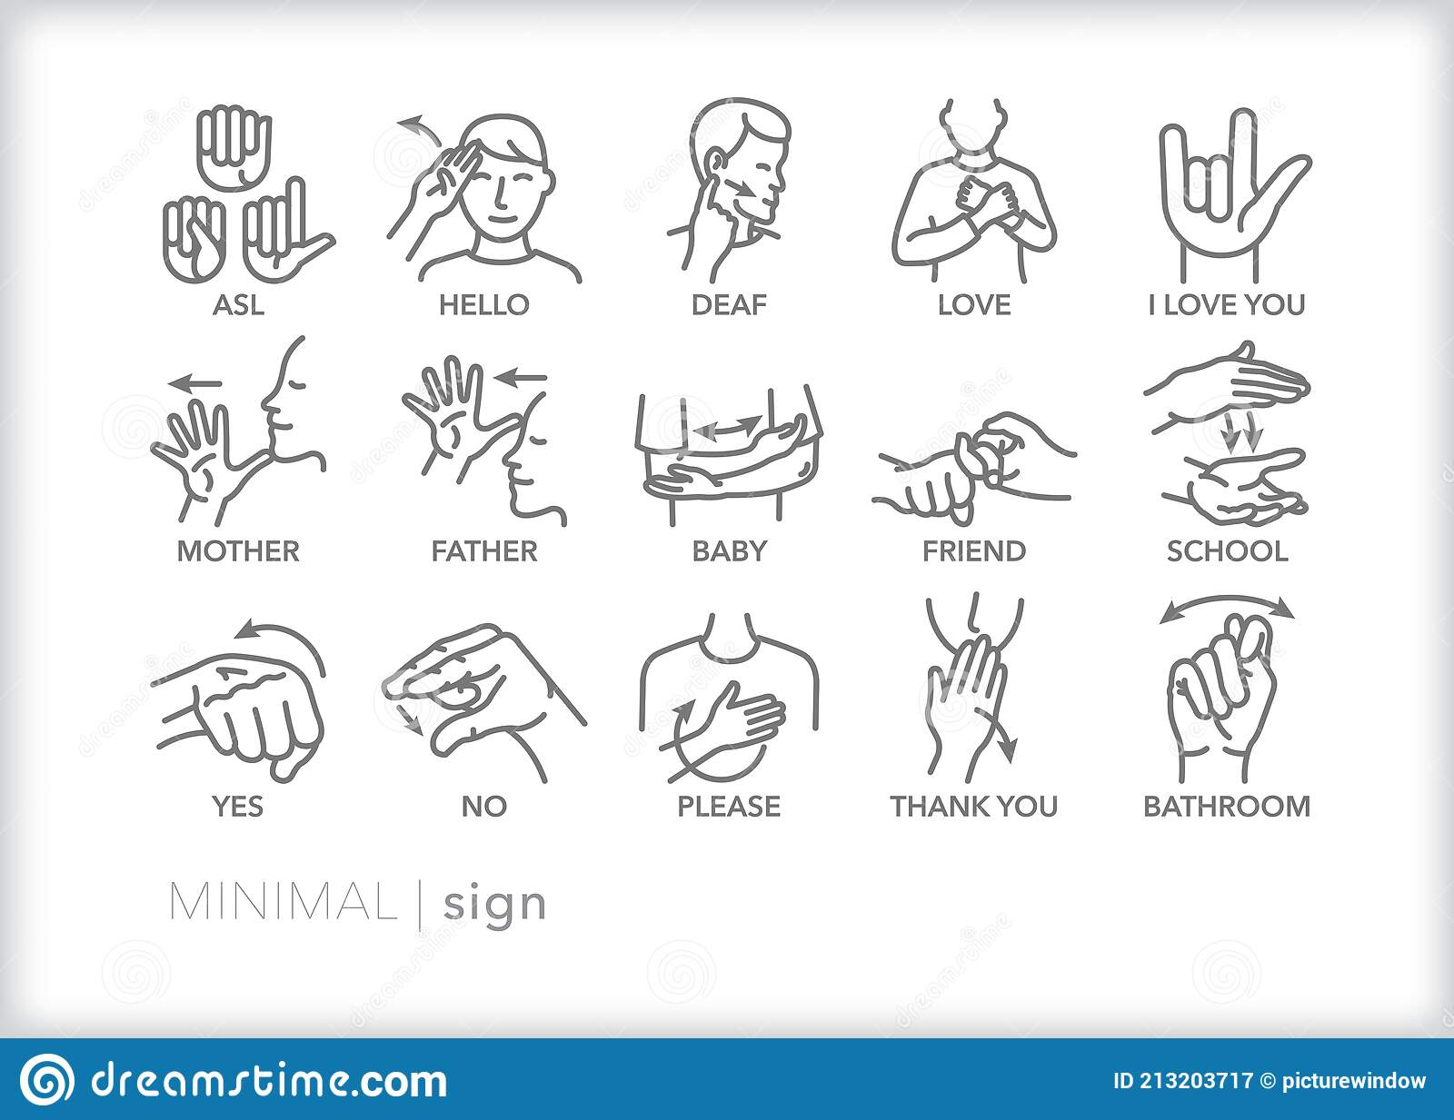
American sign Language

Slide 20
Results:
Results contain the flex sensor outputs,accelerometer outputs and sum of all flex values
After completing the hardware and software development, we tested the system on a group of individuals proficient in sign language. The system was able to accurately recognize and translate a variety of sign language gestures, with an average accuracy rate of 85%. The translated text or speech was displayed on a computer screen or spoken through a speaker.
The accuracy was measured from data collected for the sensors respective to the corresponding letters and testing each ASL gestures10 times and averaging the accuracies.
Overall, the results show that our sign language detection system using flex sensors and adxl sensor is a promising solution for improving communication between hearing and hearing-impaired individuals.
The following page has the demonstration of letters, words and sentences for ASL Gestures.

Slide 21
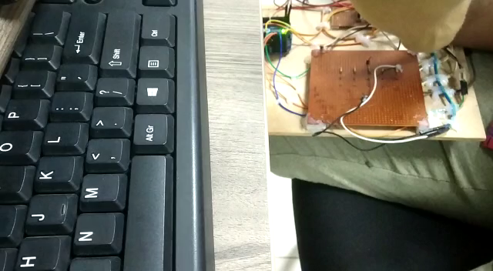
Demonstration:

Slide 22
Collected Data:

Slide 23
Conclusion:
These are the conclusions based on our objectives:
In conclusion, our final year project on sign language detection using flex sensors and ADXL sensor has shown promising results in improving communication between hearing and hearing-impaired individuals. We have developed a system that accurately recognizes and translates sign language gestures, and we plan to continue improving and expanding the system in the future.
We believe that our system has the potential to make a significant impact on the lives of hearing-impaired individuals, allowing them to communicate more easily and effectively with others.

Slide 24
Future Scope
In the future, we plan to improve the system by adding more sensors to detect additional hand movements and gestures. We also plan to integrate the system with mobile devices, making it more accessible and portable for everyday use.
We plan to implement this on Teensy 4.0 microcontroller or rasberry pi which has faster processing power and is able to take more analog inputs, hence making them applicable two handed device instead of one hand.
Additionally, we hope to expand the system to recognize other sign languages, such as British Sign Language (BSL) or Indian Sign Language (ASL), and to make the system available in multiple languages.

Slide 25
References
[1] “Sign Language Recognition”,IEEE publication, Anup Kumar, Dept. Of ComputerScience and Engineering,National Institutte of Technology,Calicut,India, 2016 .
[2] “Resistive flex sensors: A survey”, Topical Review publication, Giovanni Saggio,Dept. Of Electronic Engineering,University of Rome, Italy, 2015.
[3] “Development of Sign Language using Flex Sensors” ,IEEE Publication, Ajay Suri, Dept.of Electronics and Communication Engineering, ABES Engineering College, Ghaziabad,India, 2020 .
[4] Suharjito, Suharjito & Ariesta, Meita & Wiryana, Fanny & Kusuma Negara, Gede Putra.(2018). A Survey of Hand Gesture Recognition Methods in Sign Language Recognition.Pertanika Journal of Science and Technology.
[5] Abhinandan Das, Lavish Yadav, Mayank Singhal, Raman Sachan, Hemang Goyal, KeshavTaparia Raghav Gulati, Ankit Singh, Gaurav Trivedi,” Smart Glove for Sign LanguageCommunications”,2016 IEEE.

Slide 26
THANK YOU!

