Slide 1


Semantic-Driven Topic Modeling Using Transformer-Based Embeddings and Clustering Algorithms
Student: Hengameh Shah Ali
40307604

Slide 2
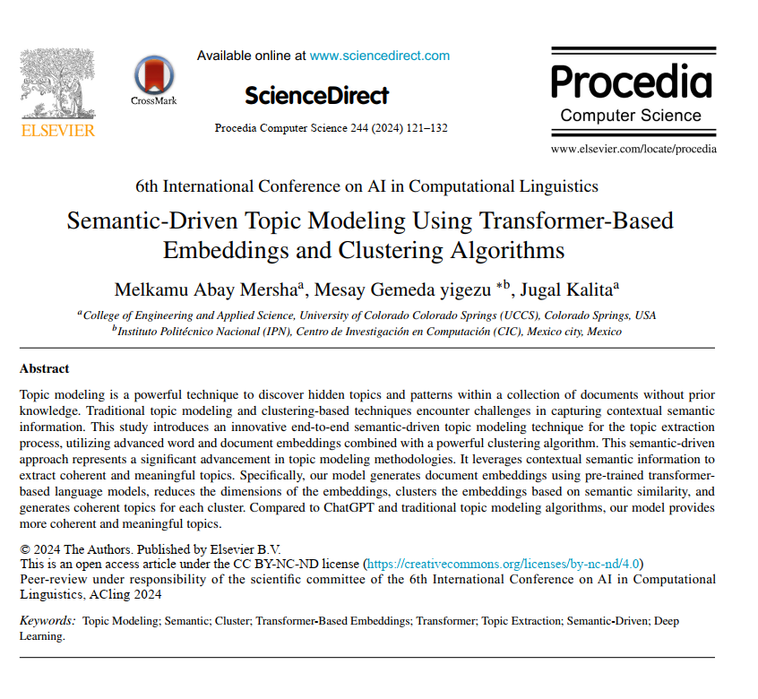
Problem Definition
The subject of the paper is a powerful technique for discovering hidden topics and semantic patterns in a collection of text documents without requiring prior knowledge. Classical methods such as LDA, NMF, and LSA are based on the Bag-of-Words model, which ignores contextual meanings and relationships between words and merely counts word occurrences in the text without any understanding of the actual meaning of words within sentence context. This leads to two main issues:
Lack of understanding of word meanings in sentences
Generation of low-quality and incoherent topics
New language models such as Transformers understand complex semantic relationships, but many topic modeling techniques do not utilize this capability, resulting in the extraction of inconsistent, inaccurate, and meaningless topics.
Thus, the main problem addressed in the paper is:
How can topics be extracted based on meaning rather than just word frequency?

Slide 3
Models Used: all-MiniLM-L6-v2 and all-mpnet-base-v2
Implementation Method
Document Embedding
Method Used: Sentence-BERT (SBERT)
Process: Text documents are converted into meaningful numerical vectors (embeddings).
Details: Each sentence receives a fixed-length vector representation using pre-trained transformer models.
Dimensionality Reduction
Why Needed? High-dimensional vectors make clustering difficult (curse of dimensionality).
Method Used: UMAP (Uniform Manifold Approximation and Projection)
Details: UMAP parameters (number of neighbors, minimum distance) are tuned to preserve both global and local data structures.
Document Clustering
Algorithm Used: HDBSCAN (Hierarchical Density-Based Spatial Clustering)
Why HDBSCAN?
  Finds clusters of varying densities
  Robust to noise
  Identifies outliers automatically
  No need to predefine the number of clusters
Clustering Basis: Semantic similarity of reduced document embeddings.

Slide 4

Implementation Method
Topic Extraction
Process for Each Cluster:
  Vocabulary Construction: Words from each sentence are extracted and mapped to their embedding vectors.
  Irrelevant Word Removal: Words without semantic contribution to sentences are eliminated.
  Average Similarity Calculation: For each word, the average cosine similarity with all sentences in the cluster is computed .
  $$\text{a}\text{vg}\text{_}\text{sim}(w_{i)=}\frac{1}{N}\sum_{j=1}^{N}{\text{cosine}(}w_{i},s_{j})$$
  Top Word Selection: The *k* words with the highest similarity scores are selected as the cluster's topic.
  Topic Merging: Topics with high similarity are merged to control the final number of topics.
Topic Refinement and Evaluation
  Use metrics such as CV​, Cnpmi​, UMass​, and Cuci to evaluate topic coherence.
  Adjust hyperparameters (e.g., minimum cluster size in HDBSCAN, k in topic words) based on validation results.
  Employ OCTIS toolkit for standardized comparison with baseline models (LDA, BERTopic, CTM, etc.).

Slide 5
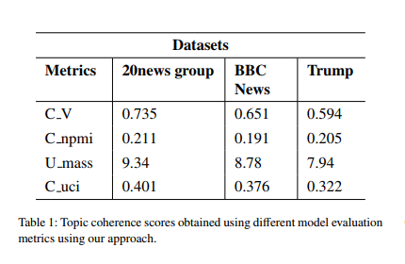
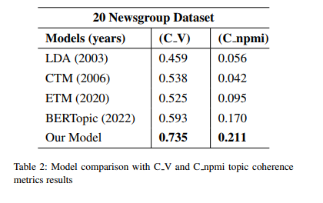
Main Results of the Paper
Topic Coherence Evaluation
The proposed model achieved the highest topic coherence scores across all three datasets (20NewsGroups, BBC News, Trump's Tweets) compared to all baseline models. It attained notable and superior scores across all four evaluation metrics (C_V, C_npmi, U_Mass, and C_uci), demonstrating its consistent performance and effectiveness in extracting meaningful topics.(Table1)
The best performance was observed on the 20NewsGroups dataset, indicating that the model performs optimally on structured and long-form data (such as news articles). At the same time, the results demonstrate that the model also performs adequately on short texts like tweets, achieving a reasonable and competitive score.
Comparison with Traditional and Embedding-Based Models
The proposed model significantly outperformed both classical and modern models.(Table2)
Comparison with ChatGPT:
ChatGPT was not suitable for large datasets and required chunking, which led to:
  Loss of latent themes
  Inability to process sequential data effectively
  Lack of built-in evaluation metrics
The proposed model performed better than ChatGPT in terms of scalability, reliability, and topic quality.

Slide 6
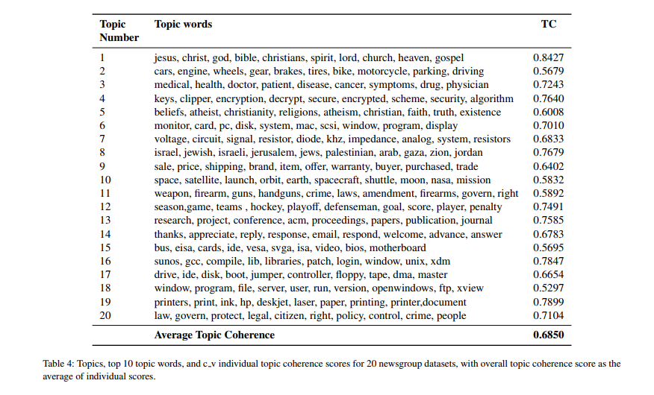
Sample Extracted Topics
For the 20NewsGroups dataset, 20 meaningful topics were extracted, including:
  Religion: jesus, christ, god, bible, christians, ...
  Technology: monitor, card, pc, disk, system, ...
  Medical: medical, health, doctor, patient, disease, ...
  Sports: season, game, teams, hockey, playoff, ...
  Politics: law, govern, protect, legal, citizen, ...
Average topic coherence for these topics: 0.685

Slide 7
Semantic-Driven Topic Modeling Using Transformer-Based Embeddings and Clustering Algorithms
Mersha, M. A., Yigezu, M. G., & Kalita, J. (2024). Semantic-Driven Topic Modeling Using Transformer-Based Embeddings and Clustering Algorithms. Procedia Computer Science, 244, 121–132.
Main objective of the article:
This article addresses the key limitation of traditional Topic Modeling methods: the inability to comprehend context-dependent meaning. Methods such as LDA operate solely based on word co-occurrence and fail to capture conceptual semantics. Even certain Transformer-based models do not fully utilize the linguistic understanding power of these models in the final stage of topic extraction.
Proposed Method Architecture:
Unsupervised Pipeline :
Document Embedding
Dimension Reduction
Document Clustering
Topic Extraction
Key Results:
The proposed model demonstrated significantly better performance across all metrics for topic coherence compared to BERTopic and traditional models.
The model's output generated interpretable and meaningful topics.
Strengths of the Method:
Semantic-centric: Focuses on the concept of words rather than their repetition.
Modular design
Unsupervised
Automatic noise removal and outlier data management
Controllability: Users can adjust the similarity threshold to merge or separate topics.
Weaknesses or Limitations:
High computational cost
Sensitivity to parameters
Failure to identify hidden subtopics: Weakness in discovering topics embedded within the text.
Limited scope of evaluation: Other metrics, such as topic diversity, were less explored, with the main focus being on coherence.

Slide 8
Practical Applications of Transformer-based Topic Modeling
Advanced and intelligent content analysis systems
Advanced social media monitoring and analysis platforms such as Brandwatch and NetBase Quid, aimed at achieving a more nuanced and informed understanding of conversations.
Intelligent customer support and complaint analysis systems
These systems can extract complex topics and subtopics from textual conversations (chat, email).
Content Recommender System: Recommending articles, news, and content based on user interests
Extract topics from the content consumed by the user
Match with topics of new content
Suggest content with similar topics
Semantic search engines and organizational knowledge management systems
Next-generation research systems and digital libraries
Scientific databases such as Semantic Scholar and arXiv, designed for recommending articles with related concepts.
Cybersecurity monitoring platforms
Cyber threat analysis systems: Used for processing large volumes of security reports, incident logs, and extracting emerging threat topics,
attack techniques (TTPs), and indicators of compromise (IOCs) from them.

