Slide 1
ML downfolding VQE

Slide 2
Basis Set Should Match Algorithm
Accuracy
...
Wave Function Theory:
CC, MP, FCI etc
cc-pVTZ, def2-TZVP
cc-pVDZ, def2-SVP
Mean Field Theory:
HF, DFT etc
Sto-3G
https://sites.google.com/site/orcainputlibrary/basis-sets?authuser=0

Slide 3
Mismatch of VQE
widely used VQE setting [1]:
Sto-3G + UCCSD ansatz
Accuracy
...
Wave Function Theory:
CC, MP, FCI etc
cc-pVTZ, def2-TZVP
cc-pVDZ, def2-SVP
Mean Field Theory:
HF, DFT etc
Sto-3G
[1] McArdle, Sam, et al. "Quantum computational chemistry." Reviews of Modern Physics 92.1 (2020): 015003.

Slide 4
Benchmark of Error Sources
basis error > convergence error > system noise(?)
results here

Slide 5
One way to amend: basis downfolding
Why mismatch?
Near term device cannot afford large scale basis
only UCCSD, lack of algorithms
Our solution: basis downfolding
some math formulas here

Slide 6
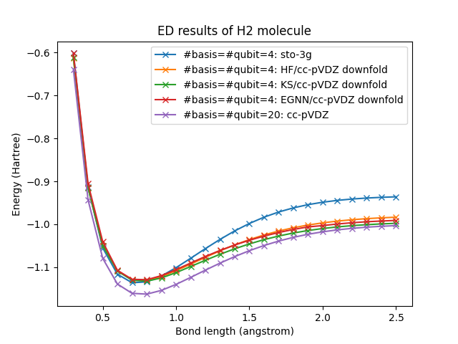
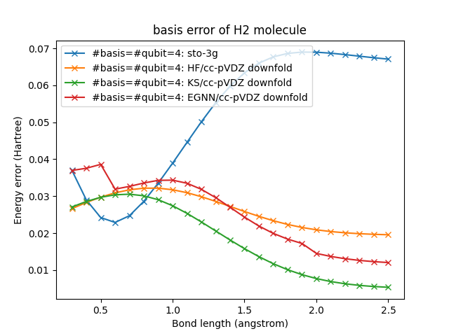
Results of basis downfolding

Slide 7
Test on Qiskit Emulator
results here

Slide 8
Discussion
increase of measurement complexity

