Slide 1


Passwordless authentication on web
How to secure web applications and web services without using password

Slide 2
Topics
Passwordless authentication between:
user & frontend
frontend & backend
backend service & backend service
Demo: service to service authentication without password
Focusing mainly on Azure technologies/options

Slide 3

User to Frontend - Traditional password-protected systems
Today the primary method of authentication
Disadventages:
Needs to be complex -> hard to remember
Need to change frequently
Reusing the same password at multiple places
Need for a password management system
Threat from hackers (phishing, brute force)

Slide 4
User to Frontend - Passwordless alternatives in Azure (EntraID and Entra External ID)
Entra External ID (replacement of AD B2C): A CUSTOMER cloud-based identity access management service from Microsoft (sign up, sign in, and manage customer, external workforce profiles).
EntraID (replacement of AD B2B): An EMPLOYEE cloud-based identity and access management service from Microsoft. It helps your employees sign in and access resources (eg. PC, Microsoft Office 365, Azure…etc).
Options for authentication:
Biometric data (face recognition, fingerprint)
OTP: authenticator app, sms on phone, email
Hardware keys (FIDO2 standard)

Slide 5

Frontend to backend – access token (JWT)
Analogy – cinema ticket:
Gives access to one move
VIP/3D/normal
Gives access to a limited time
Preserves one seat
Can use bufe, toalet
Ticket usher validates it
Cannot be (easily) forged

Slide 6
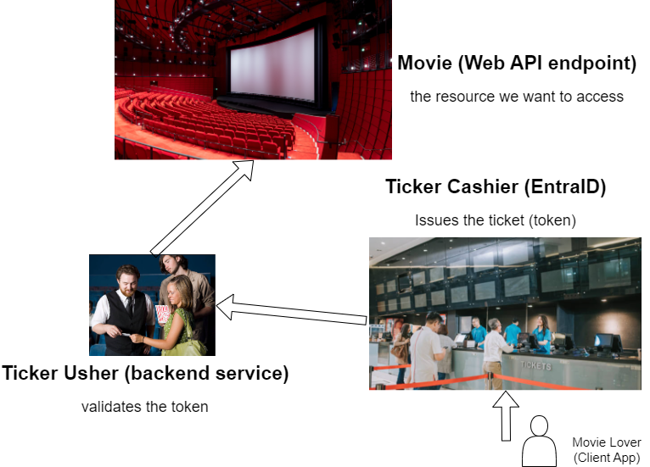
Frontend to backend - Cinema / Web analogy

Slide 7
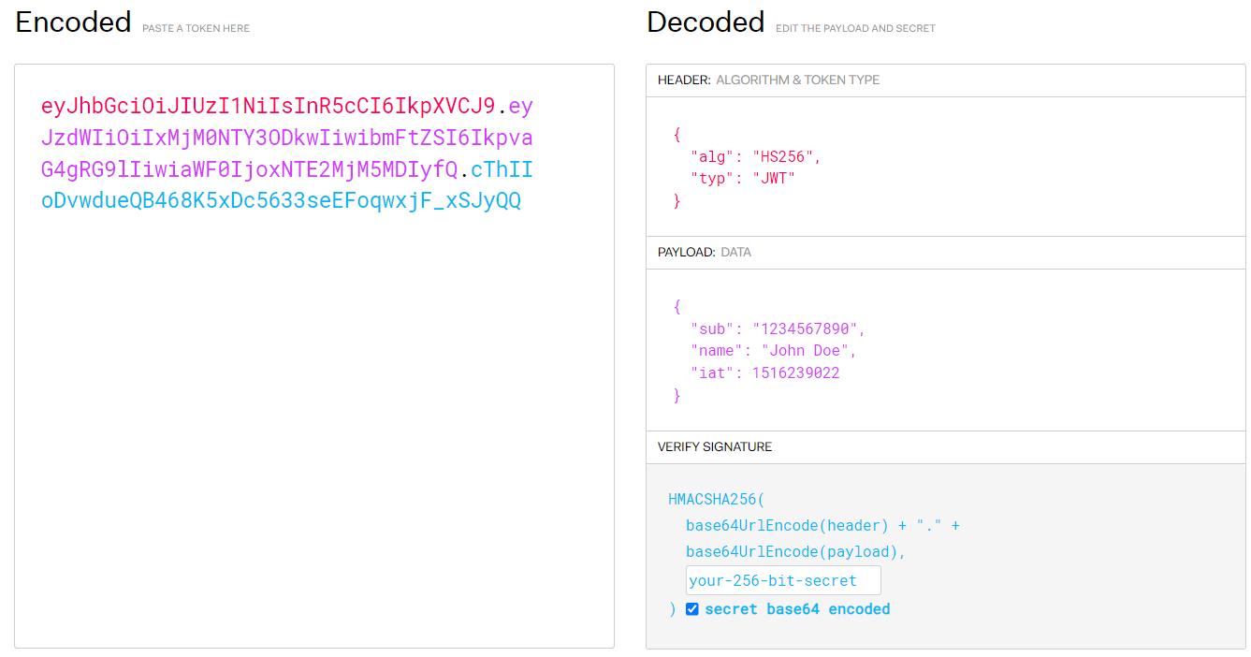
Frontend to backend – JWT tokens
Access token:
A base64 encoded string
Parts: head, payload, signature
Specifies: who you are, to what you have access to, how long the token is valid, when it was issued…etc (standardized fields)
Digitally signed: hash+encrypted (private key at IAM server, public key can be used to decrypt)
Issuing/modification only with the private key -> only IAM server has it

Slide 8
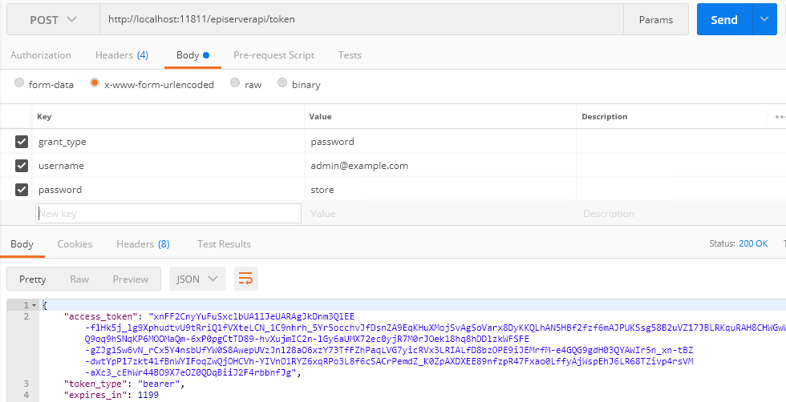
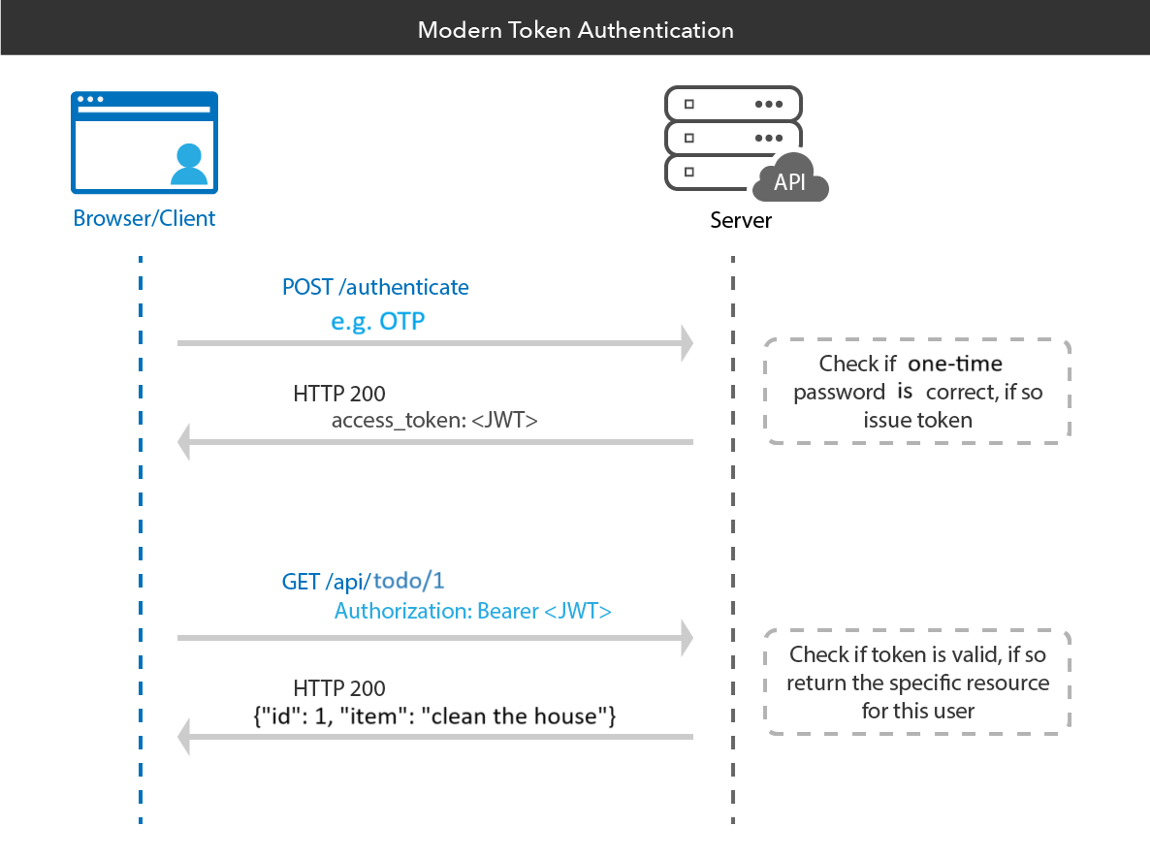
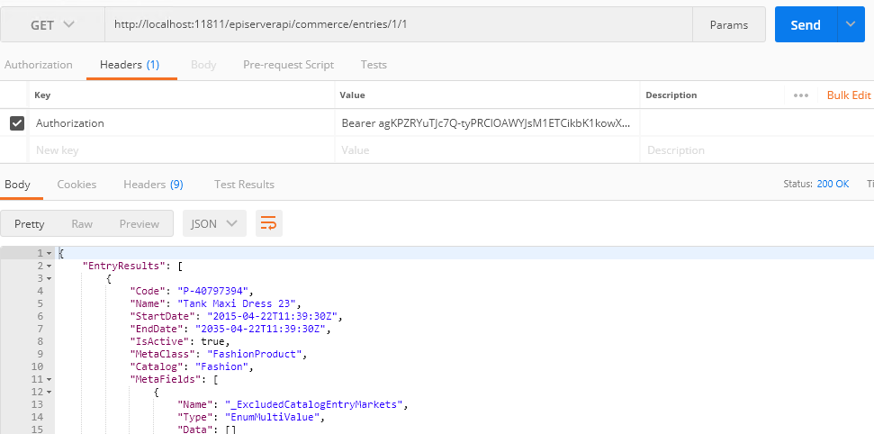
Frontend to backend – JWT tokens
When user signs into the frontend of an application using one of the passwordless methods we've discussed, EntraID generates a JWT token
When the frontend needs to communicate with the backend (eg.: to fetch data or perform an action) it includes this token in the request. The backend then validates the token using EntraID. If it's valid, the backend processes the request, all without needing a password.
No credential is sent in the network

Slide 9
Backend service to backend service – The traditional way
CosmosDb, Storage Account, SQL DB connection string:
We can store them in:
Config files
Environement variables
Secret management tools (eg. Azure Key Vault)
Docker and Kubernetes secrets
Lets follow the same pattern as on FE:
Use only the endpoint
Re-use access token approach
Do not manage secrets at all!
Azure provides a unique solution!

Slide 10
Backend service to backend service – Managed Identity
As Users can have profiles in EntraID, services can also have ”profiles” which are called Managed Identites
Both kind of profiles are objects that represent either the user or service in the IAM system
If I have a ”profile” for a service e.g.: backend API, I can give ”read permission” for a database e.g.: CosmosDb – role base access control
When the web API wants to access the DB, it does not provide the DB key, but gets an access token from EntraID and sends it during the DB read http request -> DB verifies the token and sends back the entries
Pros of MIs:
Automatic and hidden credential management (create, store, rotation)
No secrets in the code!
No secret management needed at all
No cost in Azure
More simple code -> implementation not needed (or minimal effort)
Lifecycle management -> if service is deleted, MI is also deleted
Simple authentication: service gets token and provides token easily (sometimes hidden)

Slide 11
Backend service to backend service – Managed Identity + RBAC
Example:
How to use MI to access a Storage Account from a Function App:
Create a MI in Azure for the Function App
Assign a ”Storage Blob Data Contributor” role in the in the scope of the SA for the previously created MI
Use the endpoint of the SA without the credentials to access it
How it works underneath:
The identity is used to obtain a token from EntraID.
This token is then presented to the second backend service.
The second service validates this token against EntraID to ensure it's valid.

Slide 12
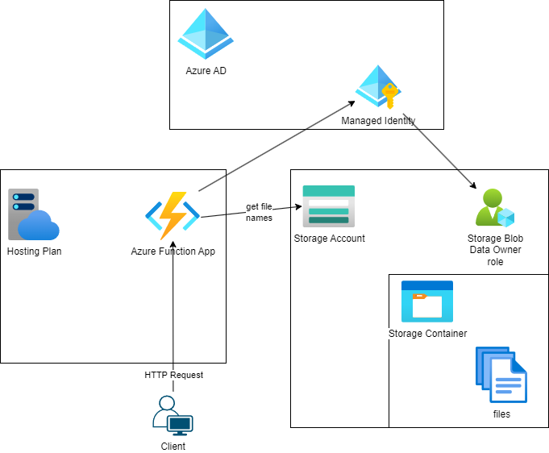
DEMO: Service to service
An Azure Function reads the name of blobs from a Storage Container and return the list in a http response body.

Slide 13
Passwordless authentication on the web
Q&A

