Slide 1
Introduction to Python
Prof Xiaosong Yang
Professor in Computer Animation
National Centre for Computer Animation
Faculty of Media and Communication
Bournemouth University
Email: xyang@bournemouth.ac.uk
https://staffprofiles.bournemouth.ac.uk/display/xyang

Slide 2
References
Python programming for the absolute beginner
Python programming: an introduction to computer science
Tutorialspoint, Python Programming, Python Basic Tutorial, Python Advanced Tutorial
http://www.tutorialspoint.com/python/python_basic_syntax.htm
Autodesk Maya Python API
Maya Programming with Python Cookbook

Slide 3
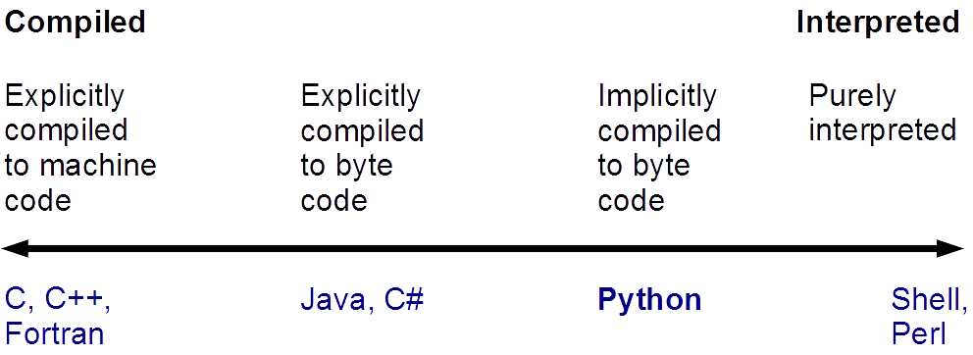
Python Programming

Slide 4
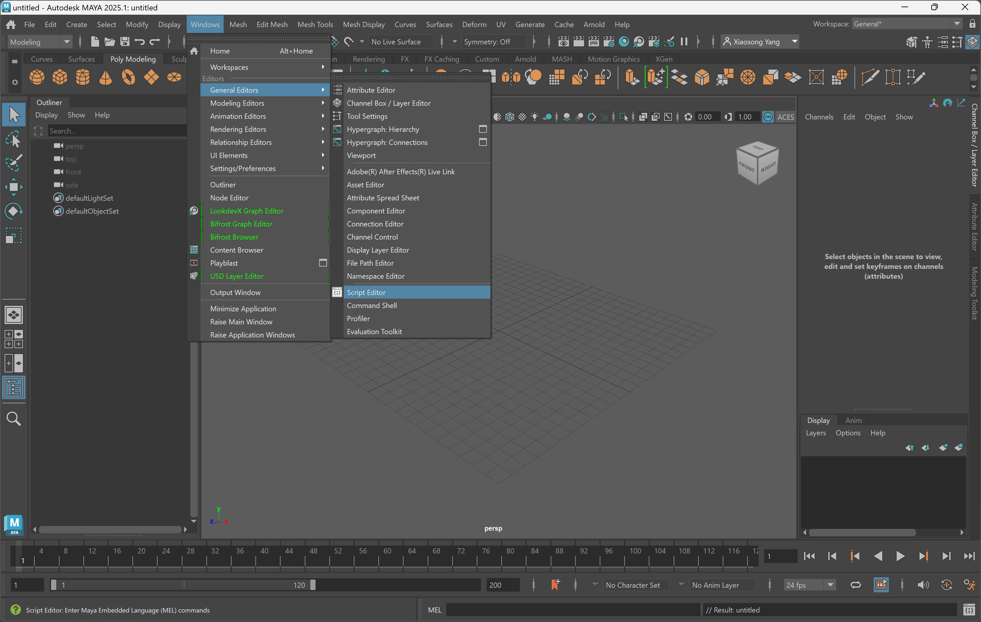
Python – Script Editor in Maya

Slide 5
Python – Script Editor in Maya

Slide 6
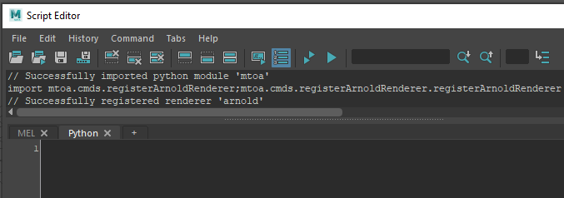
Python – Script Editor in Maya
In the lower section, select “Python” tab for enter python script.
“MEL” is for MEL script.

Slide 7
Interface in Script Editor

Slide 8
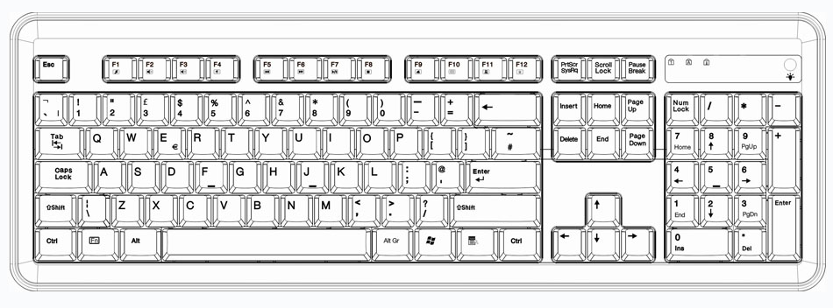
Python – Keyboard
Tab
Execute Enter
Line break
Space
'Hello␣world

Slide 9
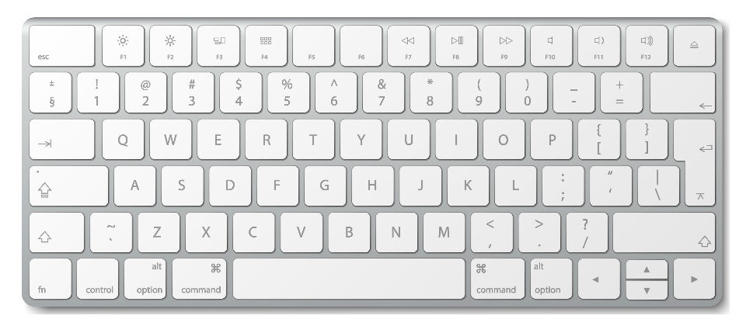
Python – Keyboard
Execute: Ctl + Enter
Line break

Slide 10
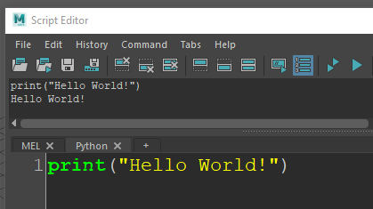
Hello world example
Output
Python script
print('Hello␣World!')
Hello␣World!
Python script
Output
Case sensitive: print is different from PRINT
Python text (string of characters) - quotation marks
difference between print ‘print’

Slide 11
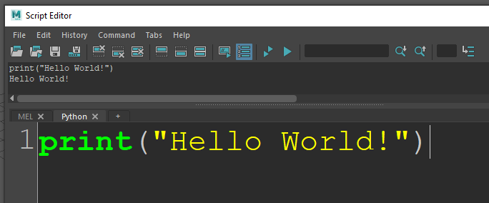
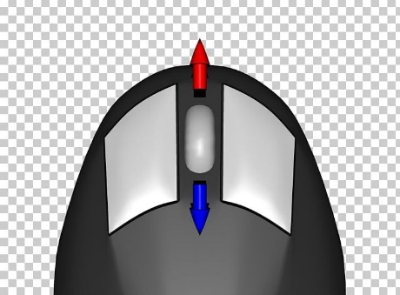
Python – Keyboard
Zoom in or out: Ctl + Scroll

Slide 12

Text: a string of characters
'Hello,␣world!'
Python script
Python script
Output
type ('Hello, world!')
<type ‘str’>
chr(72)
'H'
Output
Python script
Output
ord('H')
72

Slide 13
Text: adding strings together, “+” Concatenation
Python script
'Hello,␣' + 'world!'
'Hello, world!'
String repetition *
'Hello' * 3
'HelloHelloHello'
Output
Python script
Output

Slide 14
Text: strings literals concatenation
# Two string literals next to each other are automatically
# concatenated; this only works with two literals, not
# with arbitrary string expressions:
'str' 'ing' # <- This is ok
'string'
Python script
Output

Slide 15
Text: Single & double quotes, same string objects
'Hello, world!'
'Hello, world!'
"Hello, world!"
'Hello, world!'
Python script
Output
Python script
Output

Slide 16
Text: Nest Single & double quotes
print('He said "hello" to her.')
He said "hello" to her.
print("He said 'hello' to her.")
He said 'hello' to her.
print('He said 'hello' to her.')
SyntaxError: invalid syntax
Python script
Output
Python script
Output
Python script
Output

Slide 17
Text: Escaping
print('He said \'hello\' to her.')
He said 'hello' to her.
Escaping \' => '
Escaping \" => "
Python script
Output

Slide 18

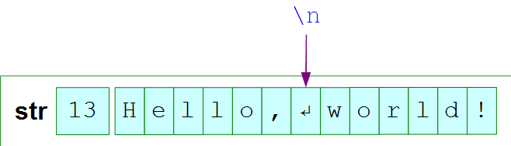
Text: line breaks in text
Output
Hello,
world!
print('Hello,
world')
print('Hello,\nworld! ')
Python script
Python script
>>> len('Hello,\nworld!')
13

Slide 19
Text: backslash
1. Special character => ordinary character
\' \"
2. Ordinary => Special
\n \t \v … etc.

Slide 20
Text: powerful \n
'SQUIRE TRELAWNEY, Dr. Livesey, and the\n rest of these gentlemen having asked me\n to write down the whole particulars\nabout Treasure Island, from the\nbeginning to the end, keeping nothing\nback but the bearings of the island,\nand that only because there is still\ntreasure not yet lifted, I take up my\npen in the year of grace 17__ and go\nback to the time when my father kept\nthe Admiral Benbow inn and the brown\nold seaman with the sabre cut first\ntook up his lodging under our roof.'
SQUIRE TRELAWNEY, Dr. Livesey, and the
rest of these gentlemen having asked me
to write down the whole particulars
about Treasure Island, from the
beginning to the end, keeping nothing
back but the bearings of the island,
and that only because there is still
treasure not yet lifted, I take up my
pen in the year of grace 17__ and go
back to the time when my father kept
the Admiral Benbow inn and the brown
old seaman with the sabre cut first
took up his lodging under our roof.

Slide 21
Text: Triple quotes
'''SQUIRE TRELAWNEY, Dr. Livesey, and the
rest of these gentlemen having asked me
to write down the whole particulars
about Treasure Island, from the
beginning to the end, keeping nothing
back but the bearings of the island,
and that only because there is still
treasure not yet lifted, I take up my
pen in the year of grace 17__ and go
back to the time when my father kept
the Admiral Benbow inn and the brown
old seaman with the sabre cut first
took up his lodging under our roof. '''
SQUIRE TRELAWNEY, Dr. Livesey, and the
rest of these gentlemen having asked me
to write down the whole particulars
about Treasure Island, from the
beginning to the end, keeping nothing
back but the bearings of the island,
and that only because there is still
treasure not yet lifted, I take up my
pen in the year of grace 17__ and go
back to the time when my father kept
the Admiral Benbow inn and the brown
old seaman with the sabre cut first
took up his lodging under our roof.

Slide 22

Python Programming
Text: Quotes, all the same
'Hello,\nworld!'
"Hello,\nworld!"
'''Hello,
world!'''
"""Hello,
world!"""

Slide 23

Triple Quotes Exercist
Write a funny story about an AI and an animator working at ZJU.
Requirements:
• use triple quotes
• minimum 5 lines
• include dialogue
The AI arrived at NCCA. It wanted coffee. It opened Maya. It forgot to save. The computer restarted.
The AI finished its animation. It pressed Render. Estimated time remaining: 3 days 17 hours.
"""
The AI arrived at NCCA.
It said, 'I know everything about animation.'
A student asked:
'Can you fix my rig?'
The AI applied for annual leave.
"""

