Slide 1
Tree & AI Ethics Review
-Pre-production presentation
Team Members and Division of Labor:
Liu yingqi —— Core Algorithm Generation for Trunks and Branch
Wu yuanan —— Leaf and Flower Generation & Season System
He guanqi —— Weather Systems and Animation Effects
Liu Hengxu —— Integration of Code, UI and Exploration of AI Ethical Issues

Slide 2
01
Project work

Slide 3
Effect we want to achieve
Parametric Tree Modeling
Season System
Weather System and Animation
Generate several preset types of trees based on parameters such as trunk radius and branch hierarchy
Control the generation of trees in different seasons by restricting the quantity of leaves and flowers and altering their states
Add various weather and physical effects to realize animation effects such as trees swaying in the wind and petals and leaves blown off by the wind.

Slide 4
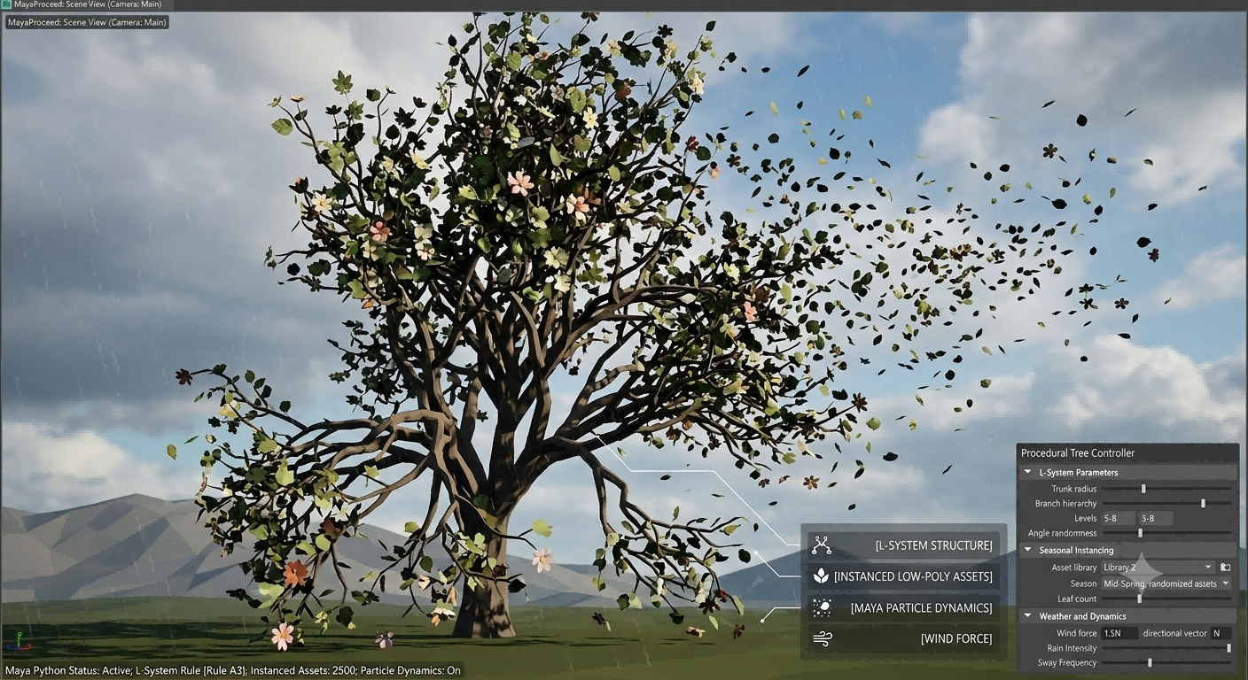
Reference Image
Generate images with Gemini
Prompt:We expect to implement procedural tree modeling in Maya Python, which is mainly used for the procedural generation and animation production of trees in games and animations to achieve the above effects. The trees are generated via L-systems; flowers and leaves are randomly selected from self-collected low-poly model assets, with instances randomly created at specific positions on the trees. The weather system and animation effects are realized through Maya's native particle effects. Generate a render image for me that is produced in Maya using the above methods and can reflect the expected effects we aim to achieve.

Slide 5
Ralated work
Our trunk generation algorithm mainly refers to open-source projects on GitHub and their cited papers:
https://github.com/openalea/lpy
https://github.com/openalea/plantgl
Boudon, T. Cokelaer, C. Pradal, P. Prusinkiewicz and C. Godin, L-Py: an L-system simulation framework for modeling plant architecture development based on a dynamic language, Frontiers in Plant Science, 30 May 2012.

Slide 6
Detail of methodology
Trunk Core Generation Algorithm
Topology Generation via Parametric and Stochastic L-Systems: Adopt weighted parallel production L-Systems (including modules such as growth points, internodes and attachment candidate points) to generate hierarchical topological structures of tree trunks and branches.
01
Deterministic Randomness with Reproducibility Guaranteed: A custom hash function is adopted in the algorithm to ensure that tree branches, bifurcations and appearances under the same seed remain absolutely stable when parameters are modified.
02
03
Space Envelope and Pipeline Constraints: Introduce tree crown envelopes of different shapes (such as ellipsoidal, conical or pendulous) to constrain the distribution of organs, and calculate backward the pipeline model radius of branches based on the terminal load index.

Slide 7
Detail of methodology
Leaf and flower generation and seasonal system
Fully decoupled organ attachment system: During the trunk generation phase, a set of "local coordinate frame attachment points" containing position, tangent and normal information is computed and output.
01
Instantiation of Asset Library Weighting Logic: According to tree species, seasons, LOD and stable hash seeds, randomly select corresponding flower and leaf assets from the organ model assets of the project by weight to carry out logical instance assembly.
02
Discrete Organ State Machine Model: Both leaves and flowers have complete life cycle state chains (such as the dormant, bud, mature, and withered states of leaves). Organs on the same tree can independently stay at different developmental stages based on probabilities, avoiding abrupt synchronous changes across the entire tree.
03
State transition calculation under environmental constraints: The state transition probability is dominated by the seasonal base matrix, with additional constraints such as temperature, humidity and organ age superimposable; its calculation results independently control the number of organs at target attachment points, the adopted models and their materials (color, roughness).
04

Slide 8
Detail of methodology
Weather System and Animation
Pure Vertex Fixed Topology Animation: The weather system does not employ any skeleton, rigid body or particle solvers. Vertex positions are updated throughout via analytical functions on a fixed topology, which drastically reduces performance overhead and facilitates vertex cache baking.
01
Trajectory replay-based leaf and blossom abscission mechanism: falling leaves and blossoms share instance parameters with organs on the tree; once the preset abscission time is reached, vertex motion seamlessly switches from swaying with branches to analytic descent trajectories, and prefabricated low-dimensional trajectory libraries are utilized to replay tumbling and spiral movements.
02
Fixed Pool Rain-Snow with Snow Cap Model: Preallocated quad pools and time modulo cycles render rain and falling snow. Snow caps matching branch/organ topology form on upward-facing surfaces, accumulating by normal, occlusion and slope; snow thickness is realized via Laplacian-smoothed vertex offset along normals.
03

Slide 9
02
AI Ethics Review

Slide 10
The AI topic we choose
The Ethical Implications of
AI-Driven 3D Modeling and Animation Generation
In this ethics review report, we focus on one of the most disruptive technological inflection points in contemporary digital media and industrial design ― AI-driven 3D modeling and animation generation.
This topic spans the full spectrum from early text-to-3D mesh generation and single-image multi-view 3D asset reconstruction, to machine learning-based automated character rigging, AI-assisted keyframe generation, and the prediction and simulation of physically interactive motion. At the core of our inquiry is the profound ethical dilemma inevitably triggered by these cutting-edge generative algorithms, even as they fundamentally reshape the digital asset production pipeline.

Slide 11
Why we want to choose the topic
First, it drives a seismic shift in productivity and creative paradigms. Traditional 3D
asset creation is labor-intensive, requiring a long and rigorous pipeline of concept
sketching, polygonal modeling, topology retopology, UV unwrapping, texture baking, and
more. Today's AI models attempt to output production-ready 3D assets through end-to-end black-box algorithms, and can even integrate with professional software and engines
such as Unity, Blender, and Maya to enable rapid scene iteration and physical state
simulation. This technological leap fundamentally disrupts conventional digital asset
creation workflows
01
Second, it sparks intense collision between "efficiency-ism" and originality. While
these AI tools dramatically lower technical barriers and multiply the efficiency of early-
stage visual concept iteration, they directly challenge traditional human definitions of
"originality" and "artistic value." Do machine-generated models possess soul? Do
algorithmically assembled motion data carry intellectual property rights? More
importantly, they exert enormous pressure on existing industry ecosystems and creative
talent cultivation systems. This is an issue of both high engineering research value and
acute real-world contradiction, urgently demanding scrutiny and intervention from the
perspective of technology ethics
02

Slide 12
How we are going to do the review
Literature Review and Industry Case Analysis
We will track landmark controversy cases that have recently emerged online. For
instance, numerous original artists and independent studios have discovered that their
painstakingly constructed 3D asset topologies, intricate ZBrush sculpting details, and
bespoke material node networks have been directly used ― without authorization ― to
train commercial 3D generative foundation models. We will analyze the legal blind spots
in these rights-protection cases and explore the gray zone between open-source
community licenses and AI commercial exploitation
01
Multi-Dimensional Stakeholder Game Analysis
The ethical issues surrounding digital asset generation are not a matter of right or wrong
along a single dimension, but rather a misalignment of interests across different groups.
We will deconstruct the issue from three core perspectives:
Foundational algorithm developers;
AI tool users (industrial designers / animators / developers);
Unauthorized training data providers (original artists).
02

Slide 13
What potential ethics issues we want to review
Data Plagiarism and Intellectual Property
Without the original creators' consent, AI models scrape vast quantities of these high value assets from major 3D asset platforms via web crawlers for deep learning. As a result, the copyright ownership of the resulting 3D models or animation clips becomes extremely ambiguous.This severely infringes upon the digital property rights of original creators and creates profound evidentiary difficulties at
the legal level.
01
Employment Disruption and Industry Exploitation
AI-driven 3D automation is quickly replacing entry-level design and animation jobs. Newcomers who once gained experience via basic modeling, UV work, and rigging now face AI that produces professional-grade assets directly. This substitution triggers unemployment, severs career progression, disrupts industry ecology, and exploits lower-tier workers.
02
Algorithmic Bias and Stereotyping
AI generative outputs rely heavily on training data. Open-source 3D libraries often carry cultural, aesthetic and physical biases, leading AI to produce racially and gender-biased 3D models and animations. For instance, generated products may follow a Western-dominant paradigm, female characters may be objectified, and behaviors may reflect cultural stereotypes. Such aesthetic homogenization and bias, amplified by algorithmic opacity, seriously threaten multicultural expression.
03
Deepfake Content and the Crisis of Trust
AI can generate photorealistic 3D and VR content. Unethical misuse of this technology may create fabricated visuals to stir social turmoil, while physically inaccurate simulated VR feedback damages user cognition, erodes public trust and brings legal risks.
04

Slide 14
感谢各位观看
Thank You

