Slide 1
Maya Python GUI Design
Prof Xiaosong Yang
Professor of Computer Animation
National Centre for Computer Animation
Faculty of Media and Communication
Bournemouth University
Email: xyang@bournemouth.ac.uk
http://staffprofiles.bournemouth.ac.uk/display/xyang

Slide 2
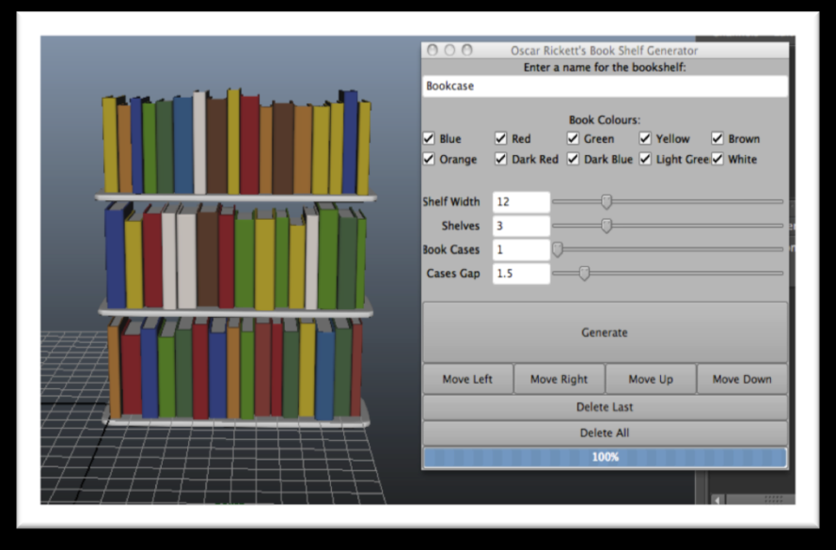
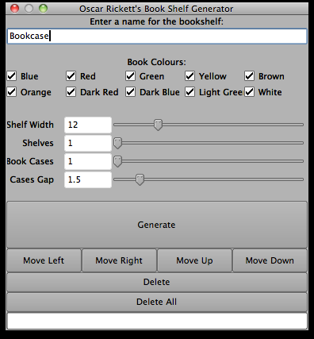
User interface

Slide 3
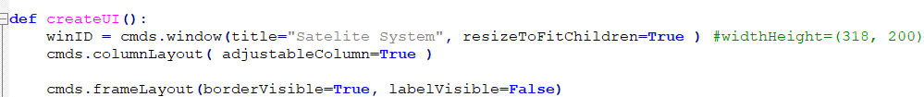
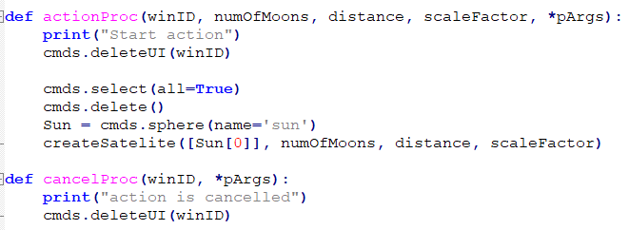
User interface (10 + 5 + 10)
10: scripting, 5 doc how to use it, 10 different result with relevant UI snapshot

Slide 4
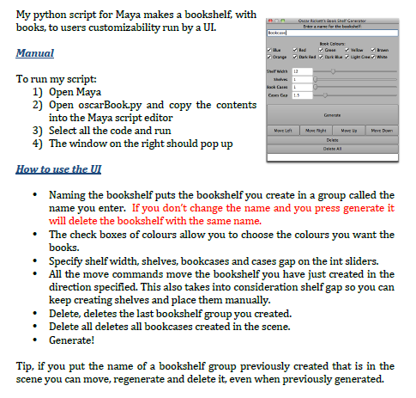
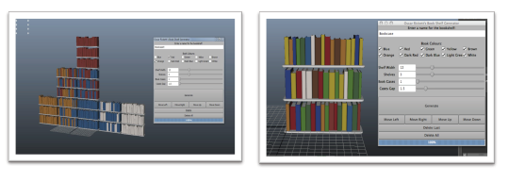
User interface (10 + 5 + 10)
10: scripting, 5 doc how to use it, 10 different result with relevant UI snapshot

Slide 5
GUI Design – essential information
10 minutes work:
Settle down the key information you want to collect from users
write a list
For each input, what is the data type, what is default value, range, options, etc.
Today: Implement the basic interface collecting (all) the required information

Slide 6
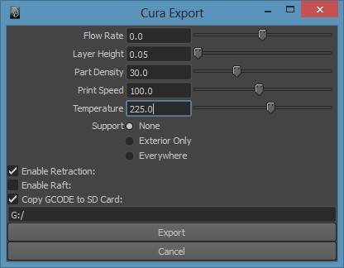
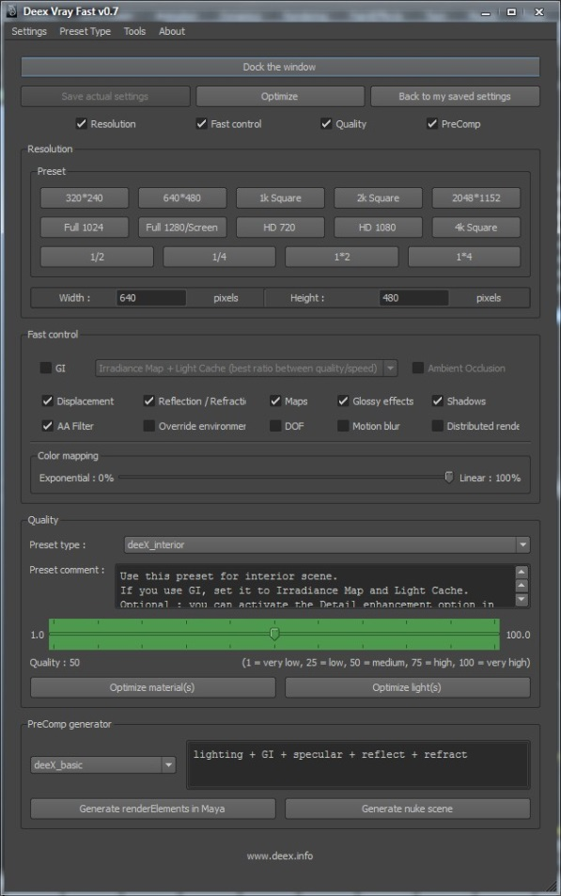
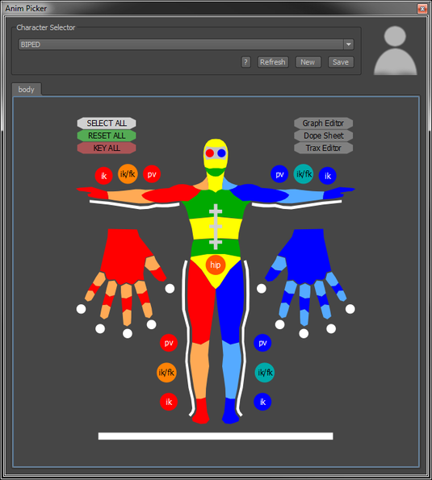
How to put them into GUI

Slide 7
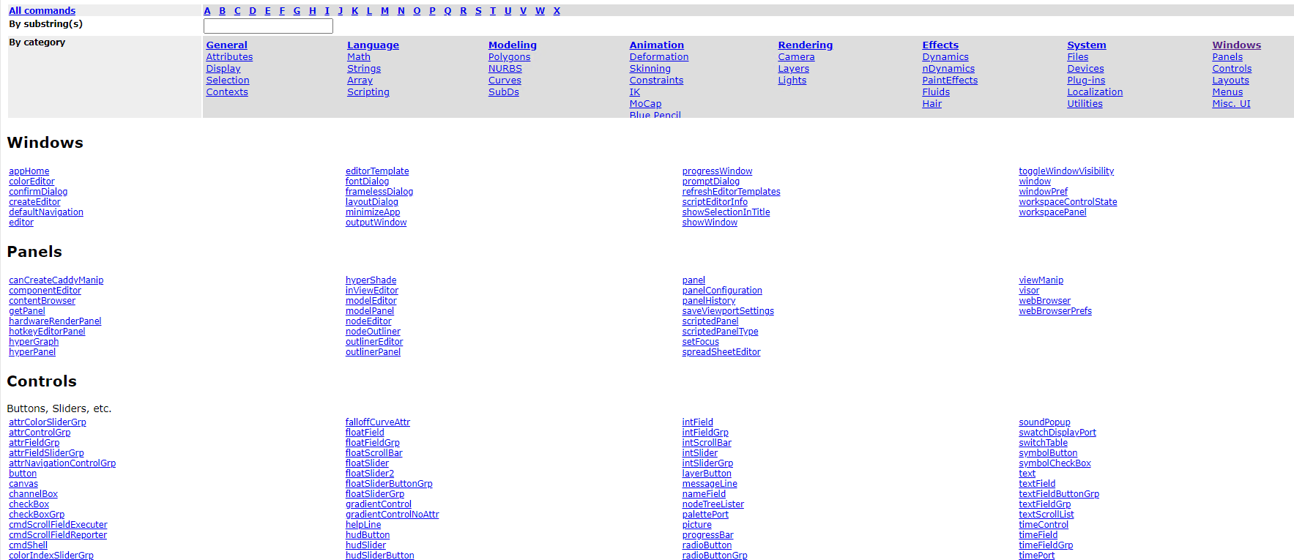
Maya Python command for GUI
https://help.autodesk.com/view/MAYADEV/2027/ENU/index.html?contextId=COMMANDSPYTHON-INDEX

Slide 8
Maya GUI – basic code structure
import maya.cmds as cmds
def createUI ( ):
...
cmds.button(command=actionCallback)
def actionCallback(*pArgs): #Variable-length arguments
...
...
# main program start from here ....
# main program
if __name__ == "__main__":
createUI( )

Slide 9
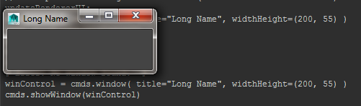
Maya GUI – create a window
def createUI ( ):
# Make a new window #
winControl = cmds.window( title="Long Name", widthHeight=(200, 55) )
...
...
cmds.showWindow( winControl )

Slide 10
Maya GUI – create a window
def createUI ( ):
windowID = "myWindow"
if cmds.window(windowID, exists=True):
cmds.deleteUI(windowID)
# Make a new window #
cmds.window( windowID, title="Long Name", widthHeight=(200, 55) )
...
...
cmds.showWindow( )

Slide 11
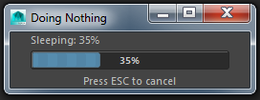
Maya GUI – create a window
progressWindow
The progressWindow command creates a window containing a status message, a graphical progress gauge, and optionally a "Hit ESC to Cancel" label for interruptable operations.
amount = 0
cmds.progressWindow(title='Doing Nothing', progress=amount, status='Sleeping: 0%', isInterruptable=True )
while True :
# Check if the dialog has been cancelled
if cmds.progressWindow( query=True, isCancelled=True ) :
break
# Check if end condition has been reached
if cmds.progressWindow( query=True, progress=True ) >= 100 :
break
amount += 5
cmds.progressWindow( edit=True, progress=amount, status=('Sleeping: ‘ + str(amount) + '%' ) )
cmds.pause( seconds=1 )
cmds.progressWindow(endProgress=1)

Slide 12
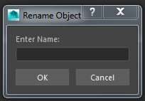
Maya GUI – create a window
promptDialog
The promptDialog command creates a modal dialog with a message to the user, a text field in which the user may enter a response, and a variable number of buttons to dismiss the dialog.
result = cmds.promptDialog(
title='Rename Object',
message='Enter Name:',
button=['OK', 'Cancel'],
defaultButton='OK',
cancelButton='Cancel',
dismissString='Cancel')
if result == 'OK':
text = cmds.promptDialog(query=True, text=True)
print(text)

Slide 13
Maya GUI – Layout (hierarchical)
columnLayout
dockControl
flowLayout
formLayout
frameLayout
gridLayout
menuBarLayout
paneLayout
rowColumnLayout
rowLayout
scrollLayout
shelfLayout
shelfTabLayout
tabLayout
toolBar

Slide 14
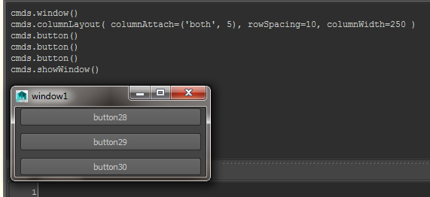
Maya GUI – columnLayout
This command creates a layout that arranges its children in a single column.
cmds.window()
cmds.columnLayout( columnAttach=('both', 5), rowSpacing=10, columnWidth=250 )
cmds.button()
cmds.button()
cmds.button()
cmds.showWindow()

Slide 15
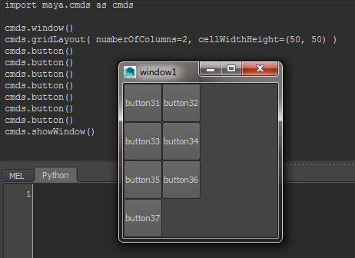
Maya GUI – gridLayout
This layout arranges children in a grid fashion where every cell in the grid is the same size. You may specify the number of rows and columns as well as the width and height of the grid cells.
cmds.window()
cmds.gridLayout( numberOfColumns=2, cellWidthHeight=(50, 50) )
cmds.button()
cmds.button()
cmds.button()
cmds.button()
cmds.button()
cmds.button()
cmds.button()
cmds.showWindow()

Slide 16
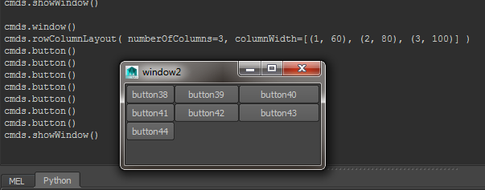
Maya GUI – rowColumnLayout
This command creates a rowColumn layout. A rowColumn layout positions children in either a row or column format. A column layout, specified with the -nc/numberOfColumns flag, allows you set text alignment, attachments and offsets for each column in the layout. Every member of a column will have the same alignment, attachment and offsets. Likewise the row format, specified by the -nr/numberOfRows flag, allows setting of these attributes for each row in the layout. Every member of a row will have the same attributes. The layout must be either a row or column format.
cmds.window()
cmds.rowColumnLayout( numberOfColumns=3, columnWidth=[(1, 60), (2, 80), (3, 100)] )
cmds.button()
cmds.button()
cmds.button()
cmds.button()
cmds.button()
cmds.button()
cmds.button()
cmds.showWindow()

Slide 17
Maya GUI – Layout (hierarchical)
columnLayout
formLayout
button1
button2
intField
frameLayout
picture
“Current Parent” changes when create a new layout.
setParent
This command changes the default parent to be the specified parent. Two special parents are "|" which indicates the top level layout of the window hierarchy, or ".." which indicates one level up in the hierarchy.
A control must be parented to a control layout. A control layout may be parented to another control layout or a window.
setParent( [string] , [defineTemplate=string], [menu=boolean], [topLevel=boolean], [upLevel=boolean], [useTemplate=string])

Slide 18
Maya GUI – Controls
attrColorSliderGrp attrControlGrp attrFieldGrp attrFieldSliderGrp attrNavigationControlGrp button canvas channelBox checkBox checkBoxGrp cmdScrollFieldExecuter cmdScrollFieldReporter cmdShell colorIndexSliderGrp colorSliderButtonGrp colorSliderGrp commandLine componentBox control floatField floatFieldGrp floatScrollBar floatSlider floatSlider2 floatSliderButtonGrp floatSliderGrp gradientControl gradientControlNoAttr helpLine hudButton hudSlider hudSliderButton iconTextButton iconTextCheckBox iconTextRadioButton iconTextRadioCollection iconTextScrollList iconTextStaticLabel image intField intFieldGrp intScrollBar intSlider intSliderGrp layerButton messageLine nameField nodeTreeLister palettePort picture progressBar radioButton radioButtonGrp radioCollection rangeControl scriptTable scrollField separator shelfButton soundControl swatchDisplayPort switchTable symbolButton symbolCheckBox text textField textFieldButtonGrp textFieldGrp textScrollList timeControl timePort toolButton toolCollection treeLister treeView

Slide 19
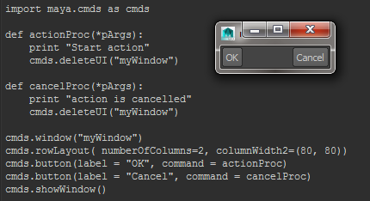
Maya GUI – button
import maya.cmds as cmds
def actionProc(*pArgs):
print("Start action")
cmds.deleteUI("myWindow")
def cancelProc(*pArgs):
print("action is cancelled")
cmds.deleteUI("myWindow")
# the main program start from here ....
cmds.window("myWindow")
cmds.rowLayout( numberOfColumns=2, columnWidth2=(80, 80))
cmds.button(label = "OK", command = actionProc)
cmds.button(label = "Cancel", command = cancelProc)
cmds.showWindow()

Slide 20
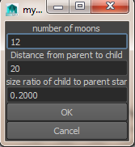
Maya GUI – text, intField, floatField
import maya.cmds as cmds
def actionProc(*pArgs):
print("Start action")
cmds.deleteUI("myWindow")
def cancelProc(*pArgs):
print("action is cancelled")
cmds.deleteUI("myWindow")
def createUI():
cmds.window("myWindow")
cmds.columnLayout( adjustableColumn=True )
cmds.text( label='number of moons' )
numMoonsControl = cmds.intField( minValue=4, maxValue=20, value=12)
cmds.text( label='Distance from parent to child' )
distControl = cmds.intField( minValue=5, maxValue=40, value=20)
cmds.text( label='size ratio of child to parent star' )
resizeControl = cmds.floatField( minValue = 0.1, maxValue = 1, value = 0.2, step = 0.01 )
cmds.button(label = "OK", command = actionProc)
cmds.button(label = "Cancel", command = cancelProc)
cmds.showWindow()
createUI()

Slide 21
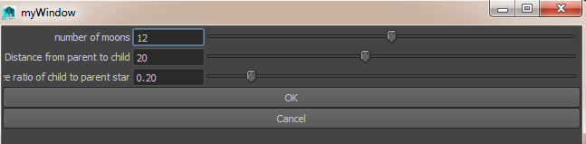
Maya GUI – text, intSliderGrp, floatSliderGrp
import maya.cmds as cmds
def actionProc(*pArgs):
print("Start action")
cmds.deleteUI("myWindow")
def cancelProc(*pArgs):
print("action is cancelled")
cmds.deleteUI("myWindow")
def createUI():
cmds.window("myWindow")
cmds.columnLayout( adjustableColumn=True )
numMoonsControl = cmds.intSliderGrp(label='number of moons', minValue=4, maxValue=20, value=12, field=True)
distControl = cmds.intSliderGrp(label='Distance from parent to child', minValue=5, maxValue=40, value=20, field=True)
resizeControl = cmds.floatSliderGrp( label='size ratio of child to parent star', minValue=0.1, maxValue=1, value=0.2, step=0.01, field = True )
cmds.button(label = "OK", command = actionProc)
cmds.button(label = "Cancel", command = cancelProc)
cmds.showWindow()
createUI()

Slide 22
Maya GUI – fetch the value from UI
Query mode
numMoonsControl = cmds.intSliderGrp(label='number of moons',
minValue=4, maxValue=20, value=12, field=True)
cmds.intSliderGrp(numMoonsControl, query=True, value=True)
Different functions ????
def createUI( ):
numMoonsControl = cmds.intSliderGrp(label='number of moons',
minValue=4, maxValue=20, value=12, field=True)
def actionProc(*pArgs):
cmds.intSliderGrp(numMoonsControl, query=True, value=True)

Slide 23
Maya GUI – fetch the value from UI
Query mode
# 1st method
import functools
cmds.button(label='OK', command=functools.partial(actionProc, numMoonsControl, distControl, resizeControl))
# actionProc function take the control name instead of the value!!!
def actionProc(numMoonsControl, distControl, resizeControl, *pArgs):
numMools = cmds.intSliderGrp(numMoonsControl, query=True, value=True)
# 2nd method
cmds.button(label = "OK", command = lambda *args:
actionProc(cmds.intSliderGrp(numMoonsControl, query=True, value=True),
cmds.intSliderGrp(distControl, query=True, value=True), cmds.floatSliderGrp(resizeControl,
query=True, value=True)))
def actionProc(numMoons, dist, resizeValue, *pArgs):

Slide 24
Maya GUI – fetch the value from UI
#3rd method – risk!!!
cmds.intSliderGrp('numMoonsControl', mylabel='number of moons', minValue=4, maxValue=20, value=12, field=True)
cmds.button(label = "OK", command = actionProc)
def actionProc( *pArgs):
numMoons = cmds.intSliderGrp('numMoonsControl', query=True, value=True)
Don’t use constant value

Slide 25
Maya GUI – fetch the value from UI
# 4th method – someplace holding the control name
Class member, attribute
Maya node attribute (create new node or create new attribute, etc.)
Global variables
Don’t use global variable

Slide 26
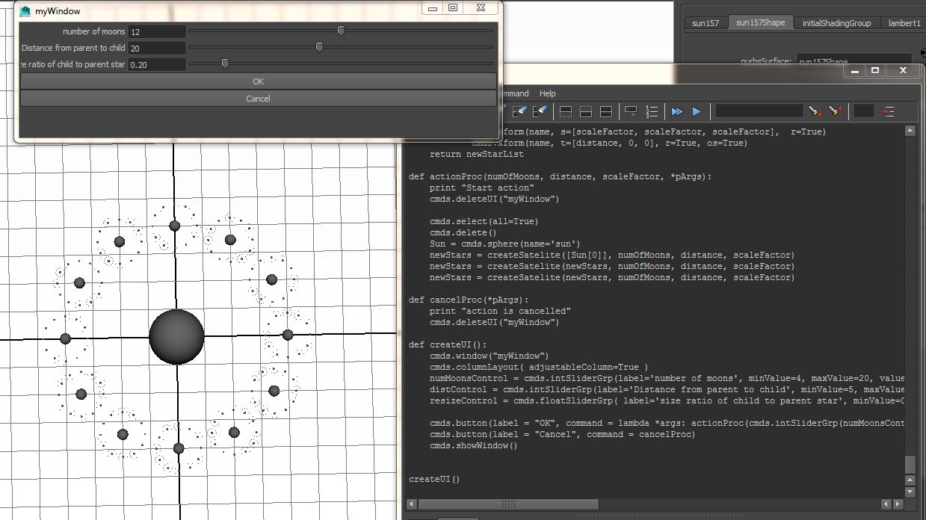
Example – UI Satellite System

Slide 27
Maya GUI – basic code structure
import maya.cmds as cmds
def createUI ( ):
def actionCallback( … ):
createCity(…)
def createCity(width, depth, numBlocks, numBuilding):
print width, depth, numBlocks, numBuilding
# main program start from here ....
# main program
if __name__ == "__main__":
createUI( )

Slide 28
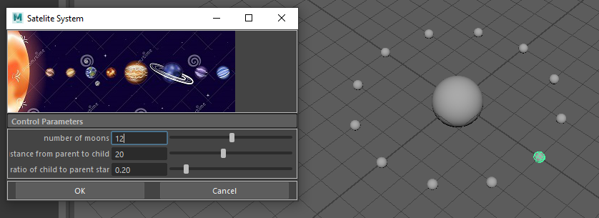
Exercise

Slide 29
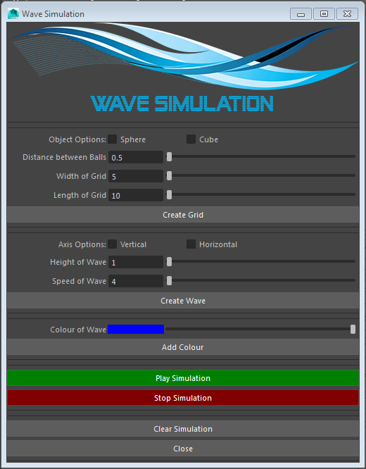
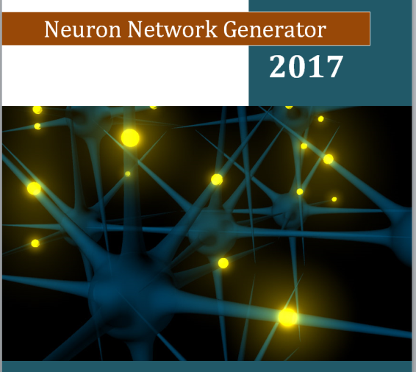
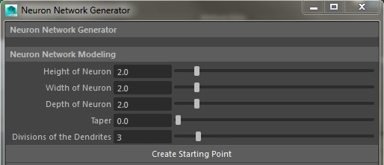
Exercise – Interface for your project

Slide 30
Maya Python GUI Exercise
Finish the design of the GUI for your project
Each group submit your design (word doc) before the lecture on the next day
Visual Design - Draw/sketch your UI
Hierarchy of layouts and controls
Key callback functions
Windows
formLayout
button1
button2
intField
frameLayout
picture

