Slide 1
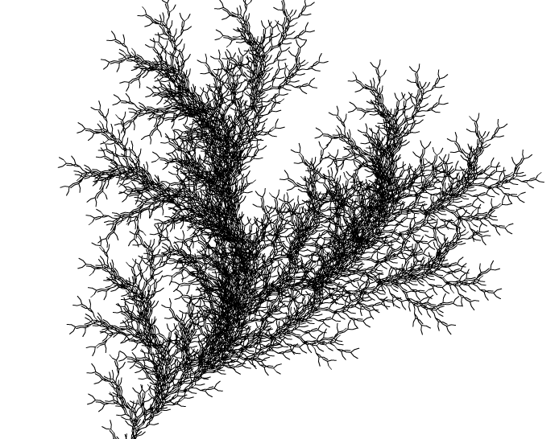
L-System
Prof Xiaosong Yang
Professor of Computer Animation
National Centre for Computer Animation
Faculty of Media and Communication
Bournemouth University
Email: xyang@bournemouth.ac.uk
http://staffprofiles.bournemouth.ac.uk/display/xyang

Slide 2
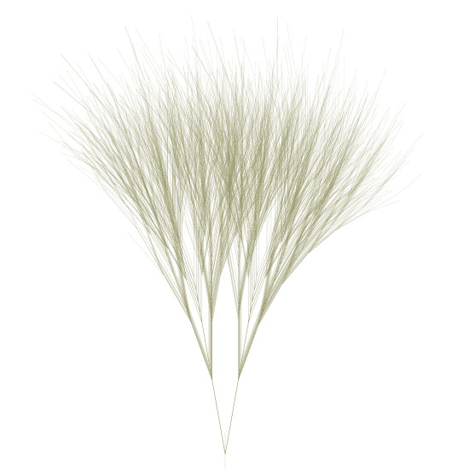

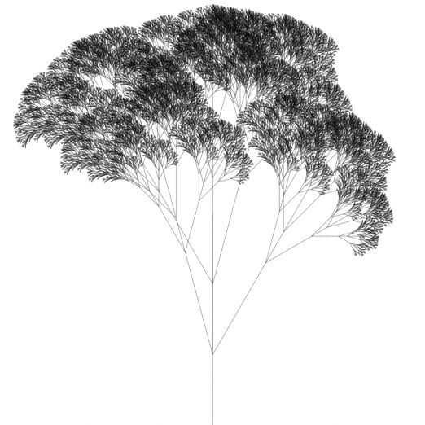
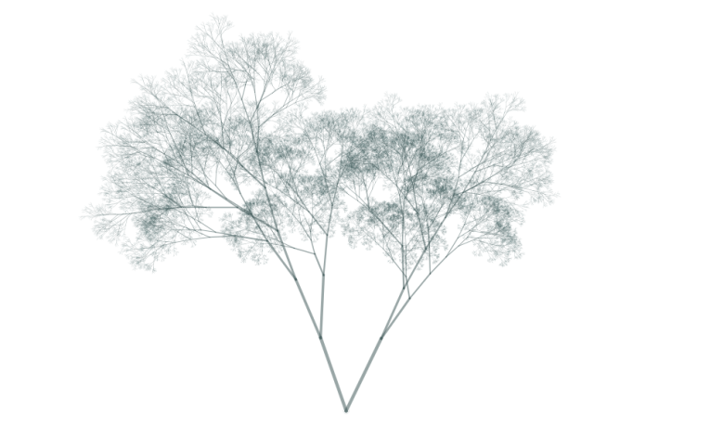
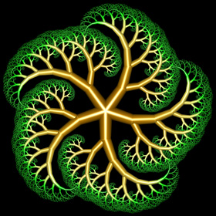
L-System - Plant growth

Slide 3
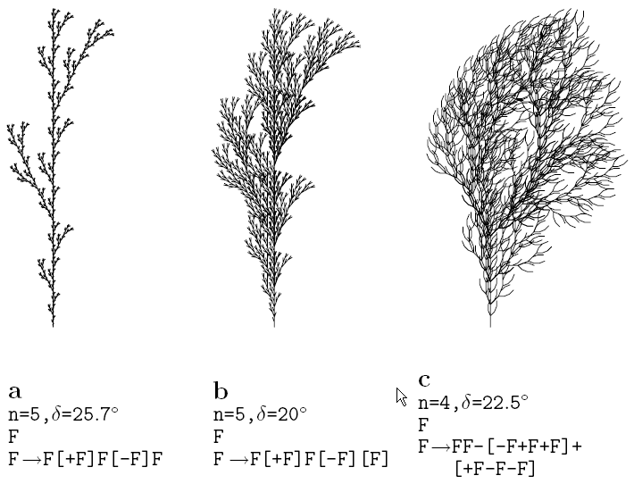
L-System - Plant growth
Notes:
δdelta

Slide 4
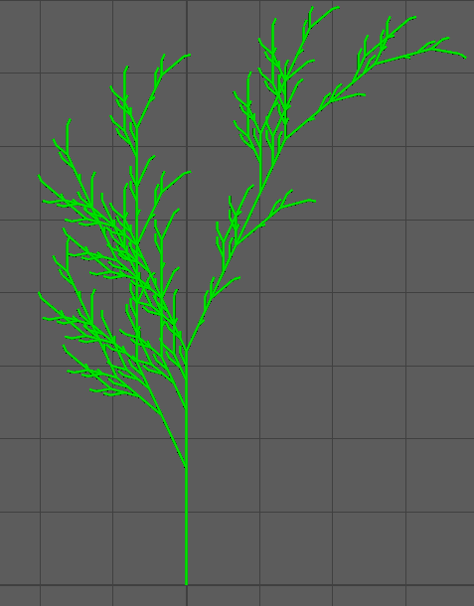
L-System - Plant growth
n = 5, X, 25
X -> F-[[X]+X]+F[+FX]-X
F -> FF
FFFFFFFFFFFFFFFF-[[FFFFFFFF-[[FFFF-[[FF-[[F-[[X]+X]+F[+FX]-X]+F-[[X]+X]+F[+FX]-X]+FF[+FFF-[[X]+X]+F[+FX]-X]-F-[[X]+X]+F[+FX]-X]+FF-[[F-[[X]+X]+F[+FX]-X]+F-[[X]+X]+F[+FX]-X]+FF[+FFF-[[X]+X]+F[+FX]-X]-F-[[X]+X]+F[+FX]-X]+FFFF[+FFFFFF-[[F-[[X]+X]+F[+FX]-X]+F-[[X]+X]+F[+FX]-X]+FF[+FFF-[[X]+X]+F[+FX]-X]-F-[[X]+X]+F[+FX]-X]-FF-[[F-[[X]+X]+F[+FX]-X]+F-[[X]+X]+F[+FX]-X]+FF[+FFF-[[X]+X]+F[+FX]-X]-F-[[X]+X]+F[+FX]-X]+FFFF-[[FF-[[F-[[X]+X]+F[+FX]-X]+F-[[X]+X]+F[+FX]-X]+FF[+FFF-[[X]+X]+F[+FX]-X]-F-[[X]+X]+F[+FX]-X]+FF-[[F-[[X]+X]+F[+FX]-X]+F-[[X]+X]+F[+FX]-X]+FF[+FFF-[[X]+X]+F[+FX]-X]-F-[[X]+X]+F[+FX]-X]+FFFF[+FFFFFF-[[F-[[X]+X]+F[+FX]-X]+F-[[X]+X]+F[+FX]-X]+FF[+FFF-[[X]+X]+F[+FX]-X]-F-[[X]+X]+F[+FX]-X]-FF-[[F-[[X]+X]+F[+FX]-X]+F-[[X]+X]+F[+FX]-X]+FF[+FFF-[[X]+X]+F[+FX]-X]-F-[[X]+X]+F[+FX]-X]+FFFFFFFF[+FFFFFFFFFFFF-[[FF-[[F-[[X]+X]+F[+FX]-X]+F-[[X]+X]+F[+FX]-X]+FF[+FFF-[[X]+X]+F[+FX]-X]-F-[[X]+X]+F[+FX]-X]+FF-[[F-[[X]+X]+F[+FX]-X]+F-[[X]+X]+F[+FX]-X]+FF[+FFF-[[X]+X]+F[+FX]-X]-F-[[X]+X]+F[+FX]-X]+FFFF[+FFFFFF-[[F-[[X]+X]+F[+FX]-X]+F-[[X]+X]+F[+FX]-X]+FF[+FFF-[[X]+X]+F[+FX]-X]-F-[[X]+X]+F[+FX]-X]-FF-[[F-[[X]+X]+F[+FX]-X]+F-[[X]+X]+F[+FX]-X]+FF[+FFF-[[X]+X]+F[+FX]-X]-F-[[X]+X]+F[+FX]-X]-FFFF-[[FF-[[F-[[X]+X]+F[+FX]-X]+F-[[X]+X]+F[+FX]-X]+FF[+FFF-[[X]+X]+F[+FX]-X]-F-[[X]+X]+F[+FX]-X]+FF-[[F-[[X]+X]+F[+FX]-X]+F-[[X]+X]+F[+FX]-X]+FF[+FFF-[[X]+X]+F[+FX]-X]-F-[[X]+X]+F[+FX]-X]+FFFF[+FFFFFF-[[F-[[X]+X]+F[+FX]-X]+F-[[X]+X]+F[+FX]-X]+FF[+FFF-[[X]+X]+F[+FX]-X]-F-[[X]+X]+F[+FX]-X]-FF-[[F-[[X]+X]+F[+FX]-X]+F-[[X]+X]+F[+FX]-X]+FF[+FFF-[[X]+X]+F[+FX]-X]-F-[[X]+X]+F[+FX]-X]+FFFFFFFF-[[FFFF-[[FF-[[F-[[X]+X]+F[+FX]-X]+F-[[X]+X]+F[+FX]-X]+FF[+FFF-[[X]+X]+F[+FX]-X]-F-[[X]+X]+F[+FX]-X]+FF-[[F-[[X]+X]+F[+FX]-X]+F-[[X]+X]+F[+FX]-X]+FF[+FFF-[[X]+X]+F[+FX]-X]-F-[[X]+X]+F[+FX]-X]+FFFF[+FFFFFF-[[F-[[X]+X]+F[+FX]-X]+F-[[X]+X]+F[+FX]-X]+FF[+FFF-[[X]+X]+F[+FX]-X]-F-[[X]+X]+F[+FX]-X]-FF-[[F-[[X]+X]+F[+FX]-X]+F-[[X]+X]+F[+FX]-X]+FF[+FFF-[[X]+X]+F[+FX]-X]-F-[[X]+X]+F[+FX]-X]+FFFF-[[FF-[[F-[[X]+X]+F[+FX]-X]+F-[[X]+X]+F[+FX]-X]+FF[+FFF-[[X]+X]+F[+FX]-X]-F-[[X]+X]+F[+FX]-X]+FF-[[F-[[X]+X]+F[+FX]-X]+F-[[X]+X]+F[+FX]-X]+FF[+FFF-[[X]+X]+F[+FX]-X]-F-[[X]+X]+F[+FX]-X]+FFFF[+FFFFFF-[[F-[[X]+X]+F[+FX]-X]+F-[[X]+X]+F[+FX]-X]+FF[+FFF-[[X]+X]+F[+FX]-X]-F-[[X]+X]+F[+FX]-X]-FF-[[F-[[X]+X]+F[+FX]-X]+F-[[X]+X]+F[+FX]-X]+FF[+FFF-[[X]+X]+F[+FX]-X]-F-[[X]+X]+F[+FX]-X]+FFFFFFFF[+FFFFFFFFFFFF-[[FF-[[F-[[X]+X]+F[+FX]-X]+F-[[X]+X]+F[+FX]-X]+FF[+FFF-[[X]+X]+F[+FX]-X]-F-[[X]+X]+F[+FX]-X]+FF-[[F-[[X]+X]+F[+FX]-X]+F-[[X]+X]+F[+FX]-X]+FF[+FFF-[[X]+X]+F[+FX]-X]-F-[[X]+X]+F[+FX]-X]+FFFF[+FFFFFF-[[F-[[X]+X]+F[+FX]-X]+F-[[X]+X]+F[+FX]-X]+FF[+FFF-[[X]+X]+F[+FX]-X]-F-[[X]+X]+F[+FX]-X]-FF-[[F-[[X]+X]+F[+FX]-X]+F-[[X]+X]+F[+FX]-X]+FF[+FFF-[[X]+X]+F[+FX]-X]-F-[[X]+X]+F[+FX]-X]-FFFF-[[FF-[[F-[[X]+X]+F[+FX]-X]+F-[[X]+X]+F[+FX]-X]+FF[+FFF-[[X]+X]+F[+FX]-X]-F-[[X]+X]+F[+FX]-X]+FF-[[F-[[X]+X]+F[+FX]-X]+F-[[X]+X]+F[+FX]-X]+FF[+FFF-[[X]+X]+F[+FX]-X]-F-[[X]+X]+F[+FX]-X]+FFFF[+FFFFFF-[[F-[[X]+X]+F[+FX]-X]+F-[[X]+X]+F[+FX]-X]+FF[+FFF-[[X]+X]+F[+FX]-X]-F-[[X]+X]+F[+FX]-X]-FF-[[F-[[X]+X]+F[+FX]-X]+F-[[X]+X]+F[+FX]-X]+FF[+FFF-[[X]+X]+F[+FX]-X]-F-[[X]+X]+F[+FX]-X]+FFFFFFFFFFFFFFFF[+FFFFFFFFFFFFFFFFFFFFFFFF-[[FFFF-[[FF-[[F-[[X]+X]+F[+FX]-X]+F-[[X]+X]+F[+FX]-X]+FF[+FFF-[[X]+X]+F[+FX]-X]-F-[[X]+X]+F[+FX]-X]+FF-[[F-[[X]+X]+F[+FX]-X]+F-[[X]+X]+F[+FX]-X]+FF[+FFF-[[X]+X]+F[+FX]-X]-F-[[X]+X]+F[+FX]-X]+FFFF[+FFFFFF-[[F-[[X]+X]+F[+FX]-X]+F-[[X]+X]+F[+FX]-X]+FF[+FFF-[[X]+X]+F[+FX]-X]-F-[[X]+X]+F[+FX]-X]-FF-[[F-[[X]+X]+F[+FX]-X]+F-[[X]+X]+F[+FX]-X]+FF[+FFF-[[X]+X]+F[+FX]-X]-F-[[X]+X]+F[+FX]-X]+FFFF-[[FF-[[F-[[X]+X]+F[+FX]-X]+F-[[X]+X]+F[+FX]-X]+FF[+FFF-[[X]+X]+F[+FX]-X]-F-[[X]+X]+F[+FX]-X]+FF-[[F-[[X]+X]+F[+FX]-X]+F-[[X]+X]+F[+FX]-X]+FF[+FFF-[[X]+X]+F[+FX]-X]-F-[[X]+X]+F[+FX]-X]+FFFF[+FFFFFF-[[F-[[X]+X]+F[+FX]-X]+F-[[X]+X]+F[+FX]-X]+FF[+FFF-[[X]+X]+F[+FX]-X]-F-[[X]+X]+F[+FX]-X]-FF-[[F-[[X]+X]+F[+FX]-X]+F-[[X]+X]+F[+FX]-X]+FF[+FFF-[[X]+X]+F[+FX]-X]-F-[[X]+X]+F[+FX]-X]+FFFFFFFF[+FFFFFFFFFFFF-[[FF-[[F-[[X]+X]+F[+FX]-X]+F-[[X]+X]+F[+FX]-X]+FF[+FFF-[[X]+X]+F[+FX]-X]-F-[[X]+X]+F[+FX]-X]+FF-[[F-[[X]+X]+F[+FX]-X]+F-[[X]+X]+F[+FX]-X]+FF[+FFF-[[X]+X]+F[+FX]-X]-F-[[X]+X]+F[+FX]-X]+FFFF[+FFFFFF-[[F-[[X]+X]+F[+FX]-X]+F-[[X]+X]+F[+FX]-X]+FF[+FFF-[[X]+X]+F[+FX]-X]-F-[[X]+X]+F[+FX]-X]-FF-[[F-[[X]+X]+F[+FX]-X]+F-[[X]+X]+F[+FX]-X]+FF[+FFF-[[X]+X]+F[+FX]-X]-F-[[X]+X]+F[+FX]-X]-FFFF-[[FF-[[F-[[X]+X]+F[+FX]-X]+F-[[X]+X]+F[+FX]-X]+FF[+FFF-[[X]+X]+F[+FX]-X]-F-[[X]+X]+F[+FX]-X]+FF-[[F-[[X]+X]+F[+FX]-X]+F-[[X]+X]+F[+FX]-X]+FF[+FFF-[[X]+X]+F[+FX]-X]-F-[[X]+X]+F[+FX]-X]+FFFF[+FFFFFF-[[F-[[X]+X]+F[+FX]-X]+F-[[X]+X]+F[+FX]-X]+FF[+FFF-[[X]+X]+F[+FX]-X]-F-[[X]+X]+F[+FX]-X]-FF-[[F-[[X]+X]+F[+FX]-X]+F-[[X]+X]+F[+FX]-X]+FF[+FFF-[[X]+X]+F[+FX]-X]-F-[[X]+X]+F[+FX]-X]-FFFFFFFF-[[FFFF-[[FF-[[F-[[X]+X]+F[+FX]-X]+F-[[X]+X]+F[+FX]-X]+FF[+FFF-[[X]+X]+F[+FX]-X]-F-[[X]+X]+F[+FX]-X]+FF-[[F-[[X]+X]+F[+FX]-X]+F-[[X]+X]+F[+FX]-X]+FF[+FFF-[[X]+X]+F[+FX]-X]-F-[[X]+X]+F[+FX]-X]+FFFF[+FFFFFF-[[F-[[X]+X]+F[+FX]-X]+F-[[X]+X]+F[+FX]-X]+FF[+FFF-[[X]+X]+F[+FX]-X]-F-[[X]+X]+F[+FX]-X]-FF-[[F-[[X]+X]+F[+FX]-X]+F-[[X]+X]+F[+FX]-X]+FF[+FFF-[[X]+X]+F[+FX]-X]-F-[[X]+X]+F[+FX]-X]+FFFF-[[FF-[[F-[[X]+X]+F[+FX]-X]+F-[[X]+X]+F[+FX]-X]+FF[+FFF-[[X]+X]+F[+FX]-X]-F-[[X]+X]+F[+FX]-X]+FF-[[F-[[X]+X]+F[+FX]-X]+F-[[X]+X]+F[+FX]-X]+FF[+FFF-[[X]+X]+F[+FX]-X]-F-[[X]+X]+F[+FX]-X]+FFFF[+FFFFFF-[[F-[[X]+X]+F[+FX]-X]+F-[[X]+X]+F[+FX]-X]+FF[+FFF-[[X]+X]+F[+FX]-X]-F-[[X]+X]+F[+FX]-X]-FF-[[F-[[X]+X]+F[+FX]-X]+F-[[X]+X]+F[+FX]-X]+FF[+FFF-[[X]+X]+F[+FX]-X]-F-[[X]+X]+F[+FX]-X]+FFFFFFFF[+FFFFFFFFFFFF-[[FF-[[F-[[X]+X]+F[+FX]-X]+F-[[X]+X]+F[+FX]-X]+FF[+FFF-[[X]+X]+F[+FX]-X]-F-[[X]+X]+F[+FX]-X]+FF-[[F-[[X]+X]+F[+FX]-X]+F-[[X]+X]+F[+FX]-X]+FF[+FFF-[[X]+X]+F[+FX]-X]-F-[[X]+X]+F[+FX]-X]+FFFF[+FFFFFF-[[F-[[X]+X]+F[+FX]-X]+F-[[X]+X]+F[+FX]-X]+FF[+FFF-[[X]+X]+F[+FX]-X]-F-[[X]+X]+F[+FX]-X]-FF-[[F-[[X]+X]+F[+FX]-X]+F-[[X]+X]+F[+FX]-X]+FF[+FFF-[[X]+X]+F[+FX]-X]-F-[[X]+X]+F[+FX]-X]-FFFF-[[FF-[[F-[[X]+X]+F[+FX]-X]+F-[[X]+X]+F[+FX]-X]+FF[+FFF-[[X]+X]+F[+FX]-X]-F-[[X]+X]+F[+FX]-X]+FF-[[F-[[X]+X]+F[+FX]-X]+F-[[X]+X]+F[+FX]-X]+FF[+FFF-[[X]+X]+F[+FX]-X]-F-[[X]+X]+F[+FX]-X]+FFFF[+FFFFFF-[[F-[[X]+X]+F[+FX]-X]+F-[[X]+X]+F[+FX]-X]+FF[+FFF-[[X]+X]+F[+FX]-X]-F-[[X]+X]+F[+FX]-X]-FF-[[F-[[X]+X]+F[+FX]-X]+F-[[X]+X]+F[+FX]-X]+FF[+FFF-[[X]+X]+F[+FX]-X]-F-[[X]+X]+F[+FX]-X

Slide 5
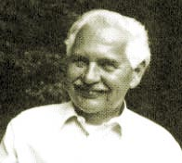
L-System
Development process of plants is captured in the formalism of L-systems
Aristid Lindenmayer (November 17, 1925 – October 30, 1989) was a Hungarian biologist. In 1968 he developed a type of formal languages that is today called L-systems or Lindenmayer Systems. Using those systems Lindenmayer modelled the behaviour of cells of plants.
Later applied to investigate higher plants and plant organs
Geometric interpretations of L-systems allowed realistic graphical visualizations of plants

Slide 6
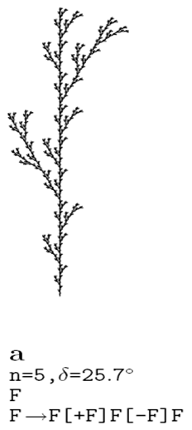
L-System – Modelling Plants
L-systems make use of rewriting – defining complex objects by successively replacing parts of a simple initial object using a set of rewriting rules or productions

Slide 7
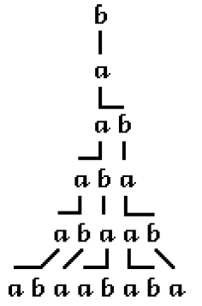
L-System – Modelling Plants
In grammars, production rules are applied sequentially, whereas in L-systems they are applied in parallel and simultaneously replace all letters in a given word
For example:
a→ ab means the letter a is to be replaced with ab
b→ a means the letter b is to be replaced with a

Slide 8
L-System – Action String Developing
Starting string F (axiom)
Iteration of replacing each character in the current string with new string following the growing rules
Start string: F
1) F[+F]F[-F]F
2)F[+F]F[-F]F[+F[+F]F[-F]F]F[+F]F[-F]F[-F[+F]F[-F]F]F[+F]F[-F]F
3) ...

Slide 9
L-System – Interpret string for modeling
n = 5, X, δ=25
X -> F-[[X]+X]+F[+FX]-X
F -> FF
FFFFFFFFFFFFFFFF-[[FFFFFFFF-[[FFFF-[[FF-[[F-[[X]+X]+F[+FX]-X]+F-[[X]+X]+F[+FX]-X]+FF[+FFF-[[X]+X]+F[+FX]-X]-F-[[X]+X]+F[+FX]-X]+FF-[[F-[[X]+X]+F[+FX]-X]+F-[[X]+X]+F[+FX]-X]+FF[+FFF-[[X]+X]+F[+FX]-X]-F-[[X]+X]+F[+FX]-X]+FFFF[+FFFFFF-[[F-[[X]+X]+F[+FX]-X]+F-[[X]+X]+F[+FX]-X]+FF[+FFF-[[X]+X]+F[+FX]-X]-F-[[X]+X]+F[+FX]-X]-FF-[[F-[[X]+X]+F[+FX]-X]+F-[[X]+X]+F[+FX]-X]+FF[+FFF-[[X]+X]+F[+FX]-X]-F-[[X]+X]+F[+FX]-X]+FFFF-[[FF-[[F-[[X]+X]+F[+FX]-X]+F-[[X]+X]+F[+FX]-X]+FF[+FFF-[[X]+X]+F[+FX]-X]-F-[[X]+X]+F[+FX]-X]+FF-[[F-[[X]+X]+F[+FX]-X]+F-[[X]+X]+F[+FX]-X]+FF[+FFF-[[X]+X]+F[+FX]-X]-F-[[X]+X]+F[+FX]-X]+FFFF[+FFFFFF-[[F-[[X]+X]+F[+FX]-X]+F-[[X]+X]+F[+FX]-X]+FF[+FFF-[[X]+X]+F[+FX]-X]-F-[[X]+X]+F[+FX]-X]-FF-[[F-[[X]+X]+F[+FX]-X]+F-[[X]+X]+F[+FX]-X]+FF[+FFF-[[X]+X]+F[+FX]-X]-F-[[X]+X]+F[+FX]-X]+FFFFFFFF[+FFFFFFFFFFFF-[[FF-[[F-[[X]+X]+F[+FX]-X]+F-[[X]+X]+F[+FX]-X]+FF[+FFF-[[X]+X]+F[+FX]-X]-F-[[X]+X]+F[+FX]-X]+FF-[[F-[[X]+X]+F[+FX]-X]+F-[[X]+X]+F[+FX]-X]+FF[+FFF-[[X]+X]+F[+FX]-X]-F-[[X]+X]+F[+FX]-X]+FFFF[+FFFFFF-[[F-[[X]+X]+F[+FX]-X]+F-[[X]+X]+F[+FX]-X]+FF[+FFF-[[X]+X]+F[+FX]-X]-F-[[X]+X]+F[+FX]-X]-FF-[[F-[[X]+X]+F[+FX]-X]+F-[[X]+X]+F[+FX]-X]+FF[+FFF-[[X]+X]+F[+FX]-X]-F-[[X]+X]+F[+FX]-X]-FFFF-[[FF-[[F-[[X]+X]+F[+FX]-X]+F-[[X]+X]+F[+FX]-X]+FF[+FFF-[[X]+X]+F[+FX]-X]-F-[[X]+X]+F[+FX]-X]+FF-[[F-[[X]+X]+F[+FX]-X]+F-[[X]+X]+F[+FX]-X]+FF[+FFF-[[X]+X]+F[+FX]-X]-F-[[X]+X]+F[+FX]-X]+FFFF[+FFFFFF-[[F-[[X]+X]+F[+FX]-X]+F-[[X]+X]+F[+FX]-X]+FF[+FFF-[[X]+X]+F[+FX]-X]-F-[[X]+X]+F[+FX]-X]-FF-[[F-[[X]+X]+F[+FX]-X]+F-[[X]+X]+F[+FX]-X]+FF[+FFF-[[X]+X]+F[+FX]-X]-F-[[X]+X]+F[+FX]-X]+FFFFFFFF-[[FFFF-[[FF-[[F-[[X]+X]+F[+FX]-X]+F-[[X]+X]+F[+FX]-X]+FF[+FFF-[[X]+X]+F[+FX]-X]-F-[[X]+X]+F[+FX]-X]+FF-[[F-[[X]+X]+F[+FX]-X]+F-[[X]+X]+F[+FX]-X]+FF[+FFF-[[X]+X]+F[+FX]-X]-F-[[X]+X]+F[+FX]-X]+FFFF[+FFFFFF-[[F-[[X]+X]+F[+FX]-X]+F-[[X]+X]+F[+FX]-X]+FF[+FFF-[[X]+X]+F[+FX]-X]-F-[[X]+X]+F[+FX]-X]-FF-[[F-[[X]+X]+F[+FX]-X]+F-[[X]+X]+F[+FX]-X]+FF[+FFF-[[X]+X]+F[+FX]-X]-F-[[X]+X]+F[+FX]-X]+FFFF-[[FF-[[F-[[X]+X]+F[+FX]-X]+F-[[X]+X]+F[+FX]-X]+FF[+FFF-[[X]+X]+F[+FX]-X]-F-[[X]+X]+F[+FX]-X]+FF-[[F-[[X]+X]+F[+FX]-X]+F-[[X]+X]+F[+FX]-X]+FF[+FFF-[[X]+X]+F[+FX]-X]-F-[[X]+X]+F[+FX]-X]+FFFF[+FFFFFF-[[F-[[X]+X]+F[+FX]-X]+F-[[X]+X]+F[+FX]-X]+FF[+FFF-[[X]+X]+F[+FX]-X]-F-[[X]+X]+F[+FX]-X]-FF-[[F-[[X]+X]+F[+FX]-X]+F-[[X]+X]+F[+FX]-X]+FF[+FFF-[[X]+X]+F[+FX]-X]-F-[[X]+X]+F[+FX]-X]+FFFFFFFF[+FFFFFFFFFFFF-[[FF-[[F-[[X]+X]+F[+FX]-X]+F-[[X]+X]+F[+FX]-X]+FF[+FFF-[[X]+X]+F[+FX]-X]-F-[[X]+X]+F[+FX]-X]+FF-[[F-[[X]+X]+F[+FX]-X]+F-[[X]+X]+F[+FX]-X]+FF[+FFF-[[X]+X]+F[+FX]-X]-F-[[X]+X]+F[+FX]-X]+FFFF[+FFFFFF-[[F-[[X]+X]+F[+FX]-X]+F-[[X]+X]+F[+FX]-X]+FF[+FFF-[[X]+X]+F[+FX]-X]-F-[[X]+X]+F[+FX]-X]-FF-[[F-[[X]+X]+F[+FX]-X]+F-[[X]+X]+F[+FX]-X]+FF[+FFF-[[X]+X]+F[+FX]-X]-F-[[X]+X]+F[+FX]-X]-FFFF-[[FF-[[F-[[X]+X]+F[+FX]-X]+F-[[X]+X]+F[+FX]-X]+FF[+FFF-[[X]+X]+F[+FX]-X]-F-[[X]+X]+F[+FX]-X]+FF-[[F-[[X]+X]+F[+FX]-X]+F-[[X]+X]+F[+FX]-X]+FF[+FFF-[[X]+X]+F[+FX]-X]-F-[[X]+X]+F[+FX]-X]+FFFF[+FFFFFF-[[F-[[X]+X]+F[+FX]-X]+F-[[X]+X]+F[+FX]-X]+FF[+FFF-[[X]+X]+F[+FX]-X]-F-[[X]+X]+F[+FX]-X]-FF-[[F-[[X]+X]+F[+FX]-X]+F-[[X]+X]+F[+FX]-X]+FF[+FFF-[[X]+X]+F[+FX]-X]-F-[[X]+X]+F[+FX]-X]+FFFFFFFFFFFFFFFF[+FFFFFFFFFFFFFFFFFFFFFFFF-[[FFFF-[[FF-[[F-[[X]+X]+F[+FX]-X]+F-[[X]+X]+F[+FX]-X]+FF[+FFF-[[X]+X]+F[+FX]-X]-F-[[X]+X]+F[+FX]-X]+FF-[[F-[[X]+X]+F[+FX]-X]+F-[[X]+X]+F[+FX]-X]+FF[+FFF-[[X]+X]+F[+FX]-X]-F-[[X]+X]+F[+FX]-X]+FFFF[+FFFFFF-[[F-[[X]+X]+F[+FX]-X]+F-[[X]+X]+F[+FX]-X]+FF[+FFF-[[X]+X]+F[+FX]-X]-F-[[X]+X]+F[+FX]-X]-FF-[[F-[[X]+X]+F[+FX]-X]+F-[[X]+X]+F[+FX]-X]+FF[+FFF-[[X]+X]+F[+FX]-X]-F-[[X]+X]+F[+FX]-X]+FFFF-[[FF-[[F-[[X]+X]+F[+FX]-X]+F-[[X]+X]+F[+FX]-X]+FF[+FFF-[[X]+X]+F[+FX]-X]-F-[[X]+X]+F[+FX]-X]+FF-[[F-[[X]+X]+F[+FX]-X]+F-[[X]+X]+F[+FX]-X]+FF[+FFF-[[X]+X]+F[+FX]-X]-F-[[X]+X]+F[+FX]-X]+FFFF[+FFFFFF-[[F-[[X]+X]+F[+FX]-X]+F-[[X]+X]+F[+FX]-X]+FF[+FFF-[[X]+X]+F[+FX]-X]-F-[[X]+X]+F[+FX]-X]-FF-[[F-[[X]+X]+F[+FX]-X]+F-[[X]+X]+F[+FX]-X]+FF[+FFF-[[X]+X]+F[+FX]-X]-F-[[X]+X]+F[+FX]-X]+FFFFFFFF[+FFFFFFFFFFFF-[[FF-[[F-[[X]+X]+F[+FX]-X]+F-[[X]+X]+F[+FX]-X]+FF[+FFF-[[X]+X]+F[+FX]-X]-F-[[X]+X]+F[+FX]-X]+FF-[[F-[[X]+X]+F[+FX]-X]+F-[[X]+X]+F[+FX]-X]+FF[+FFF-[[X]+X]+F[+FX]-X]-F-[[X]+X]+F[+FX]-X]+FFFF[+FFFFFF-[[F-[[X]+X]+F[+FX]-X]+F-[[X]+X]+F[+FX]-X]+FF[+FFF-[[X]+X]+F[+FX]-X]-F-[[X]+X]+F[+FX]-X]-FF-[[F-[[X]+X]+F[+FX]-X]+F-[[X]+X]+F[+FX]-X]+FF[+FFF-[[X]+X]+F[+FX]-X]-F-[[X]+X]+F[+FX]-X]-FFFF-[[FF-[[F-[[X]+X]+F[+FX]-X]+F-[[X]+X]+F[+FX]-X]+FF[+FFF-[[X]+X]+F[+FX]-X]-F-[[X]+X]+F[+FX]-X]+FF-[[F-[[X]+X]+F[+FX]-X]+F-[[X]+X]+F[+FX]-X]+FF[+FFF-[[X]+X]+F[+FX]-X]-F-[[X]+X]+F[+FX]-X]+FFFF[+FFFFFF-[[F-[[X]+X]+F[+FX]-X]+F-[[X]+X]+F[+FX]-X]+FF[+FFF-[[X]+X]+F[+FX]-X]-F-[[X]+X]+F[+FX]-X]-FF-[[F-[[X]+X]+F[+FX]-X]+F-[[X]+X]+F[+FX]-X]+FF[+FFF-[[X]+X]+F[+FX]-X]-F-[[X]+X]+F[+FX]-X]-FFFFFFFF-[[FFFF-[[FF-[[F-[[X]+X]+F[+FX]-X]+F-[[X]+X]+F[+FX]-X]+FF[+FFF-[[X]+X]+F[+FX]-X]-F-[[X]+X]+F[+FX]-X]+FF-[[F-[[X]+X]+F[+FX]-X]+F-[[X]+X]+F[+FX]-X]+FF[+FFF-[[X]+X]+F[+FX]-X]-F-[[X]+X]+F[+FX]-X]+FFFF[+FFFFFF-[[F-[[X]+X]+F[+FX]-X]+F-[[X]+X]+F[+FX]-X]+FF[+FFF-[[X]+X]+F[+FX]-X]-F-[[X]+X]+F[+FX]-X]-FF-[[F-[[X]+X]+F[+FX]-X]+F-[[X]+X]+F[+FX]-X]+FF[+FFF-[[X]+X]+F[+FX]-X]-F-[[X]+X]+F[+FX]-X]+FFFF-[[FF-[[F-[[X]+X]+F[+FX]-X]+F-[[X]+X]+F[+FX]-X]+FF[+FFF-[[X]+X]+F[+FX]-X]-F-[[X]+X]+F[+FX]-X]+FF-[[F-[[X]+X]+F[+FX]-X]+F-[[X]+X]+F[+FX]-X]+FF[+FFF-[[X]+X]+F[+FX]-X]-F-[[X]+X]+F[+FX]-X]+FFFF[+FFFFFF-[[F-[[X]+X]+F[+FX]-X]+F-[[X]+X]+F[+FX]-X]+FF[+FFF-[[X]+X]+F[+FX]-X]-F-[[X]+X]+F[+FX]-X]-FF-[[F-[[X]+X]+F[+FX]-X]+F-[[X]+X]+F[+FX]-X]+FF[+FFF-[[X]+X]+F[+FX]-X]-F-[[X]+X]+F[+FX]-X]+FFFFFFFF[+FFFFFFFFFFFF-[[FF-[[F-[[X]+X]+F[+FX]-X]+F-[[X]+X]+F[+FX]-X]+FF[+FFF-[[X]+X]+F[+FX]-X]-F-[[X]+X]+F[+FX]-X]+FF-[[F-[[X]+X]+F[+FX]-X]+F-[[X]+X]+F[+FX]-X]+FF[+FFF-[[X]+X]+F[+FX]-X]-F-[[X]+X]+F[+FX]-X]+FFFF[+FFFFFF-[[F-[[X]+X]+F[+FX]-X]+F-[[X]+X]+F[+FX]-X]+FF[+FFF-[[X]+X]+F[+FX]-X]-F-[[X]+X]+F[+FX]-X]-FF-[[F-[[X]+X]+F[+FX]-X]+F-[[X]+X]+F[+FX]-X]+FF[+FFF-[[X]+X]+F[+FX]-X]-F-[[X]+X]+F[+FX]-X]-FFFF-[[FF-[[F-[[X]+X]+F[+FX]-X]+F-[[X]+X]+F[+FX]-X]+FF[+FFF-[[X]+X]+F[+FX]-X]-F-[[X]+X]+F[+FX]-X]+FF-[[F-[[X]+X]+F[+FX]-X]+F-[[X]+X]+F[+FX]-X]+FF[+FFF-[[X]+X]+F[+FX]-X]-F-[[X]+X]+F[+FX]-X]+FFFF[+FFFFFF-[[F-[[X]+X]+F[+FX]-X]+F-[[X]+X]+F[+FX]-X]+FF[+FFF-[[X]+X]+F[+FX]-X]-F-[[X]+X]+F[+FX]-X]-FF-[[F-[[X]+X]+F[+FX]-X]+F-[[X]+X]+F[+FX]-X]+FF[+FFF-[[X]+X]+F[+FX]-X]-F-[[X]+X]+F[+FX]-X

Slide 10
L-System – Interpret string for modeling
Starting position - root
In 2D, the state of growing is defined as (x, y, α), the current position and orientation.
Given a step size d (growing distance) and
angle increment δ (delta, changes in orientation),
the plant can grow step by step following commands.
n = 5, X, δ =25
X -> F-[[X]+X]+F[+FX]-X
F -> FF

Slide 11
L-System – Modelling Plants
The symbol F control moving forward with step size d in the direction of α
The following symbols control the orientation in space (2D):
+ Turn left by angle δ (delta)
− Turn right by angle δ
n = 5, X, δ =25
X -> F-[[X]+X]+F[+FX]-X
F -> FF

Slide 12
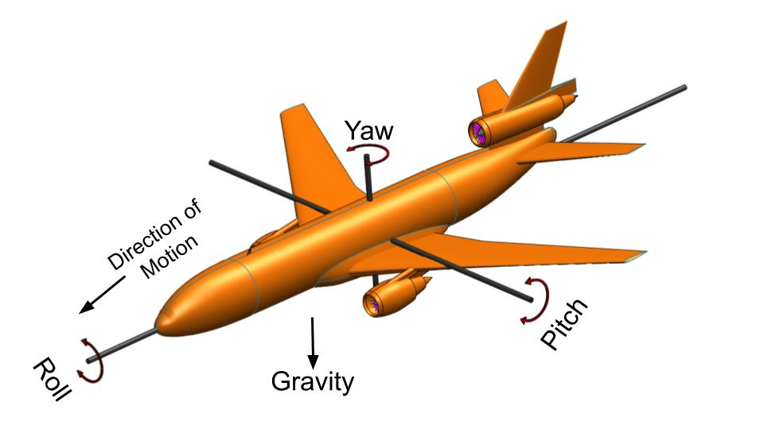
L-System – Modelling Plants
For 3D, you can use other symbols to control the changing of direction in 3D such as & Pitch down, ^ for pitch up, \ for roll left, / for roll right, | for turn around)

Slide 13
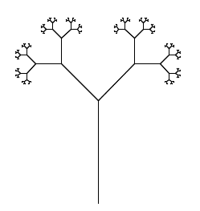
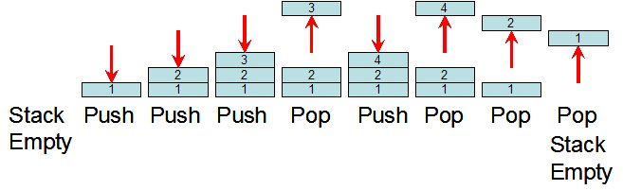
L-System – Branching
Additional symbols to allow for axial branching:
[ Push the current state onto a pushdown stack. The information saved on the stack contains the current position and orientation, and possibly other attributes such as the color and width of branch.
] Pop a state from the stack and make it the current state of growing. Restore previous branching position, start to grow from a different direction.
Stack data structure

Slide 14
L-System – Modeling Plants
Using Lists as Stacks
The list methods make it very easy to use a list as a stack, where the last element added is the first element retrieved (“last-in, first-out”). To add an item to the top of the stack, use append(). To retrieve an item from the top of the stack, use pop() without an explicit index. For example:
>>> stack = []
>>> stack.append(1)
>>> stack.append(2)
>>> stack.append(3)
>>> stack
[1, 2, 3]
>>> stack.pop()
3
>>> stack
[1, 2]
>>> stack.append(4)
>>> stack.pop()
4
>>> stack.pop()
2
>>> stack.pop()
1
>>> stack
[]

Slide 15
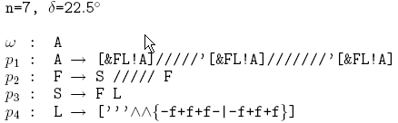
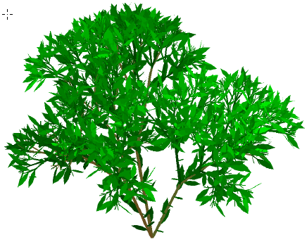
L-System – 3D Example
Production (rule) p4 specifies the leaf as a filled polygon with six edges. Its boundary is formed from the edges f enclosed between the braces { and }
The symbols ! are used to decrement the diameter of segments and increment the current index to the color table

Slide 16
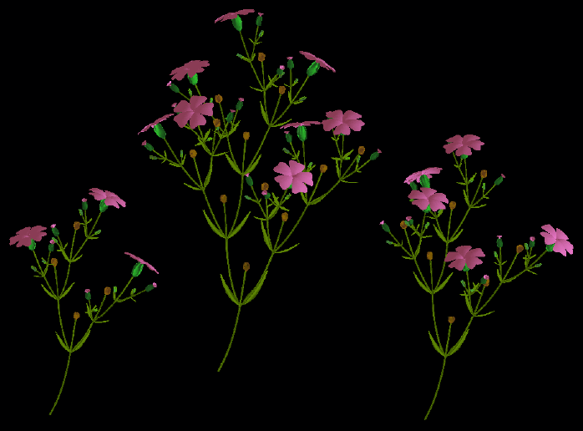
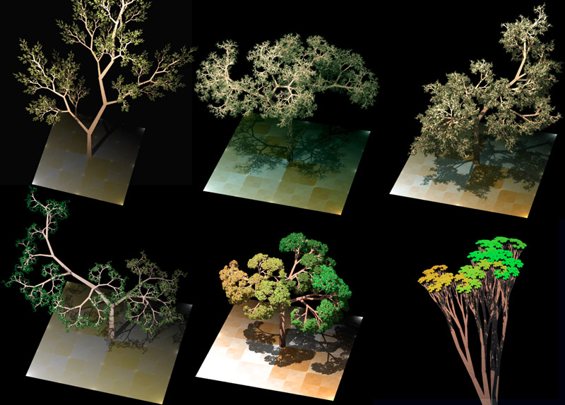
L-System – 3D Example
http://en.wikipedia.org/wiki/L-system

Slide 17
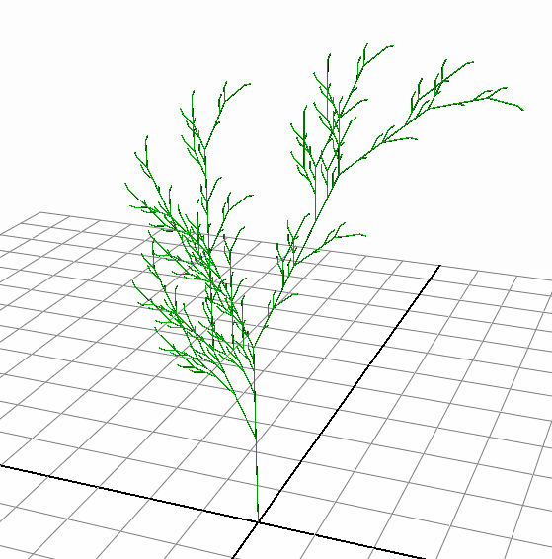
Exercise
iterations = 5
axiom = "X"
stepLength = 0.1
rotateAngle = 25
Rules:
X => F-[[X]+X]+F[+FX]-X
F => FF

Slide 18

Exercise – step 1
Modular programming is a software design technique that emphasizes separating the functionality of a program into independent, interchangeable modules, such that each contains everything necessary to execute only one aspect of the desired functionality.
If your project contains several python files, only one file have the statement like the followings, all other files will only contain function definitions,
When the Python interpreter reads a source file, it executes all of the code found in it. Before executing the code, it will define a few special variables. For example, if the python interpreter is running that module (the source file) as the main program, it sets the special __name__ variable to have a value "__main__". If this file is being imported from another module, __name__ will be set to the module's name.
One of the reasons for doing this is that sometimes you write a module (a .py file) where it can be executed directly. Alternatively, it can also be imported and used in another module. By doing the main check, you can have that code only execute when you want to run the module as a program and not have it execute when someone just wants to import your module and call your functions themselves.
# main program, start with the function buildTree()
if __name__ == "__main__":
buildTree()

Slide 19
Exercise – step 2
def buildTree():
''' add the rules, initialise the control parameters, such as
iteration numbers, branch rotation angle, step size of growing '''
# clear up the scene
...
# add the rules to the rule dictionary
ruleDictionary = {}
addRule(ruleDictionary, "X", "F-[[X]+X]+F[+FX]-X" )
addRule(ruleDictionary, "F", "FF" )
# set growing parameters
iterations = 5
stepLength = 0.1
rotateAngle = 25

Slide 20
Exercise – step 2
# create the action string
axiom = "X"
actionString = "" # the final action string to build the tree
finalString=iterate(axiom, iterations, ruleDictionary)
# create the 3D model
modelGroup = createModel(finalString, stepLength, rotateAngle)
# set the color to green
setMaterial(modelGroup)

Slide 21
Exercise – step 3
def addRule(ruleDict, replaceStr, newStr ):
''' add a new rule to the ruleDict
ruleDict : the dictionary holding the rules
replaceStr : the old character to be replaced
newStr : the new string replacing the old one
'''
ruleDict[ replaceStr ] = newStr

Slide 22
Exercise – step 4
def iterate(baseString, numIterations, ruleDict):
''' following the rules, replace old characters with new ones
baseString : start string
numIterations : how many times the rules will be used
ruleDict : the dictionary holding the rules
return : return the final expanded string
'''
baseString "X"
ruleDict: {"X" : "F-[[X]+X]+F[+FX]-X", "F" : "FF"}
actionString
"X"
"F-[[X]+X]+F[+FX]-X"
"FF-[[F-[[X]+X]+F[+FX]-X]+F-[[X]+X]+F[+FX]-X]+FF[+FFF-[[X]+X]+F[+FX]-X]-F-[[X]+X]+F[+FX]-X"
You need to use the Python dictionary get() method to find the matching replacing string
http://www.tutorialspoint.com/python/dictionary_get.htm

Slide 23
angle
Exercise – step 5
def calculateVector( length, rotation ):
'''calculate the vector from the start point to the end point for each branch
length : step size for growing
rotation : the rotation angle for branching
return : return the vector from start point to end point
'''
radians = math.pi * rotation / 180
return [length* math.sin(radians), length* math.cos(radians), 0.0]
def createBranch(startPoint, length, angle):
''' create a cylinder for each branch
startPoint : startPoint, base point for the new cylinder
length : step size for growing
angle : the rotation angle for branching, used for calculating the axis of the cylinder
return : return the created object
'''
radians = angle * math.pi /180.0
branch = cmds.polyCylinder(axis=[math.sin(radians), math.cos(radians), 0.0], r=length/5.0, height=length)
cmds.move(startPoint[0] + 0.5*length*math.sin(radians), startPoint[1] + 0.5*length*math.cos(radians),startPoint[2]+0.0)
return branch[0]

Slide 24
Exercise – step 6
def createModel( actionString, length, turn):
''' create the 3D model based on the actionString, following the characters in the string,
one by one, grow the branches, and finally group all branches together into one group
actionString: instructions on how to construct the model, "F-[[X]+X]+F[+FX]-X"
length : step size for growing
turn : the rotation angle for branching
return : return the group of all the branches
'''
inputString = actionString
index = 0 # Where at the input string we start from
angle = 0 # Degrees, nor radians
currentPoint = [0.0, 0.0, 0.0] # Start from origin
coordinateStack = [] # Stack where to store coordinates
angleStack = [] # Stack to store angles
branchList = []

Slide 25
Exercise – step 6
"FF-[[F-[[X]+X]+F[+FX]-X]+F-[[X]+X]+F[+FX]-X]+FF[+FFF-[[X]+X]+F[+FX]-X]-F-[[X]+X]+F[+FX]-X"
Parsing through the actionString character by character (using for or while loop):
If the current character is :
"F": call createBranch(), add the new branch to branchList, update currentPosition using calculateVector();
"-": decrease the current angle by “turn”
"+": increase the current angle by “turn”
"[": save current position and angle to stacks
"]": pop current position and angle from stacks
Move on to next character in the action string
Group all branches into one group, give a name called “tree”

Slide 26
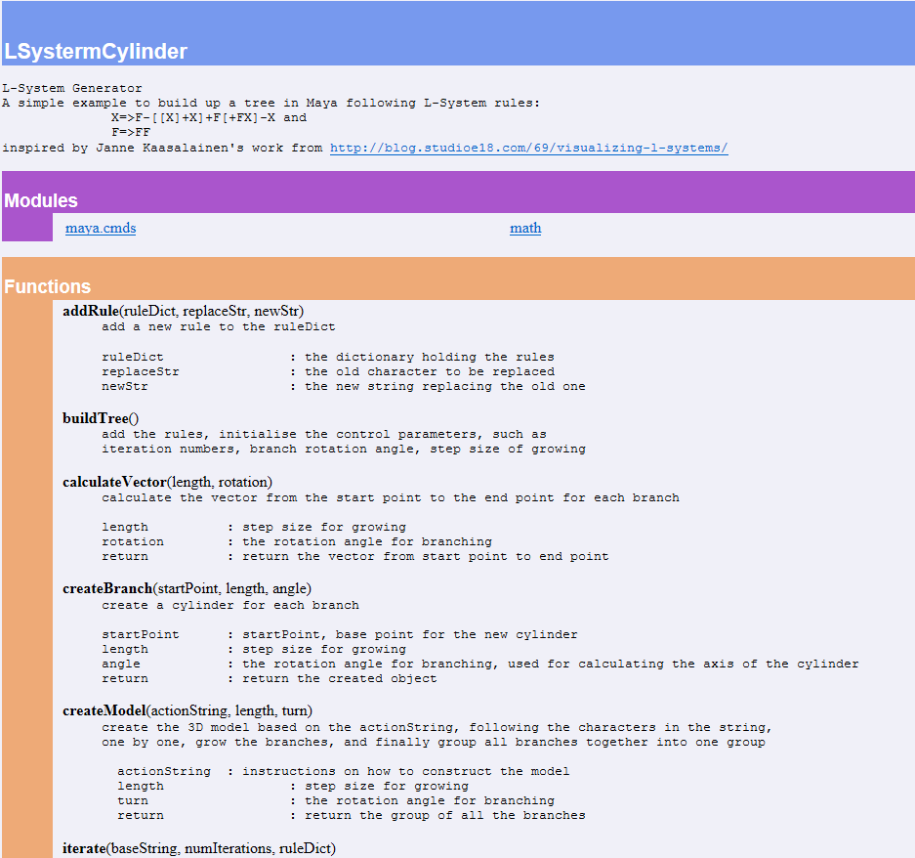
Exercise – step 7
Comments:
Add docstring for the whole file
Add comments (docstring) to each function
Add comments for important flow and statements
Documents (not required)
1) Change to the folder of the source code
2) Command line: pydoc -w ./LSystermCylinder.py
3) LSystermCylinder.html is created.

Slide 27
Exercise – work left
Report:
User manual, instructions on how to execute the code
Explanation for the algorithm used
Description about the code structure, flow of controls
Snapshot pictures of the result
Extension
1) Extension to 3D
2) Use different rules
3) Create leaves or flowers, or different styles of plants
4) Forrest, various styles of plants
5) Animation, growing procedure, wind blow
6) User interface

Slide 28
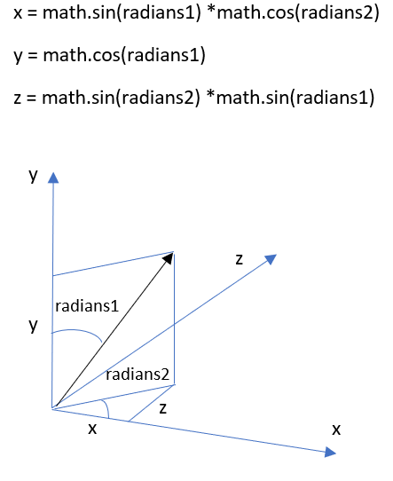
L-System – Extension to 3D

Slide 29
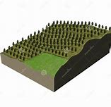
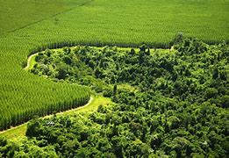
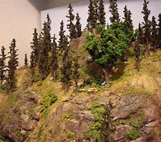
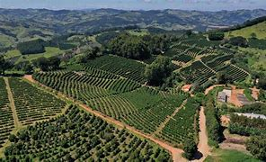
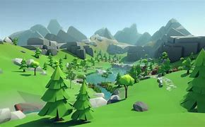
L-System – Plantation on terrain

Slide 30
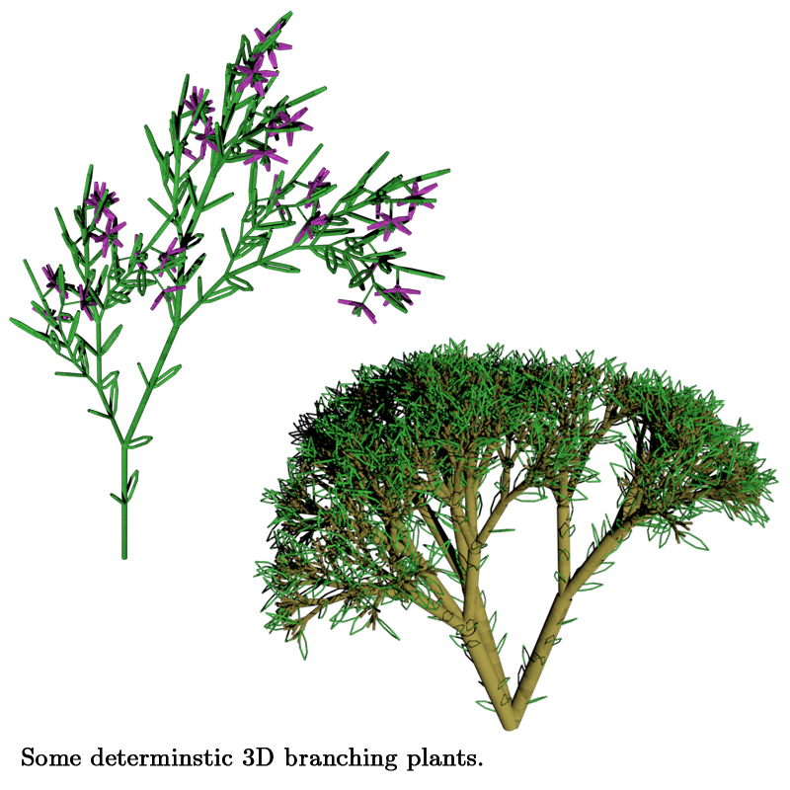
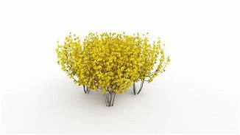
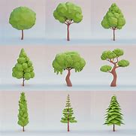
L-System – Leaves + flowers

Slide 31
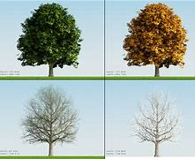

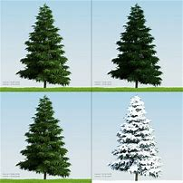
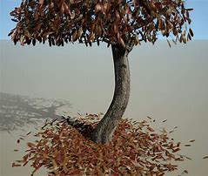
L-System – Dynamic of the tree
Growth of tree
Different season
Snow on tree
Tree falling leaves

Slide 32
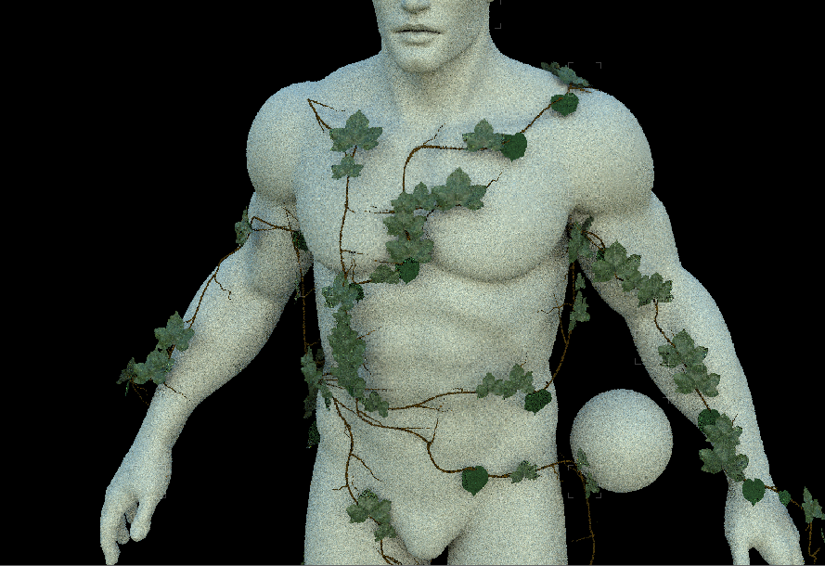
L-System – Grow Ivy on mesh
Project branches onto the surface,
Apart from LSystem, also consider gravity, grow in the up direction
MFnMesh::getClosestPointAndNormal
Get the coordinates of all the mesh vertices
meshName = "pSphereShape1"
cmds.select(meshName+".vtx[*]")
selection = cmds.ls(selection=True, flatten=True)
numVertices = len(selection)
print numVertices
for i in range(numVertices):
pos = cmds.xform(selection[i], query=True, translation=True, worldSpace=True)

Slide 33
Alternative way of implementation
No stack, use Maya internal hierarchical structure, not necessary to record the absolute (global space) orientation and location of current point, relative to parent node only, local space (object space) orientation.
B2
B1

Slide 34
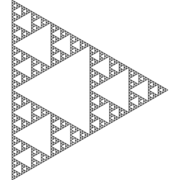
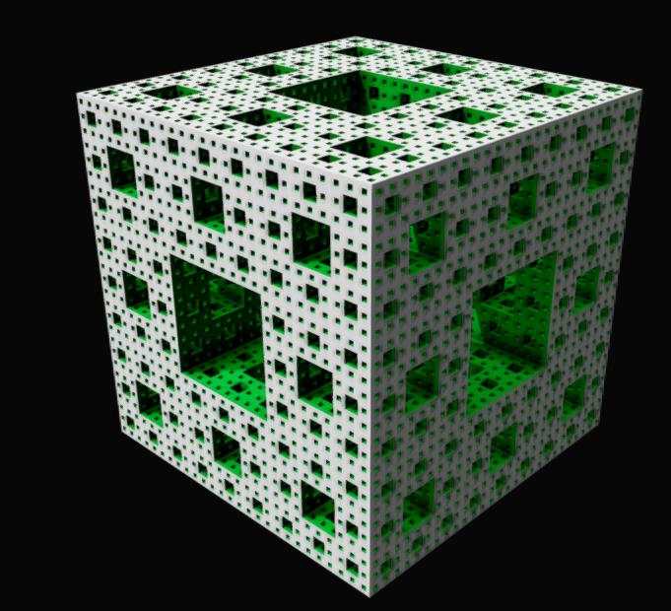
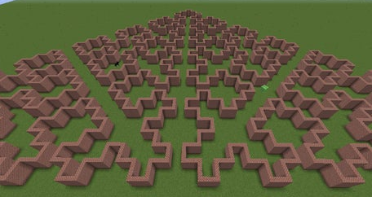
L-System – Other Models
L-systems have also been used to model the morphology of a variety of organisms and can be used to generate self-similar fractals.
Floor plan for building architecture

