Slide 1
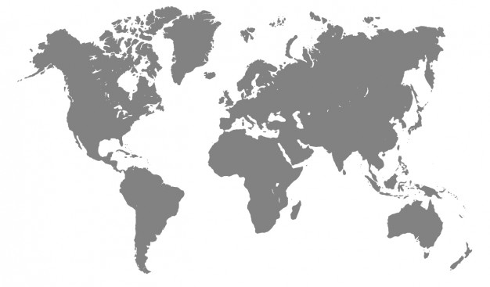
Image
Prof Xiaosong Yang
Professor in Computer Animation
National Centre for Computer Animation
Faculty of Media and Communication
Bournemouth University
Email: xyang@bournemouth.ac.uk
http://staffprofiles.bournemouth.ac.uk/display/xyang

Slide 2
Top Image Processing libraries
scikit-image (skimage)
NumPy
SciPy (scipy.ndimage)
PIL/Pillow (Image, ImageFilter, ImageEnhance)
OpenCV-Python
SimpleCV
Mahotas
SimpleTK (CT, image segmentation, registration)
Pgmagick
Pycairo
Top 8 Image-Processing Python Libraries Used in Machine Learning - neptune.ai
10 Python image manipulation tools | Opensource.com
Top Python Libraries For Image Processing In 2021 (analyticsvidhya.com)

Slide 3
Python Image Library (PIL)
Image Archives
Read/Convert/Write a large number of formats.
Some of the file formats supported include PPM, PNG, JPEG, GIF, TIFF, and BMP.
import sys
sys.path.append("/usr/lib64/python2.7/site-packages/")
from PIL import Image
imagePath = "/home/xyang/MayaScripts/"
imageFileName = imagePath + "grey-world-map.jpg"
import os.path
if os.path.isfile(imageFilename):
im = Image.open(imageFileName)

Slide 4
Pixels
A “bitmap” is a data structure that stores a rectangular grid of width x height discrete picture elements or pixels that describe an image.
Pixels
A pixel resides in a specific position on the rectangular grid data structure and stores a colour value. Usually, a pixel's position is specified by two discrete coordinates. The coordinates (0, 0), for example, usually specify the pixel on the top left corner of the grid and the coordinates (width-1, height-1) specify the pixel on the bottom right corner of the grid.
A pixel stores the colour value of the bitmap at the given position on the grid data structure.

Slide 5
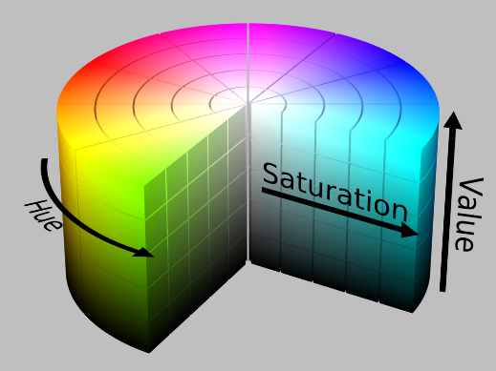
Pixel Depth
Each pixel corresponds to a colour displayed on the screen. A pixel may store a colour value in one or more bits, and the number of colours that can be displayed depends on the numbers of bits per pixel (bpp) or pixel depth.
For example, a 1bpp bitmap displays 2^1 colours, a 8bpp = 2^8 displays 256 colours, and a 24 bpp = 2^24 displays approximately16.8 million colours.
A pixel, in order to represented colours, needs to store information about the intensity of the different types of colour components displayed.
Each colour is usually displayed as a combination of three (or four) primary colours. These are usually Red, Green and Blue or RGB. The set of all primary values of one type, such as R(ed) for example, is also know as a colour channel (or a band in PIL).
However there are several ways of describing colour primaries such as HSV (Hue, Saturation, Value), or CMYK (Printing: cyan, magenta, yellow, and black)

Slide 6
Image Modes
Modes of PIL images:
 1 (1bit pixels, black and white, stored with one pixel per byte)
 L (8bit pixels, black and white)
 P (8bit pixels, mapped to any other mode using a colour palette)
 RGB (3x8bit pixels, true colour)
 RGBA (4x8bit pixels, true colour with transparency mask)
 CMYK (4x8bit pixels, colour separation)
 YCbCr (3x8bit pixels, colour video format)
 I (32bit signed integer pixels)
 F (32bit floating point pixels)

Slide 7
Open an existing image
from PIL import Image
imagePath = "/home/xyang/MayaScripts/"
imageFileName = imagePath + "grey-world-map.jpg"
im = Image.open(imageFileName)
print(im.format)
print(im.size) # (626, 626)
print(im.mode)
im.show() # display the bitmap

Slide 8
Create an image for drawing
from PIL import Image, ImageDraw
img = Image.new(mode, size, color)
Creates a new image with the given mode and size.
Size is given as a 2tuple.
The colour is given as a single value for singleband images, and a tuple for multiband images (with one value for each band). If the colour argument is omitted, the image is filled with black. If the colour is None, the image is not initialised.
#! /usr/bin/python
from PIL import Image, ImageDraw
# create an 'RGB ' 300x300' bitmap
img = Image.new('RGB', (300, 300))
print img.size # print bitmap's width and height
print img.mode # print bitmap's mode
img.show() # display the bitmap

Slide 9
Create a Draw object
from PIL import Image, ImageDraw
img = Image.new('RGB', (300, 300))
# create a 'Draw' object
draw = ImageDraw.Draw(img)
To draw shapes and lines on a bitmap using PIL one needs to create a 'Draw' object associated with a given bitmap object already created. Once a draw object is created, then one can use it to call procedures that draw lines, circles, arcs, polygons, rectangles, text, etc.
Drawing procedures, involve specifying geometric coordinates, rectangles or bounding boxes, and colours.
Coordinate: Cartesian pixel coordinate system, with (0,0) in the upper left corner. Coordinates are usually passed to the library as 2tuples (x, y). Rectangles, and bounding boxes, are represented as 4tuples, (x1,y1, x2, y2) with the upper left corner given first.
Color: For 'RGB' images one need to define 3tuples of (r, g, b), where r,g,b are values in the range [0, 255], in order to specify the colour of a pixel. For example: the tuple (255, 0, 0) is pure red, the tuple (0, 255, 0) is pure green, (0, 0, 255) is pure blue, (0, 0, 0) is black, and (255, 255, 255) is white. For one channel images, such as mode 'L' one need define one value, in the 'L' case it has to be within the range [0, 255], where 0 is black and 255 is white.

Slide 10

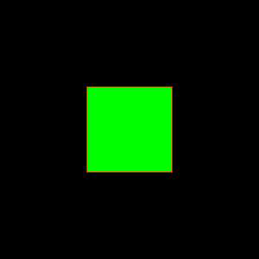
Python Image Library
Draw a line, width argument
from PIL import Image, ImageDraw
img = Image.new('RGB', (300, 300))
# create a 'Draw' object
draw = ImageDraw.Draw(img)
draw.line((0,0, 299,299), fill=(255, 0, 0), width=10)
img.show() # display the bitmap
img.save('example_03.jpg') # save the bitmap into a file
from PIL import Image, ImageDraw
img = Image.new('RGB', (300, 300))
draw = ImageDraw.Draw(img)
draw.rectangle((100,100, 199,199), fill=(0, 255, 0), outline=(255, 0, 0))
img.show()
img.save('example_04.jpg')

Slide 11
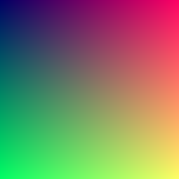
Python Image Library
To set pixel values
from PIL import Image
img = Image.new( 'RGB', (255,255), "black") # create a new black image
pixels = img.load( ) # create the pixel map
for i in range(img.size[0]): # for every pixel:
for j in range(img.size[1]):
pixels[i,j] = (i, j, 100) # set the colour accordingly
img.show()

Slide 12
Python Image Library
Other functions in PIL
filters such as blur, emboss, sharpen, contour, Edge_enhance, smooth, find_edges
Colorize, flip, grayscale, invert, mirror, solarize, posterize watermark
Loading (Image.open) and saving (Image.save) an image. Formats supported in reading AND writing: bmp, gif, jpg, msp, pcx, png, ppm, tiff and xbm.

Slide 13
Image processing
The Python Imaging Library (PIL) allows for a wide range of image processing operations.:
per-pixel manipulations,
masking and transparency handling,
image filtering, such as blurring, contouring, smoothing, or edge finding,
image enhancing, such as sharpening, adjusting brightness, contrast or color,
adding text to images and much more.

Slide 14
OpenImageIO library
OpenImageIO is a library for reading and writing images, and a bunch of related classes, utilities, and applications. There is a particular emphasis on formats and functionality used in professional, large-scale animation and visual effects work for film.
OpenImageIO is used extensively in animation and VFX studios all over the world, and is also incorporated into several commercial products.
Format plugins for TIFF, JPEG/JFIF, OpenEXR, PNG, HDR/RGBE, ICO, BMP, Targa, JPEG-2000, RMan Zfile, FITS, DDS, Softimage PIC, PNM, DPX, Cineon, IFF, Field3D, Ptex, Photoshop PSD, Wavefront RLA, SGI, WebP, GIF, and a variety of "RAW" digital camera formats, and a variety of movie formats (readable as individual frames).
An ImageBuf class that makes it easy to deal with whole images, and a whole bunch of image processing algorithms (in the ImageBufAlgo namespace) that operate on them.
C++ and Python bindings

Slide 15
OpenImageIO library
import OpenImageIO as OIIO
from OIIO import ImageInput, ImageOutput
from OIIO import ImageBuf, ImageSpec, ImageBufAlgo
input = ImageInput.open(filename)
if not input :
print 'Could not open "' + filename + '"'
print "\tError: ", oiio.geterror()
return
nchans = spec.nchannels
pixels = input.read_image()
if not pixels :
print "Could not read:", input.geterror()
return
input.close() # we're done with the file at this point
minval = pixels[0][0] # initialize to the first pixel value
maxval = pixels[0][0]
https://openimageio.readthedocs.io/en/master/pythonbindings.html#

Slide 16
OpenMaya.Mimage if no PIL
import maya.api.OpenMaya as OpenMaya
import ctypes
class MayaImage :
""" The main class, needs to be constructed with a filename """
def __init__(self,filename) :
""" constructor pass in the name of the file to load (absolute file name with path) """
# create an MImage object
self.image=OpenMaya.MImage()
# read from file MImage should handle errors for us so no need to check
self.image.readFromFile(filename)
self.width,self.height=self.image.getSize()
# get the pixel data
self.charPixelPtr = ctypes.cast(self.image.pixels(), ctypes.POINTER(ctypes.c_char) )
# query to see if it's an RGB or RGBA image, this will be True or False
self.hasAlpha=self.image.isRGBA()
# if we are doing RGB we step into the image array in 3's
# data is always packed as RGBA even if no alpha present
self.imgStep=4
https://github.com/NCCA/ScriptingForDCC/blob/master/TerrainFromMap/MayaImage.py
https://github.com/NCCA/DemoPythonCode/blob/master/Maya/ImageMapExample.py

Slide 17
OpenMaya.Mimage (Jon Macey)
def getPixel(self,x,y) :
""" get the pixel data at x,y and return a 3/4 tuple depending upon type """
# check the bounds to make sure we are in the correct area
if x<0 or x>self.width :
print "error x out of bounds\n"
return
if y<0 or y>self.height :
print "error y our of bounds\n"
return
# now calculate the index into the 1D array of data
index=(y*self.width*4)+x*4
# grab the pixels we need to convert from char to integer ordinal type so use ord
red = ord(self.charPixelPtr[index])
green = ord(self.charPixelPtr[index+1])
blue = ord(self.charPixelPtr[index+2])
alpha = ord(self.charPixelPtr[index+3])
#print type(red),green,blue,alpha
return (red,green,blue,alpha)
def getRGB(self,x,y) :
r,g,b,_=self.getPixel(x,y)
return (r,g,b)
https://github.com/NCCA/ScriptingForDCC/blob/master/TerrainFromMap/MayaImage.py
https://github.com/NCCA/DemoPythonCode/blob/master/Maya/ImageMapExample.py

Slide 18
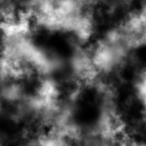
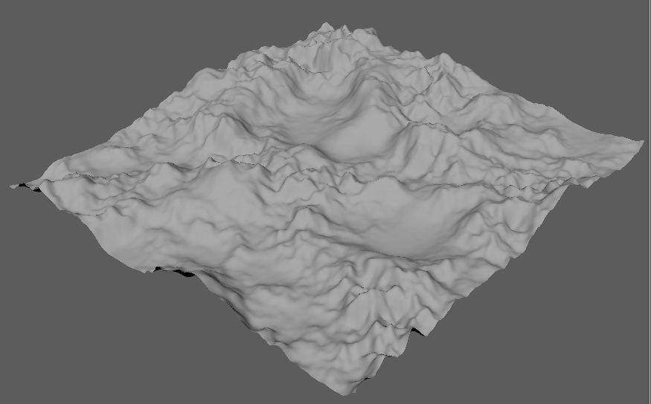
Exercise 1 – Height map
With PIL: HeightMapTerrain.py
Without PIL: MImage.py + HeightMapTerrain_MImage.py

Slide 19
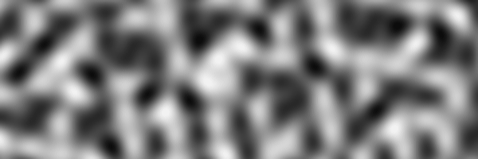
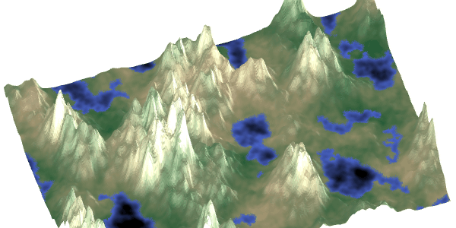
Exercise 1 – Noise Height map
A common way to generate 2D maps is to use a bandwidth-limited noise function, such as Perlin or Simplex noise, as a building block. This is what the noise function looks like:
https://www.redblobgames.com/maps/terrain-from-noise/
terrainNoise.py

Slide 20
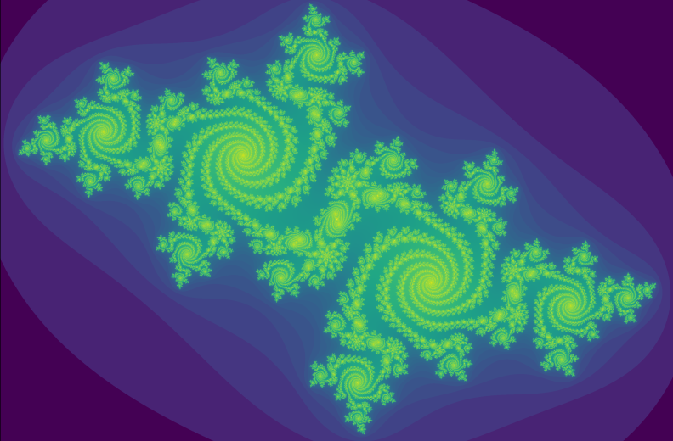
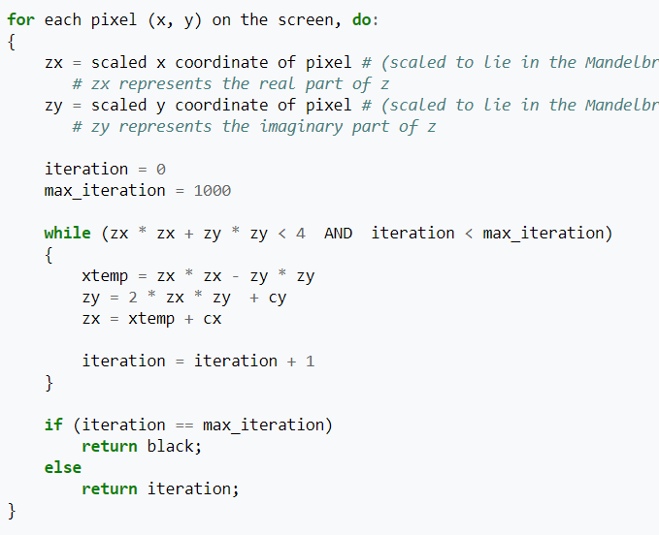

Exercise 2 – create fractal image
julieSet.py + julie.png
https://en.wikipedia.org/wiki/Julia_set
"Geodes" - 3D Julia set fractals - YouTube
Notes:
"Geodes" - 3D Julia set fractals - YouTube

Slide 21
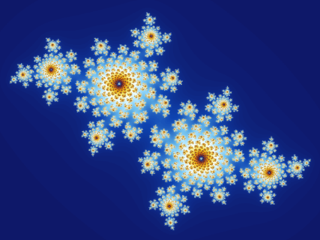
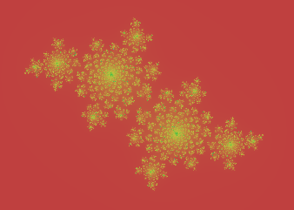
Exercise 2 – create fractal image
Julia set c = −0.4 + 0.6i
Z₀ = (x₀, y₀)
Z₁ = Z_{0*} Z₀+c
Z₂ = Z_{1*} Z₁+c
Z₃ = Z_{2*} Z₂+c
Notes:
"Geodes" - 3D Julia set fractals - YouTube

Slide 22
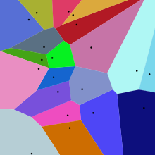
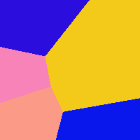
Exercise 3 – Voronoi – fracture of wall
a Voronoi diagram is a partition of a plane into regions close to each of a given set of objects.
https://en.wikipedia.org/wiki/Voronoi_diagram

Slide 23
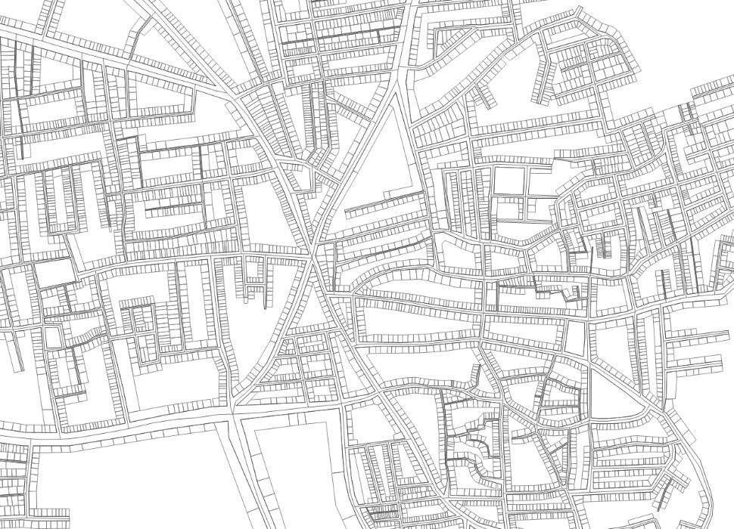
Exercise 4 – City

Slide 24
Exercise 4 – City
def imageSegmentLabelling(img):
width = img.size[0]
height = img.size[1]
pixels = img.load()
labelImage = Image.new("I", (width, height),0)
labelPixels = labelImage.load()
regionIndex = 1
result = searchUnlabelledPixel(pixels,width, height) # [true/false-found, x, y] index of the found pixel
foundUnlablelledPixel = result[0]
while(foundUnlablelledPixel):
labelNewRegion(pixels, labelPixels, result[1], result[2], regionIndex, width, height)
result = searchUnlabelledPixel(pixels, width, height)
foundUnlablelledPixel = result[0]
regionIndex+=1
return labelImage
imageFile = "City_Inventory.jpg"
img = Image.open(imageFile)
labelImage = imageSegmentLabelling(img)
img.show()
img.save("City_Inventory_seg.jpg")

Slide 25

Exercise 4 – City
from PIL import Image, ImageFilter
from collections import deque
import random
def labelNewRegion(pixels, labelPixels, x, y, regionIndex, width, height):
'''(x,y) is the seed pixel, searching the neighbour'''
seedPixelQueue = deque()
seedPixelQueue.append([x,y])
segColor = 100+random.randint(1,10)*10-1
pixels[x, y] = segColor
labelPixels[x, y] = regionIndex
while len(seedPixelQueue)>0:
nextPixelPos = seedPixelQueue.popleft()
x= nextPixelPos[0]
y= nextPixelPos[1]
# check all neighbours

Slide 26

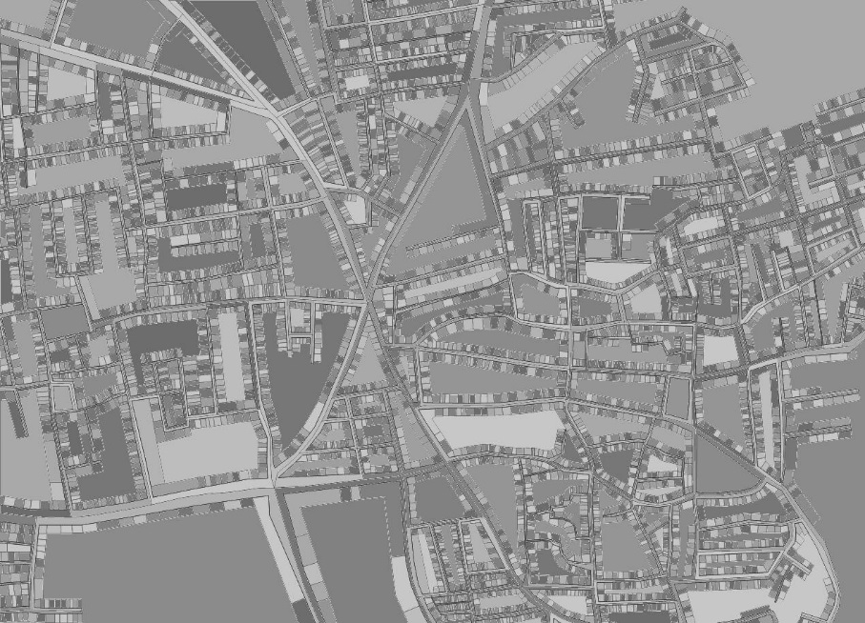
Exercise 4 – City

Slide 27



Exercise 4 – City
19
47
id
203

