Slide 1
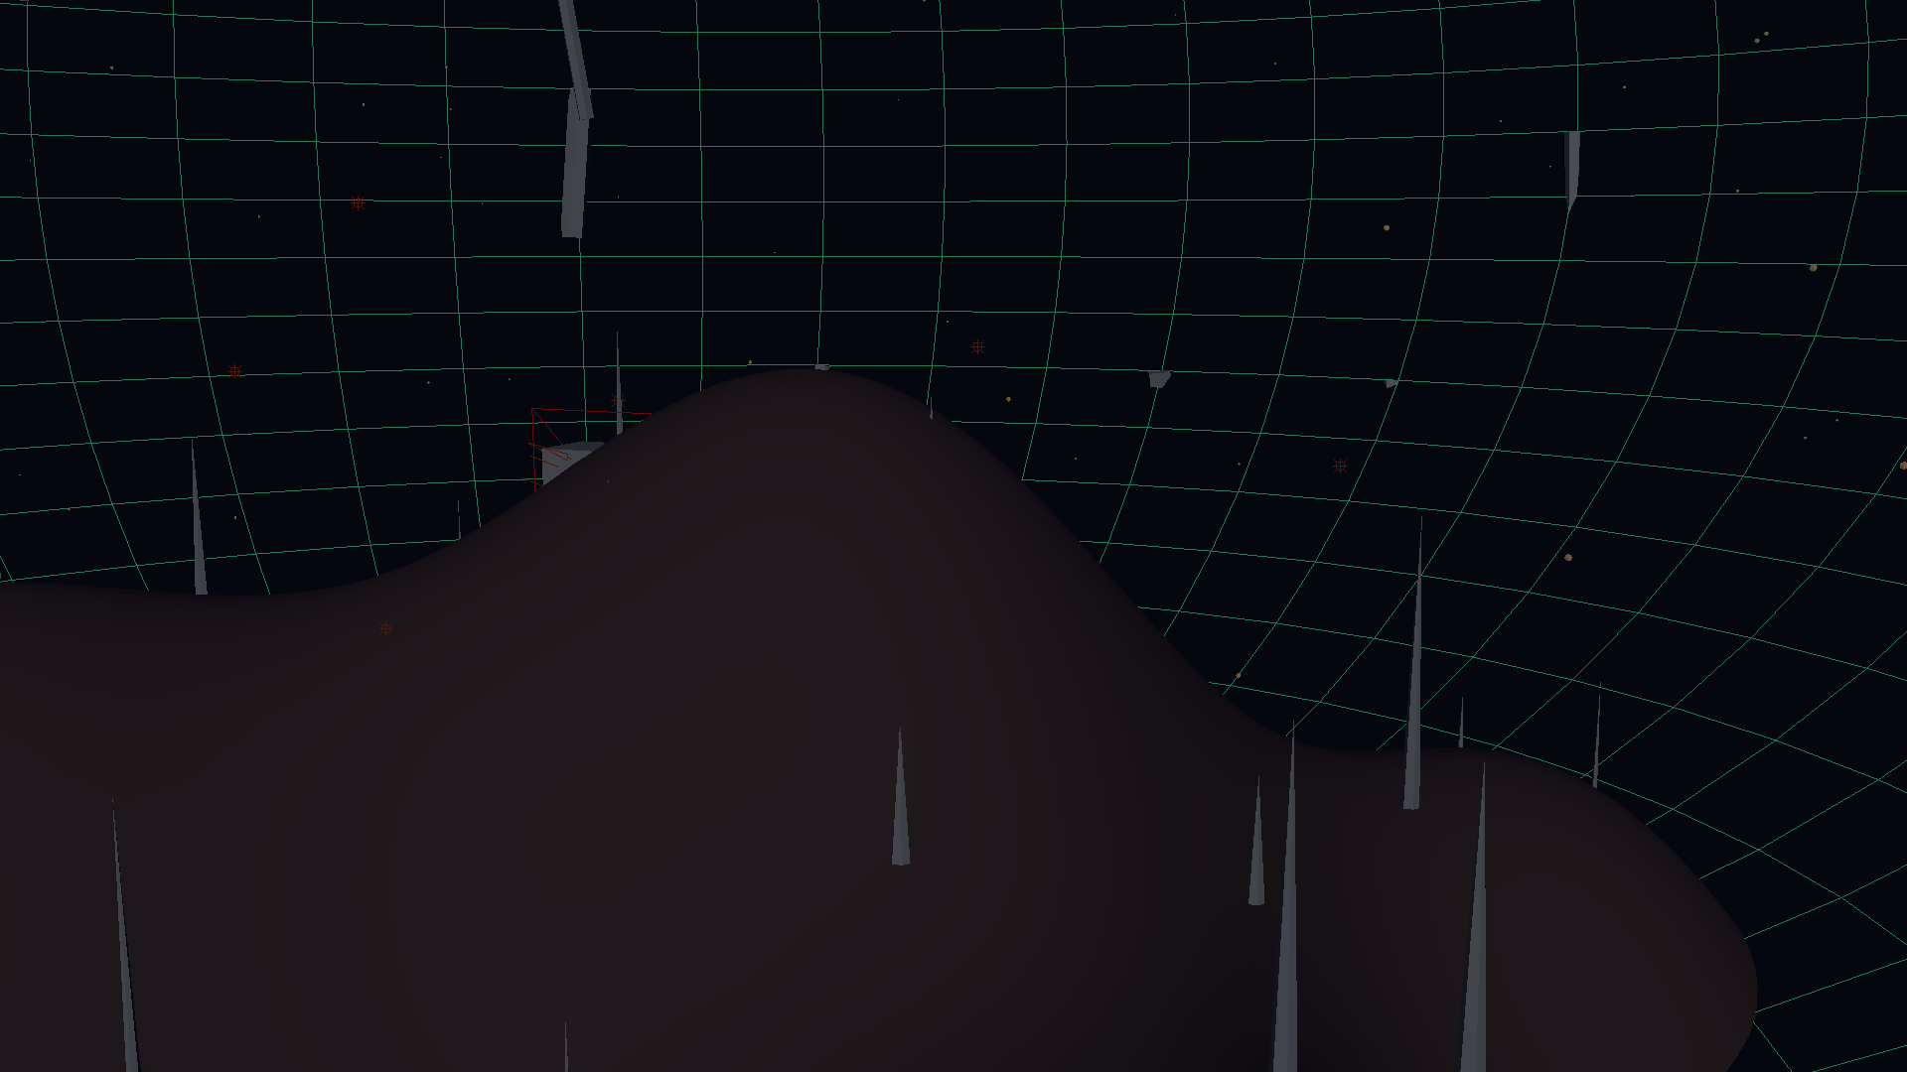
PROCEDURAL · MAYA PYTHON · 2026
CRYSTAL CAVERN
Python-Driven Maya Procedural Crystal Cave Generator
Innovation Design for Future · ZJU 2026 · Prof. Xiaosong Yang
He Xiangrong 3230104205

Slide 2
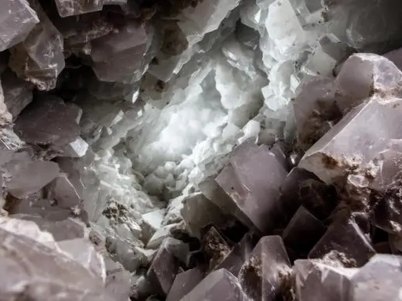
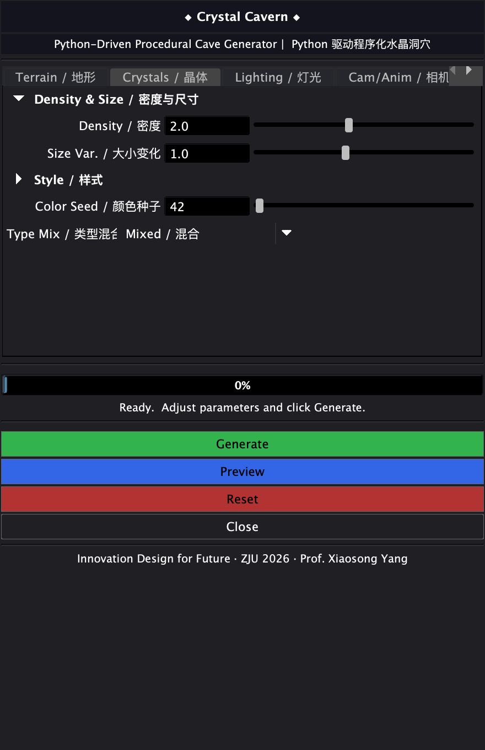
02 · PROJECT OVERVIEW
v1→v2→v3 Iteration
Project Overview — From Reference to Procedural Generation
66,049
terrain vertices
56
hexagonal prism crystals
960
-frame fly-through animation
One click → Maya auto-generates complete cave: terrain, crystals, lighting, camera — zero manual modeling.
7/19
7/20
7/21
v1 Prototype
v2 Pipeline
3 days from algorithm prototype to complete deliverable. 4 core modules each underwent 2–3 rounds of iterative evolution.
v3 Production
Crystal Cavern · ZJU 2026 · Prof. Xiaosong Yang
02 / 11

Slide 3
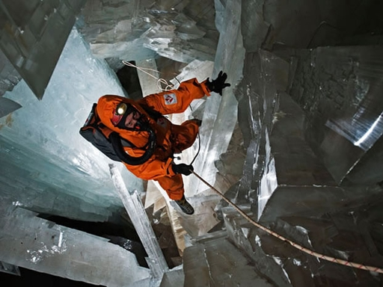
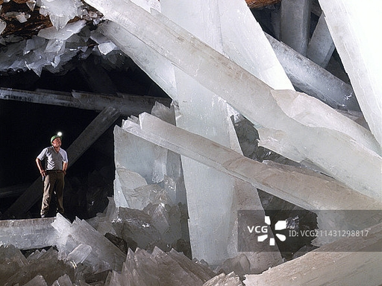
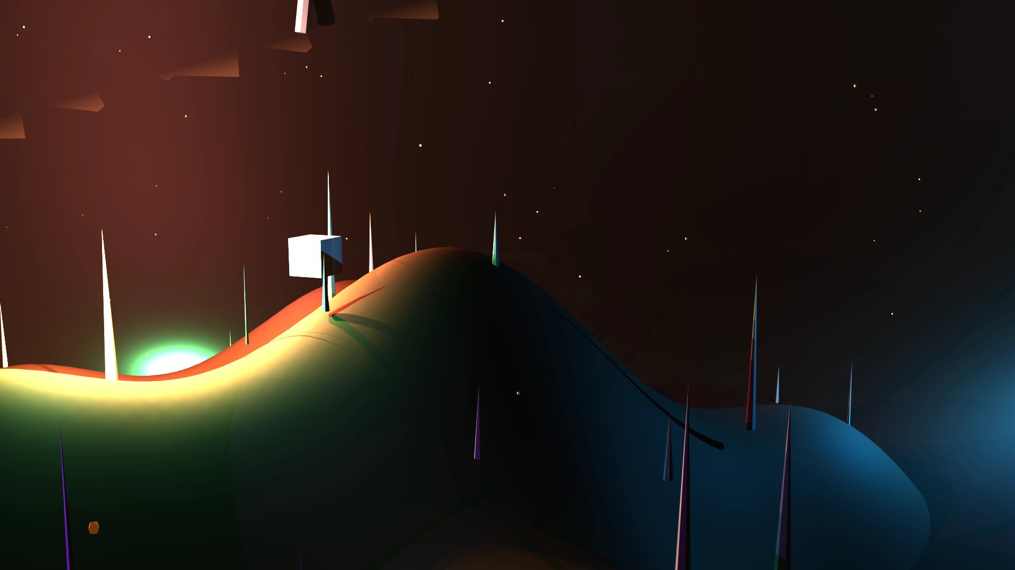
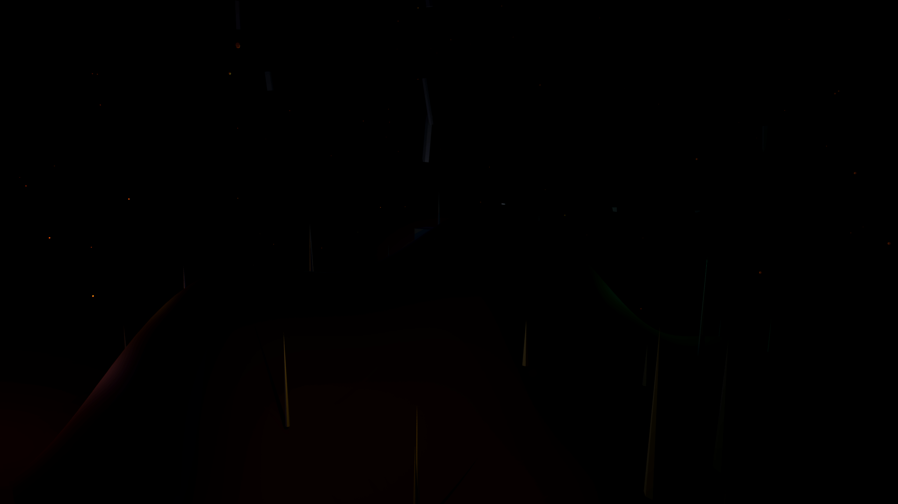
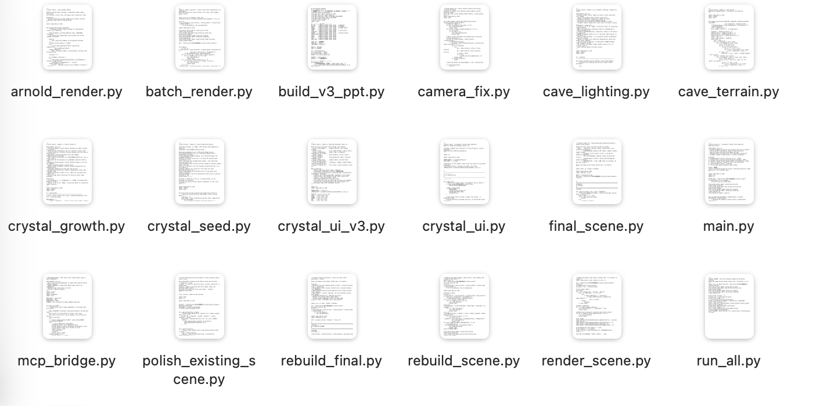
03 · REFERENCE
Real-World Reference — Naica Crystal Cave vs Algorithm Target
Reference · Naica Crystal Cave, Mexico
Our Target · Procedural Generation
From Real-World Reference to Algorithm Target
▸
Crystal cluster growth · Multi-color glow
▸
Subsurface scattering · Dark cave atmosphere
▸
Volumetric light beams · 10 gem material types
Real crystals up to 12m — reproducing their geometry and lighting with algorithms
Crystal Cavern · ZJU 2026 · Prof. Xiaosong Yang
03 / 11

Slide 4
04 · ALGORITHM INNOVATION
Algorithm Innovation — 3D Application of Four Classic Algorithms
Diamond-Square
66,049-vertex terrain · Cave shaping (radial power + sine perturbation)
Fournier, Fussell & Carpenter · 1982
v1→v3 — algorithm unchanged; v3 adds OpenMya2 batch vertex write
Poisson-disc Sampling
Crystal seed distribution · Natural spacing without clumping
Bridson · 2007
v1 ❌ Fake Bridson → v3 ✅ True Bridson + spatial hash
L-System Branching
3D spherical-coordinate branching · Self-similar crystal cluster morphology
Prusinkiewicz & Lindenmayer · 1990
v1 None → v2 Single-layer → v3 Recursive rewrite + hexagonal system
Subsurface Scattering
Arnold BSSRDF · Light emerges from inside crystals
Jensen et al. · 2001
v3 clarification: BSSRDF ≠ accent point lights
Crystal Cavern · ZJU 2026 · Prof. Xiaosong Yang
04 / 11

Slide 5
05 · PIPELINE
v1→v3 Evolution
Five-Stage Fully Automated Generation Pipeline
Stage 1
Stage 2
Stage 3
Stage 4
Stage 5
Terrain Generation
Seed Distribution
Crystal Growth
Lighting & Fog
Camera Animation
Diamond-Square
Poisson-disc
L-system + axis-angle
3-layer lighting · Volumetric fog
960-frame fly-through
Version iteration annotations
v1 7/19
Terrain only + random scattered crystals
v2 7/20
Hex prisms + single-layer branches + root embed + aimConstraint
v3 7/22
Recursive L-system + True Bridson + OpenMaya2 + axis-angle
Crystal Cavern · ZJU 2026 · Prof. Xiaosong Yang
05 / 11

Slide 6
06 · CODE ARCHITECTURE
v1:6 v2:7 v3:10 modules
Code Architecture — 7 Independent Modules
Full docstrings · Algorithm citations · Single responsibility · Independently testable · ~2,200 lines
cave_terrain.py
Diamond-Square
Terrain · Cave enclosure · Stalactites/stalagmites
crystal_seed.py
Poisson-disc
Crystal seed distribution · Spatial hash
crystal_growth.py
L-System
Hexagonal crystals · Tips · Recursive branching
cave_lighting.py
Subsurface
3-layer lighting · Volumetric fog · Dust · Camera
crystal_ui.py
GUI
4 tabs · 16 controls · One-click generation
arnold_render.py
Arnold
AA/Sampling/AOV/Render camera
batch_render.py
Batch
Multi-seed → Multiple .ma scenes
Entry point: final_scene.py → build(seed, density, fog_density, render)
Crystal Cavern · ZJU 2026 · Prof. Xiaosong Yang
06 / 11

Slide 7
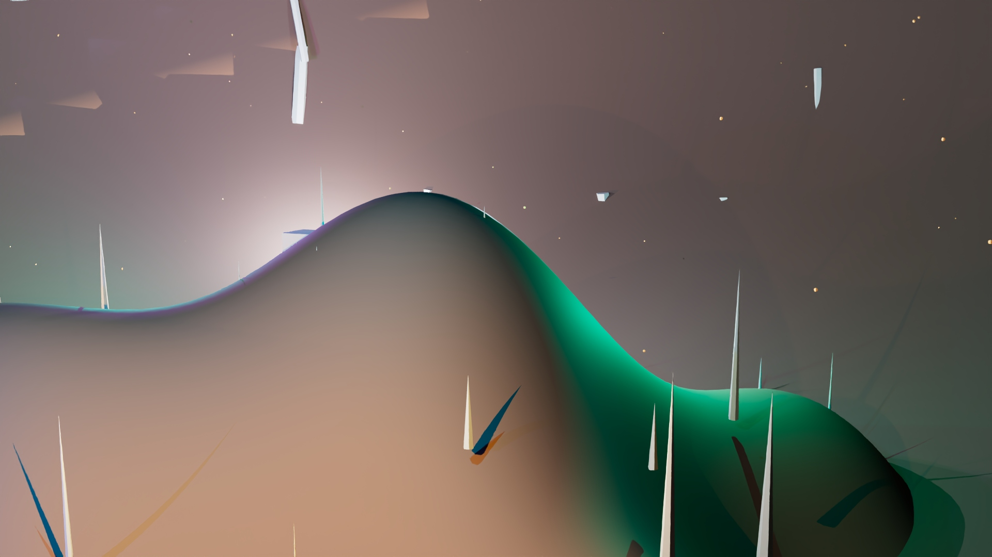
07 · CRYSTAL GEOMETRY · CORE
Crystal Geometry Evolution — From Pegs to Photorealistic Crystals
v1 7/19
v2 7/20
v3 7/22
Cylinder stacking
Hexagonal prisms + single-layer branching
Recursive L-system
Peg-like · No branches
Root embedding · aimConstraint
2nd & 3rd level branches · Crystal face azimuth
Key innovation: Recursive L-system × 60° hexagonal azimuth bias × axis-angle shortest rotation (no aimConstraint · no gimbal lock)
Crystal Cavern · ZJU 2026 · Prof. Xiaosong Yang
07 / 11

Slide 8
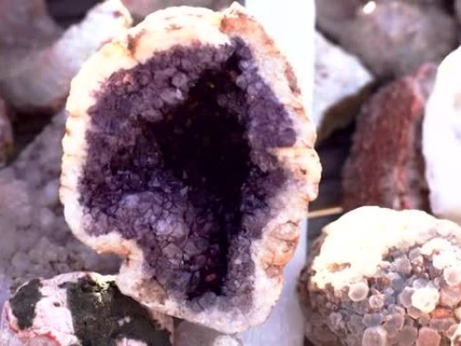
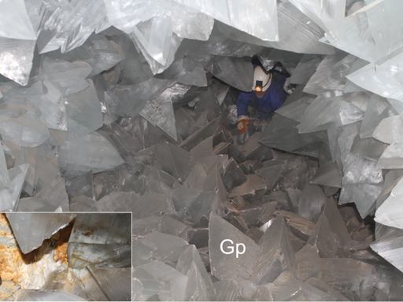
08 · MATERIAL & LIGHTING
v3 Academic Clarification
Materials & Lighting — SSS Academic Rigor Clarification
Target Visual Quality Goals
Who does SSS? · Material side ≠ Light side
Material side · Arnold BSSRDF (Jensen 2001)
✓ True subsurface scattering
✓ subsurface / Color / Radius
✓ Coat thin-film + Transmission translucency
✓ Light emerges from inside the crystal
Lighting side · 20 accent point lights
10 gem types · aiStandardSurface
▸ Exterior fill light · Not SSS
▸ intensity 800–1600 · decayRate 0
▸ Color-matched to gem glow
Amethyst
Ruby
Citrine
Aquamarine
Fluorite
Obsidian
▸ Placed at tallest crystal anchors
Separate concerns — citations match code implementation
Crystal Cavern · ZJU 2026 · Prof. Xiaosong Yang
08 / 11

Slide 9
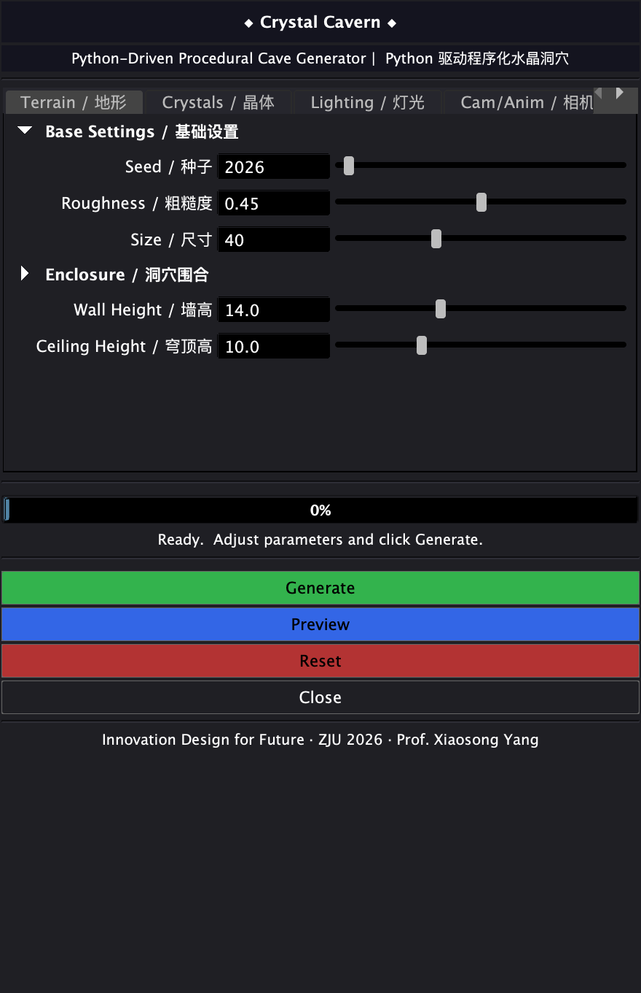
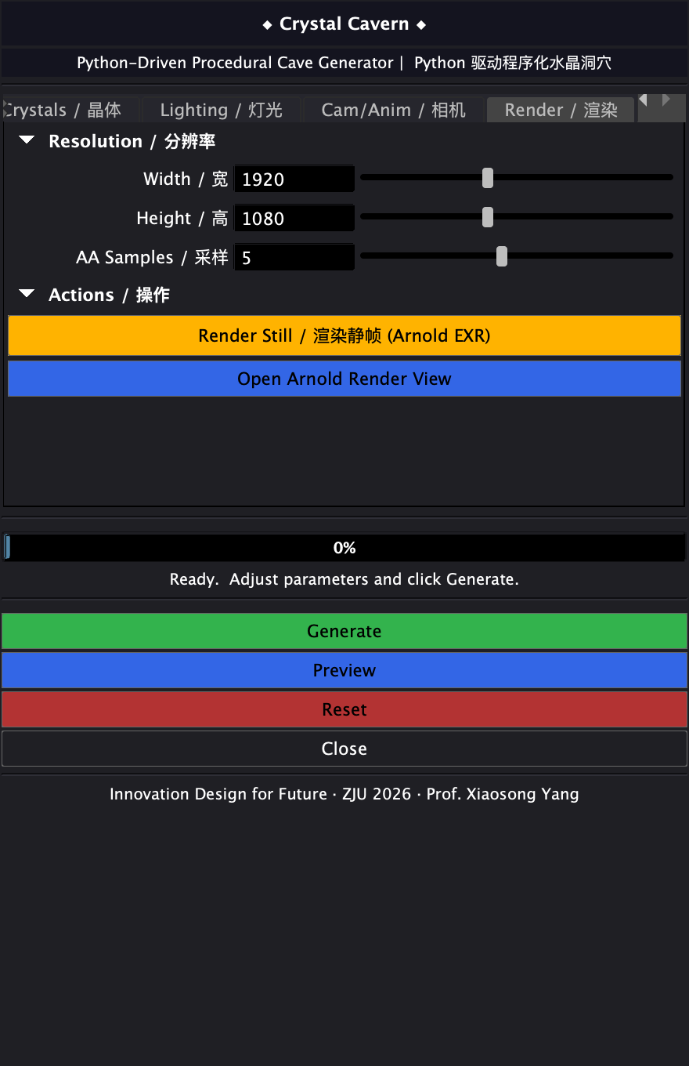
09 · INTERACTIVE GUI
Interactive GUI — Maya Embedded Visual Control Panel
4 tabs
Terrain · Crystals · Lighting · Render
16 controls
All min/max safe ranges + defaults
Generate
Read control values → final_scene.build()
progressWindow
8-stage progress bar · Anti-stall feedback
Render Still
Triggers Arnold EXR batch render
v2→v3: Added brand logo + 8-stage progressWindow
◆ Crystal Cavern v10 · Maya standard tabLayout hierarchy
Crystal Cavern · ZJU 2026 · Prof. Xiaosong Yang
09 / 11

Slide 10
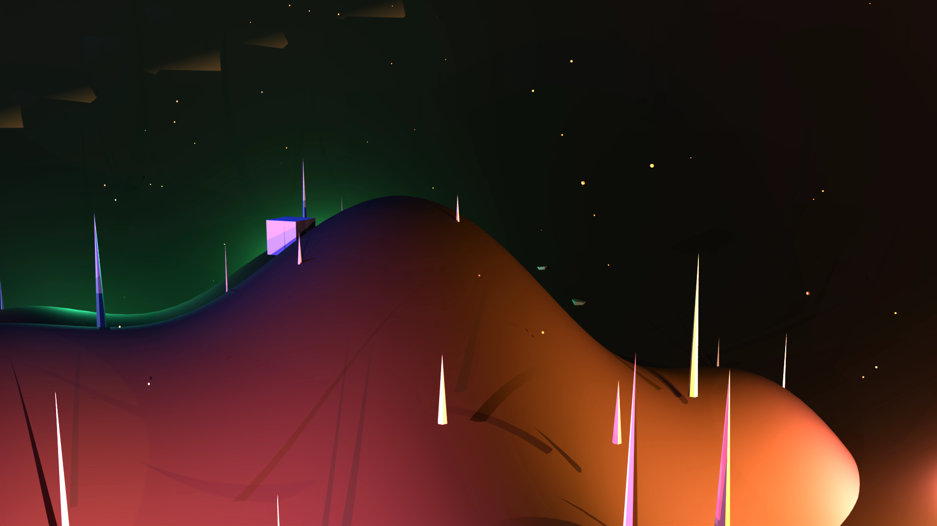
10 · FINAL RENDERS
v3 Recursive L-system + True Bridson
Final Render Results — Two-Parameter Comparison
Amethyst Cavern · seed=2026 · 56 crystals
Ruby Vault · seed=7777 · 56 crystals
1920×1080 Arnold EXR · AA=5 / transmission=5 / SSS=3 · Different seed = completely different cave
Crystal Cavern · ZJU 2026 · Prof. Xiaosong Yang
10 / 11

Slide 11
11 · AI USAGE & ASSESSMENT
AI Tools · Assessment Mapping · Thank You
AI Tool Usage Log · With contribution scope
Assessment Criteria Mapping
Claude Code
Flow Control & Functions
7 modules · 30+ functions
Algorithm design · Code generation · Full refactoring · Scene building
Data Structures
2D heightmap · Seed dicts · Light anchors
Claude MCP
Direct Maya control · 28 MCP skills · Debug diagnostics
GUI
4 tabs · 16 controls
GLM-5.2
Algorithm Complexity
4 published algorithms · With citations
Recursive L-system · Bridson implementation · OpenMaya2 optimization · PPT v3
ChatGPT
Visual Impact
Hexagons · 10 gems · Volumetric fog
Algorithm selection · Citation verification
Python-Driven Maya
One-click generation + animation · Zero manual work
Disclaimer: AI is implementation tool, not creative agent — design decisions by author, code verified in Maya
Thank You
Crystal Cavern · Innovation Design for Future · ZJU 2026 · Q&A
Crystal Cavern · ZJU 2026 · Prof. Xiaosong Yang
11/ 11

