Slide 1
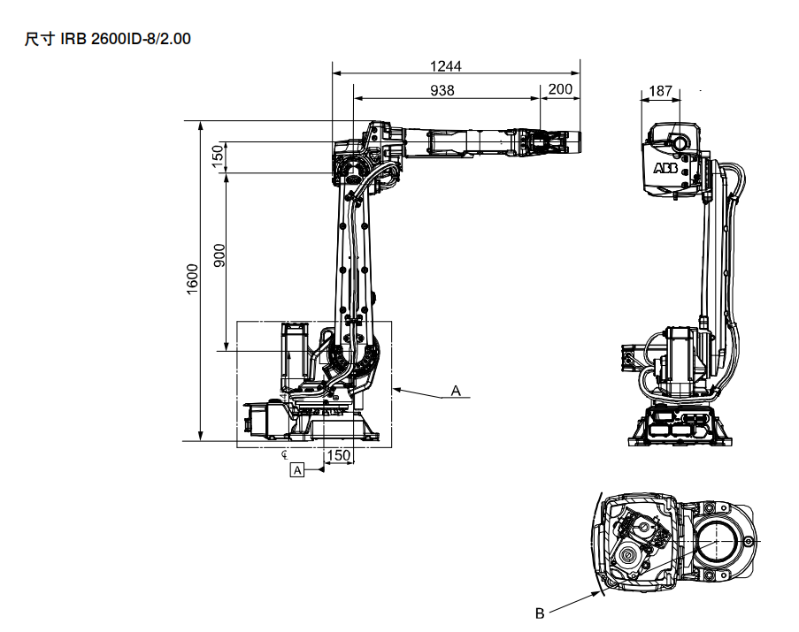
















$$x_{4}$$
$$x_{4}$$
$$z_{4}$$
938
$$x_{5}$$
150
$$x_{3}$$
$$z_{4}$$
$$z_{5}$$
200
$$z_{6}$$
$$z_{3}$$
$$x_{6}$$
$$z_{7}$$
900
$$x_{7}$$
$$x_{2}$$
$$z_{2}$$
$z_{1}$ ${(z}_{0})$
150
445
$x_{1}$ ${(x}_{0})$

Slide 2
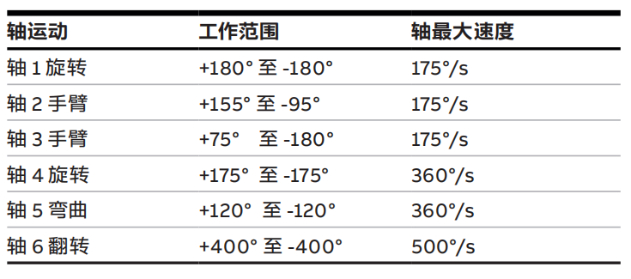
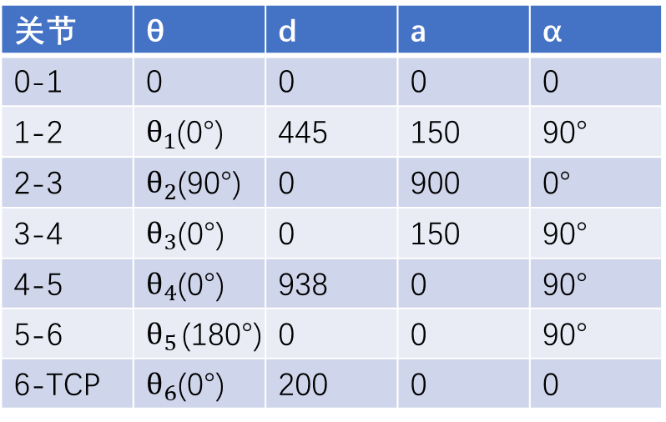
$$x_{4}$$
IRB 2600 ID-8/2.00
$$x_{4}$$
$$z_{4}$$
938
$$x_{5}$$
150
$$x_{3}$$
$$z_{4}$$
$$z_{5}$$
200
$$z_{6}$$
$$z_{3}$$
$$x_{6}$$
$$z_{7}$$
$$x_{7}$$
关节 | θ | d | a | α
0-1 | 0 | 0 | 0 | 0
1-2 | $θ_{1}$(0°) | 445 | 150 | 90°
2-3 | $θ_{2}$(90°) | 0 | 900 | 0°
3-4 | $θ_{3}$(0°) | 0 | 150 | 90°
4-5 | $θ_{4}$(0°) | 938 | 0 | 90°
5-6 | $θ_{5}$(180°) | 0 | 0 | 90°
6-TCP | $θ_{6}$(0°) | 200 | 0 | 0
900
$$x_{2}$$
$$z_{2}$$
$z_{1}$ ${(z}_{0})$
150
445
$x_{1}$ ${(x}_{0})$

