Slide 1
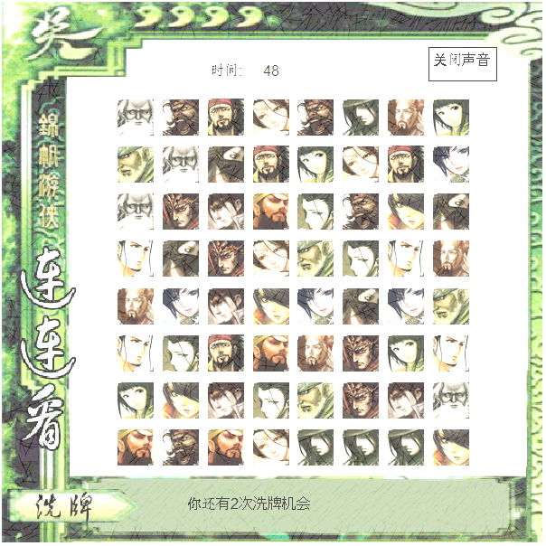

连连看

Slide 2

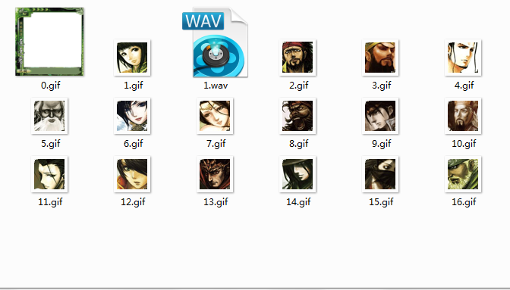
素材

Slide 3
打开窗口
from random import randrange
from graphics import*
import math
import time
import copy
import winsound
import thread
win=GraphWin('game interface',600,600)
win.setCoords(-100,500,500,-75)

Slide 4
列表
position=[[0 for i in range(10)] for k in range(10)]
[0, 0, 0, 0, 0, 0, 0, 0, 0, 0]
[0, 0, 0, 0, 0, 0, 0, 0, 0, 0]
[0, 0, 0, 0, 0, 0, 0, 0, 0, 0]
[0, 0, 0, 0, 0, 0, 0, 0, 0, 0]
[0, 0, 0, 0, 0, 0, 0, 0, 0, 0]
[0, 0, 0, 0, 0, 0, 0, 0, 0, 0]
[0, 0, 0, 0, 0, 0, 0, 0, 0, 0]
[0, 0, 0, 0, 0, 0, 0, 0, 0, 0]
[0, 0, 0, 0, 0, 0, 0, 0, 0, 0]
[0, 0, 0, 0, 0, 0, 0, 0, 0, 0]

Slide 5
产生图片
position=[[0 for i in range(10)] for k in range(10)]
for i in range (1,17):
k=0
while k<4:
x=randrange(1,9)
y=randrange(1,9)
if position[x][y]==0:
k=k+1
position[x][y]=i
point=Point(x*50,y*50)
picture=Image(point,'pictures\\%s.gif'%i).draw(win)

Slide 6
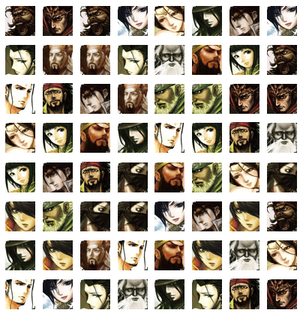
产生图片
[0, 0, 0, 0, 0, 0, 0, 0, 0, 0]
[0, 8, 11, 4, 7, 1, 12, 14, 4, 0]
[0, 13, 10, 2, 1, 9, 16, 12, 6, 0]
[0, 8, 10, 9, 3, 2, 15, 10, 11, 0]
[0, 6, 11, 10, 14, 15, 15, 4, 5, 0]
[0, 7, 5, 16, 4, 3, 6, 3, 14, 0]
[0, 14, 3, 16, 1, 16, 9, 12, 11, 0]
[0, 9, 1, 13, 2, 7, 12, 5, 2, 0]
[0, 6, 8, 13, 5, 15, 8, 7, 13, 0]
[0, 0, 0, 0, 0, 0, 0, 0, 0, 0]

Slide 7

记时
def play_time():
global playtime,playtime_text
playtime_text=Text(Point(200,0),playtime)
playtime_text.draw(win)
playtime_text2=Text(Point(150,0),"时间:").draw(win)
while playtime>0:
time.sleep(1)
playtime=playtime-1
playtime_text.setText(playtime)
playtime=50
thread.start_new_thread(play_time,())

Slide 8
声音
winsound.PlaySound('pictures\\1', winsound.SND_ASYNC)
close=Polygon(Point(375,10),Point(450,10),Point(450,-25),Point(375,-25))
close.draw(win)
close_text=Text(Point(412,-12),"关闭声音").draw(win)
if po2.getX()>375 and po2.getX()<450 and po2.getY()>-25 and\po2.getY()<10:
winsound.PlaySound('pictures\\2', winsound.SND_ASYNC)

Slide 9
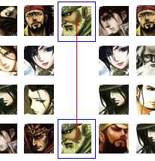
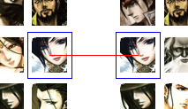
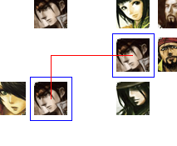
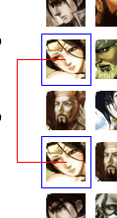
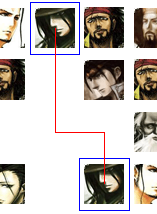
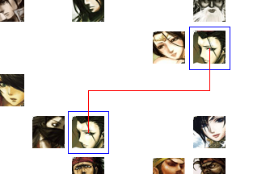
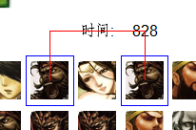
连线算法
直线：
一折（两条线）：
两折（三条线）：

Slide 10
连线算法

Slide 11
连线算法

Slide 13
连线判断
if x1==x2 and y1!=y2:
i=-1
link=1
if yma!=ymi+1:
for k in range(ymi+1,yma):
if position[x1][k]!=0:
link=0
if link==1:
drawline(x1,y1,x2,y2,x1,y1,x2,y2)
while i<9 and link==0:
i=i+1
link=1
for k in range(min(xmi,i),max(xmi,i)+1):
if k!=x1:
if position[k][ymi]!=0:
link=0
if position[k][yma]!=0:
link=0
for k in range(ymi,yma+1):
if position[i][k]!=0:
link=0
if link==1:
z=i
drawline(x1,y1,z,y1,z,y2,x1,y2)

Slide 14
连线判断
elif x1!=x2 and y1!=y2:
i=-1
link=0
while i<9 and link==0:
i=i+1
link=1
if y11!=i:
for k in range(min(y11,i),max(y11,i)+1):
if k!=y11:
if position[xmi][k]!=0:
link=0
if y22!=i:
for k in range(min(y22,i),max(y22,i)+1):
if k!=y22:
if position[xma][k]!=0:
link=0
for k in range(xmi+1,xma):
if position[k][i]!=0:
link=0
if link==1:
z=i
drawline(xmi,y11,xmi,z,xma,z,xma,y22)

Slide 15
连线判断
while i<9 and link==0:
i=i+1
link=1
if xmi!=i:
for k in range(min(xmi,i),max(xmi,i)+1):
if k!=xmi:
if position[k][y11]!=0:
link=0
if xma!=i:
for k in range(min(xma,i),max(xma,i)+1):
if k!=xma:
if position[k][y22]!=0:
link=0
for k in range(ymi+1,yma):
if position[i][k]!=0:
link=0
if link==1:
z=i
drawline(xmi,y11,z,y11,z,y22,xma,y22)

Slide 16
if link==1:
position[x1][y1]=0
position[x2][y2]=0
c=Draw(x1,y1)
c.m()
c=Draw(x2,y2)
c.m()
picture_left=picture_left-2
elif link==0:
xo1=0
yo1=0
cl1.undraw()
cl2.undraw()

Slide 17
画线的函数
def drawline(a,b,c,d,e,f,g,h):
global playtime,cl1,cl2,playtime_text
l1=Line(Point(a*50,b*50),Point(c*50,d*50))
l1.setOutline("red")
l1.draw(win)
l2=Line(Point(c*50,d*50),Point(e*50,f*50))
l2.setOutline("red")
l2.draw(win)
l3=Line(Point(e*50,f*50),Point(g*50,h*50))
l3.setOutline("red")
l3.draw(win)
tt=Text(Point(300,0),"+2 seconds")
tt.draw(win)
playtime=playtime+2
playtime_text.setText(playtime)
time.sleep(0.5)
tt.undraw()
l1.undraw()
l2.undraw()
l3.undraw()
cl1.undraw()
cl2.undraw()

Slide 18
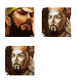
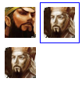
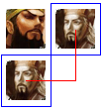

画框的类
class Draw:
def __init__(self,a,b):
self.p1=Point(50*a-25,50*b-25)
self.p2=Point(50*a+25,50*b-25)
self.p3=Point(50*a+25,50*b+25)
self.p4=Point(50*a-25,50*b+25)
def circle(self):
self.c=Polygon(self.p1,self.p2,self.p3,self.p4)
self.c.setOutline("blue")
self.c.draw(win)
return c
def m(self):
self.c=Polygon(self.p1,self.p2,self.p3,self.p4)
self.c.setFill("white")
self.c.setOutline("white")
self.c.draw(win)
def undraw(self):
self.c.undraw()

Slide 19
洗牌算法
copy1
copy2
[0, 0, 0, 0, 0, 0, 0, 0, 0, 0]
[0, 0, 0, 0, 14, 0, 0, 0, 11, 0]
[0, 0, 16, 1, 12, 0, 0, 5, 11, 0]
[0, 7, 11, 9, 11, 1, 13, 16, 5, 0]
[0, 5, 4, 0, 0, 0, 0, 3, 10, 0]
[0, 12, 5, 0, 0, 10, 8, 0, 9, 0]
[0, 8, 10, 8, 1, 4, 6, 0, 0, 0]
[0, 0, 8, 7, 13, 0, 0, 0, 9, 0]
[0, 2, 1, 10, 2, 9, 14, 6, 3, 0]
[0, 0, 0, 0, 0, 0, 0, 0, 0, 0]
[0, 0, 0, 0, 0, 0, 0, 0, 0, 0]
[0, 0, 0, 0, 14, 0, 0, 0, 11, 0]
[0, 0, 16, 1, 12, 0, 0, 5, 11, 0]
[0, 7, 11, 9, 11, 1, 13, 16, 5, 0]
[0, 5, 4, 0, 0, 0, 0, 3, 10, 0]
[0, 12, 5, 0, 0, 10, 8, 0, 9, 0]
[0, 8, 10, 8, 1, 4, 6, 0, 0, 0]
[0, 0, 8, 7, 13, 0, 0, 0, 9, 0]
[0, 2, 1, 10, 2, 9, 14, 6, 3, 0]
[0, 0, 0, 0, 0, 0, 0, 0, 0, 0]
[0, 0, 0, 0, 0, 0, 0, 0, 0, 0]
[0, 0, 0, 0, 14, 0, 0, 0, 11, 0]
[0, 0, 16, 1, 12, 0, 0, 5, 11, 0]
[0, 7, 11, 9, 11, 1, 13, 16, 5, 0]
[0, 5, 4, 0, 0, 0, 0, 3, 10, 0]
[0, 12, 5, 0, 0, 10, 8, 0, 9, 0]
[0, 8, 10, 8, 1, 4, 6, 0, 0, 0]
[0, 0, 8, 7, 13, 0, 0, 0, 9, 0]
[0, 2, 1, 10, 2, 9, 14, 6, 3, 0]
[0, 0, 0, 0, 0, 0, 0, 0, 0, 0]
positiona=copy.deepcopy (position)
positionb=copy.deepcopy (position)

Slide 20
洗牌算法
copy1
copy2
[0, 0, 0, 0, 0, 0, 0, 0, 0, 0]
[0, 0, 0, 0, 0, 0, 0, 0, 0, 0]
[0, 0, 0, 0, 0, 0, 0, 0, 0, 0]
[0, 0, 0, 0, 0, 0, 0, 0, 0, 0]
[0, 0, 0, 0, 0, 0, 0, 0, 0, 0]
[0, 0, 0, 0, 0, 0, 0, 0, 0, 0]
[0, 0, 0, 0, 0, 0, 0, 0, 0, 0]
[0, 0, 0, 0, 0, 0, 0, 0, 0, 0]
[0, 0, 0, 0, 0, 0, 0, 0, 0, 0]
[0, 0, 0, 0, 0, 0, 0, 0, 0, 0]
[0, 0, 0, 0, 0, 0, 0, 0, 0, 0]
[0, 0, 0, 0, 14, 0, 0, 0, 11, 0]
[0, 0, 16, 1, 12, 0, 0, 5, 11, 0]
[0, 7, 11, 9, 11, 1, 13, 16, 5, 0]
[0, 5, 4, 0, 0, 0, 0, 3, 10, 0]
[0, 12, 5, 0, 0, 10, 8, 0, 9, 0]
[0, 8, 10, 8, 1, 4, 6, 0, 0, 0]
[0, 0, 8, 7, 13, 0, 0, 0, 9, 0]
[0, 2, 1, 10, 2, 9, 14, 6, 3, 0]
[0, 0, 0, 0, 0, 0, 0, 0, 0, 0]
[0, 0, 0, 0, 0, 0, 0, 0, 0, 0]
[0, 0, 0, 0, 1, 0, 0, 0, 1, 0]
[0, 0, 1, 1, 1, 0, 0, 1, 1, 0]
[0, 1, 1, 1, 1, 1, 1, 1, 1, 0]
[0, 1, 1, 0, 0, 0, 0, 1, 1, 0]
[0, 1, 1, 0, 0, 1, 1, 0,1, 0]
[0, 1, 1, 1, 1, 1, 1, 0, 0, 0]
[0, 0,1, 1, 1, 0, 0, 0,1, 0]
[0, 1, 1, 1, 1, 1, 1, 1, 1, 0]
[0, 0, 0, 0, 0, 0, 0, 0, 0, 0]
[0, 0, 14, 0, 0, 0, 0, 0, 0, 0]

Slide 21
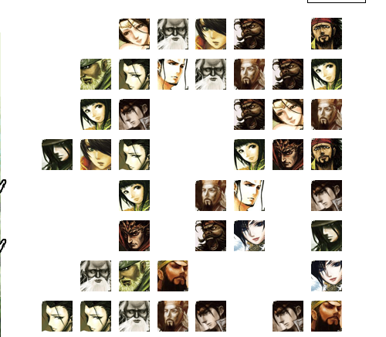
洗牌算法
[0, 0, 0, 0, 0, 0, 0, 0, 0, 0]
[0, 0, 0, 0, 14, 0, 0, 0, 11, 0]
[0, 0, 16, 1, 12, 0, 0, 5, 11, 0]
[0, 7, 11, 9, 11, 1, 13, 16, 5, 0]
[0, 5, 4, 0, 0, 0, 0, 3, 10, 0]
[0, 12, 5, 0, 0, 10, 8, 0, 9, 0]
[0, 8, 10, 8, 1, 4, 6, 0, 0, 0]
[0, 0, 8, 7, 13, 0, 0, 0, 9, 0]
[0, 2, 1, 10, 2, 9, 14, 6, 3, 0]
[0, 0, 0, 0, 0, 0, 0, 0, 0, 0]

Slide 22
洗牌算法
def wash1():
global click,wash,position
if click==1:
cl1.undraw()
elif click==2:
cl1.undraw()
cl2.undraw()
click=0
wash=wash-1
wash_text.setText("你还有%s次洗牌机会"%wash)
positiona=copy.deepcopy (position)
positionb=copy.deepcopy (position)
for i in range (1,9):
for k in range(1,9):
if positiona[i][k]!=0:
while 1:
x=randrange(1,9)
y=randrange(1,9)
if positionb[x][y]!=0:
position[x][y]=positiona[i][k]
positionb[x][y]=0
a=position[x][y]
p=Point(x*50,y*50)
picture=Image(p,'pictures\\%s.gif'%a)
picture.draw(win)
break

Slide 23
判断输赢
if picture_left==0:
ach=Text(Point(225,475),"you win,click anywhere to restart")
ach.draw(win)
playtime=0
win.getMouse()
time.sleep(1)
break
if playtime=0:
fail=Text(Point(225,475),"you fail,click anywhere to restart")
fail.draw(win)
win.getMouse()
time.sleep(1)
break

Slide 24
谢谢大家

