Slide 1
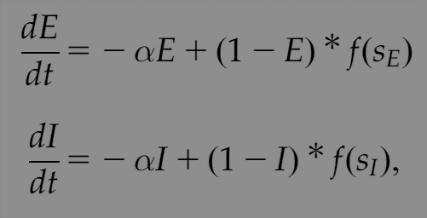
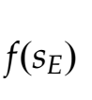
Wilson-Cowan model
Why sigmoid shape?
“… (Neuronal ) these threshold distributions were either Poisson-like, or Gaussian. It then followed that the integrals of such curves would lead to an expression for the firing rate curves as the fraction of neurons receiving at least threshold excitation.”
-- Hil G.E. Meijer, Jack D. Cowan et al. Journal of Mathematical Neuroscience 2016

Slide 2
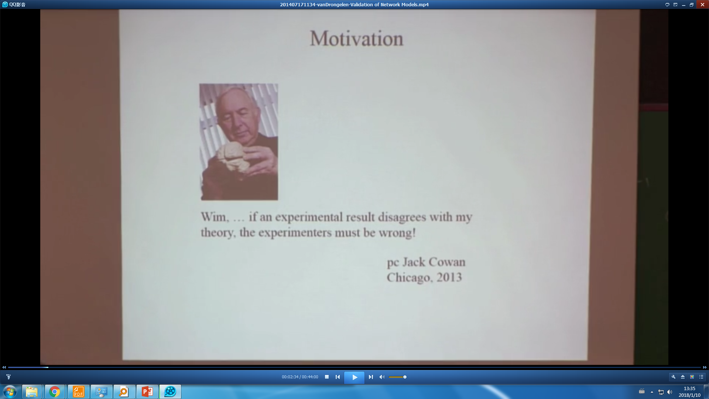
https://www.birs.ca/events/2014/5-day-workshops/14w5138/videos

