Slide 1
Dereification and Immersion in the AAT
Data Set description and Route map

Slide 2
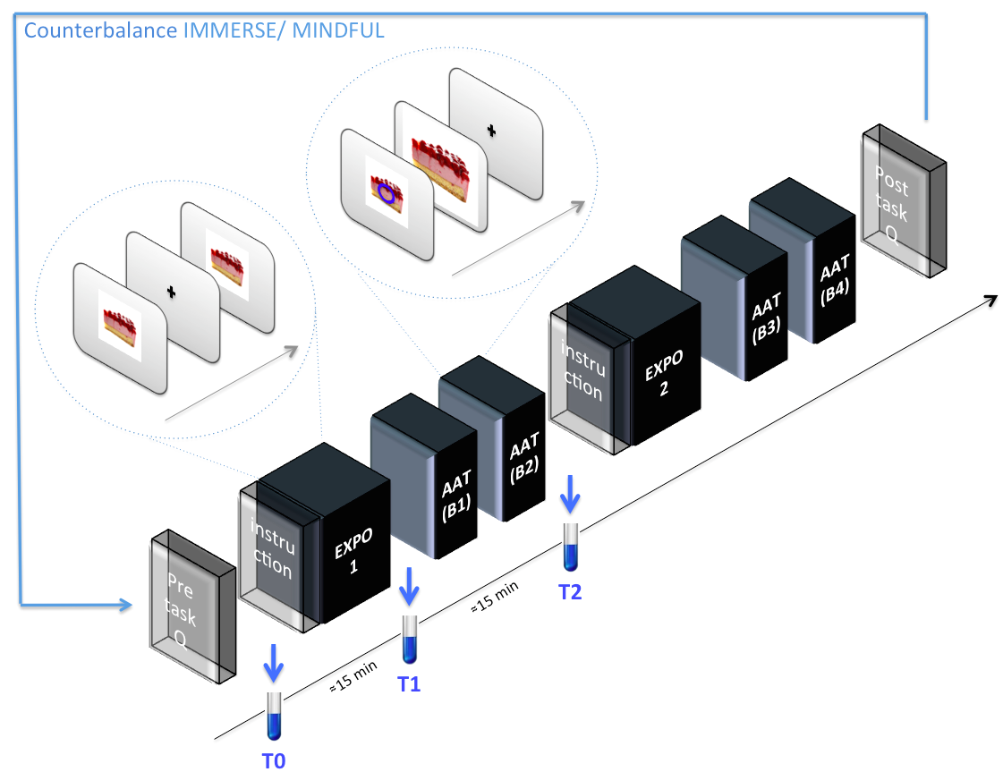
General Design:
Independent variables:
Instruction Type (intra-subject): Mindful / Immerse
Food Type: Appetizing / Neutral
Response Type: Approach / Avoidance
Dependent variables:
Reaction times
Electroencephalogram (EEG).
Saliva volume
Salivary alpha amylase activity
Self-report questionnaires
Elicitation and semi-structured interviews
Notes:
Exclusion criteria: Anxiety scores, Eating disorders, Diet intentions.
Controls: Circadian Rhythm & Individual food preferences where taking in to account for the analysis
Participants: 25 healthy adults, (28±-7) years, 12 males, 3 vegetarians.
AAT: Is implicit task for assessing both automatic and regulated approach-avoidance impulses behavior. Here participants are asked to move a joystick either towards or forward pictures according to cues. Following this button press pictures grew or shrank, mimicking approach or avoidance.
We adapted a protocol of exposure to neutral and attractive food pictures, with either a mindful or immerse attitude, followed by an Approach–Avoidance Task (AAT)³.
Independent variables:
Instruction Type (intra-subject): Mindful / Immerse
Food Type: Appetizing / Neutral
Response Type: Approach / Avoidance
Dependent variables:
Reaction times
Electroencephalogram (EEG). (not included here)
Saliva volume
Elicitation and semi-structured interviews (not included here)
Self-report questionnaires
Exclusion criteria: Anxiety scores, Eating disorders, Diet intentions.
Controls: Circadian Rhythm & Individual food preferences where taking in to account for the analysis
Participants: 25 healthy adults, (28±-7) years, 12 males, 3 vegetarians.

Slide 3
General Design 2:
(starting Right/Left hand Counterbalance across subjects)
AAT instruction
& Right hand
AAT instruction
& Left hand
AAT instruction
& Right hand
AAT instruction
& Left hand
Trait
EXPO
1
AAT
1
AAT
1
EXPO
2
AAT
2
AAT
2
EXPO
1
AAT
1
AAT
1
EXPO
2
AAT
2
AAT
2
Mindful instruction
with 60 images (30 atr & 30 Neu)
AAT
with 60 images showed in EXPO1
Mindful instruction
With the remaining 60 images
(30 atr & 30 Neu)
AAT
with 60 images showed in EXPO 2
Rest and wash out
Immerse instruction
with 60 images
Mindful instruction
With the remaining 60 images
All images are presented before any instruction
Trait/non manipulation CONDITION
Mindful CONDITION
Immerse CONDITION
(starting IMMERSE/ MINDFUL Counterbalance across subjects)

Slide 4
TTL EEG labels
1-60 =Attractive images ID
61-120= Neutral images ID
121-180 = Objects images ID
181= Appearing first time
182= Appearing second time
183= Appearing third time
184= Appearing fourth time
186= Attractive- Trait
187= Neutral- Trait
188= Objet- Trait
191=Circle
192=Square
194 = Block 1
195 = Block 2
196= Block 3
197= Block 4
201-mind = Avoid attractive
202-mind = Approach attractive
203-imme= Avoid attractive
204-imme= Approach attractive
211-mind = Avoid Neutral
212-mind = Approach Neutral
213-imme= Avoid Neutral
214-imme= Approach Neutral
221-mind = Avoid Objet
222-mind = Approach Objet
223-imme= Avoid Objet
224-imme= Approach Objet
226= Circle-(only behavior)
227 Square-(only behavior)
230=Approach with right hand
231= Avoid with right hand
232= Approach with left hand
233= Avoid with left hand
235=Incorrect response (Approach/avoid)& incorrect hand
236=Incorrect response (Approach/avoid)&correct hand
237=Correct response (Approach/avoid)&correct hand
238= Correct response (Approach/avoid)& incorrect hand
240-mind = Exposure Attractive 1
241-imme = Exposure Attractive 1
242-mind = Exposure Attractive 2
243-imme= Exposure Attractive 2
244-mind = Exposure Neutral 1
245-imme= Exposure Neutral 1
246-mind= Exposure Neutral 2
247-imme= Exposure Neutral 2
248-mind = Exposure Objet 1
249-imme= Exposure Objet 1
250-mind= Exposure Objet 2
251-imme= Exposure Objet 2
AAT response
zone
Generalities
EXPOSURE zone
AAT presentation
zone
Notes: * objects where include to control for some stuff, as left/right hand counterbalance
* I knew I was going to concatenate Imme and mind datasets, that’s why I choose to differentiate
at the TTL level, immerse and mindful, so the bins where more easy to operate afterwards

Slide 5
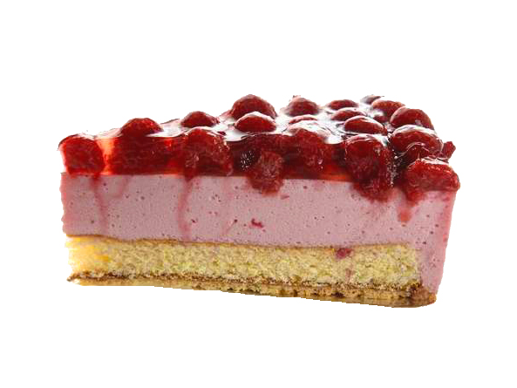
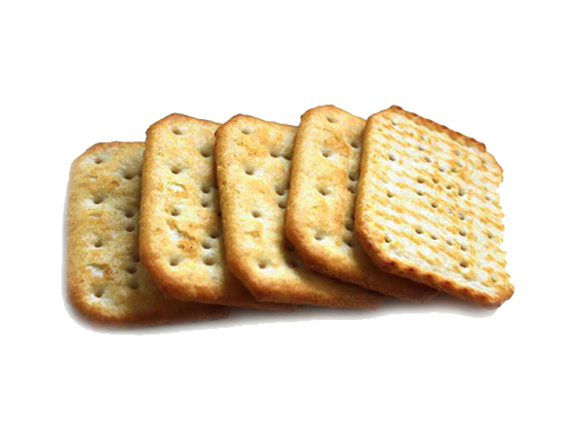
Trial Design : (TTL EEG labels in red)
a As Trait trials:
500 ms
600 ms
A/N/O
(186/187/188)
Id_image
(1 to 120)
b Exposure trials (MIND/ IMME):
500 ms
3500 ms
500 ms
500 ms
1000-1300 ms
Id_image
(1 to 120)
A/N/O EXPO1
(240/244/)
or
(241/245/)
A/N/O EXPO2
(242/246/250)
or
(243/247/251)
150 fix cruz
c AAT trials:
150 ms
500 ms
Up to 3000 ms
Zoom in or zoom out 1000 ms
200 ms
150 ms
500 ms
Up to 3000 ms
Zoom in or zoom out 1000 ms
200 ms
Id_
Block
(194 to
197)
Appearing
position
(181 to
184)
A/N/O- In/Out
(201/202/211/212/221/222)
or
(203/204/213/214/223/224)
Response type
(230 to 233)
Correctness
(237 to 238)
Cue type
(191 or 192)
Id_image
(1 to 120)

Slide 6
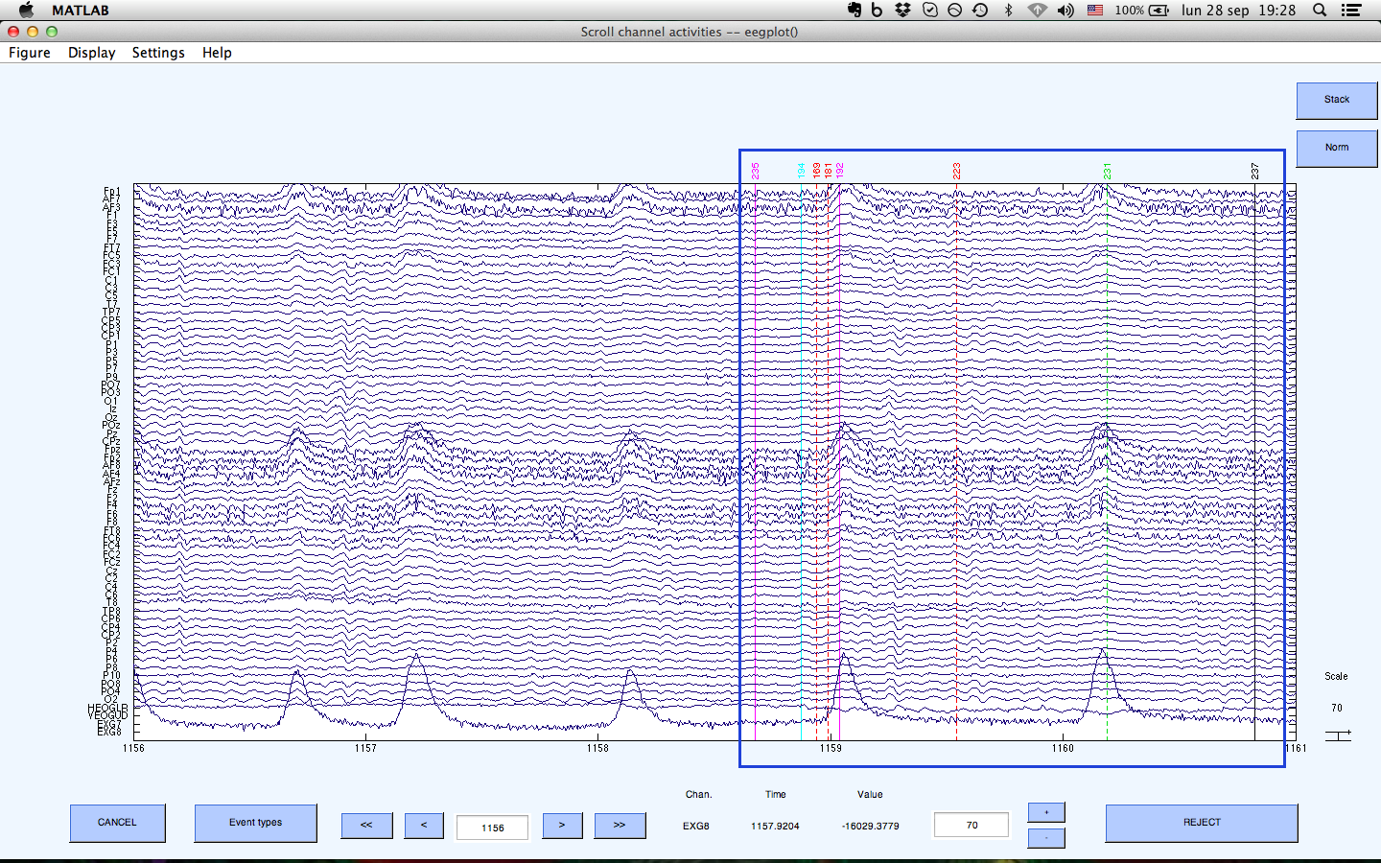
Example:
AAT starting in immerse
169, which indicates the identity of an object..
181, which indicates that it is the first time that image appears.
192 which indicates that square appears
223 which indicates object to zoom out in immerse
231 which indicates zoom out right
237 would indicate the subject's response is correct

Slide 7
Then …
Bins to epoch (with the TTL EEG labels) for the ERPs
BINLISTER
Bin1 At_Trait .{186}
Bin2 Ne_Trait .{187}
Bin3 Ob_Trait .{188}
Bin4 At_Ex1_Mind .{240}
Bin5 At_Ex2_Mind .{242}
Bin6 At_Ex1_Inme .{241}
Bin7 At_Ex2_Inme .{243}
Bin8 Ne_Ex1_Mind .{244}
Bin9 Ne_Ex2_Mind .{246}
Bin10 Ne_Ex1_Inme .{245}
Bin11 Ne_Ex2_Inme .{247}
Bin12 Ob_Ex1_Mind .{248}
Bin13 Ob_Ex2_Mind .{250}
Bin14 Ob_Ex1_Inme .{249}
Bin15 Ob_Ex2_Inme .{251}
Bin16 At_Avo_MindC .{201}{t<50-2000>231;233}
Bin17 At_App_MindC .{202}{t<50-2000>230;232}
Bin18 At_Avo_ImmeC .{203}{t<50-2000>231;233}
Bin19 At_App_ImmeC .{204}{t<50-2000>230;232}
Bin20 Ne_Avo_MindC .{211}{t<50-2000>231;233}
Bin21 Ne_App_MindC .{212}{t<50-2000>230;232}
Bin22 Ne_Avo_ImmeC .{213}{t<50-2000>231;233}
Bin23 Ne_App_ImmeC .{214}{t<50-2000>230;232}
Bin24 Ob_Avo_MindC .{221}{t<50-2000>231;233}
Bin25 Ob_App_MindC .{222}{t<50-2000>230;232}
Bin26 Ob_Avo_ImmeC .{223}{t<50-2000>231;233}
Bin27 Ob_App_ImmeC .{224}{t<50-2000>230;232}

Slide 8
Data Processing Pipeline:
Input Data: RAW Data
(BDF files_141 GB)
Read BDF
Down sampling to 512
Broad filter 0.5-100 Hz
Mastoid referenciation
Read BDF
Down sampling to 128
Broad filter 0.1-40
Output Data: Set 128.set (to model artifacts)
Output Data: Set_512_paraDenoise.set (45 GB)
ICA component selection (component+ topography)
ICA remove
DenoisingMatrix multiplication
Output Data: 128_denoisingMatrix. Set (64x64)
Output Data: 512_ICAcleaned.set
Concatenate imme & mind datasets
Output Data:512_ICAcleaned_concatenated.set (43.45 GB)
Change to individual
food preferences
Output Data:512_ICAcleaned_concPREF.set
Output Data:512_ICAcleaned_conc.set (16.54 GB)
Epoch generation (bin_log)
Artifact rejection 110 mv(Art_log)
filter 40hz
Output Data: _IcaClean_merge_erp_PREF.set
Output Data: _IcaClean_merge_erp.set
Average ERP x subjects
Color Cue Squema
Output Data: _ERP_PREF.set
Output Data: _ERP.set
Script
Data Set

