Slide 1
极限运算

Slide 2
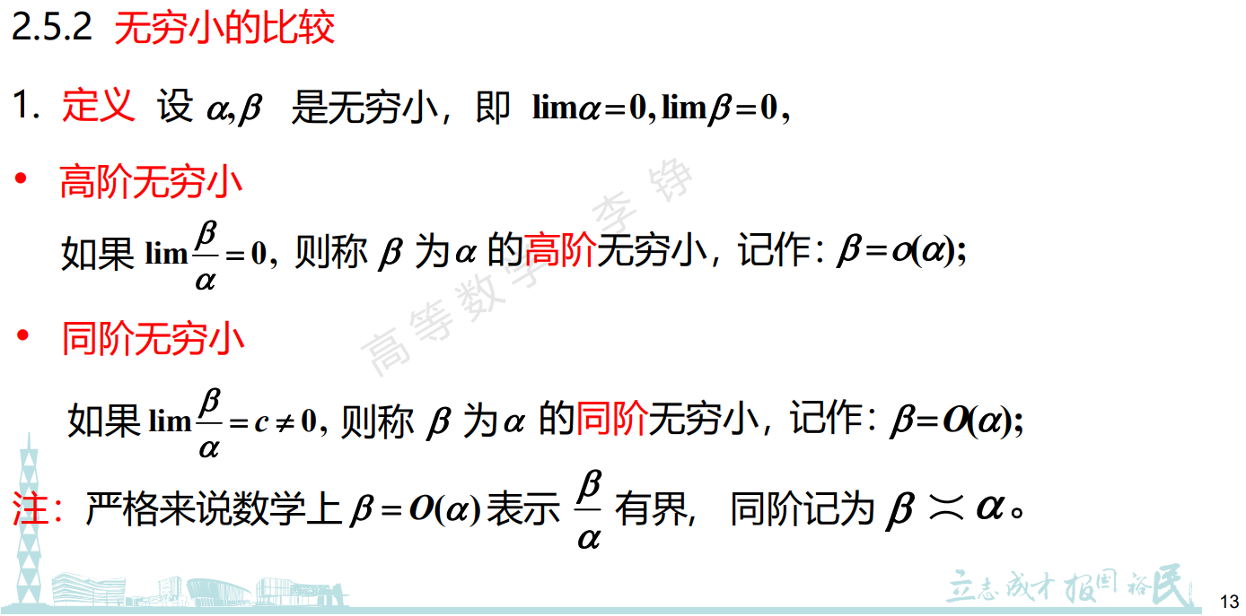

Slide 3
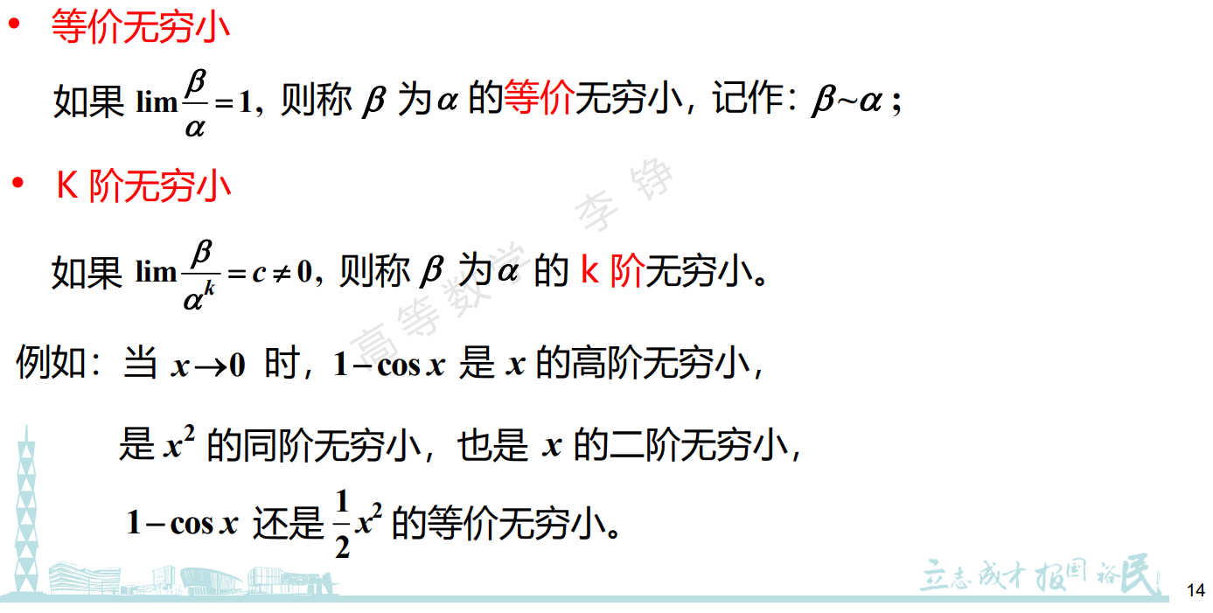

Slide 4
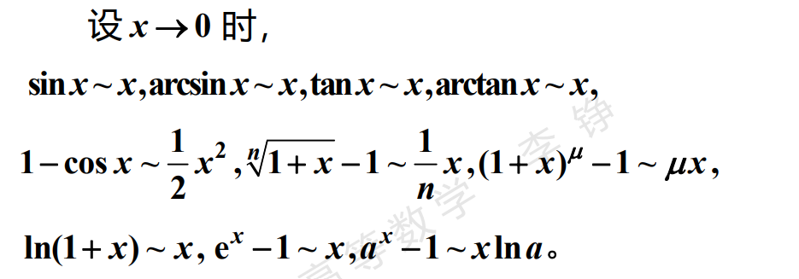

Slide 5
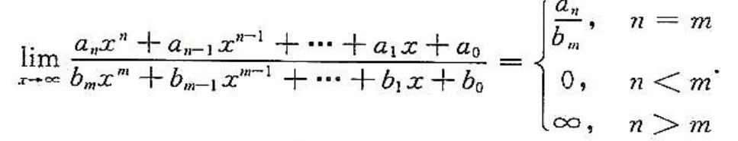

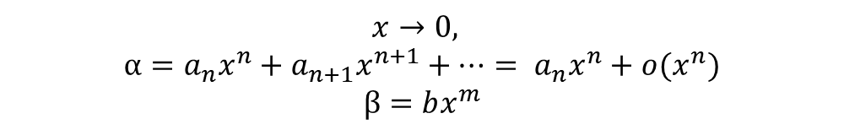
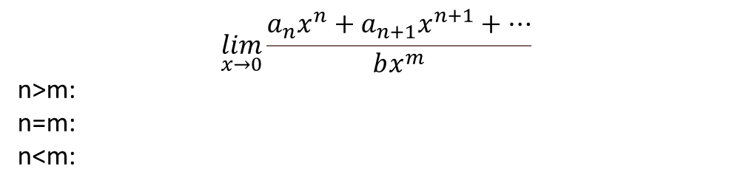
$$\lim_{x→0}\frac{a_{n}x^{n}+a_{n+1}x^{n+1}+…}{bx^{m}}$$
n>m:
n=m:
n<m:
$$x→0,$$
$α=a_{n}x^{n}+a_{n+1}x^{n+1}+…= a_{n}x^{n}+o(x^{n})$
$$β=bx^{m}$$
$$\lim_{x→0}\frac{α}{β}=\lim_{x→0}\frac{a_{n}x^{n}+a_{n+1}x^{n+1}+…}{bx^{m}}$$

Slide 6
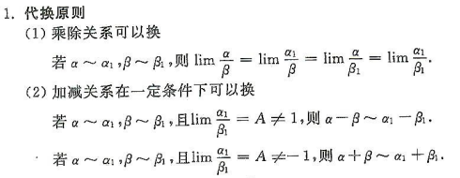
等价无穷小替换：

Slide 7



$$\frac{x−sinx}{x^{3}} =$$
设极限存在，则
$$A= \lim_{x→0}\frac{x−sinx}{x^{3}} =\lim_{x→0}\frac{x−xcos⁡\frac{x}{2}}{x^{3}}+\lim_{x→0}\frac{xcos\frac{x}{2}−2sin\frac{x}{2}cos\frac{x}{2}}{x^{3}}$$
$$=\frac{1}{8}+\lim_{x→0}cos\frac{x}{2}⋅\frac{\frac{x}{2}−sin\frac{x}{2}}{{4⋅(\frac{x}{2})}^{3}}$$
替换$\frac{x}{2}$，
$$=\frac{1}{8}+\frac{1}{4}\lim_{x→0}\frac{x−sinx}{x^{3}}$$
$$A=\frac{1}{8}+\frac{1}{4}A$$
$$A=\lim_{x→0}\frac{x−sinx}{x^{3}}=\frac{1}{6}$$
$x−sinx \sim o(x)$

Slide 8

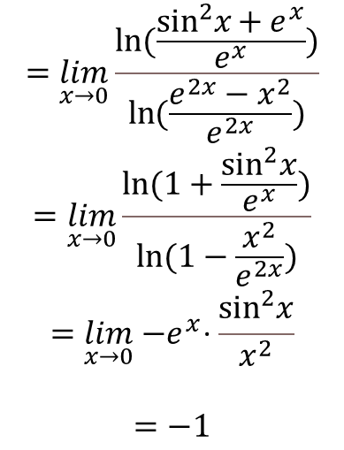

30(4)
$$=\lim_{x→0}\frac{\ln{(\frac{\sin^{2}x{+ e^{x}}}{e^{x}})}}{\ln{(\frac{e^{2x}−x^{2}}{e^{2x}})}}$$
$$=\lim_{x→0}\frac{\ln{(1+\frac{\sin^{2}x}{e^{x}})}}{\ln{(1−\frac{x^{2}}{e^{2x}})}}$$
$$=\lim_{x→0}{−e}^{x}⋅\frac{\sin^{2}x}{x^{2}}$$
$$=−1$$
$$\lim_{x→0}\frac{\ln\left(\sin^{2}x{+ e^{x}}\right)−ln⁡(e^{x})}{\ln\left(e^{2x}−x^{2}\right)−ln⁡(e^{2x})}$$

Slide 9

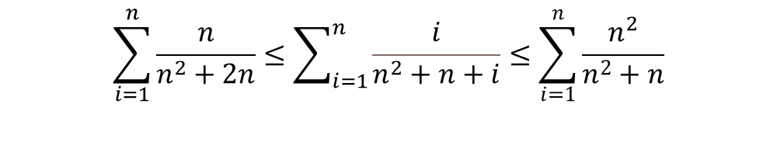
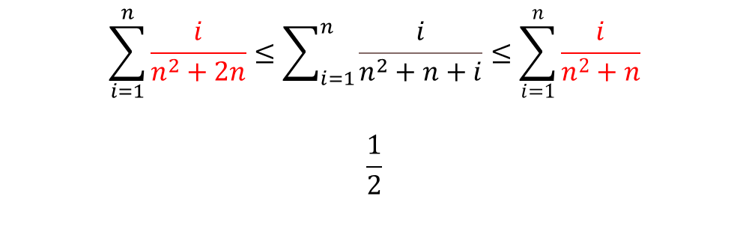
13(4)
$$\sum_{i=1}^{n}{\frac{n}{n^{2}+2n}}≤\sum_{i=1}^{n}{\frac{i}{n^{2}+n+i}}≤\sum_{i=1}^{n}{\frac{n^{2}}{n^{2}+n}}$$
$$\sum_{i=1}^{n}{\frac{i}{n^{2}+2n}}≤\sum_{i=1}^{n}{\frac{i}{n^{2}+n+i}}≤\sum_{i=1}^{n}{\frac{i}{n^{2}+n}}$$
$$\frac{1}{2}$$

Slide 10


$4^{n}≤2^{n}+3^{n}+4^{n}≤3⋅$ $4^{n}$

Slide 11
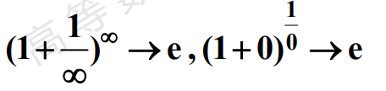


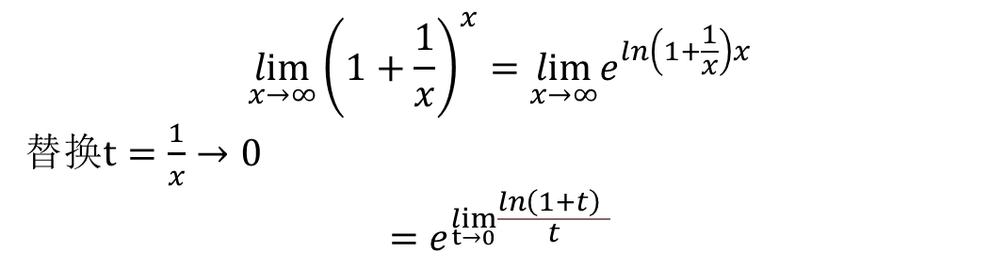
$$\lim_{x→∞}{\left(1+\frac{1}{x}\right)}^{x}= e$$
$$\lim_{x→∞}{\left(1+\frac{1}{x}\right)}^{x}=\lim_{x→∞}e^{ln\left(1+\frac{1}{x}\right)x}$$
替换$t=\frac{1}{x}→0$
$$=e^{\lim_{t→0}\frac{ln\left(1+t\right) }{t}}$$
$$\lim_{f(x)→0}{\left(1+f(x)\right)}^{\frac{1}{f(x)}}= e$$

Slide 12

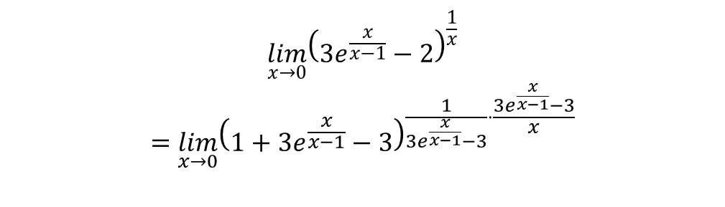

30(8)
$$\lim_{x→0}{{\left(3e^{\frac{x}{x−1}}−2\right)}^{\frac{1}{x}}}$$
$$=\lim_{x→0}{{\left(1+3e^{\frac{x}{x−1}}−3\right)}^{\frac{1}{3e^{\frac{x}{x−1}}−3}⋅\frac{3e^{\frac{x}{x−1}}−3}{x}}}$$
$$={e^{\lim_{x→0}\frac{3(e^{\frac{x}{x−1}}−1)}{x}}}$$
$$={e^{\lim_{x→0}\frac{3\frac{x}{x−1}}{x}}}$$
$$={e^{−3}}$$

Slide 13


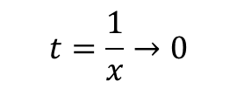
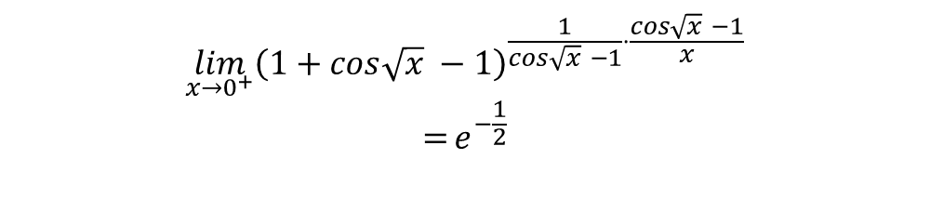
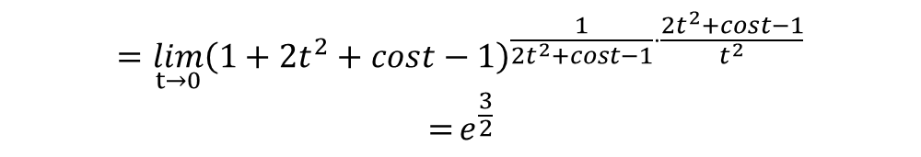
27(4)
$$=\lim_{t→0}{{\left(1+2t^{2}+cost−1\right)}^{\frac{1}{2t^{2}+cost−1}⋅\frac{2t^{2}+cost−1}{t^{2}}}}$$
$$={e^{\frac{3}{2}}}$$
$$t=\frac{1}{x}→0$$
27(9)
$$\lim_{x→0^{+}}{{\left(1+cos\sqrt{x} −1\right)}^{\frac{1}{cos\sqrt{x} −1}⋅\frac{cos\sqrt{x} −1}{x}}}$$
$$={e^{−\frac{1}{2}}}$$

Slide 14

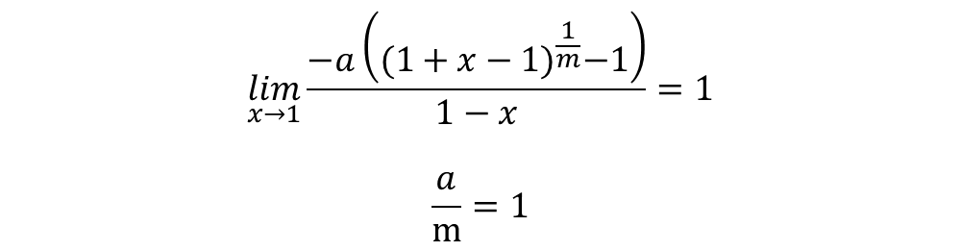
29(7)
$$\lim_{x→1}{\frac{a\left(1−x^{\frac{1}{m}}\right)}{1−x}=1}$$
$$\lim_{x→1}{\frac{−a\left({(1+x−1)}^{\frac{1}{m}}−1\right)}{1−x}=1}$$
$$\frac{a}{m}{=1}$$

Slide 15


28(8)
$$\lim_{x→0}{\frac{\left(cos{\left.x\right)}^{x}−1\right.}{x^{3}}}$$
$$=\lim_{x→0}{\frac{e^{xln(cosx)}−1}{x^{3}}}$$
$$=\lim_{x→0}{\frac{xln(1+cosx−1)}{x^{3}}}$$
$$=\lim_{x→0}{\frac{cosx−1}{x^{2}}}$$
$$=−{\frac{1}{2}}$$
阶数为3，主部为$−\frac{1}{2}{x^{3}}$

Slide 16

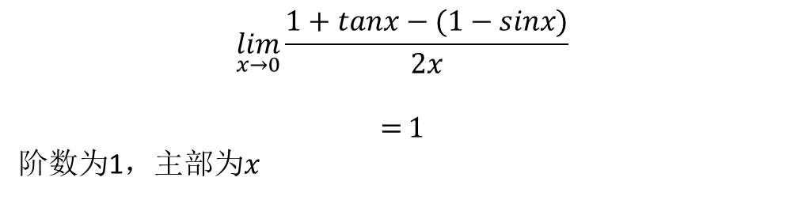
28(7)
$$\lim_{x→0}{\frac{1+tanx−(1−sinx)}{2x}}$$
$$={1}$$
阶数为1，主部为$x$

Slide 17






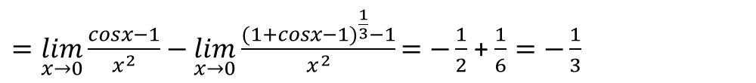


26(6)
$=\lim_{x→0}{\frac{cosx−1}{x^{2}}−\lim_{x→0}\frac{{(1+cosx−1)}^{\frac{1}{3}}−1}{x^{2}}=−{\frac{1}{2}}}$ + $\frac{1}{6}=−\frac{1}{3}$
26(9)
$$={\lim_{x→0}\frac{{(sinx)}^{2}+{(cosx)}^{2}−{(cosx)}^{2}cos2x}{x^{2}(1+cosx{(cos2x)}^{\frac{1}{2}})}}$$
$$=\frac{1}{2}\lim_{x→0}{\frac{{(sinx)}^{2}}{x^{2}}+\frac{1}{2}\lim_{x→0}\frac{{\left(cosx\right)}^{2}(1−cos2x)}{x^{2}}={\frac{3}{2}}}$$
26(10)
$$t=1−x →0$$
$$={\lim_{x→0}\frac{t}{tan\frac{π}{2}t}=\frac{2}{π}}$$
$$tan\left(\frac{π}{2}−x\right)=\frac{1}{tanx}$$

Slide 18

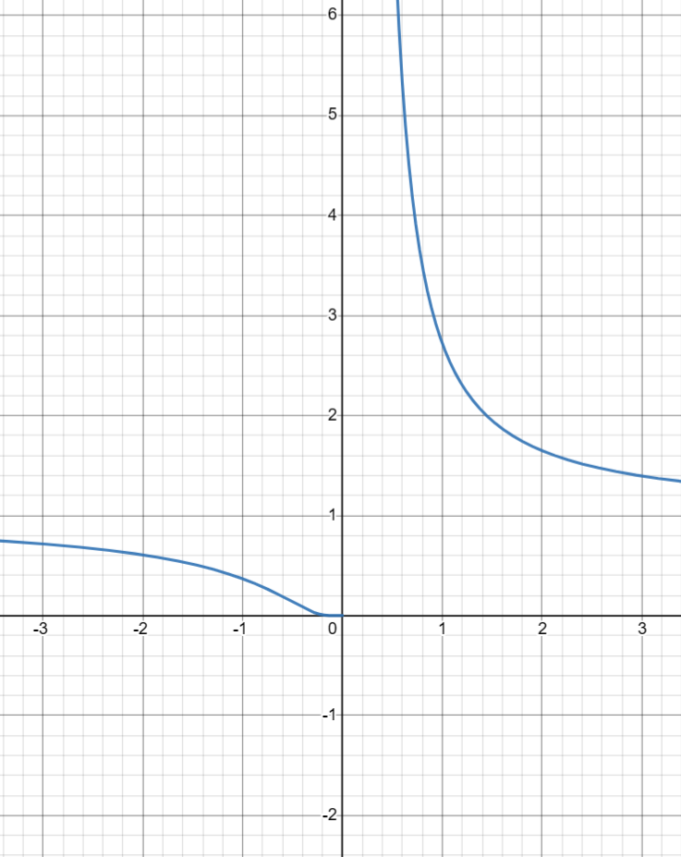
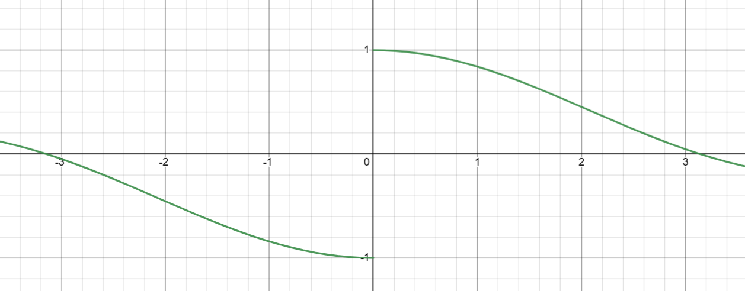



30(9)
$$\lim_{x→0^{+}}{\frac{2+e^{\frac{1}{x}}}{1+e^{\frac{2}{x}}}}+\frac{sinx}{x}$$
t = $e^{\frac{1}{x}}$ $→+∞$
$$=\lim_{t→+∞}{\frac{2+t}{1+t^{2}}}+\lim_{x→0^{+}}\frac{sinx}{x}$$
$=1$
$$\lim_{x→0^{−}}{\frac{2+e^{\frac{1}{x}}}{1+e^{\frac{2}{x}}}}−\frac{sinx}{x}$$
$$\text{t}\text{ = }e^{\frac{1}{x}} →0$$
$$=\lim_{t→0}{\frac{2+t}{1+t^{2}}}−\lim_{x→0^{+}}\frac{sinx}{x}$$
$$=1$$
$$e^{\frac{1}{x}}$$
$$\frac{sinx}{\left|x\right|}$$
https://www.desmos.com/

Slide 19


Slide 20

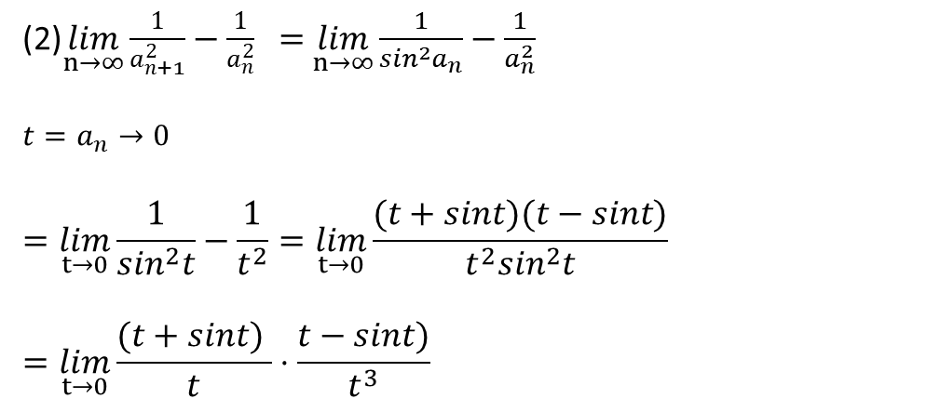
(1) $A=sinA$
(2)$\lim_{n→∞}{\frac{1}{a_{n+1}^{2}}−\frac{1}{a_{n}^{2}} }=$ $\lim_{n→∞}{\frac{1}{\sin^{2}a_{n}}−\frac{1}{a_{n}^{2}} }$
$$t=a_{n}→0$$
$$=\lim_{t→0}{\frac{1}{\sin^{2}t}−\frac{1}{t^{2}}=\lim_{t→0}{\frac{(t+sint)(t−sint)}{{t^{2}sin}^{2}t}}}$$
$$=\lim_{t→0}{\frac{(t+sint) }{t}⋅\frac{t−sint)}{t^{3}}}$$

Slide 21

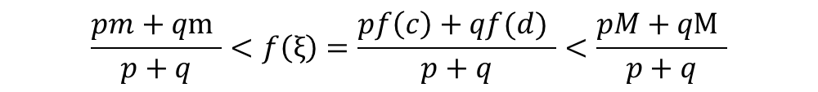
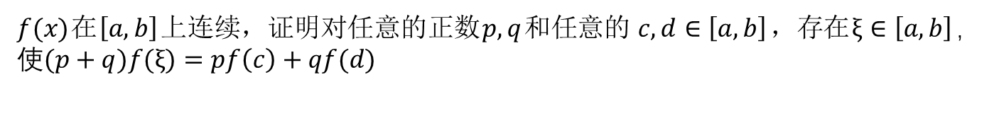

$f(x)$在$\left[a,b\right]$上连续，证明对任意的正数$p, q$和任意的$c,d∈\left[a,b\right]$，存在$ξ∈\left[a,b\right]$，
使$(p+q)f(ξ)=pf\left(c\right)+qf(d)$
$$\frac{pm+q\text{m} }{p+q}<f\left(ξ\right)=\frac{pf\left(c\right)+qf(d) }{p+q}<\frac{pM+q\text{M} }{p+q}$$
$$F\left(x\right)=f\left(a+x\right)−f\left(x\right)$$
$$F\left(a\right)=f\left(2a\right)−f\left(a\right)$$
$$F\left(0\right)=f\left(a\right)−f\left(0\right)$$

