Slide 1
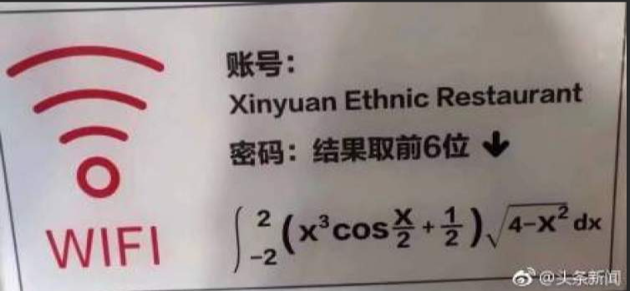

$$\int_{−2}^{2}{\left(x^{3}\cos\left(\frac{x}{2}\right)+\frac{1}{2}\right)\sqrt{4−x^{2}}dx}$$

Slide 2



Slide 3



Slide 4



求$\int_{0}^{x}{tf\left(x−t\right)dt}的导数$

Slide 5



Slide 6



