Slide 1
定积分

Slide 2
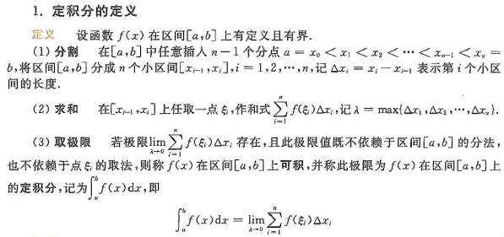
定积分定义

Slide 3
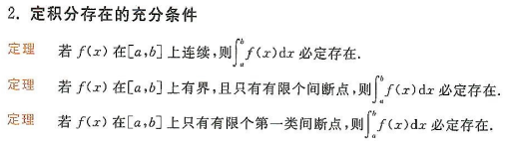

Slide 4




Slide 5
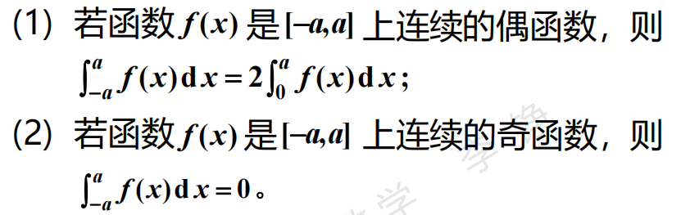

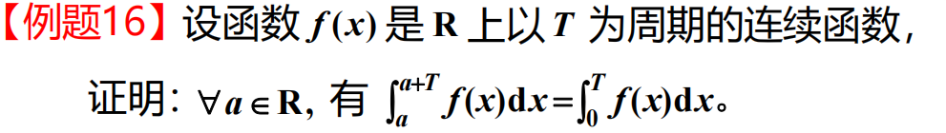
奇偶性和周期性

Slide 6

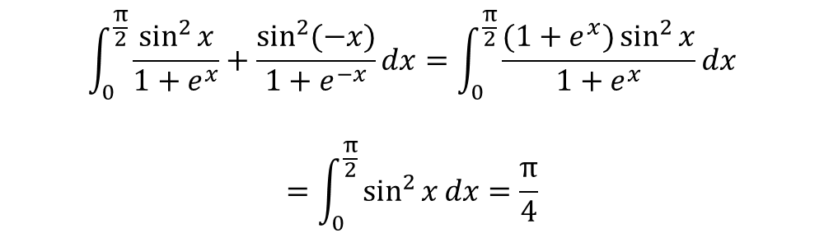
$$\int_{0}^{\frac{π}{2}}{\frac{\sin^{2}{x}}{1+e^{x}}+\frac{\sin^{2}{(−x)}}{1+e^{−x}}dx}=\int_{0}^{\frac{π}{2}}{\frac{(1+e^{x})\sin^{2}{x}}{1+e^{x}}dx}$$
$$=\int_{0}^{\frac{π}{2}}{\sin^{2}{x}dx}=\frac{π}{4}$$

Slide 7

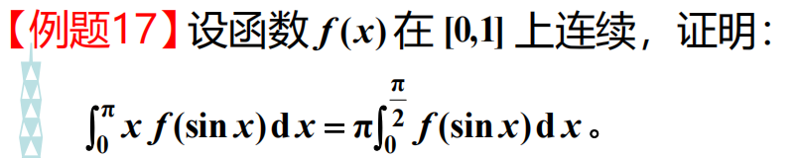

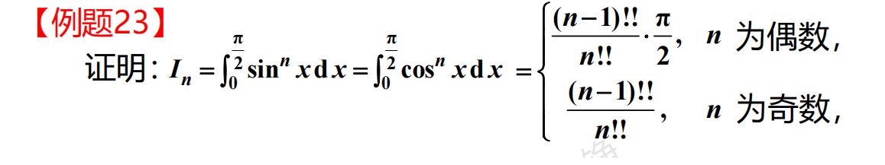
三角函数定积分

Slide 8


$$=\int_{0}^{4}{x^{2}\sqrt{4−{\left(x−2\right)}^{2}}dx}$$
$$x=2+2sint,$$
$$=\int_{−\frac{π}{2}}^{\frac{π}{2}}{{\left(2+2sint\right)}^{2}4\cos^{2}{t}dt}$$
$$=16\int_{−\frac{π}{2}}^{\frac{π}{2}}{\left(1+2sint+\sin^{2}{t}\right)\cos^{2}{t}dt}$$
$$=32\int_{−\frac{π}{2}}^{\frac{π}{2}}{\left(1+\sin^{2}{t}\right)\cos^{2}{t}dt}$$
$$=32\int_{0}^{\frac{π}{2}}{\left(1−\sin^{4}{t}\right)dt}$$
$$=10π$$

Slide 9

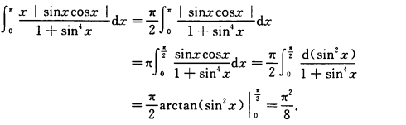

Slide 10
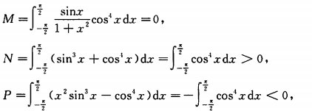
比较M,N,P的大小关系

Slide 11

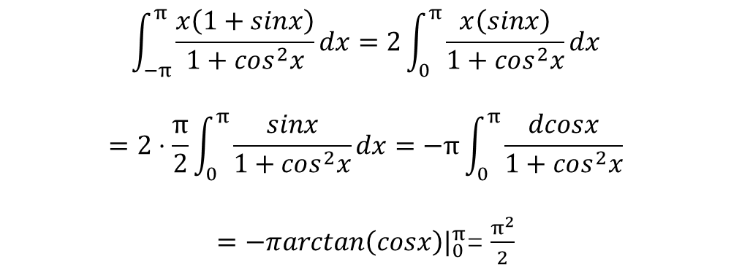
$$\int_{−π}^{π}{\frac{x\left(1+sinx\right)}{1+cos^{2}x}dx}=2\int_{0}^{π}{\frac{x\left(sinx\right)}{1+cos^{2}x}dx}$$
$$=2⋅\frac{π}{2}\int_{0}^{π}{\frac{sinx}{1+cos^{2}x}dx}=−π\int_{0}^{π}{\frac{dcosx}{1+cos^{2}x}}$$
$=−πarctan\left(cosx\right)|_{0}^{π}$=$\frac{π^{2}}{2}$

Slide 12
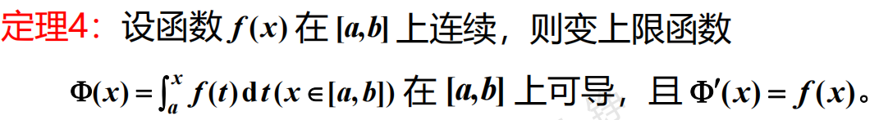
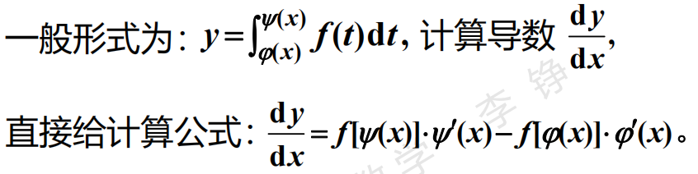
变上限积分

Slide 13


$$\int_{0}^{π}{f\left(x\right)dx}=xf\left(x\right){\left.​\right|}_{0}^{π}−\int_{0}^{π}{xf^{′}\left(x\right)dx}$$
$$=π\int_{0}^{π}{\frac{sint}{π−t}dt}−\int_{0}^{π}{t\frac{sint}{π−t}dt}$$
$$=\int_{0}^{π}{sintdt}=2$$

Slide 14

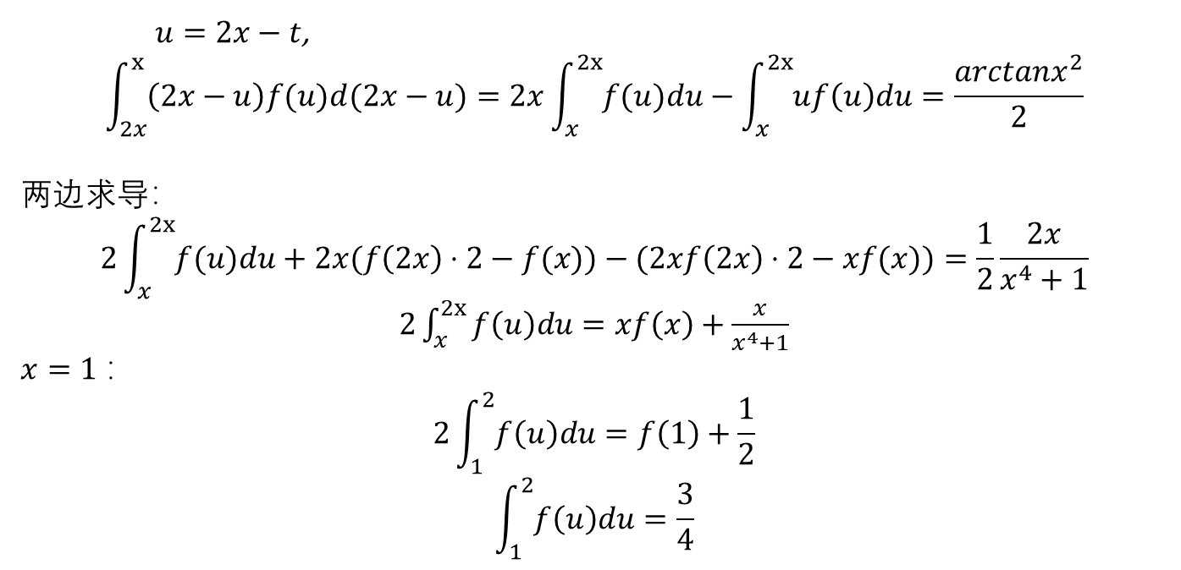
$u=2x−t$,
$$\int_{2x}^{x}{\left(2x−u\right)f(u)d(2x−u)}=2x\int_{x}^{2x}{f(u)du}−\int_{x}^{2x}{uf\left(u\right)du}=\frac{arctanx^{2}}{2}$$
两边求导：
$$2\int_{x}^{2x}{f(u)du}+2x(f\left(2x\right)⋅2−f(x))−(2xf\left(2x\right)⋅2−xf(x))=\frac{1}{2}\frac{2x}{x^{4}+1}$$
$2\int_{x}^{2x}{f\left(u\right)du}=xf\left(x\right)+$ $\frac{x}{x^{4}+1}$
$x=1$：
$$2\int_{1}^{2}{f\left(u\right)du}=f\left(1\right)+\frac{1}{2}$$
$$\int_{1}^{2}{f\left(u\right)du}=\frac{3}{4}$$

Slide 15


$\lim_{x→0^{+}}\frac{\sin^{2}\sqrt{x}}{2x}$ = $\frac{1}{2}$

Slide 16


Slide 17


反常积分敛散性

Slide 18
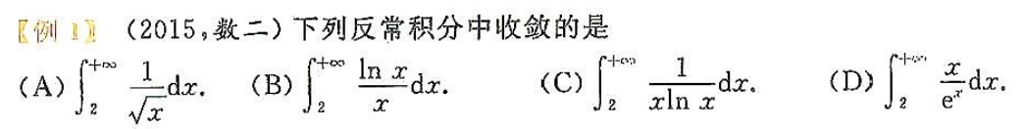
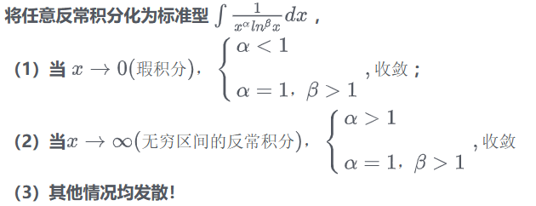

Slide 19





Slide 20
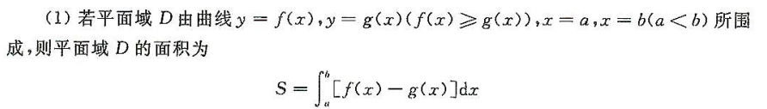

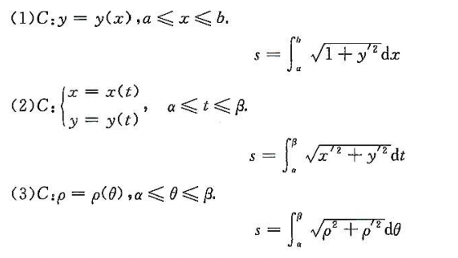


面积弧长和旋转体

Slide 21
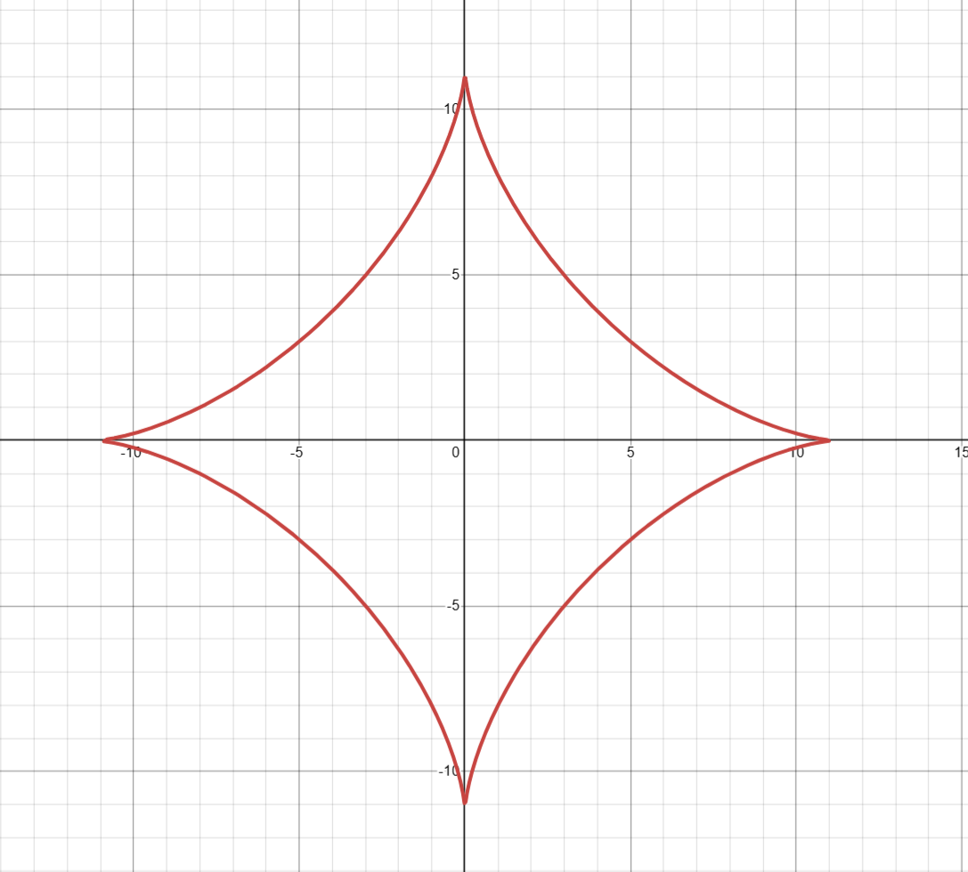




$$=\frac{3πa^{2}}{32}$$

Slide 22
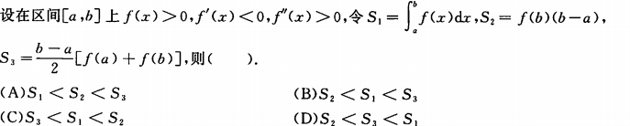

Slide 23
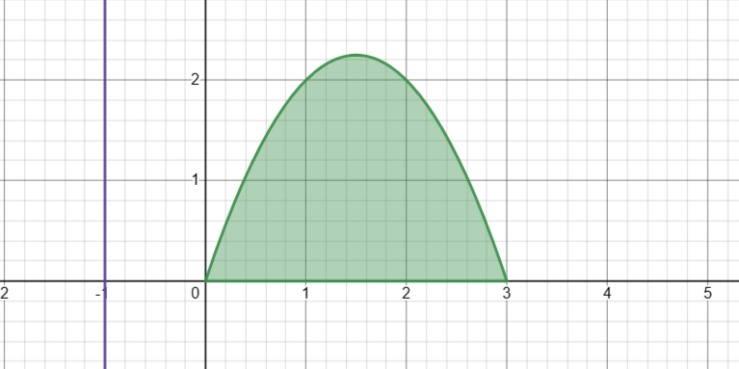

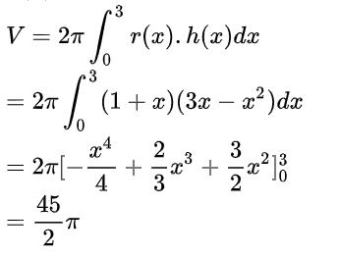
由x轴和抛物线$y=3x−x^{2}$围成的区域绕直线$x=−1$旋转一周产生一个旋转体，求旋转体体积。

Slide 24


