Slide 1
导数运算

Slide 2
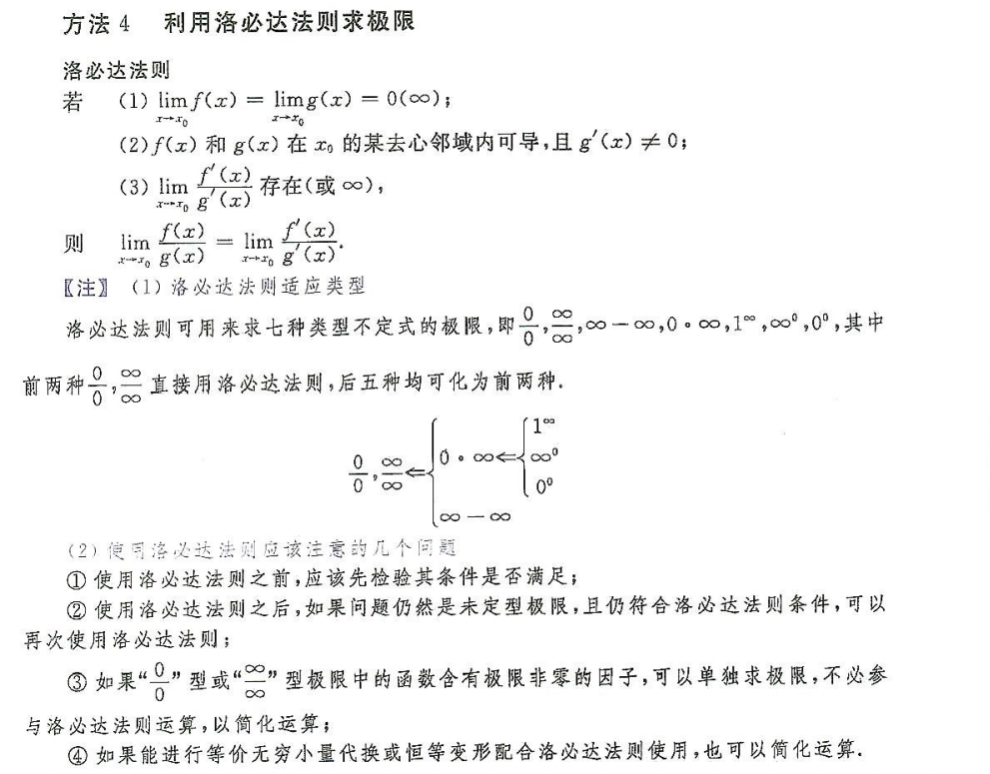

Slide 3


$$−\frac{4}{π^{2}}$$

Slide 4


$$\lim_{x→∞}\frac{x+sinx}{x+\frac{1}{2}sin2x}$$
$$\lim_{x→∞}\frac{1+\frac{sinx}{x}}{1+\frac{1}{2}\frac{sin2x}{x}}=1$$

Slide 5


$$\lim_{x→0}{\frac{f^{′}\left(x\right)−1}{2x}}=\lim_{x→0}{\frac{f^{′}′\left(x\right)}{2}}$$
$$=\frac{1}{2}\lim_{x→0}{\frac{f^{′}\left(x\right)−f^{′}\left(0\right)}{x}}$$

Slide 6
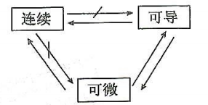

Slide 7
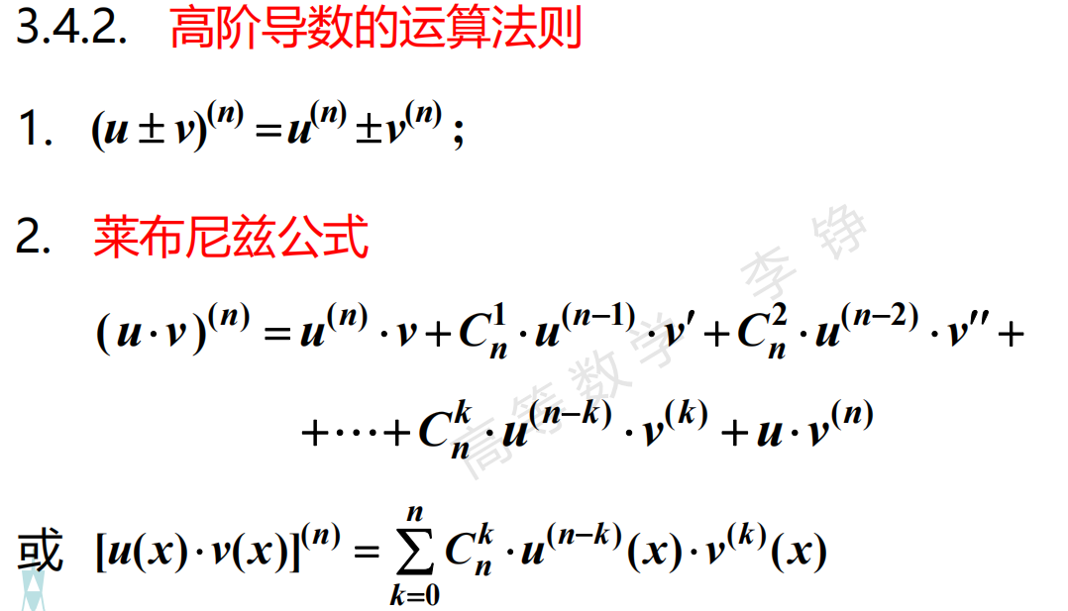
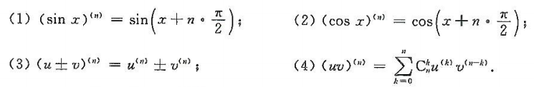

Slide 8
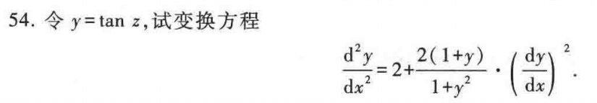
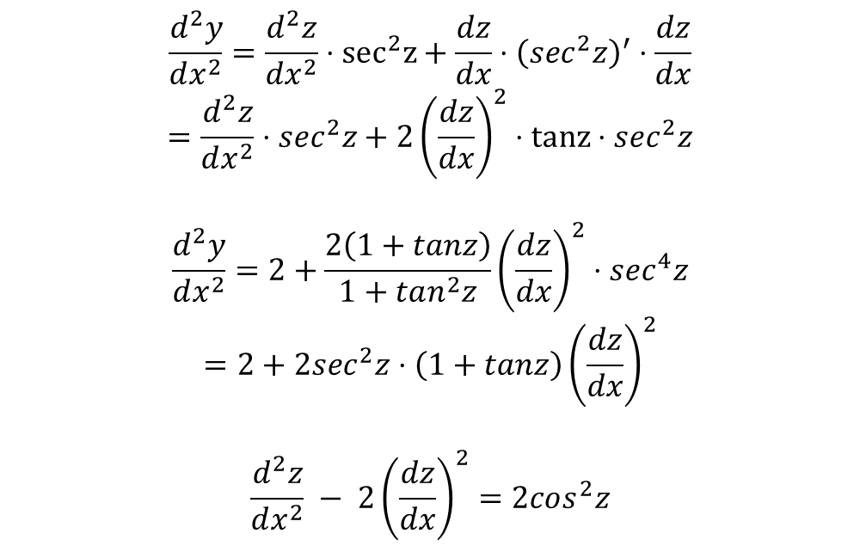
$$\frac{d^{2}y}{dx^{2}}=\frac{d^{2}z}{dx^{2}}⋅sec^{2}z+\frac{dz}{dx}⋅{\left(sec^{2}z\right)}^{′}⋅\frac{dz}{dx}$$
$$=\frac{d^{2}z}{dx^{2}}⋅sec^{2}z+{2\left(\frac{dz}{dx}\right)}^{2}⋅tanz⋅sec^{2}z$$
$$\frac{d^{2}y}{dx^{2}}=2+\frac{2\left(1+tanz\right)}{1+tan^{2}z}{\left(\frac{dz}{dx}\right)}^{2}⋅sec^{4}z$$
$$=2+2sec^{2}z⋅\left(1+tanz\right){\left(\frac{dz}{dx}\right)}^{2}$$
$$\frac{d^{2}z}{dx^{2}} − {2\left(\frac{dz}{dx}\right)}^{2}=2cos^{2}z$$

Slide 9


$y = x + lnx$，对y求导
$$f^{′}\left(y\right) = \frac{x}{1+x }$$
$$f^{′′}\left(y\right) = \frac{x}{{(1+x)}^{3}}$$

Slide 10


$$y =\frac{1}{x−2 } − \frac{1}{x−1 }$$

Slide 11
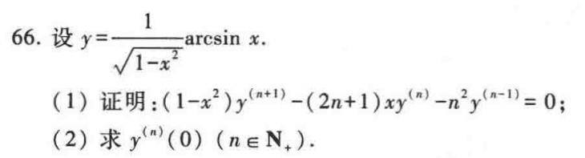
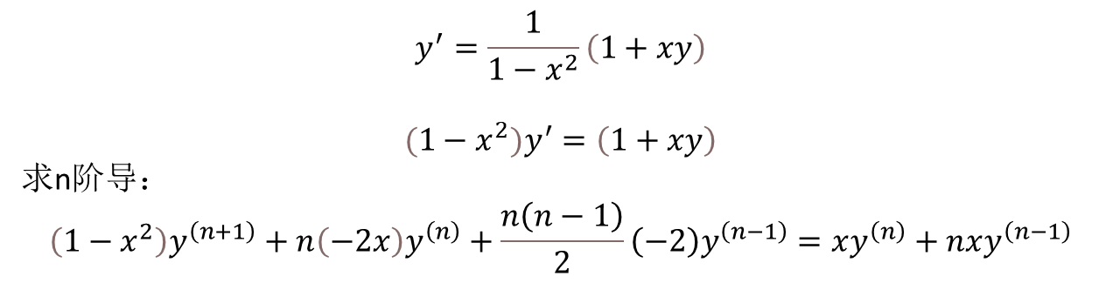
$$y^{′}=\frac{1}{1−x^{2}}\left(1+xy\right)$$
$$(1−x^{2})y^{′}=\left(1+xy\right)$$
求n阶导：
$$\left(1−x^{2}\right)y^{\left(n+1\right)}+n\left(−2x\right)y^{\left(n\right)}+\frac{n\left(n−1\right)}{2}\left(−2\right)y^{\left(n−1\right)}=xy^{\left(n\right)}+nxy^{\left(n−1\right)}$$
$${y\left(0\right)=0, y}^{′}\left(0\right)=1, y^{′′}\left(0\right)=0$$

Slide 12
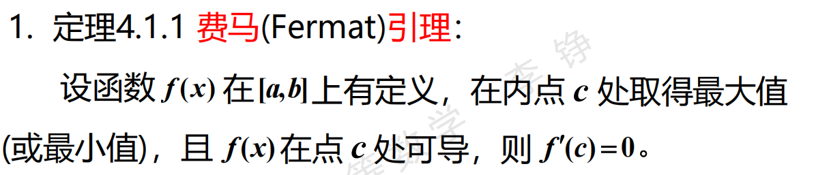
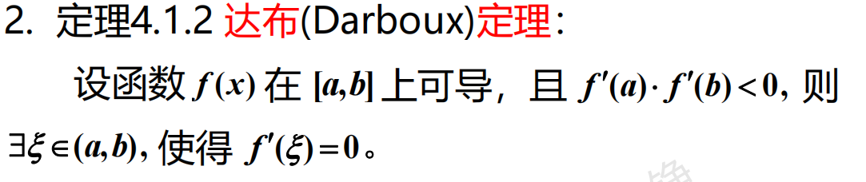
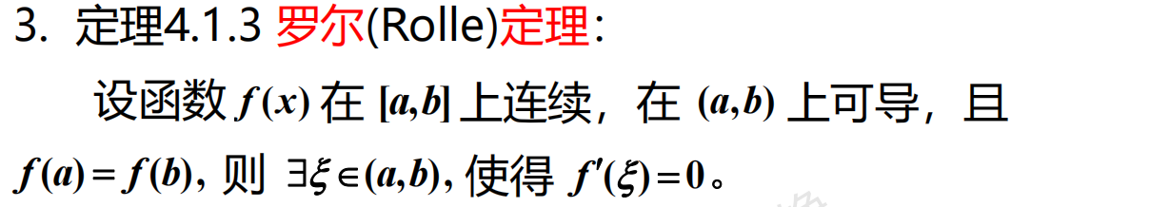

Slide 13
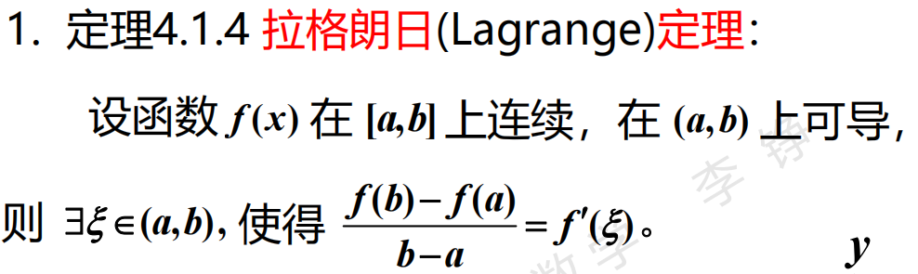
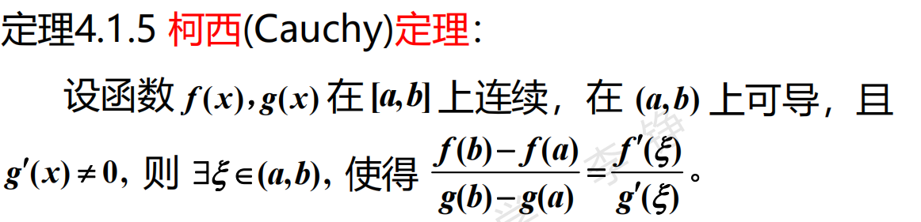

Slide 14

$$φ\left(x\right)=e^{−x^{2}}f\left(x\right)$$
$$φ\left(x\right)=xf\left(x\right)$$

Slide 15

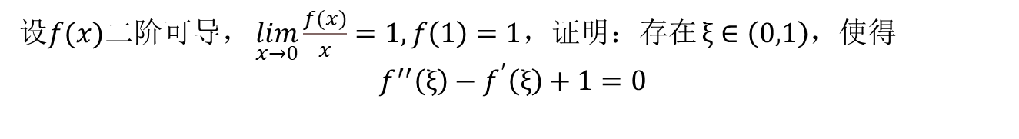

设$f(x)$二阶可导， $\lim_{x→0}\frac{f(x)}{x}=1, f\left(1\right)=1$，证明：存在 $ξ∈\left(0,1\right)$，使得
$$f^{′′}\left(ξ\right)−f^{′}\left(ξ\right)+1=0$$
$$\lim_{x→0}\frac{f(x)}{x}=1⇒f\left(0\right)=0，f^{′}\left(0\right)=1$$
由拉格朗日中值定理，存在$c∈\left(0,1\right),f^{′}\left(c\right)=\frac{f\left(1\right)−f(0)}{1−0}=1$
$φ\left(x\right)=e^{−x}[f′\left(x\right)−1]，$ 罗尔定理

Slide 16



Slide 17

设$f\left(x\right)在\left[1,2\right]$上连续，在(1,2)内可导，证明：存在 $ξ∈\left(1, 2\right)$，使得
$$ξf^{′}\left(ξ\right)−f\left(ξ\right)=f\left(2\right)−2f(1)$$
$$\frac{xf^{′}\left(x\right)−f\left(x\right)}{x^{2}}=(\frac{f\left(x\right)}{x})′$$
$$φ\left(x\right)=\frac{f\left(x\right)+f\left(2\right)−2f(1)}{x}$$

Slide 18
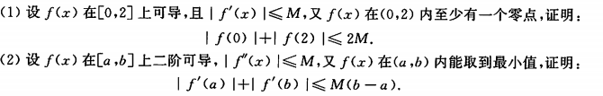

由拉格朗日中值定理，存在$c∈\left(0, 2\right), f\left(c\right)=0$
$\frac{f\left(c\right)− f\left(0\right)}{c−0}=f^{′}{(ξ}_{1})$, $\frac{f\left(2\right)− f\left(c\right)}{2−c}=f^{′}{(ξ}_{2})$
$$\left|f\left(0\right)\right|+|f(2)|=\left|f^{′}{(ξ}_{1}\right)\left|⋅c+\left|f^{′}{(ξ}_{2}\right)\right|⋅\left(2−c\right)≤2M$$

Slide 19
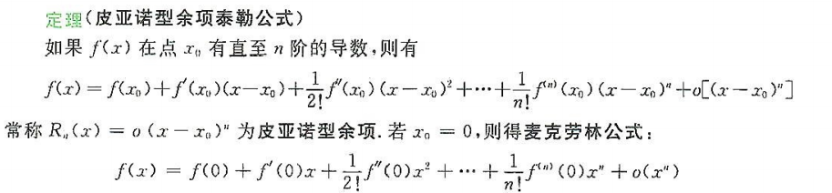
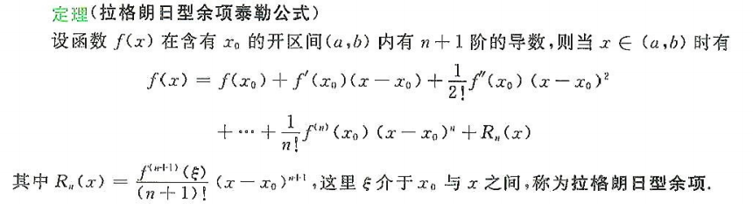

Slide 20
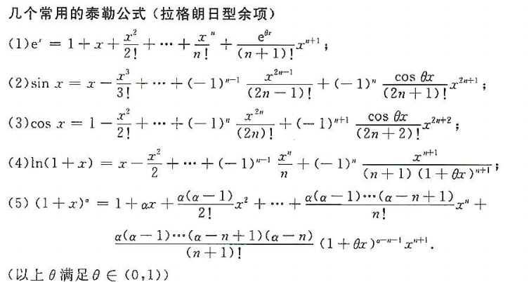

Slide 21
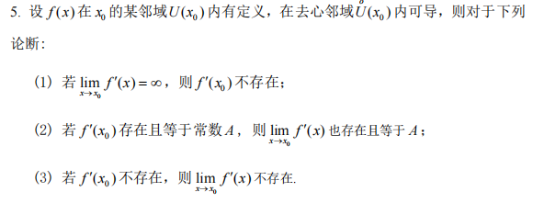
(1)$为真$，(2)(3)为假

Slide 22
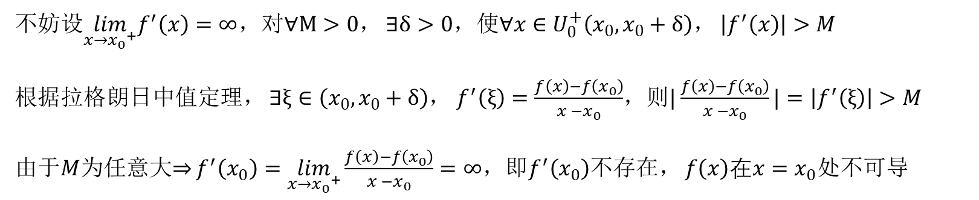
(1)$即证：{x=x}_{0}为f^{′}\left(x\right)的无穷间断点，f\left(x\right)在{x=x}_{0}$处不可导
不妨设$\lim_{x→{x_{0}}^{+}}f^{′}\left(x\right)=∞$，对$∀M>0$， $∃δ>0$，使$∀x∈U_{0}^{+}\left(x_{0},x_{0}+δ\right)，$ $\left|f^{′}\left(x\right)\right|>M$
根据拉格朗日中值定理， $∃ξ∈\left(x_{0},x_{0}+δ\right)$， $f^{′}\left(ξ\right)=\frac{f\left(x\right)−f\left(x_{0}\right)}{x −x_{0}}$，则$|\frac{f\left(x\right)−f\left(x_{0}\right)}{x −x_{0}}|=\left|f^{′}\left(ξ\right)\right|>M$
由于$M$为任意大$⇒$ $f^{′}\left(x_{0}\right)=\lim_{x→{x_{0}}^{+}}\frac{f\left(x\right)−f\left(x_{0}\right)}{x −x_{0}}=∞$，即$f^{′}\left(x_{0}\right)$不存在， $f\left(x\right)在{x=x}_{0}$处不可导

Slide 23

(3)$f^{′}\left(x_{0}\right)=\lim_{x→x_{0}}\frac{f\left(x\right)−f\left(x_{0}\right)}{x −x_{0}}$不存在，但$\lim_{x→x_{0}}$ $f^{′}\left(x\right)\text{存在}$（例：原函数$f\left(x\right)在x=x_{0}处$不连续）
$$f\left(x\right)=\left\{\begin{aligned}&x, x≤0 \\ &x + 1, x>0\end{aligned}\right.$$
$f^{′}\left(x\right)=1$，$x≠0$
但$\lim_{x→0}$ $f^{′}\left(x\right)$ 仅与$x=$0去心邻域内$f^{′}\left(x\right)$有关，与$f^{′}\left(0\right)处$是否有定义$(f\left(x\right)在0处是否可导)$无关

Slide 24
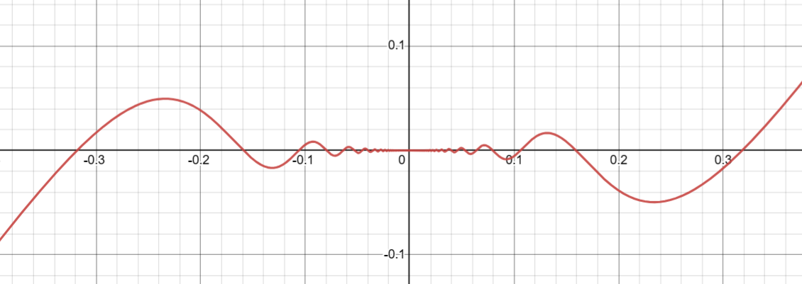
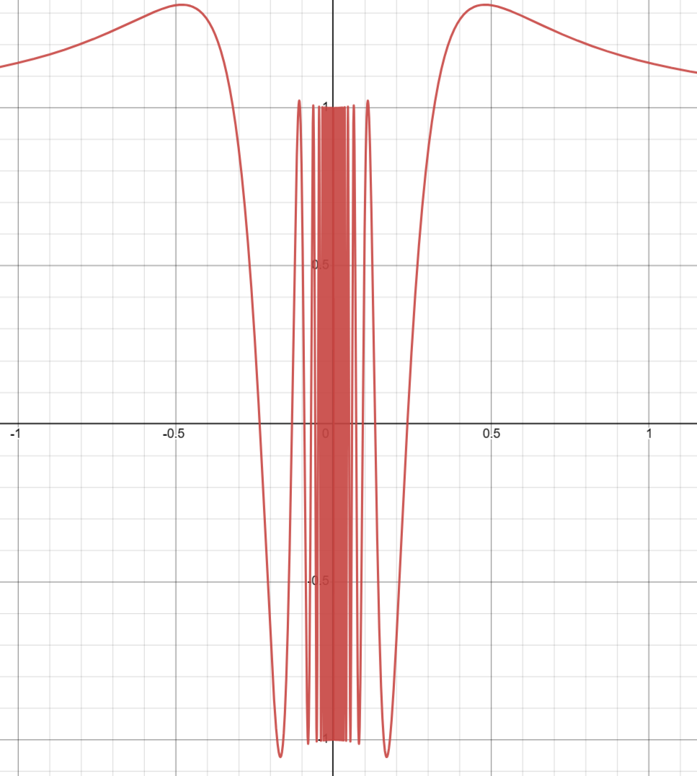
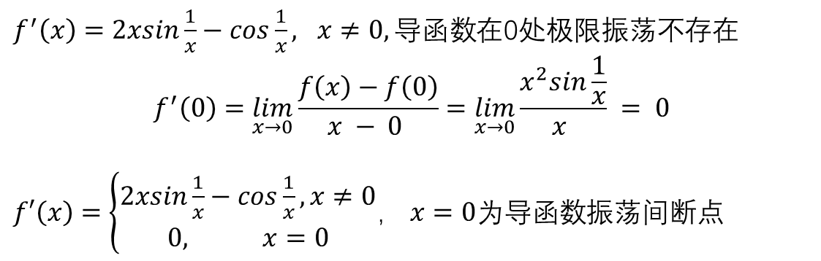

(2)$x=x_{0}$点处导数$f^{′}\left(x_{0}\right)=\lim_{x→x_{0}}\frac{f\left(x\right)−f\left(x_{0}\right)}{x −x_{0}}$存在，但$\lim_{x→x_{0}}$ $f^{′}\left(x\right)\text{不存在}（例：导函数不连续$）
$f\left(x\right)=\left\{\begin{aligned}&x^{2}sin\frac{1}{x},x≠0 \\ &0, x=0\end{aligned}\right.，f\left(x\right)$连续
$f^{′}\left(x\right)=2xsin\frac{1}{x}−cos\frac{1}{x}, x≠0, 导函数$在0处极限振荡不存在
$$f^{′}\left(0\right)=\lim_{x→0}\frac{f\left(x\right)−f\left(0\right)}{x − 0 }=\lim_{x→0}\frac{x^{2}sin\frac{1}{x}}{x } = 0$$
$f′\left(x\right)=\left\{\begin{aligned}2xsin\frac{1}{x}−cos\frac{1}{x},x≠0 \\ 0, x=0\end{aligned}\right.$， $x=0为导函数$振荡间断点

Slide 25
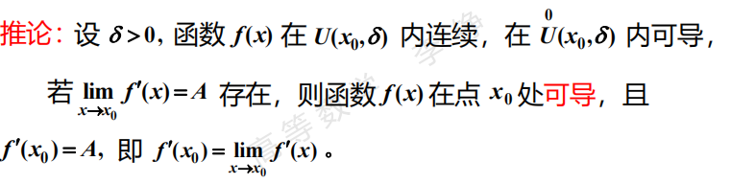
定理4.2.4 ：
区间上可导的函数，其导函数不存在第一类间断点和无穷间断点，但可能存在振荡间断点。
导函数的连续性讨论 - 知乎 (zhihu.com)

Slide 26
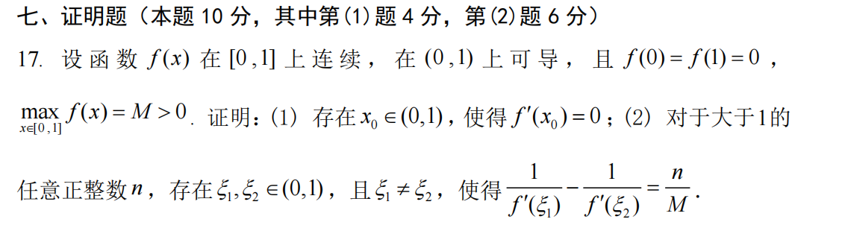
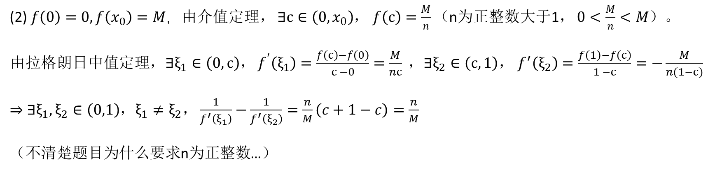
(2) $f\left(0\right)=0,f\left(x_{0}\right)=M，$由介值定理， $∃c∈\left(0,x_{0}\right)$， $f\left(c\right)=\frac{M}{n}（$n为正整数大于1， $0<\frac{M}{n}<M）。$
由拉格朗日中值定理，$∃ξ_{1}∈\left(0,c\right)$， $f^{′}\left(ξ_{1}\right)=\frac{f\left(c\right)−f\left(0\right)}{c −0}=\frac{M}{nc} ，∃ξ_{2}∈\left(c,1\right)$， $f^{′}\left(ξ_{2}\right)=\frac{f\left(1\right)−f\left(c\right)}{1 −c}=−\frac{M}{n(1−c)}$
$⇒$ $∃ξ_{1},ξ_{2}∈\left(0,1\right)$，$ξ_{1}≠ξ_{2}，\frac{1}{f^{′}\left(ξ_{1}\right)}−\frac{1}{f^{′}\left(ξ_{2}\right)}=\frac{n}{M}\left(c+1−c\right)=\frac{n}{M}$
（不清楚题目为什么要求n为正整数…）

