Slide 1
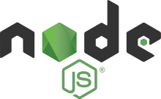
Node.js

Slide 2
What is Node.js
Open source JavaScript runtime environment for executing JavaScript outside of the browser
Allows the creation of Web servers and networking tools using JavaScript
Great for building Rest API and backend for mobile applications and share it with web applications that also use JavaScript

Slide 3
Node.js features
Built on Google Chrome V8 JavaScript engine
Fast and lightweight
Cross-platform
Windows, OS X, Linux
Event based, Asynchronous I/O
Event based: Executes tasks based on certain events eg. Someone sends a GET request to the server
Non-blocking: Can respond to a new event before the previous operation is finished

Slide 4
Node Package Manager (npm)
npm is a package manager for Node.js
Installs packages and provides tools to work with them
Packages are JavaScript modules that someone else has created and shared on npm online repository
Node.Js has a built-in command line tool, that can download and install packages with a single line command
npm install mongodb

Slide 5
Packages we used
Express.js
Used to build our server
Mongoose
Used to handle our MongoDB
Bcrypt
Encrypt passwords to our database
Json Web Token (JWT)
Used to authenticate the user accessing our server

Slide 6
Creating simple HTTP server using Node.js with Express.js
Download and install Node.js from the official website
Create project folder and use command line to initialize your Node.js project:
npm init
Creates package.json file
Contains information about the application and a list of modules that your project needs (Dependencies)
Install Express.js module using npm
npm install –-save express

Slide 7
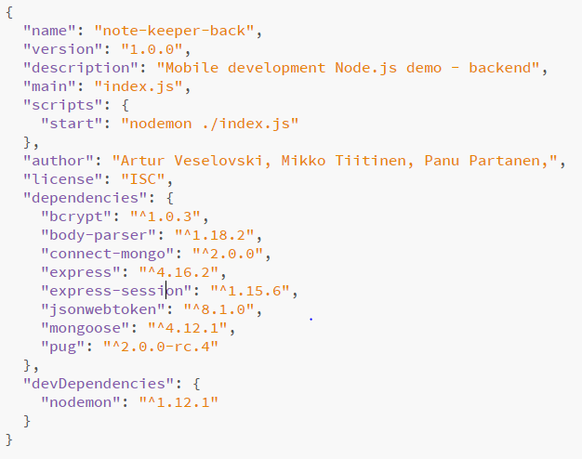

Slide 8
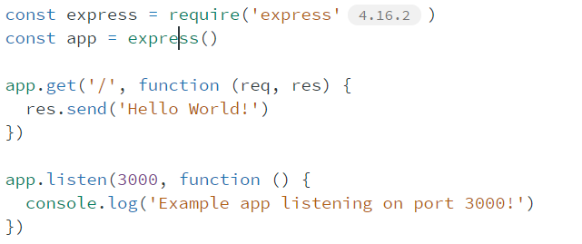
Creating simple HTTP server using Node.js with express
Create index.js file
Using Express.js model and its functions we are able to start a server that listens to port 3000 and sends ‘Hello World’ as a response when we request the root of the URL
Run with:
node index.js
Connect to localhost:3000 with browser

Slide 9
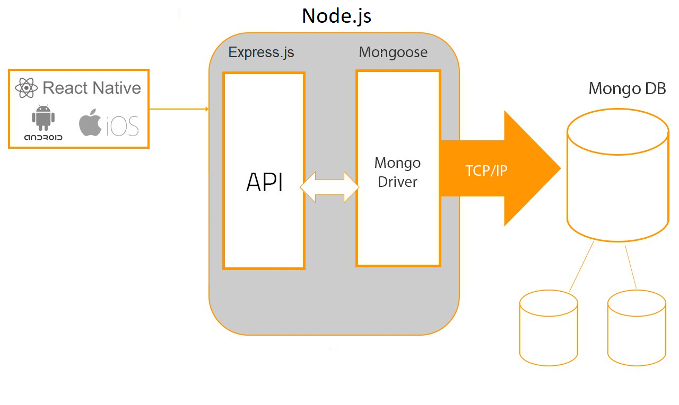

Slide 10
What did we do with Node.js
We built a Full-stack “Note Keeper” (notes, tasks) application using Node.js for Rest API
Frontend was made with react-native
Redux for state management
Axios for API calls

Slide 11
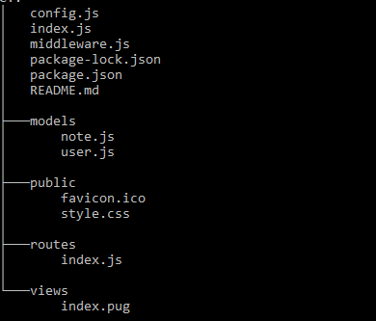
Node REST API project tree

Slide 12
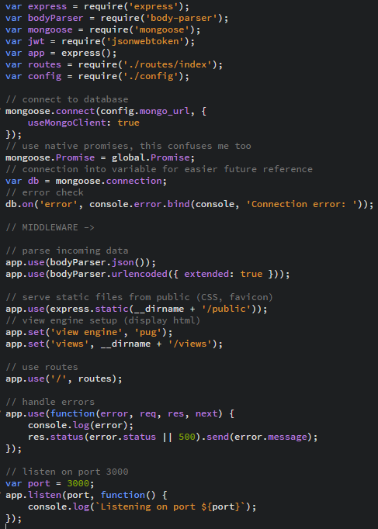
Index.js

Slide 13
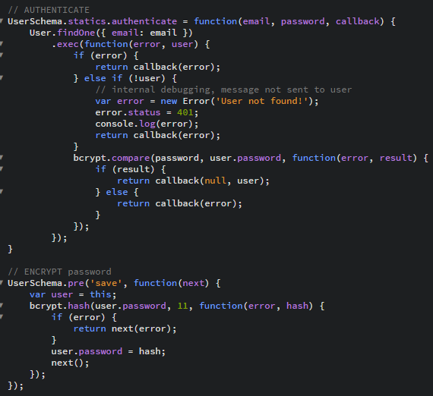
Authentication

Slide 14
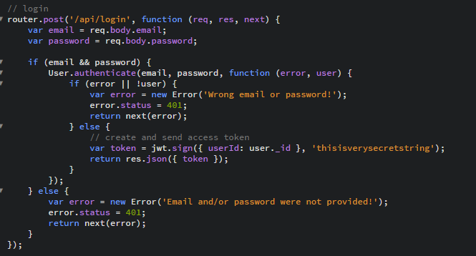
Some routes

Slide 15
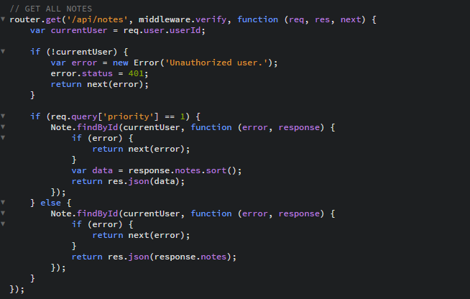
Some routes

