Slide 1
HealAssist
By: Hayden McParlane, Priyanka Bala, Komali Ghanta, Nagender Goud Teegala

Slide 2
Motivation
+ Provide patients with a centralized location at which one can access personal medical data received directly from one’s physician as well as medical data relating to family members such as children.

Slide 3
Approach
+ Apache Maven (dependency management)
+ Jersey JAX-RS REST Services
+ Oracle Database 12c
+ Bootstrap / JQuery Front-end
+ Server-side JSP pages for dynamic web content
+ PillFill API for Prescription Information
+ PubChem API for Drug Names

Slide 4
Approach
+ Users will interact with the HealAssist server housing JSP pages for dynamic web content. The HealAssist server will make REST calls to our HealAssist REST API applying business logic constraints and returning JSON objects to be parsed in the HealAssist Server.

Slide 5
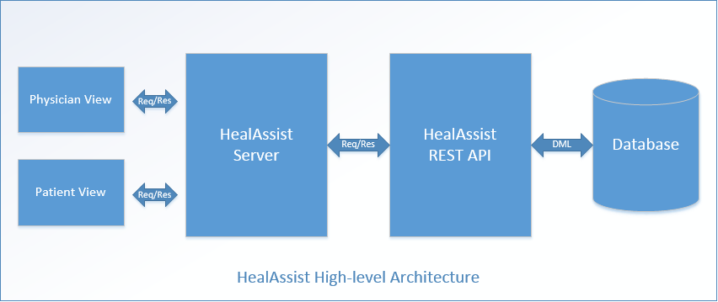
Design

Slide 6
Expected outcome
An application centralizing personal medical data such that medical care for oneself and one’s family is accessible, hopefully, bettering patient health. Our expectation is to implement most of the server and client with a couple of features fully implemented.

Slide 7
Similar Products
+ DrChrono Physician Electronic Medical Record (EMR)

