Slide 1
Review Uncertainty Evaluation in Engineering Measurements and Machine Learning
Miodrag Bolic
2022

Slide 2
Motivation
Recent success stories of machine learning, and neural nets in particular
But our algorithms still struggle with a decades-old problem: knowing what they don’t know

Slide 3
Why model uncertainty?
Confidence calibration: know how reliable a prediction is (e.g. so it can ask a human for clarification)
Regularization: prevent your model from overfitting
Model averaging: smooth your predictions by averaging them over multiple possible models
Model selection: decide which of multiple plausible models best describes the data
Exploration Active learning: decide which training examples are worth labeling
Bayesian optimization: optimize an expensive black-box function
Model-based reinforcement learning (potential orders-of-magnitude gain in sample efficiency!)

Slide 4
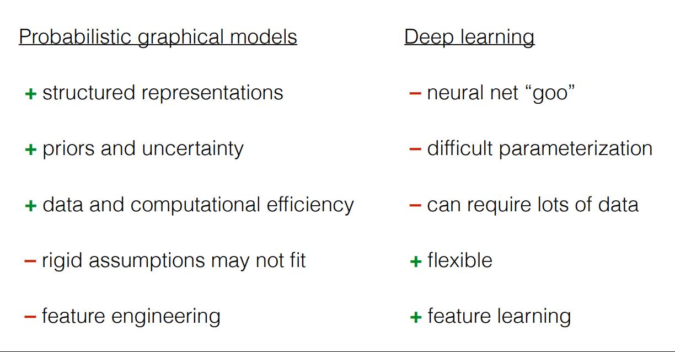
Notes:
https://www.cs.toronto.edu/~duvenaud/courses/csc2541/slides/lec1-intro.pdf

Slide 5
Course had 2 parts
IID models and inference
Lec 1: Introduction to modeling, MLE and MAP, Beta-binomial model
Lec 2: Linear Gaussian model, Bayesian linear regression
Lec 2.1 Logistic regression
Lec 3: Inference: Sampling: Rejection sampling, Importance sampling , Markov chain, MCMC: Metropolis Hastings, Gibbs sampling, Langevin dynamics
Stochastic gradient descent:
Lec 4: Variational inference, Black box variational inference
Lec 5: Bayesian models: Mixture models, Hierarchical models
Lec 6: Model checking, model selection, Bayesian averaging, Information criteria
Expending traditional models: Introducing errors in both x and y variables, Bayesian neural networks

Slide 6
Course had 2 parts
Generative models and time series
Lec 8: Gaussian Processes Regression and Classification
Lec 9: Sequential latent models: HMM, Kalman and particle filters
Lec 10.1: Deep sequential models: RNNs, RNN+state space models
Lec 10.2: Sensor Fusion, Multimodal learning
Lec 11: Sequential decision making
Lec 12: Scientific machine learning

Slide 7
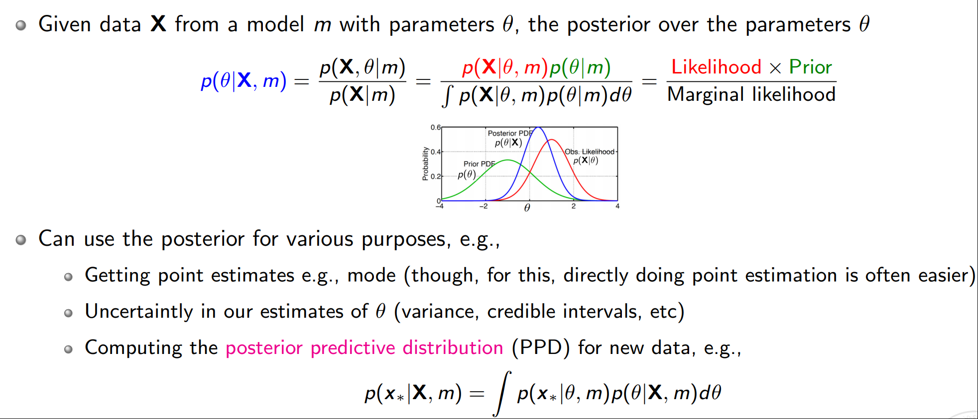
Probability and Bayesian statistics
Maximum likelihood estimation
Maximum a posteriori estimation
Examples – N coin tosses, Gaussian mean and variance

Slide 8
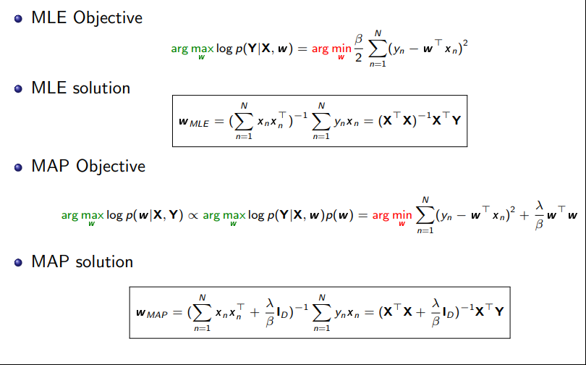
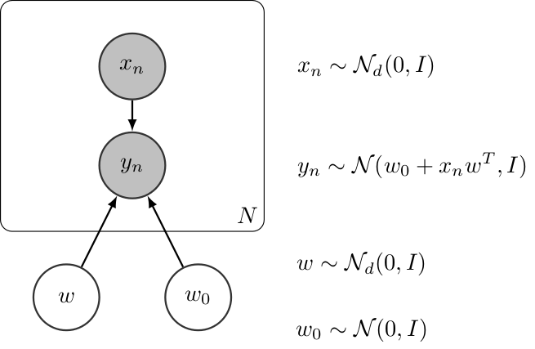
Linear regression

Slide 9
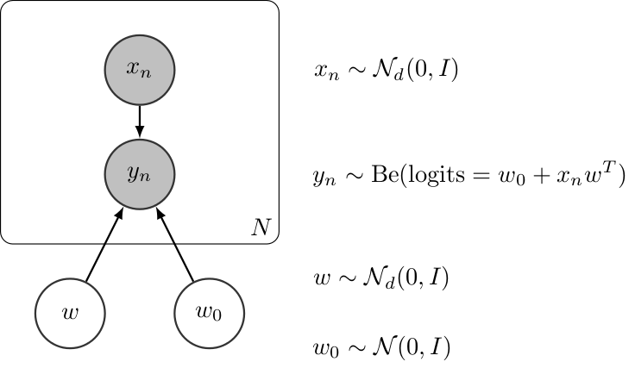
Classification
Logistic regression
Including prior
No closed form solution
Stochastic gradient descent or Monte Carlo methods

Slide 10

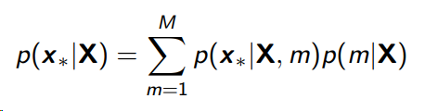
Performance metrics
Training the model
ROC curve
Model selection
Model averaging
Information criteria
Akaike Information Criteria (AIC) AIC = 2k − 2 log(L)
Bayesian Information Criteria (BIC) BIC = k log(N) − 2 log(L)
…

Slide 11
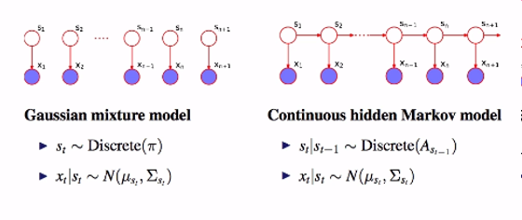
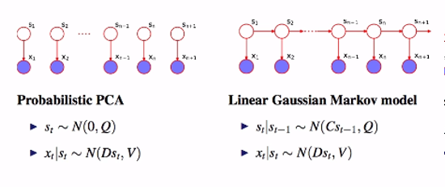
Statistical models
Clustering
Soft clustering: Gaussian mixtures
Hierarchical models
Random walk
Hidden Markov model
State space model

Slide 12
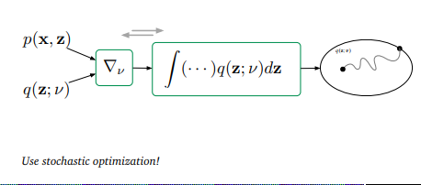
Algorithms - Approximate Inference
Variational Inference
Deriving lower bound
Mean field approximation
Deriving the model for mixture of Gaussians
Deriving the model for variational hierarchical linear regression
Black-box VI

Slide 13
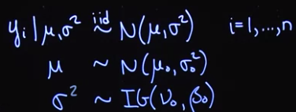
Algorithms - Sampling
Monte Carlo
Variance and accuracy
Sampling
Basic
Rejection
Importance
MCMC
Review of Markov Chains
Metropolis-Hasting Algorithm
Gibbs sampling
Derivations of Gibbs sampling for a model
Parameters of convergence of MCMC including Gelman-Rubin, autocorrelation, variance of chains
Langevin MCMC – code in Turing
HMC

Slide 14
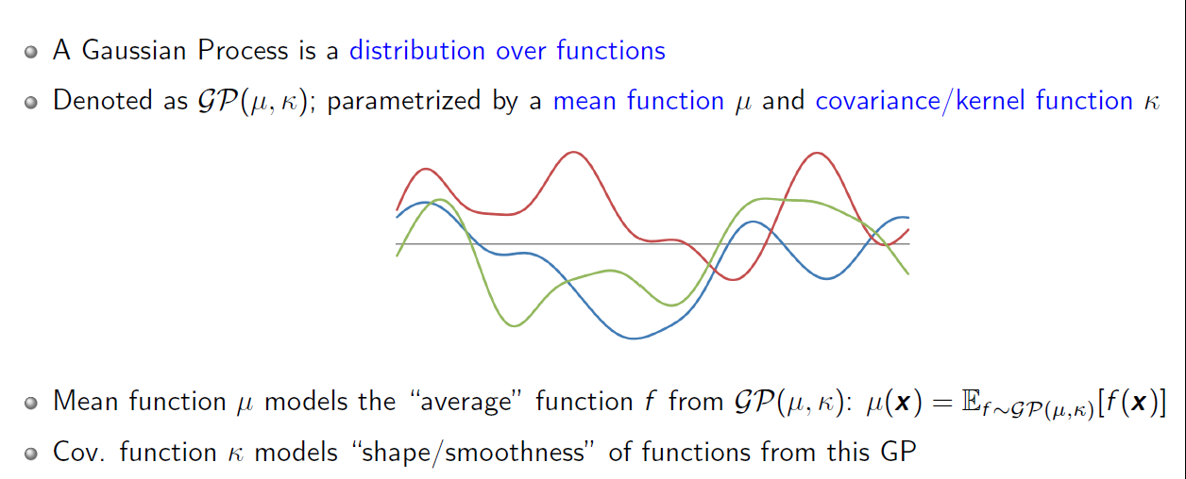
Gaussian processes
Regression
Classification
Provides uncertainties in prediction and classification

Slide 15
Time series models
Sequential processing
HMM
We did not study traditional Expectation-Minimization solutions for HMM but based our inference on MCMC
Kalman and particle filters
Derivation
Applications
Sequential or batch
RNN
LSTM

Slide 16
Sensor fusion
Sensor fusion for tracking and other engineering applications
Data association
Sensor fusion through the measurement model of the Kalman filter
Sensor fusion of measurements with same, different and unknown measurement variance
Multimodal Deep Learning
Representation
VAE for sequential data
Canonical correlation analysis
Alignment
Dynamic time warping DTW
Fusion
Modifying RNN architecture

Slide 17
Other topics
Sequential decision making
Reinforcement learning introduction
Scientific machine learning
Solving differential equations using machine learning
Fitting parameters of differential equations using machine learning

Slide 18
Many topics were not covered
Active learning
Attention models
Normalizing flows
Graphical models and Bayesian networks
Transfer and meta learning

Slide 19
Exam format
The same as midterm but 6 hours
All that we covered including lec 12

