Slide 1
Review
Miodrag Bolic

Slide 2
Motivation
Recent success stories of machine learning, and neural nets in particular
But our algorithms still struggle with a decades-old problem: knowing what they don’t know

Slide 3
Why model uncertainty?
Confidence calibration: know how reliable a prediction is (e.g. so it can ask a human for clarification)
Regularization: prevent your model from overfitting
Model averaging: smooth your predictions by averaging them over multiple possible models
Model selection: decide which of multiple plausible models best describes the data
Exploration Active learning: decide which training examples are worth labeling
Bayesian optimization: optimize an expensive black-box function
Model-based reinforcement learning (potential orders-of-magnitude gain in sample efficiency!)

Slide 4
Machine-learning-centric History of Generative Models
1940s - 1960s Motivating probability and Bayesian inference
1980s - 2000s Bayesian machine learning with MCMC
1990s - 2000s Graphical models with exact inference
1990s - present Bayesian Nonparametrics with MCMC
1990s - 2000s Bayesian ML with mean-field variational inference
1995 Helmholtz machine (almost invented variational autoencoders)
2000s - present Probabilistic Programming
2000s - 2013 Deep undirected graphical models (RBMs, pretraining)
2010s - present Stan - Bayesian Data Analysis with HMC
2000s - 2013 Autoencoders, denoising autoencoders
2000s - present Invertible density estimation
2013 - present Variational autoencoders
2014 - present Generative adversarial nets
Notes:
https://www.cs.toronto.edu/~duvenaud/courses/csc2541/slides/lec1-intro.pdf

Slide 5
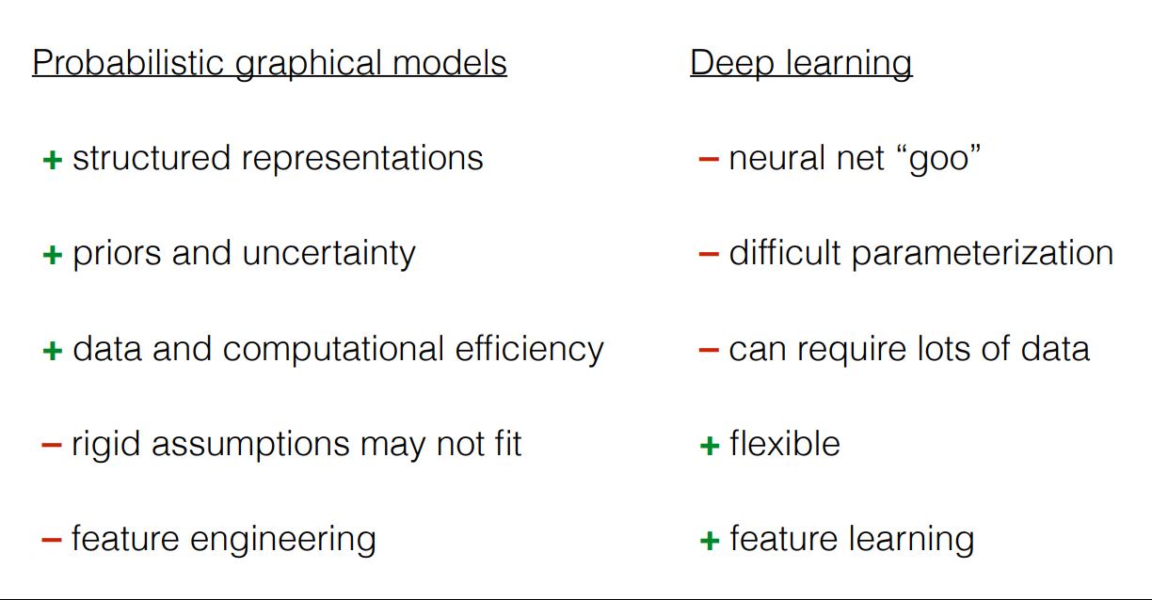
Notes:
https://www.cs.toronto.edu/~duvenaud/courses/csc2541/slides/lec1-intro.pdf

Slide 6
Course had 2 parts
IID models and inference
Lec 1: Introduction to modeling, MLE and MAP, Beta-binomial model
Lec 2: Linear Gaussian model, Bayesian linear regression
Lec 3 Logistic regression
Inference: Sampling: Rejection sampling, Importance sampling , Markov chain, MCMC: Metropolis Hastings, Gibbs sampling, Langevin dynamics
Stochastic gradient descent:
Lec 4: Variational inference, Black box variational inference
Bayesian models: Mixture models, Hierarchical models
Lec 5: Model checking, model selection, Bayesian averaging, Information criteria
Expending traditional models: Introducing errors in both x and y variables, Bayesian neural networks

Slide 7
Course had 2 parts
Generative models and time series
Lec 6: Gaussian Processes Regression and Classification
Lec 7: Generative models: probabilistic PCA, Variational autoencoders
Lec 8.1: Sequential latent models: HMM, Kalman and particle filters
Lec 8.2: Deep sequential models: RNNs, RNN+state space models
Lec 9: Time series: ARIMA models
Change points detection models
Lec 10: Sensor Fusion, Multimodal learning
Lec 11: Scientific machine learning
Lec 12: Sequential decision making

Slide 8
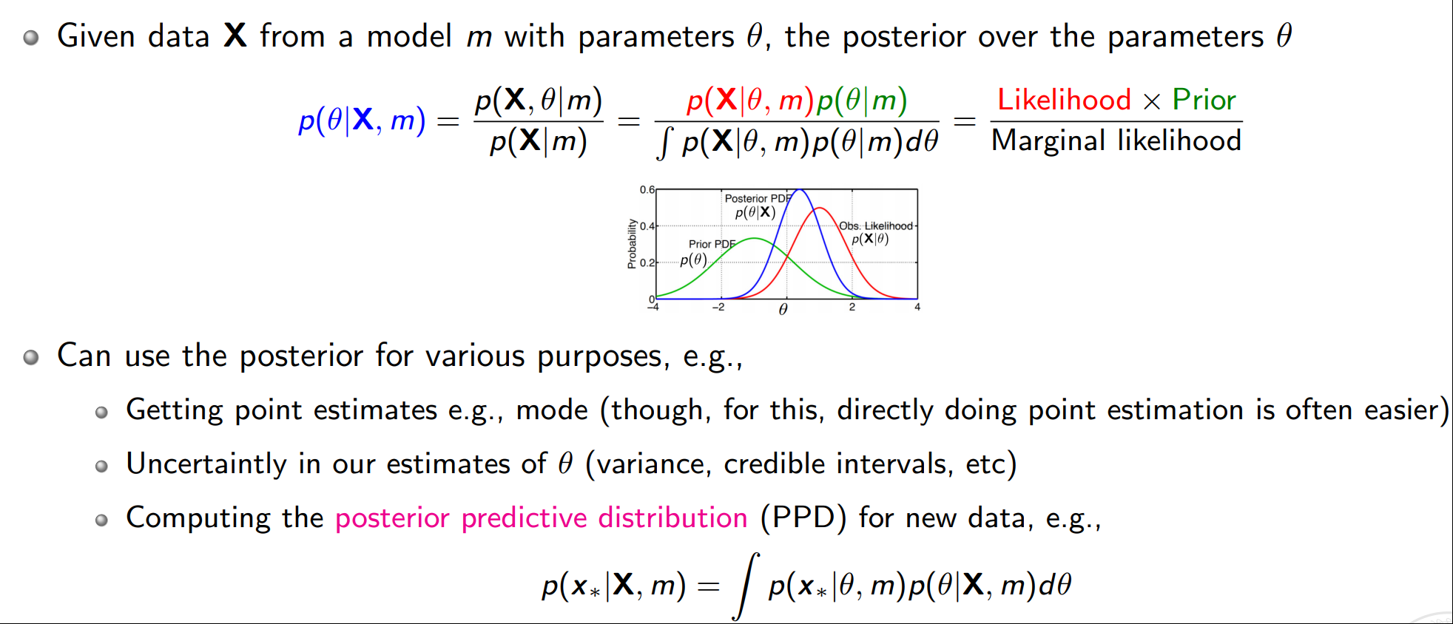
Probability and Bayesian statistics
Maximum likelihood estimation
Maximum a posteriori estimation
Examples – N coin tosses, Gaussian mean and variance

Slide 9
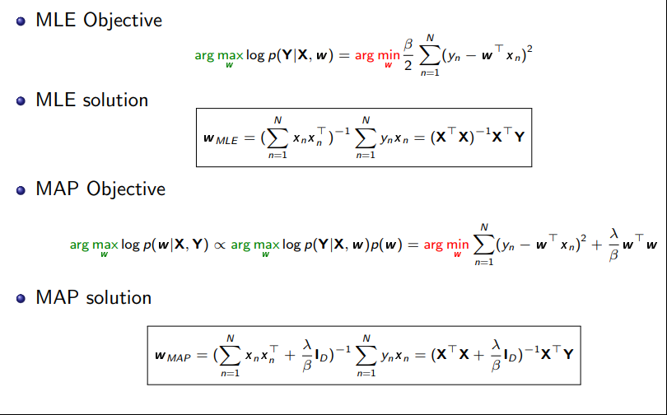
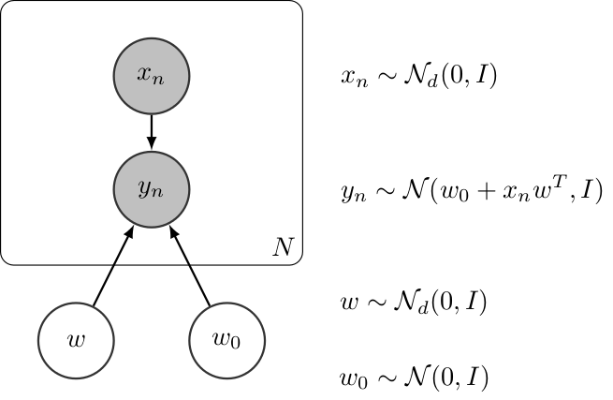
Linear and ridge regression

Slide 10
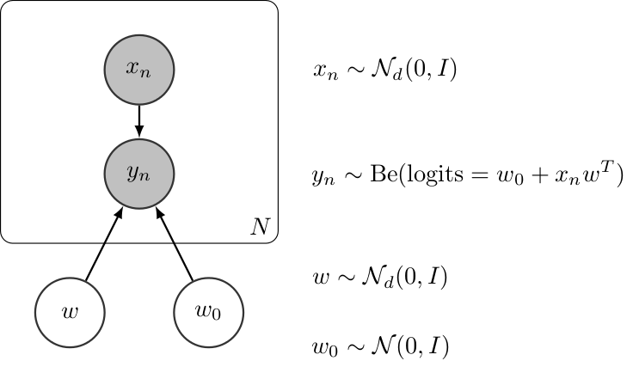
Classification
Logistic regression
Including prior
No closed form solution
Stochastic gradient descent or Monte Carlo methods

Slide 11
Unsupervised learning
Dimensionality reduction -- lossy compression
Clustering -- assigning each point to a representative cluster
Note: in classification groups are known, in clustering they are learned
Gaussian mixture models
Deconvolution -- splitting mixed signals such as instruments or speakers in sound signal
Applications
Data summarization/compression
Denoising, outlier detection
Feature construction

Slide 12
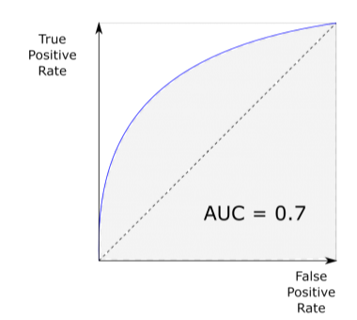

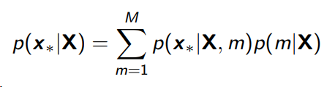
Performance metrics
Training the model
ROC curve
Model selection
Model averaging
Information criteria
Akaike Information Criteria (AIC) AIC = 2k − 2 log(L)
Bayesian Information Criteria (BIC) BIC = k log(N) − 2 log(L)
…

Slide 13
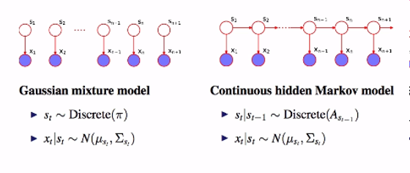
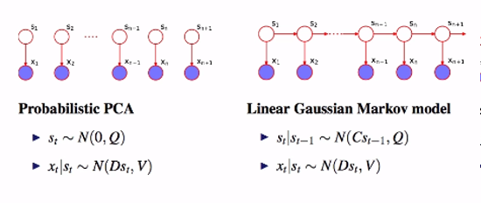
Statistical models
Clustering
Hars: K-means
Soft clustering: Gaussian mixtures
Hierarchical models
Random walk
Hidden Markov model
State space model

Slide 14
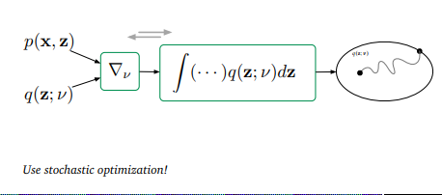
Algorithms - Approximate Inference
Variational Inference
Deriving lower bound
Mean field approximation
Deriving the model for mixture of Gaussians
Deriving the model for variational hierarchical linear regression
Black-box VI

Slide 15
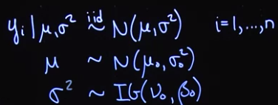
Algorithms - Sampling
Monte Carlo
Variance and accuracy
Sampling
Basic
Rejection
Importance
MCMC
Review of Markov Chains
Metropolis-Hasting Algorithm
Gibbs sampling
Derivations of Gibbs sampling for a model
Parameters of convergence of MCMC including Gelman-Rubin, autocorrelation, variance of chains
Langevin MCMC – code in Turing
HMC

Slide 16
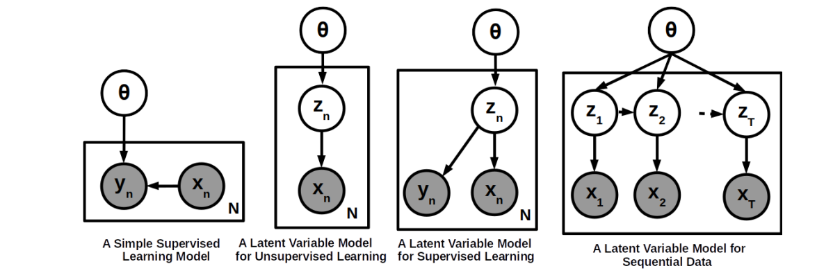
Latent variable models
Notes:
https://www.cse.iitk.ac.in/users/piyush/courses/tpmi_winter19/tpmi_w19_lec1_slides.pdf

Slide 17
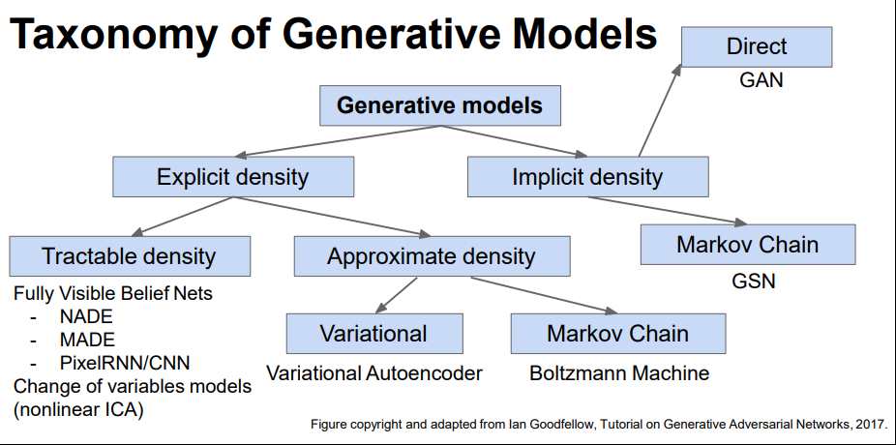

Slide 18
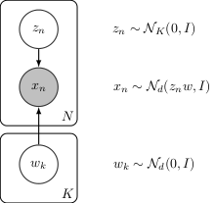
Latent Variable models
Probabilistic PCA
Factor analysis
ICA
Autoencoders
Variational Autoencoders
Conditional
Beta
Notes:
https://inferpy.readthedocs.io/en/latest/notes/probzoo.html#probabilistic-model-zoo

Slide 19
Time series models
Sequential processing
HMM
We did not study traditional Expectation-Minimization solutions for HMM but based our inference on MCMC
Kalman and particle filters
Derivation
Applications
Sequential or batch
RNN
LSTM
ARIMA models
Change-point models
Generalized ARIMA models

Slide 20
Deep learning for sequential data and data fusion
Sensor fusion for tracking and other engineering applications
Data association
Sensor fusion through the measurement model of the Kalman filter
Sensor fusion of measurements with same, different and unknown measurement variance
Multimodal Deep Learning
Representation
VAE for sequential data
Canonical correlation analysis
Alignment
Dynamic time warping DTW
Fusion
Modifying RNN architecture

Slide 21
Many topics were not covered
Active learning
Attention models
Normalizing flows
Graphical models and Bayesian networks
Transfer and meta learning

Slide 22
Exam format
The same as midterm but 5 hours
All that we covered including lec 12

