Slide 1
Theory and Implementation of Particle Filters
Miodrag Bolic
Professor
School of Electrical Engineering and Computer Science
University of Ottawa
mbolic@site.uottawa.ca
Notes:
SPOT presentation, University of Ottawa, 12 Nov 2004

Slide 2




Big picture
Observed signal 1
sensor
t
Particle
Filter
Estimation
Observed signal 2
t
t
Goal: Estimate a stochastic process given some noisy observations
Concepts:
  Bayesian filtering
  Monte Carlo sampling

Slide 3
Particle filtering operations
Particle filter is a technique for implementing recursive Bayesian filter by Monte Carlo sampling
The idea: represent the posterior density by a set of random particles with associated weights.
Compute estimates based on these samples and weights
Posterior density
Sample space
Notes:
SPOT presentation, University of Ottawa, 12 Nov 2004
Particle filters are based on recursive generation of random measures that approximate the distributions of the unknowns.
Random measures: particles and importance weights.
As new observations become available, the particles and the weights are propagated by exploiting Bayes theorem.

Slide 4
Outline
Motivation
Applications
Fundamental concepts
Sample importance resampling
Advantages and disadvantages

Slide 5
Motivation
The trend of addressing complex problems continues
Large number of applications require evaluation of integrals
Non-linear models
Non-Gaussian noise

Slide 6
Sequential Monte Carlo Techniques
Bootstrap filtering
The condensation algorithm
Particle filtering
Interacting particle approximations
Survival of the fittest

Slide 7
History
First attempts – simulations of growing polymers
  M. N. Rosenbluth and A.W. Rosenbluth, “Monte Carlo calculation of the average extension of molecular chains,” Journal of Chemical Physics, vol. 23, no. 2, pp. 356–359, 1956.
First application in signal processing - 1993
  N. J. Gordon, D. J. Salmond, and A. F. M. Smith, “Novel approach to nonlinear/non-Gaussian Bayesian state estimation,” IEE Proceedings-F, vol. 140, no. 2, pp. 107–113, 1993.
Books
  A. Doucet, N. de Freitas, and N. Gordon, Eds., Sequential Monte Carlo Methods in Practice, Springer, 2001.
  B. Ristic, S. Arulampalam, N. Gordon, Beyond the Kalman Filter: Particle Filters for Tracking Applications, Artech House Publishers, 2004.
Tutorials
  M. S. Arulampalam, S. Maskell, N. Gordon, and T. Clapp, “A tutorial on particle filters for online nonlinear/non-gaussian Bayesian tracking,” IEEE Transactions on Signal Processing, vol. 50, no. 2, pp. 174–188, 2002.

Slide 8
Outline
Motivation
Applications
Fundamental concepts
Sample importance resampling
Advantages and disadvantages

Slide 9
Applications
Signal processing
  Image processing and
  segmentation
  Model selection
  Tracking and navigation
Communications
  Channel estimation
  Blind equalization
  Positioning in wireless
  networks
Other applications¹⁾
  Biology & Biochemistry
  Chemistry
  Economics & Business
  Geosciences
  Immunology
  Materials Science
  Pharmacology &
  Toxicology
  Psychiatry/Psychology
  Social Sciences
A. Doucet, S.J. Godsill, C. Andrieu, "On Sequential Monte Carlo Sampling Methods for Bayesian Filtering",
Statistics and Computing, vol. 10, no. 3, pp. 197-208, 2000

Slide 10
Bearings-only tracking
The aim is to find the position and velocity of the tracked object.
The measurements taken by the sensor are the bearings or angles with respect to the sensor.
Initial position and velocity are approximately known.
System and observation noises are Gaussian.
Usually used with a passive sonar.

Slide 11
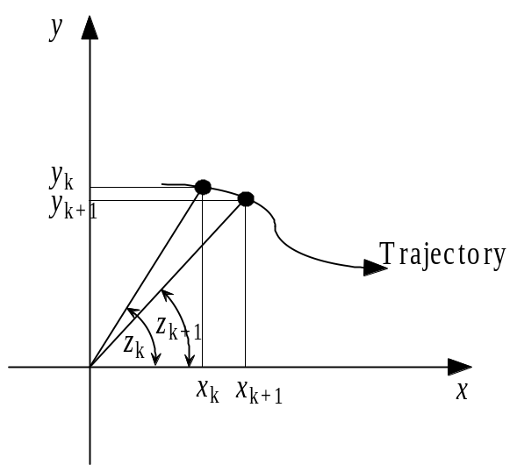
Bearings-only tracking
States: position and velocity x_{k}=[x_{k}, V_{xk}, y_{k}, V_{yk}]^{T}
Observations: angle z_{k}
Observation equation: z_{k}=atan(y_{k}/ x_{k})+v_{k}
State equation:
x_{k}=Fx_{k-1}+ Gu_{k}

Slide 12
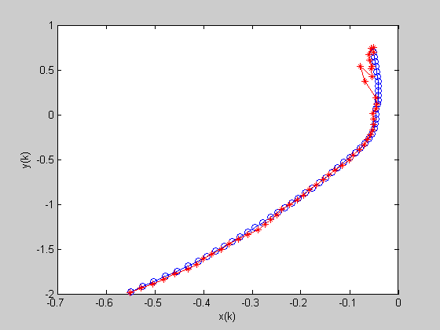
Bearings-only tracking
Blue – True trajectory
Red – Estimates

Slide 13
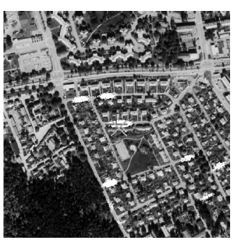
Car positioning
Observations are the velocity and turn information¹⁾
A car is equipped with an electronic roadmap
The initial position of a car is available with 1km accuracy
In the beginning, the particles are spread evenly on the roads
As the car is moving the particles concentrate at one place
1) Gustafsson et al., “Particle Filters for Positioning, Navigation, and Tracking,” IEEE Transactions on SP, 2002

Slide 14
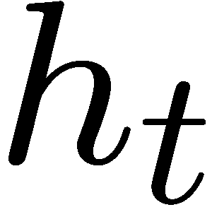
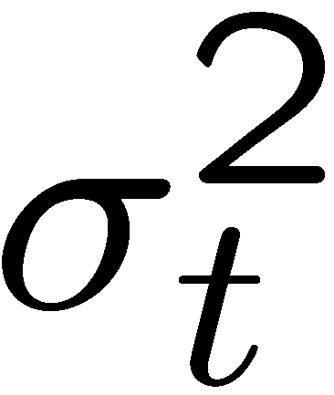

Detection over flat-fading channels
Detection of data transmitted over unknown Rayleigh fading channel
The temporal correlation in the channel is modeled using AR(r) process
At any instant of time t, the unknowns are , and , and our main objective is to detect the transmitted
symbol sequentially
h(t)
v(t)
s(t)
y(t)
s_{t}
g(t)
y_{t}
Channel
Sampling

Slide 15
Outline
Motivation
Applications
Fundamental concepts
Sample importance resampling
Advantages and disadvantages

Slide 16
Fundamental concepts
State space representation
Bayesian filtering
Monte-Carlo sampling
Importance sampling
State space
model
Solution
Problem
Estimate
posterior
Integrals are
not tractable
Monte Carlo
Sampling
Difficult to
draw samples
Importance
Sampling

Slide 17
Representation of dynamic systems
The state sequence is a Markov random process
State equation: x_{k}=f_{x}(x_{k-1}, u_{k})
  x_{k} state vector at time instant k
  f_{x} state transition function
  u_{k} process noise with known distribution
Observation equation: z_{k}=f_{z}(x_{k}, v_{k})
  z_{k} observations at time instant k
  f_{x} observation function
  v_{k} observation noise with known distribution

Slide 18

Representation of dynamic systems
The alternative representation of dynamic system is by densities.
State equation: p(x_{k}|x_{k-1})
Observation equation: p(z_{k}|x_{k})
The form of densities depends on:
  Functions f_{x}(·) and f_{z}(·)
  Densities of u_{k} and v_{k}

Slide 19
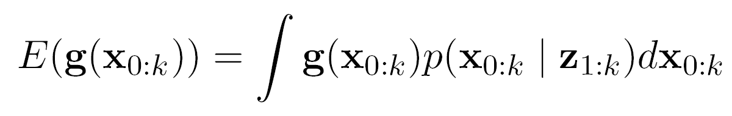
Bayesian Filtering
The objective is to estimate unknown state x_{k}, based on a sequence of observations z_{k}, k=0,1,… .
Objective in Bayesian approach
↓
Find posterior distribution p(x_{0:k}|z_{1:k})
By knowing posterior distribution all kinds of estimates can be computed:

Slide 20
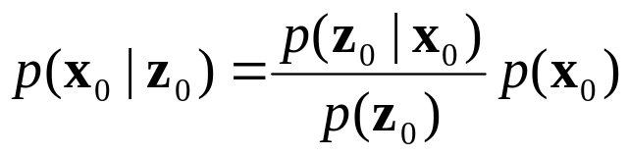
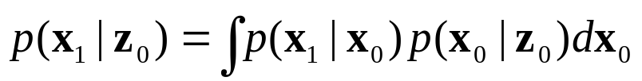
Update and propagate steps
k=0
Bayes theorem
Filtering density:
Predictive density:
z₀
z₁
z₂
p(x₀)
Update
Propagate
Update
Propagate
…
Update
Propagate
p(x₀|z₀)
p(x₁|z₀)
p(x₁|z₁)
p(x₂|z₁)
p(x_{k}|z_{k-1})
p(x_{k}|z_{k})
p(x_{k+1}|z_{k})

Slide 21
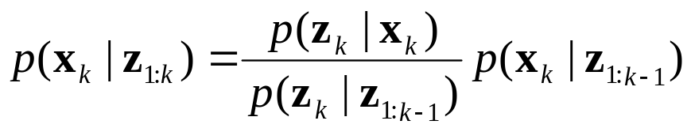
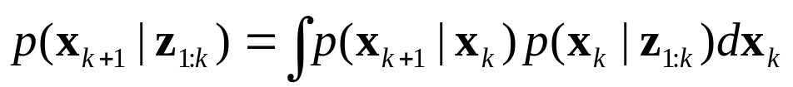
Update and propagate steps
k>0
Derivation is based on Bayes theorem and Markov property
Filtering density:
Predictive density:

Slide 22
Meaning of the densities
Bearings-only tracking problem
p(x_{k}|z_{1:k}) posterior
  What is the probability that the object is at the location x_{k} for all possible locations x_{k} if the history of measurements is z_{1:k}?
p(x_{k}|x_{k-1}) prior
  The motion model – where will the object be at time instant k given that it was previously at x_{k-1}?
p(z_{k}|x_{k}) likelihood
  The likelihood of making the observation z_{k} given that the object is at the location x_{k}.

Slide 23
Bayesian filtering - problems
Optimal solution in the sense of computing posterior
The solution is conceptual because integrals are not tractable
Closed form solutions are possible in a small number of situations
Gaussian noise process and linear state space model
↓
Optimal estimation using the Kalman filter
Idea: use Monte Carlo techniques

Slide 24
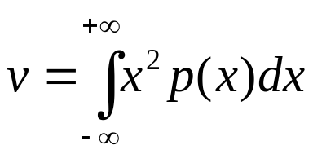
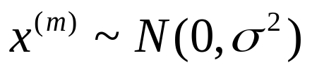
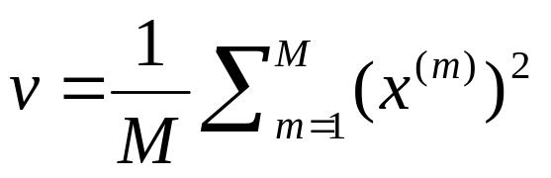
Monte Carlo method
Example: Estimate the variance of a zero mean Gaussian process
Monte Carlo approach:
Simulate M random variables from a Gaussian distribution
Compute the average

Slide 25
Importance sampling
Classical Monte Carlo integration – Difficult to draw samples from the desired distribution
Importance sampling solution:
  Draw samples from another (proposal) distribution
  Weight them according to how they fit the original distribution
Free to choose the proposal density
Important:
  It should be easy to sample from the proposal density
  Proposal density should resemble the original density as closely as possible

Slide 26
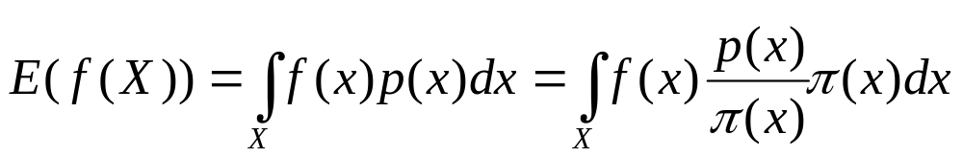
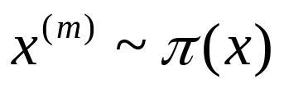
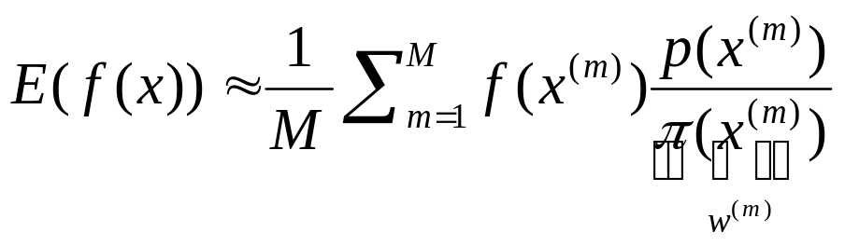
Importance sampling
Evaluation of integrals
Monte Carlo approach:
Simulate M random variables from proposal density π(x)
Compute the average

Slide 27
Outline
Motivation
Applications
Fundamental concepts
Sample importance resampling
Advantages and disadvantages

Slide 28

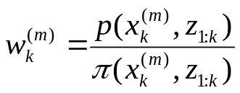
Sequential importance sampling
Idea:
Update filtering density using Bayesian filtering
Compute integrals using importance sampling
The filtering density p(x_{k}|z_{1:k}) is represented using
particles and their weights
Compute weights using:
Posterior
x

Slide 29
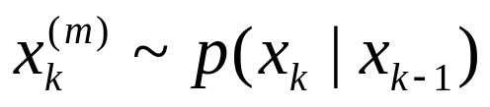
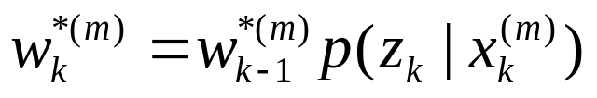
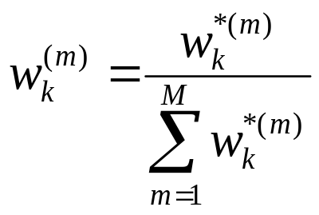
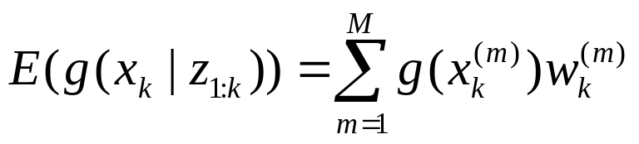
Sequential importance sampling
Let the proposal density be equal to the prior
Particle filtering steps for m=1,…,M:
1. Particle generation
2a. Weight computation
2b. Weight normalization
3. Estimate computation

Slide 30
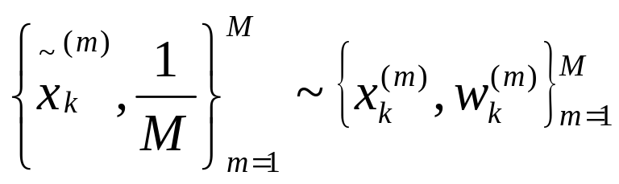
Resampling
Problems:
Weight Degeneration
Wastage of computational resources
Solution ⇒ RESAMPLING
Replicate particles in proportion to their weights
Done again by random sampling
Notes:
SPOT presentation, University of Ottawa, 12 Nov 2004
Resampling eliminates particles with small
weights and replicates the ones with large weights
Number of replications – proportional to the weight

Slide 31
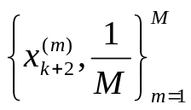
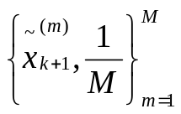

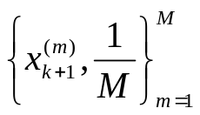
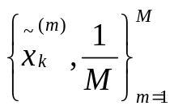


Resampling
x

Slide 32
Particle filtering algorithm
Initialize
particles
Particle
generation
New observation
1
2
. . .
M
1
2
. . .
M
Weigth
computation
Normalize weights
Output estimates
Resampling
Output
yes
More
observations?
no
Exit

Slide 33

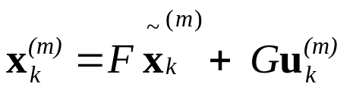

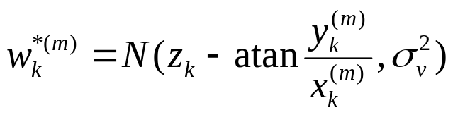

Bearings-only tracking example
MODEL
States:
x_{k}=[x_{k}, V_{xk}, y_{k}, V_{yk}]^{T}
Observations: z_{k}
Noise
State equation:
x_{k}=Fx_{k-1}+ Gu_{k}
Observation equation: z_{k}=atan(y_{k}/ x_{k})+v_{k}
ALGORITHM
Particle generation
  Generate M random numbers
  Particle computation
Weight computation
Weight normalization
Resampling
Computation of the estimates

Slide 34
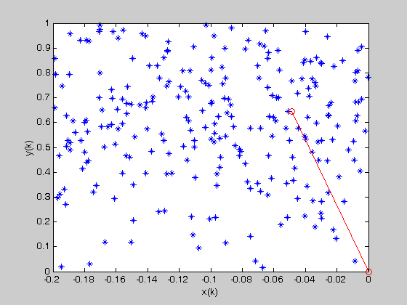
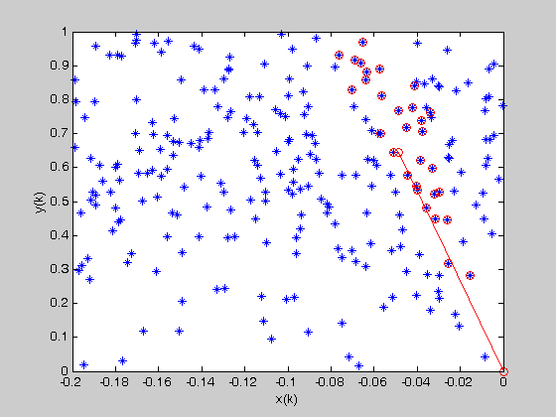
Bearings-Only Tracking Example

Slide 35
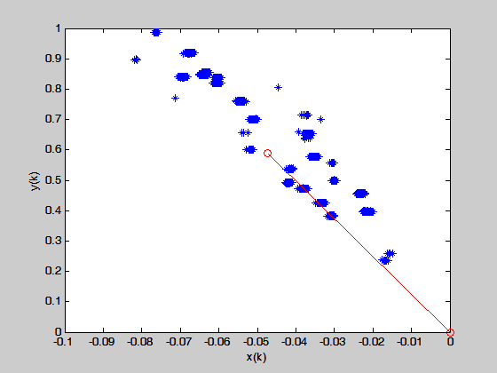
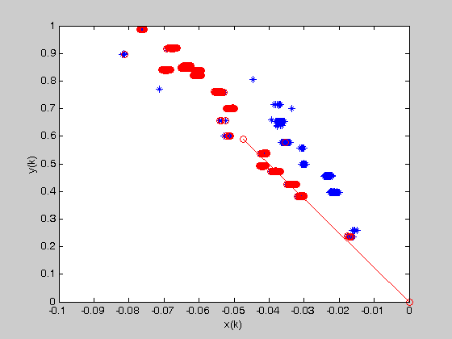
Bearings-Only Tracking Example

Slide 36
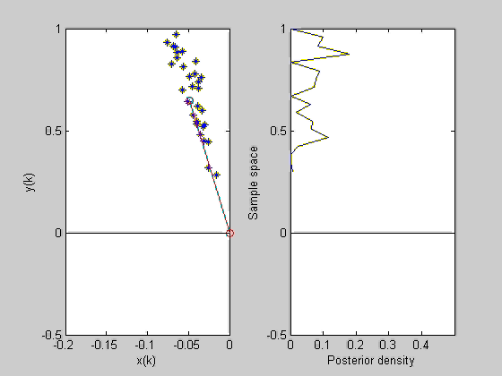
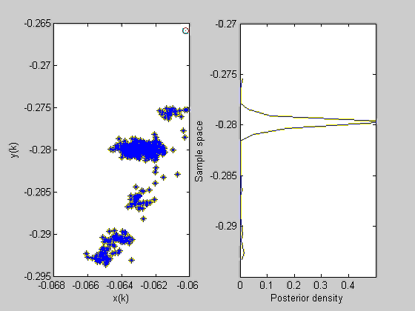
Bearings-Only Tracking Example
Notes:
SPOT presentation, University of Ottawa, 12 Nov 2004
Filtering marginal distribuution p(xy(k)|y(1:k))

Slide 37
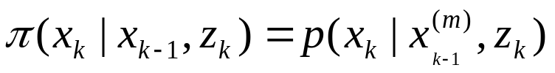

General particle filter
If the proposal is a prior density, then there can be a poor overlap between the prior and posterior
Idea: include the observations into the proposal density
This proposal density minimize

Slide 38
Outline
Motivation
Applications
Fundamental concepts
Sample importance resampling
Advantages and disadvantages

Slide 39
Advantages of particle filters
Ability to represent arbitrary densities
Adaptive focusing on probable regions of state-space
Dealing with non-Gaussian noise
The framework allows for including multiple models (tracking maneuvering targets)

Slide 40
Disadvantages of particle filters
High computational complexity
It is difficult to determine optimal number of particles
Number of particles increase with increasing model dimension
Potential problems: degeneracy and loss of diversity
The choice of importance density is crucial

Slide 41
Variations
Rao-Blackwellization:
Some components of the model may have linear dynamics and can be well estimated using a conventional Kalman filter.
The Kalman filter is combined with a particle filter to reduce the number of particles needed to obtain a given level of performance.

Slide 42
Complexity
Complexity
Initialize
particles
Particle
generation
New observation
4M random number generations
1
2
. . .
M
1
2
. . .
M
M exponential and arctangent functions
Weigth
computation
Normalize weights
Output
estimates
Resampling
Propagation of the particles
Output
yes
More
observations?
Bearings-only tracking problem
Number of particles M=1000
no
Exit
Notes:
SPOT presentation, University of Ottawa, 12 Nov 2004

Slide 43
Variations
Gaussian particle filters
Approximate the predictive and filtering density with Gaussians
Moments of these densities are computed from the particles
Advantage: there is no need for resampling
Restriction: filtering and predictive densities are unimodal

Slide 44
Summary
Very powerful framework for estimating parameters of non-linear and non-Gaussian models
Main research directions
  Finding new applications for particle filters
  Developing variations of particle filters which have reduced complexity
  Finding the optimal parameters of the algorithms (number of particles, divergence tests)
Challenge
  Popularize the particle filter so that it becomes a standard tool for solving many problems in industry
Notes:
SPOT presentation, University of Ottawa, 12 Nov 2004
Finding applicactions: applying them to the new applications or increasing complexity and accuracy of the models that are used.

