Slide 1
Launching the
NHS Knowledge for Healthcare Learning Academy
13th December 2021
#HEEKLS
Notes:
Alison

Slide 2
Launching the new
NHS Knowledge for Healthcare Learning Academy
13th December 2021
#HEEKLS
Notes:
Dom
ACTION: Alison to turn on transcription
Welcome and thanks for taking time out this lunchtime to learn about the NHS Knowledge for Healthcare Learning Academy which we are launching today.

Slide 3
Session Overview
Discuss CPD requirements for our specialist workforce and the role played by HEE
Review why the learning academy has been created
Consider the benefits of undertaking accredited CPD courses
Explore the future possibilities of the Knowledge for Healthcare Learning Academy
#HEEKLS
Notes:
Dom
Just to give you an idea of what we are going to cover today
We will be introducing the Knowledge for Healthcare Learning Academy and exploring CPD requirements and how Health Education England's Knowledge and Library team identifies these
Look at the role of the Learning Academy in this context
We will explore the benefits of undertaking accredited courses and think about future potential for the Knowledge for Healthcare Learning Academy
The Learning Academy is the culmination of many years of planning and work led by Sue Lacey Bryant and David Stewart OBE
and we are delighted that David can join us today along with Sue, National Lead for NHS Knowledge and Library Services.
So to begin the session I will pass to Sue, and our Director Patrick Mitchell, to say a few words of introduction

Slide 4


Welcome to the launch
Notes:
Sue LB
“Good afternoon everyone. Thank you for joining today’s call as we launch the Knowledge for Healthcare Learning Academy as a key development of our work within Health Education England.
Whatever your role in our health knowledge and library services, your expertise is central to the quality of patient care. Developing the right skills and experience to deliver the right knowledge services in the right way is crucial – both for your personal job satisfaction and for the NHS.
Our aims in launching this Learning Academy is to establish an employer-led centre of excellence for all health knowledge and library staff. We are delighted that all of our short courses will now be accredited by CILIP, providing assurance of the quality of each programme.
We are a small, specialist, expert workforce. From the start the Academy will offer accredited CPD opportunities, tailored for our discipline, covering a wide range of professional skills. It opens up new opportunities for you to enhance your skills, extend, expand and enrich your role, at the same time enabling NHS employers to be confident of the quality of training on offer.
In this way the Academy will help us address skills shortages and over time to take initiatives to secure a sound talent management pipeline, including through working with library schools and on apprenticeships.
So – it now gives me great pleasure to welcome Patrick Mitchell.

Slide 5
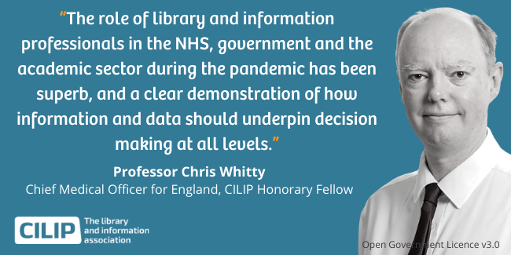
A key important specialist staff group within healthcare
Notes:
Patrick
Delighted join you this afternoon. Today we are building on a well-established Continuing Professional Development programme for you and your teams in health libraries.
I am delighted that Health Education England has been able to commit to investing in your development over the long-term, so that as knowledge specialists you have the skills you need to deliver high quality services to underpin patient care in our digital age.
Knowledge services have gained an even higher profile through the pandemic which has further highlighted the importance of evidence, and the key role that NHS knowledge and library staff play in mobilizing evidence from research, and staff ‘know-how’, to inform decision making.
The importance of your role has been recognized by Chris Whitty, who has said:
I want to take this opportunity to Thank the team, past and present, and particularly Dominic Gilroy who now leads on this work, for making The Knowledge for Healthcare Learning Academy a reality.
I know you will have an interesting session and let me take the opportunity to wish you Season’s Greetings.

Slide 6

Reflecting on your Continuing Professional Development
Take 1 minute to reflect on your learning from your most recent Continuing Professional Development (CPD).​
Now jot down in the Slido what this activity was and what you learnt.
Go to Slido.com on your browser or phone
Enter the code: # 233987
Notes:
Alison
Slido Link What was your most recent piece of CPD and what did you learn from this?
https://app.sli.do/ Enter the code: #233987
…........................
Thank you Patrick and Sue . Reflecting on good quality CPD is intrinsic to being a practising professional.
We would like to start by asking you all to reflect on your last piece of CPD.
Take a few moments to complete the slido poll. For those unfamiliar with slido follow the link in the chat or search for slido and enter the code displayed to add your responses to question posed – you will start to see the responses of others and after the session we will share on the website the word cloud created from your responses.
Maybe your CPD was a course, something you read, a discussion with a colleague, shadowing or something else. What was the topic – data management, literature searching, knowledge mobilisation? And most importantly what did you learn?

Slide 7
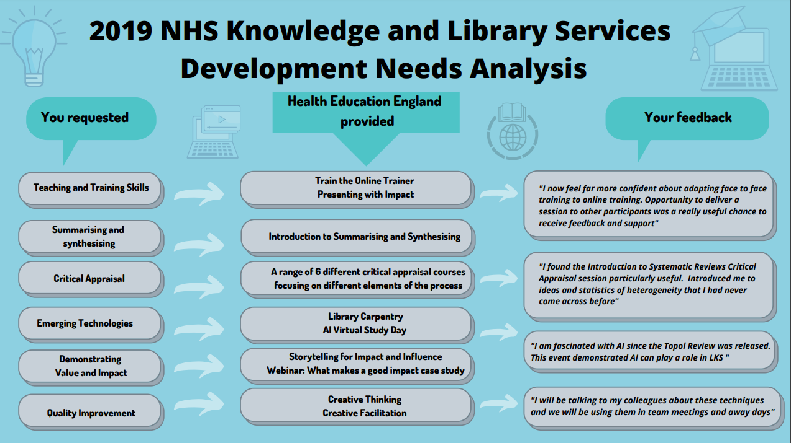
CPD requirements and the role of HEE
Notes:
Dom
We are very fortunate as a profession that healthcare knowledge and library specialists in England enjoy such a tailored range of learning opportunities, funded by Health Education England.
Health Education England's role is to identify and cater to the needs of the knowledge specialist workforce and to try and distinguish between what is nice to have and what is more essential for colleagues to fulfil the expectations of their roles.
How does HEE identify knowledge and skill development needs? – We ask our workforce and listen our network teams throughout the year to pick up on common requests and priorities. We consider what skills and knowledge are required to deliver Knowledge for Healthcare taking account of the latest developments within our professional sector.
As we start to review the trends from the Quality and Improvement Outcomes Framework Self Evaluations and Validations we will be identifying common development needs relating to this. Already from preliminary discussions we have identified User Needs, User profiles, and user journeys as an area for development.
We run a development needs survey every two years. Displayed are just some of the requests, training and feedback from CPD provision in 2019.
The slide presents a "you said – we did" analysis for some of these requests and provides examples of feedback from some delegates who attended the events.
[Go through first three as examples]

Slide 8
2020 – 2021 Development Opportunities
"I'll be using the resources, tips and tricks from the day. But also, attending this course has given me more confidence and enhanced my interest, which is motivating in itself.“
Deep Web course participant
"Explained marketing concepts very clearly and was very inspiring in sparking new things to do in campaigns.“
Strategic Marketing Workshop participant
"I have changed the way I deliver my training sessions, which has received positive feedback.“
Health Literacy – Train the Trainer participant
Notes:
Dom
We have delivered over 65 learning and development sessions covering over 30 topics in 2021.
These range from a Library Assistant Study Day to Synthesis and Summarising Sessions, Library Carpentry, and our Leadership Programme.
We receive good feedback from the courses and follow up to try and identify the impacts of the learning and development.
Some examples are shown here on the slide.
These are of course mainly personal impacts but in many cases will contribute to the development of knowledge and library services overall.
As part of our response to CILIP's recommendations from our Learning Academy Accreditation we will be introducing a more systematic process for ensuring that feedback is collected consistently and shared with our facilitators to maximise opportunities for course improvement and development.
This is particularly the case for any comments relating to how the courses can be improved

Slide 9

Why has the Knowledge for Healthcare Learning Academy been created?
Validation – giving employers and learners confidence in the quality of the training
Improvement – ensures learning objectives are well defined and programmes are improved on the basis of feedback
Guidance – aligning short courses to the CILIP Professional Knowledge and Skills Base, so that you know the content will deliver the skills and knowledge you require in your practice
Notes:
^{Dom}
The Knowledge for Healthcare Learning Academy provides an overarching umbrella of accreditation from our professional body CILIP for all the short courses that HEE commission or create in-house that ensure you have the knowledge and skills you require for your roles now and that you remain up- to date for the future.
You benefit directly as learners but so do prospective learners – people who are attracted to work in healthcare libraries, employers and CILIP as the professional association for our specialist workforce who ensure that the CPD we offer is relevant to members of our profession.

Slide 10
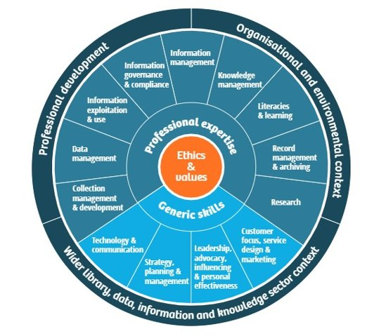
CILIP Professional Knowledge and Skills Base
Revised in 2021
Available to NHS knowledge and library staff in England
Tool for professional development, team and service development
Notes:
DOM
I will just say a few words about the revised PKSB as this tool has been central to CILIP's accreditation process.
As many of you will know the PKSB is CILIPs skills and competency framework for knowledge, library, information, and data specialists.
The revised version was released in 2021 and includes a new emphasis on areas such as knowledge mobilisation, health literacy, and digital and data literacies, all of which are important elements of our Knowledge for Healthcare learning offer.
The PKSB is a member benefit and all members have access to the online interactive personal tool. However, as an employer partner, CILIP is able to offer access to a PDF version of the tool, and the associated Healthcare Sector Guidance to NHS knowledge and library staff in England. The tool is useful for both personal development planning, and also as a way of planning the needs of the service and library team. Do get in touch later if you don’t already have access.
As we shall see shortly the PKSB is an essential element of CILIP's accreditation process and in the future we will be highlighting the PKSB areas covered in each of our learning offers.

Slide 11
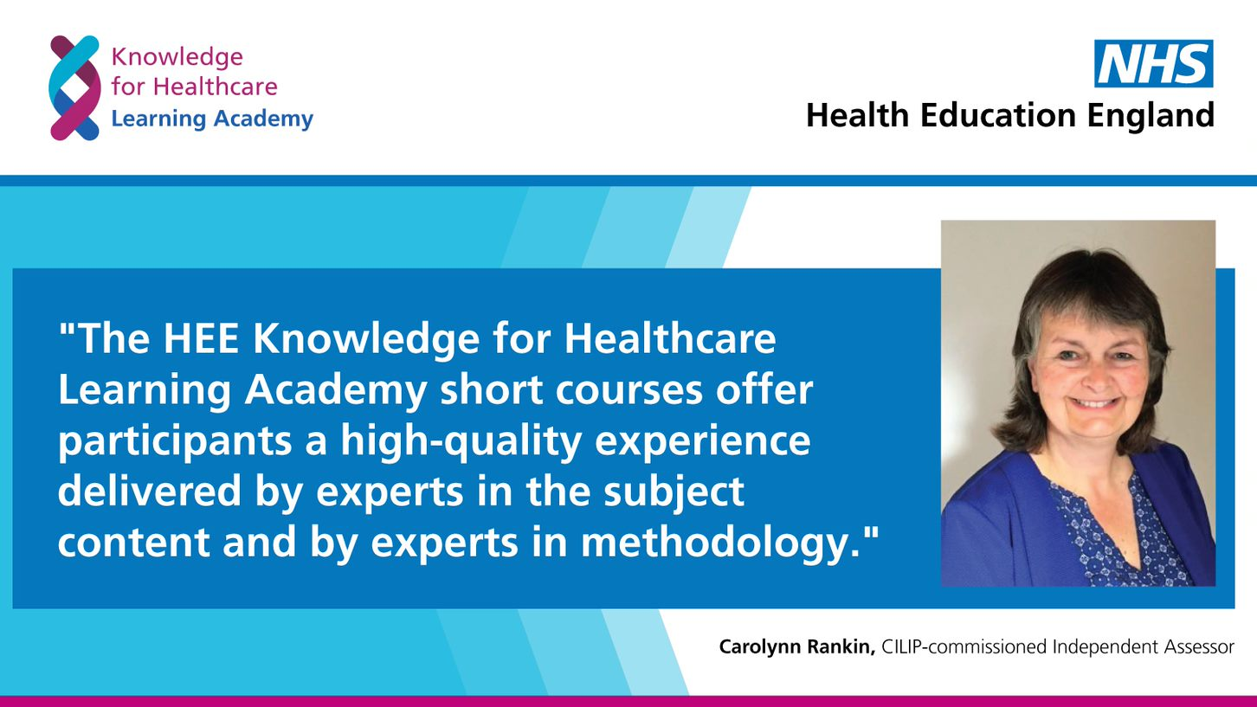
What difference will this make to the wider healthcare system and employers?
Notes:
Dom
We thought some of you may be interested in the process which Health Education England went through in seeking CILIP accreditation for our Short Course programme.
We took a sample of 25 of our short courses and shared with CILIP the outlines including the content, Learning Outcomes, and supporting information.
The courses were each mapped to the revised CILIP PKSB to demonstrate their relevance to the field of knowledge and library services.
We showed the processes we have in place for collecting information about the development needs of staff, and provided examples of the feedback we receive.
We also provided details of the credentials, experience, and expertise of the trainers and course facilitators who we commission to provide our learning opportunities.
These details were reviewed by CILIP's independent assessor, in this case Dr Carolyn Rankin –shown here on the slide
Carolyn also interviewed facilitators, and members of the HEE team, as part of the process.
At the end of the process our team at Health Education England was pleased to hear that our application was successful and we had gained accreditation.
We had a number of positive comments from CILIP, including some recommendations for further development of the Academy which we will be pursuing over the coming months.
Comments include the one show on the slide from Carolyn here [READ]
As a result of this accreditation of Learning Academy courses, participants can be even more assured that courses are of high quality and Employers can be confident releasing time for their staff to attend these development opportunities.

Slide 12
Benefits of accredited learning: what will be different in five years time?
2021 | 2026
A few employers are aware of the learning opportunities available | The Learning Academy is well respected by NHS employers
Our short courses and leadership programmes are popular but not always joined-up | Our accredited courses are the “go-to” place to gather new knowledge and skills, offering a programme of development
New learning opportunities associated with emerging technologies are gradually being developed | A range of learning opportunities are available that provide knowledge and skills to apply the latest technologies to our work
Occasionally we provide learning opportunities for healthcare professionals who are not library and knowledge staff | The Learning Academy is the place for all those involved in transforming healthcare to obtain skills on effectively using evidence and knowledge
Notes:
^{Alison}
The last 21 months make me cautious to predict the future but we expect that by 2026 the accredited learning within the Knowledge for Healthcare Learning Academy will be well known and respected by employers - the CILIP accreditation will offer a stamp of quality on the learning you receive and will be well established and well regarded.
The wide-range of short courses, e-learning and other opportunities for learning will be brought together, aligned to the CILIP Professional Knowledge and Skills Base and formed into programmes of study ensuring you have a clear pathway for development whatever your role.
The Learning Academy will become the go-to place to gather new knowledge and skills incorporating the latest developments to enable you to feel confident and capable in applying the latest technological developments to your work.
By 2026 we will establish the NHS Knowledge for Healthcare Learning Academy as a centre of excellence to develop the skills and knowledge to use evidence and mobilise knowledge that are required to underpin service change and improved healthcare outcomes - for librarians, knowledge specialists and the wider NHS workforce who need to upskill in these areas.

Slide 13

What are the short, medium and long-term plans?
Short Term:
Adding more content to the Learning Zone and website
library.hee.nhs.uk/learning-and-development
Developing an online booking system
Start the next cohort of our leadership development programme
Medium Term:
Based on analysis of workforce development survey create additional CPD content
Develop blended learning opportunities for example supporting development of critical appraisal skills
Longer Term:
Developing and promoting learning for the wider healthcare workforce
Devising further content associated with broadening our range of skills and knowledge in areas such as data science and AI
Notes:
Alison
We have plans for a range of future developments relating to the Learning Academy
These include further development of the website and the learning zone.
Introducing an online booking system for our courses which we aim to have available in the new financial year.
A highlight next year will also be the start of our next cohort of our leadership development programme.
In the medium term we will be creating more content based on analysis of the workforce development needs survey.
We will be finalising a suite of critical appraisal e-learning modules and building upon the good start in providing development opportunities in the areas of coding, programming, digital and data skills.
Longer term we will do further promotion of some of the development offers already available for the wider workforce such as the NHS Knowledge mobilisation Framework, Literature searching and health literacy e-learning modules.
We will devise further content associated with broadening out a range of skills and knowledge in areas such as data science and AI.
The aim is to establish the Learning Academy as the “go-to” place to acquire the skills and knowledge the workforce needs to use evidence and mobilise knowledge effectively for service improvement and service change.

Slide 14
What would you like included in the Learning Academy?
Take 1 minute to reflect on what you would like to see in the Learning Academy) activity.​
Now jot down in the Slido what you would like included.
Go to Slido.com on your browser or phone
Enter the code: # 357014
Go to slido.com on your browser ​
Notes:
ALISON
Slido Link What else would you like included in the Learning Academy?
https://app.sli.do/ Enter the code: #357014
…........................
So now you have heard a lot more about the Learning Academy we would really like to hear from you.
Once again take a few moments to complete the slido poll. For those unfamiliar with slido follow the link in the chat or search for slido and enter the code displayed to add your responses to question posed – you will start to see the responses of others and after the session we will share on the website the word cloud created from your responses.
Let us know what you would like included in the Learning Academy, what development needs do you currently have or perceive you may have for the future? What skills and knowledge would you team benefit from developing, or what topics would you like covered? Where are your gaps? And how would you want to fill these – a short course, a longer linked programme of study?

Slide 15
Next steps for you
Visit the website to access further information about the Learning Academy including access to the Learning Zone https://library.hee.nhs.uk/learning-and-development
Use the Professional Knowledge and Skills Base (PKSB) and the health guidance to identify your development priorities
Always provide feedback on Learning Academy learning so it can be continually improved
Update your CVs and profiles and mention in annual appraisals that you have undertaken learning accredited by CILIP
Keep a personal log of your CPD and regularly reflect on your learning - don't forget this can contribute to professional registration with CILIP - Certification, Chartership, Fellowship and Revalidation
Notes:
Alison
So some next steps you can take – take a look at the website to find out more about the Academy see a sample of course outlines and visit the Learning Zone - more will be added over time
Use the PKSB and helth guidance to identify your development priorities
If you attend a Learning Academy event do always set time aside to completed the session evaluation – this helps you to reflect on your learning and your feedback helps us to continually improve the offer
Update your CV, social media profiles and mention in your annual appraisals with your Employer when you have undertaken accredited learning from the academy.
Keep your own personal log of CPD up to date and regularly reflect on your learning - don't forget this can contribute to professional registration with CILIP

Slide 16
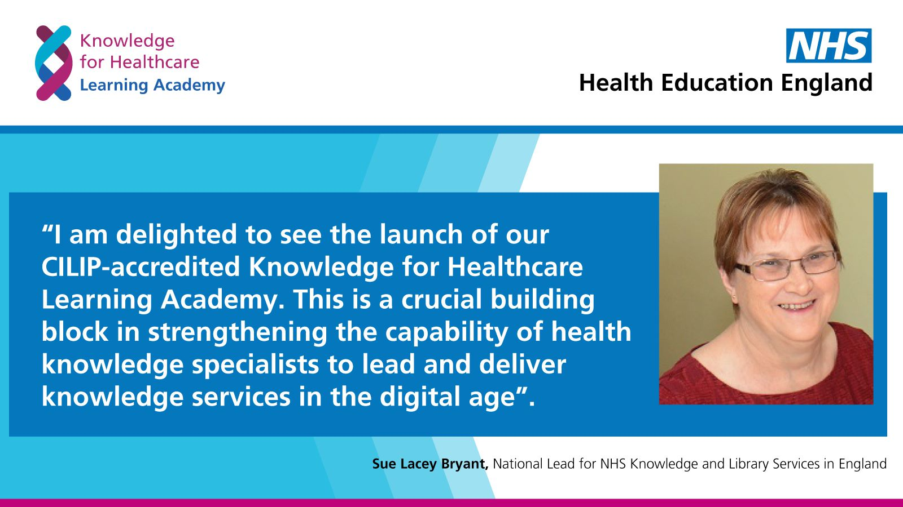
Slide from Sue Lacey Bryant praising the new Learning Academy
Notes:
Dom
We interviewed Sue about her thoughts for the future of the Learning Academy and will share this clip now.
It will also be available as a resource to view later on the website.
[Alison to play clip]

Slide 17

Thank you and Questions
Notes:
Dom
Thank you for attending the session
We'll have a opportunity to answer some of the questions which participants may have.
We may not have time to answer them all but will get back to you later with the answers for any outstanding queries.
Please add to chat or raise your hand if you don't have access to the chat feature.

Slide 18
Further Information
Dominic Gilroy, Deputy Head of Knowledge and Library Services
working across the North, Midlands and East and
Lead for Knowledge for Healthcare Workforce Development workstream
Dominic.Gilroy@hee.nhs.uk
Alison Day, Deputy Head of Knowledge and Library Services
working across London, South East and South West
Alison.Day@hee.nhs.uk
Notes:
^{Dom}
So we will draw the session to a close now
Thanks again to everyone for attending and taking time out of your busy schedules to join the session
Alison and Dom's contact details are on the slide here and you can contact us using the emails provided if you have any questions about the learning academy.

