Slide 1


Knowledge & learning based approach to supporting Organisational Transition
Making the Most of Our Knowledge & Learning
Chief Knowledge Officer DHID Knowledge Management Team
Sue Lacey-Bryant Andrew Lambe

Slide 2
Aims of the Approach
To provide a knowledge based model to support knowledge sharing, collaboration and learning that will support successful transition to the new health service model
to take a systems/process approach, designing the “lego bricks” that could sit in any organisational form – the things that need doing
to consider what the PCT priorities are for the next two years.
to ensure the approach will be applicable to all areas of health
to Illustrate readily accessible tools and techniques that can help transition
to promulgate and share learning more widely across the NHS

Slide 3
In Transition: Making the Most of Our Knowledge & Learning Workshop 18th May 2011 Purpose and Objectives
To agree the priority “knowledge domains” for action
To develop a prioritised list of recommended actions
To agree the production of a draft plan for discussion at and agreement by the Business Change Forum (BCF)

Slide 4
Workshop Provisional Agenda
Agenda Item | Timing | Who
Introductions Purpose and Objectives Background & Context Expected Participation Agreeing Knowledge Domains for Consideration Working out the details and actions Report back and discussion (prioritisation of actions) Next Steps | 13:00 13:05 13:10 13:25 13:30 13:50 14:25 14:50 | All AL SL-B AL All Groups All All

Slide 5
Background and Context
Knowledge Management
Knowledge Management first defined in early 1990s by reference to Japanese Management practice* // Emphasis on subjective insights, intuitions and hunches over processing objective information
Since mid 1990s, taken hold in the business world (often in IT or consultancy organisations), in response to emerging trends:
Large scale deployment of IT
New skills in data analysis
Response to corporate memory loss
* Nonaka, I (1991), The knowledge-creating company, Harvard Business Review, 69, November-December, 96-104

Slide 6
Context
The Knowledge Management Framework
Learning Before
Learning During
Learning After
Facilitated Learning
Before Action Review
Peer Assist
After Action Review
Retrospect
Join a CoP
Identify and communicate with subject experts (SMEs)
Interact with peer and subject expert network
Contribute learning to the CoP or network
Collaboration
Knowledge Assets
Access knowledge assets or relevant information sources
Access knowledge assets
Plan build of knowledge assets
Build and share knowledge asset

Slide 7
Adapting to Transition
Things we will need to know
GP Consortia -
Procurement
Information
Standards
application
National Infrastructure
National Applications
Local Applications
Acquire new competence
Improve and streamline existing competences
Things
we don’t know now
Things
we know now
Partners and others supply non-core competence
Projects that will not go forwards in the foreseeable future e.g. Clinical dashboards
Shared Services
Archive old competence
Things we will not need to know
Copyright: Knoco Ltd (http://www.knoco.com/ ): “The need for knowledge management as a response to the Public Sector cuts”

Slide 8
Expected Participation Today
To get everyone on the same page
To think about PCT priorities for the next two years.
To understand that there is no organisational blueprint
To try to take a generalist, PCT and local health systems role, whilst drawing on individual’s domain expertise

Slide 9
Agreeing Knowledge Domains for Consideration
The following are potential areas for us to work through.
Are they all important? What to exclude? What to lump together?
Business Resilience and Continuity
Do we know where our core knowledge resides? Can we find it?
What happens if the PCT systems fail?
Knowledge Retention
What happens when people leave or change role?
A Positive Transition (Managing our Legacy)
What will need handing over to whom?
Is this the same as 1?
Knowledge Sharing & Learning
Should the PCT be facilitating local health & social care system partners/stakeholders to share learning? What are the priority areas?
Staff Support
What could we be doing to support staff into their futures in terms of access to knowledge and sharing experience?
Capturing the Learning
What should we be capturing to pass onto other PCTs and to ourselves for the next change?

Slide 10
Knowledge and Learning Response
Things we will need to know
Acquire new knowledge
Our current knowledge
Action learning sets, learn from other
sectors,
disseminate
(KA, col, FL)
Retain knowledge (KH/KA)
Facilitate sharing (col)
Acquire new competence
Improve and streamline existing competences
Things
we don’t know now
Things
we know now
Partners and others supply non-core competence
Package, archive or transfer (KA)
Facilitate
sharing
along
the supply
chain
(col)
Archive old competence
Key:
KA: Knowledge asset
KH: Knowledge harvest
Col: Collaboration
FL: Facilitated Learning
Things we will not need to know

Slide 11
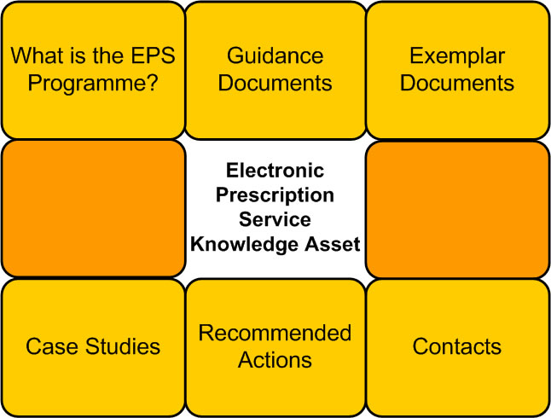
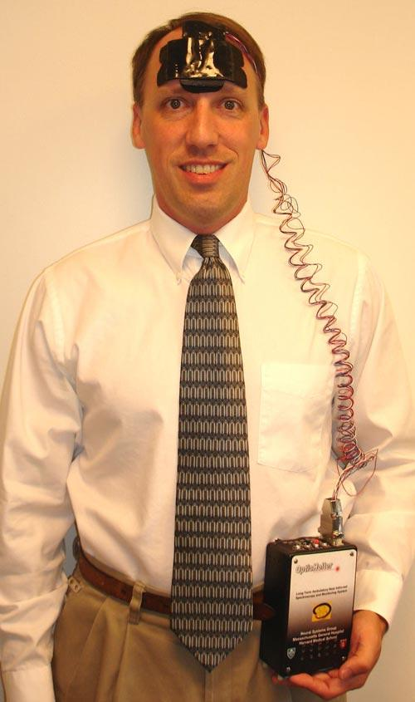
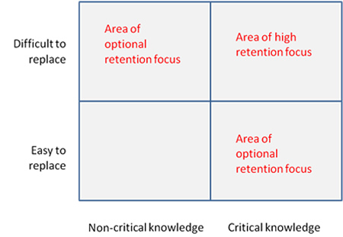
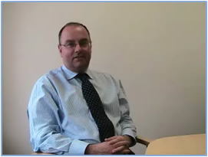
Package, archive or transfer (KA)
Archive old competence

Slide 12
Things we will need to know
Our current knowledge
Action learning sets, learn from other
sectors,
disseminate
(KA, col, FL)
Retain knowledge (KH/KA)
Facilitate sharing (col)
Acquire new competence
Improve and streamline existing competences
Things
we don’t know now
Things
we know now
Partners and others supply non-core competence
Package, archive or transfer (KA)
Facilitate
sharing
along
the supply
chain
(col)
Archive old competence
Things we will not need to know

Slide 13
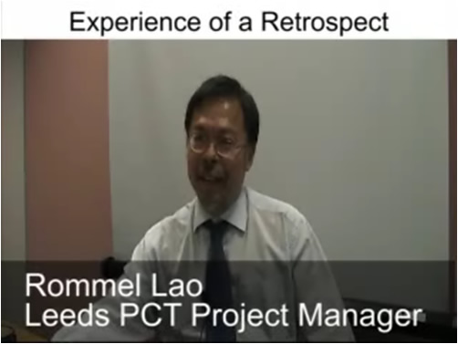

with internal knowledge…a Learning After response
Retain knowledge (KH/KA)
Facilitate sharing (col)
Learning Before
Learning During
Learning After
Learning Before
Learning During
Learning After
Learning Before
Learning During
Learning After
Learning After
Learning Before
Learning During
Improve and streamline existing competences
Before Action Review
Peer Assist
After Action Review
Retrospect
Before Action Review
Peer Assist
After Action Review
Retrospect
Facilitated Learning
Before Action Review
Peer Assist
After Action Review
Retrospect
Facilitated Learning
Facilitated Learning
Learning After
Learning Before
Learning During
Improve and Streamline
Application of Knowledge
Join a CoP
Identify and communicate with subject experts (SMEs)
Interact with peer and subject expert network
Contribute learning to the CoP or network
Join a CoP
Identify and communicate with subject experts (SMEs)
Interact with peer and subject expert network
Contribute learning to the CoP or network
Join a CoP
Identify and communicate with subject experts (SMEs)
Interact with peer and subject expert network
Contribute learning to the CoP or network
Collaboration
Collaboration
Collaboration
Define the Focus of the Community
Ensure community activities address business issues
Ensure high levels of sponsor expectation
Provide Support
Provide CoP co-rdinator training
Ensure CoP coordinator are given sufficient time for their role
Provide funding for face-to-face events
Improve the usefulness of tools provided
What can leaders do?
Ensure there are clearly stated goals
Engage members in developing good practice
Promote CoPs ability to help solve daily work challenges
Learning After
Learning Before
Learning During
Knowledge Assets
Access knowledge assets or relevant information sources
Access knowledge assets
Plan build of knowledge assets
Build and share knowledge asset
Knowledge Assets
Access knowledge assets or relevant information sources
Access knowledge assets
Plan build of knowledge assets
Build and share knowledge asset
Knowledge Assets
Access knowledge assets or relevant information sources
Access knowledge assets
Plan build of knowledge assets
Build and share knowledge asset
Time
…which iteratively supports better application of knowledge
…which can then support ongoing work in learning before and during phases…

Slide 14
Things we will need to know
Acquire new knowledge
Action learning sets, learn from other
sectors,
disseminate
(KA, col, FL)
Retain knowledge (KH/KA)
Facilitate sharing (col)
Acquire new competence
Improve and streamline existing competences
Things
we don’t know now
Things
we know now
Partners and others supply non-core competence
Package, archive or transfer (KA)
Facilitate
sharing
along
the supply
chain
(col)
Archive old competence
Things we will not need to know

Slide 15

Action Learning Sets
Community of purpose (experts)
Knowledge Assets
Action learning sets, learn from other
sectors,
disseminate
(KA, col, FL)
Acquire new competence
Professor Martin Elliott, Consultant CardioThoracic Surgeon, Great Ormond Street Hospital

Slide 16
by internalising external knowledge
Learning Before
Learning During
Learning After
Learning Before
Learning During
Learning After
Learning Before
Learning During
Learning After
Learning Before
Learning During
Learning After
Before Action Review
Peer Assist
After Action Review
Retrospect
Before Action Review
Peer Assist
After Action Review
Retrospect
Facilitated Learning
Before Action Review
Peer Assist
After Action Review
Retrospect
Facilitated Learning
Facilitated Learning
Learning Before
Learning During
Learning During
Acquire New Competence
Application of Knowledge
Join a CoP
Identify and communicate with subject experts (SMEs)
Interact with peer and subject expert network
Contribute learning to the CoP or network
Join a CoP
Identify and communicate with subject experts (SMEs)
Interact with peer and subject expert network
Contribute learning to the CoP or network
Join a CoP
Identify and communicate with subject experts (SMEs)
Interact with peer and subject expert network
Contribute learning to the CoP or network
Collaboration
Collaboration
Collaboration
Learning Before
Learning During
Learning After
Knowledge Assets
Knowledge Assets
Knowledge Assets
Access knowledge assets or relevant information sources
Access knowledge assets
Plan build of knowledge assets
Build and share knowledge asset
Access knowledge assets or relevant information sources
Access knowledge assets
Plan build of knowledge assets
Build and share knowledge asset
Access knowledge assets or relevant information sources
Access knowledge assets
Plan build of knowledge assets
Build and share knowledge asset
Time
…which can then support ongoing work in learning during and after phases…
…which iteratively supports better application of knowledge

Slide 17
Things we will need to know
Acquire new knowledge
Action learning sets, learn from other
sectors,
disseminate
(KA, col, FL)
Retain knowledge (KH/KA)
Facilitate sharing (col)
Acquire new competence
Improve and streamline existing competences
Things
we don’t know now
Things
we know now
Partners and others supply non-core competence
Package, archive or transfer (KA)
Facilitate
sharing
along
the supply
chain
(col)
Archive old competence
Things we will not need to know

Slide 18
Partners and others supply non-core competence
Facilitate
sharing
along
the supply
chain
(col)

Slide 19
Working out the details and actions
Break into small groups according to how knowledge domains have been grouped.
Work on the following questions:
What’s the issue?
For each issue
What is the desirable outcome?
What have we got/done already?
What is there still to do? (& who should do it?)

Slide 20
Working out detailed Actions Required
General Engagement & Sharing with
Partners and stakeholders
“Soft”
Active Development of Sharing and
Learning Culture
(supporting innovation and spread)
A Positive
Transition
(Legacy)
Resilience
&
Continuity
Staff
Support
Learning
from our
Own
Experience
“Hard”

Slide 21
Feedback & Report (prioritisation of actions)
Share outputs of breakouts
Discuss and prioritise
Agree next steps and who is doing them by when…

